Slide 1
Comparing EV3 & HITechnic COLOR SENSORS

Slide 2
LESSON OBJECTIVES
Learn the differences between the HiTechnic and LEGO Color Sensors

Slide 3
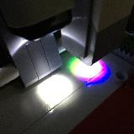

How they work
EV3 Color Sensor
HiTechnic Color V.2
Digital sensor detects color intensity of the light that
Color Mode – 7 colors, no color
Reflected Light Intensity and Ambient Light Intensity modes
A single white LED (light emitting diode) to illuminate the target and
Color Mode with 18 colors
RGB, Passive and Raw modes

Slide 4
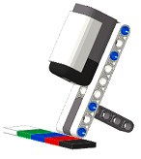
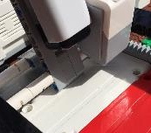
POSITION AND ANGLE
EV3 Color Sensor
HiTechnic Color Sensor
Sensor must be positioned at a right angle to surface it is examining
According to EV3 documentation, Color Sensors work best between 4-12mm (1/2 - 1 1/2 studs) off the surface you are detecting
Any higher or lower and the readings are not as accurate
The Color Sensor V2 works best when it is positioned higher
It is recommended that you install the sensor at an angle (see image)

Slide 5
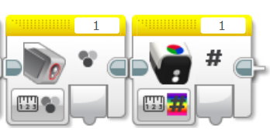
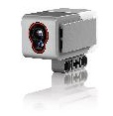
COMPARING STANDARD MODES
Both Sensors in Color-Measure mode return a value for the color (a color number)
The HiTechnic Sensor identifies 18 colors (values from 0-17)
The EV3 Color Sensor identifies 7 colors plus no color (0-7)
Color Sensor
HiTechnic Color

Slide 6
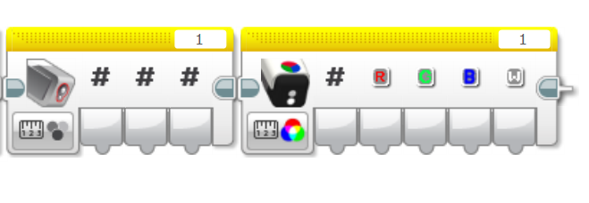
COMPARING RGB MODES
To compare RGB values, we downloaded the EV3 RGB Block from David Gilday
The HiTechnic Sensor identifies red, green, blue, and white values
The EV3 Color Sensor identifies red, green, and blue
The white output is similar to the reflected light intensity mode in the EV3 Color Sensor block.

Slide 7
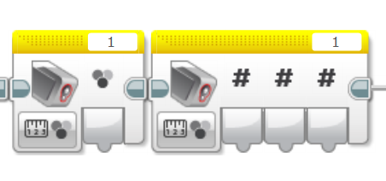
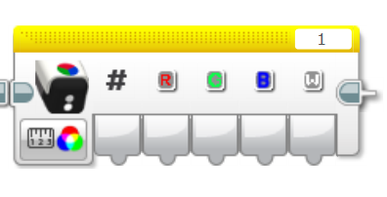
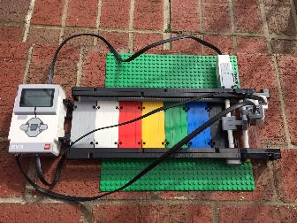
TESTS
LEGO Color Sensor RGB
VS.
HiTechnic Color Sensor RGB mode
Over the next few slides, we will go over some tests we conducted with both the sensors
The results will help you understand which sensor to use in which condition
We do not conduct any tests for angle and position as both LEGO and HiTechnic specify these in their documentation

Slide 8
Lighting conditions: Indoor Lighting
The performance of the EV3 and HiTechnic sensors are not the same
The RGB values with the EV3 are different compared to the HiTechnic Sensor. A possible reason for this is that the color sensor was designed to work best on LEGO colors.
The HiTechnic color sensor did not accurately identify Brown LEGO
 |  | EV3 Color Sensor |  |  |  |  | HiTechnic Color Sensor
LEGO Color |  | Color Number | Red | Green | Blue |  | Color Number | Red | Blue | Green
White |  | 6 | 161 | 183 | 127 |  | 14 | 125 | 124 | 103
Red |  | 5 | 105 | 19 | 11 |  | 8 | 63 | 15 | 7
Yellow |  | 4 | 140 | 94 | 21 |  | 6 | 116 | 85 | 15
Green |  | 3 | 16 | 63 | 18 |  | 4 | 13 | 30 | 18
Blue |  | 2 | 15 | 42 | 62 |  | 2 | 10 | 23 | 52
Black |  | 1 | 11 | 15 | 10 |  | 0 | 6 | 7 | 8
Brown |  | 7 | 24 | 15 | 10 |  | 14 | 20 | 12 | 8

Slide 9
Lighting conditions: Outdoor Sunlight
Neither sensor worked well in bright sunlight. They misidentified most colors
 |  | EV3 Color Sensor |  |  |  |  | HiTechnic Color Sensor
LEGO Color |  | Color Number | Red | Green | Blue |  | Color Number | Red | Blue | Green
White |  | 0 | 0 | 0 | 0 |  | 0 | 0 | 0 | 0
Red |  | 0 | 1 | 0 | 0 |  | 4 | 1 | 27 | 16
Yellow |  | 0 | 2 | 1 | 0 |  | 2 | 0 | 0 | 31
Green |  | 3, 1 | 17 | 68 | 21 |  | 4 | 12 | 28 | 16
Blue |  | 0 | 0 | 1 | 1 |  | 2, 17 | 12, 55 | 23, 36 | 54, 56
Black |  | 1 | 12 | 17 | 12 |  | 0 | 8 | 9 | 9
Brown |  | 7 | 26 | 15 | 12 |  | 1, 7, 14 | 20, 23, 17 | 11, 12, 12 | 7, 8, 9

Slide 10

Lessons learned
Position: The EV3 sensor works best when mounted horizontally and close to the target. If you need to sense something further away, the HiTechnic Sensor may be better.
Number of Colors Detected: In Color Mode, the HiTecnic Sensor does detect a larger number of colors
Modes: The HiTechnic Sensor offers some extra modes including an RGB and Raw Mode. To get RGB Mode for the EV3, you will have to install David Gilday’s custom block.
Lighting: Both the sensors were not great in sunlight.
LEGO Colors: Overall, we felt that the EV3 Sensor was more accurate in detecting LEGO colors

Slide 11
Credits
This tutorial was created by Sanjay Seshan and Arvind Seshan
More lessons at www.ev3lessons.com
This work is licensed under a Creative Commons Attribution-NonCommercial-ShareAlike 4.0 International License.

