Slide 1


Gyro Turns
ADVANCED EV3 PROGRAMMING LESSON
By Droids Robotics

Slide 2
Lesson Objectives
Learn what Gyro Lag is
Learn two ways to correct for this lag
Understand why it is important to explore alternative solutions to a problem
Pre-requisites: My Blocks with Inputs and Outputs, Data wires, Math Blocks, Loops, Proportional Control

Slide 3
Gyro Problem 2: Lag
What is lag?
The gyro sensor readings lag behind the true value sometimes
When the turn starts, it takes time for the gyro to begin changing
This lesson presents two ways to deal with lag in a turn
Reduce the amount of angle that you turn to compensate for lag (slides 4-9)
Use proportional control to continue performing your turn for a requested duration (slides 10-12)

Slide 4
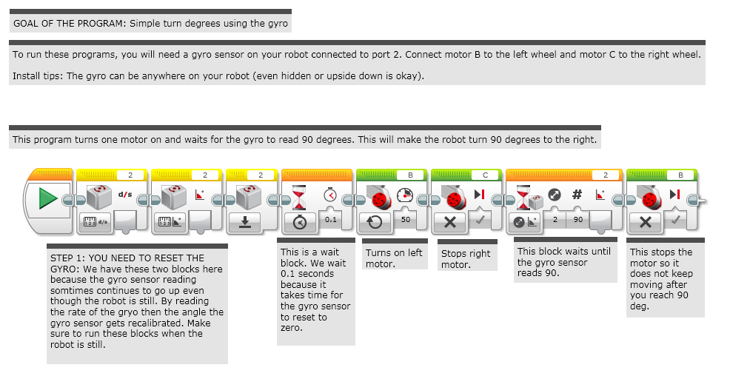
Stage 1: Simple Gyro Turn

Slide 5
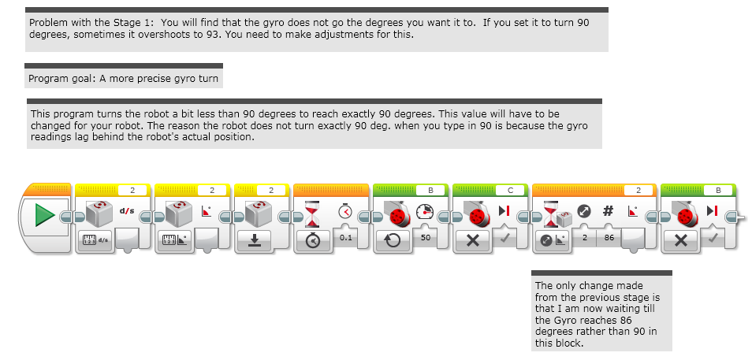
Stage 2: Dealing with Lag

Slide 6
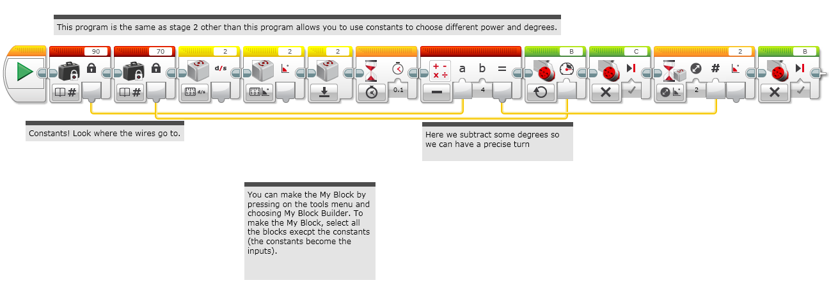
Stage 3: Making a My Block

Slide 7
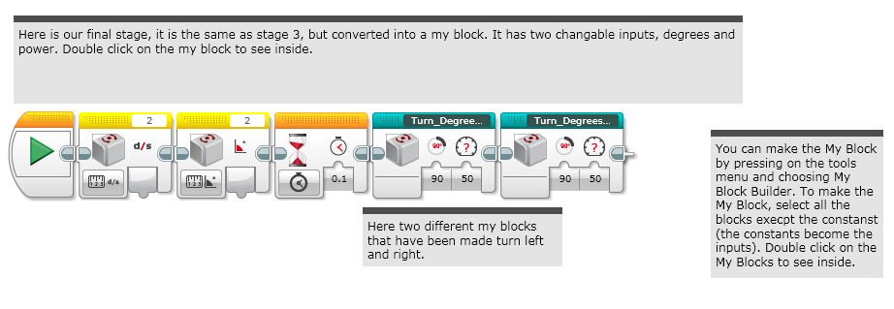
Stage 4: Using the My Block

Slide 8
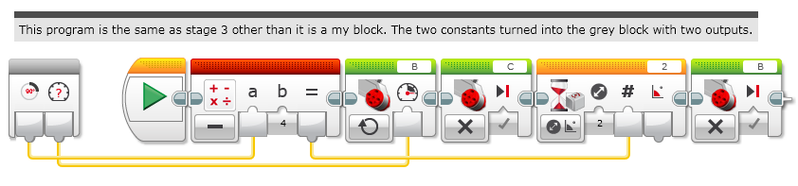
Inside the My Block: Turn Degrees Right

Slide 9
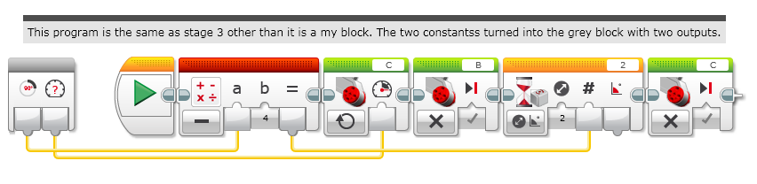
Inside the My Block: Turn Degrees Left

Slide 10
Proportional Gyro Turns by The Construction Mavericks
This method improves over the simple overshoot correction mechanism from earlier by using proportional control
If you are unfamiliar with proportional control, please see the advanced lesson on proportional control before continuing.
The basic idea is to use the current gyro position and where it wants to point to determine how to set the motor power.
Note from Construction Mavericks: It's not perfect, but we have had much better success with these blocks than the overshoot-corrected ones.
Tip from Construction Mavericks: Try to set the outer loop to an infinite loop. Once the robot settles into place, pick it up and rotate it and watch it try to get back to where it wants to be.

Slide 11
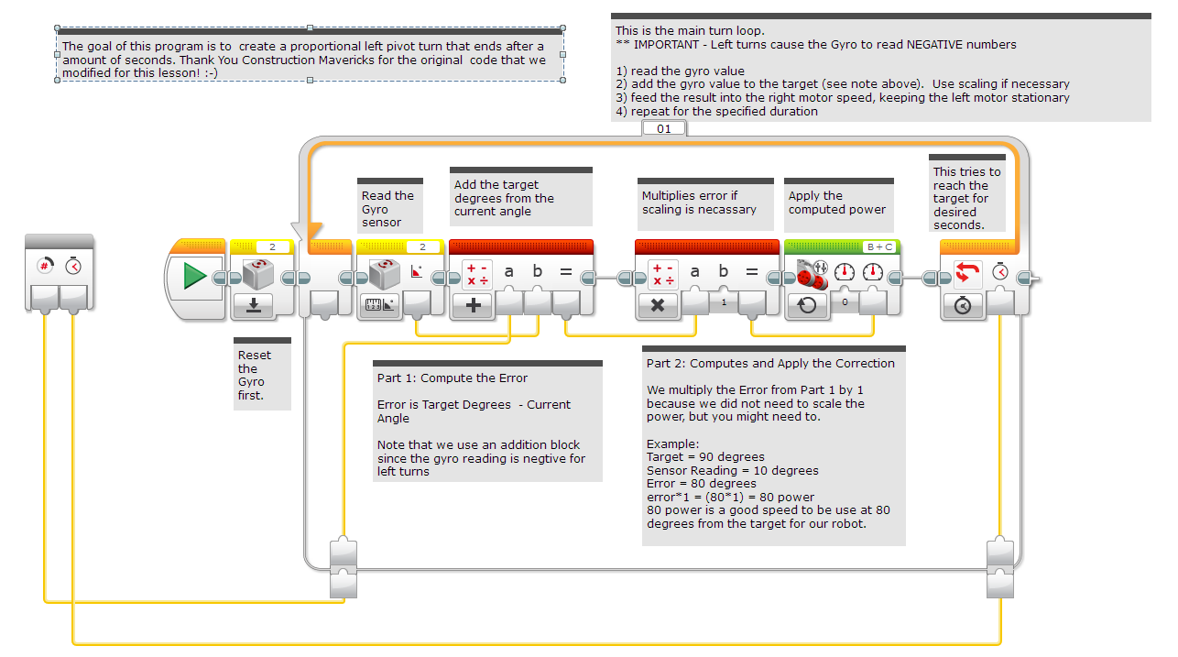
Proportional Left Turn
What is going on with the math block in Left Pivot Turn? You always calculate TARGET/GOAL MINUS CURRENT VALUE. So why an Addition Math Block? When you make a Left turn, the gyro always returns negative degrees. From math, we know that adding a negative number is the same as subtracting the number. So, that is why we use the Addition Math block in a Left Gyro Turn.

Slide 12
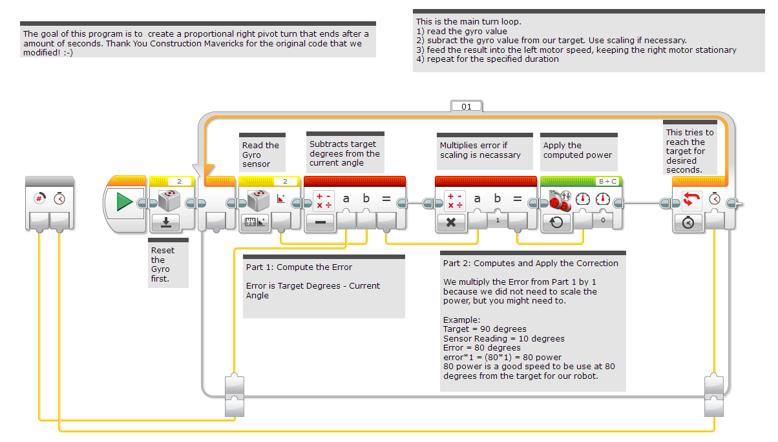
Proportional Right Turn

Slide 13
Discussion
What is gyro lag? Ans. The gyro sensor’s reading lags behind the true reading
What is the difference between the two solutions presented in this lesson? Ans. The first way was to reduce the amount of angle that you turn to compensate for lag. The second way was to use proportional control to continue performing your turn for a requested duration

Slide 14
Credits
This tutorial was written by Sanjay Seshan and Arvind Seshan from Droids Robotics using code shared by The Construction Mavericks (http://fllmavericks.wix.com/fllmavericks)
More lessons at www.ev3lessons.com
This work is licensed under a Creative Commons Attribution-NonCommercial-ShareAlike 4.0 International License.

