Slide 1


BEGINNER EV3 PROGRAMMING Lesson
Topics Covered:
Basic Sequencer
By: Droids Robotics

Slide 2
Lesson Objectives
Learn how to use the Wait for Button Press Block
Learn what a Sequencer is and why it is useful
Learn how to make a Sequencer

Slide 3
Using EV3 Brick Buttons as a Sensor
All the EV3 brick buttons (except the OFF button) are like the touch sensor
You can use the buttons to make a game, run different actions based on each button, or make a sequencer (explained on slide 4).
You do not need to waste a sensor port on a touch sensor if you plan to use the touch sensor like a button.
The first step to making a Basic Sequencer is to learn how to use the “Wait for Button Press” feature. See next slide (slide 3)

Slide 4
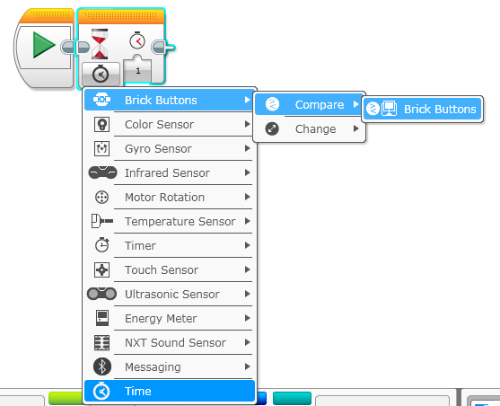
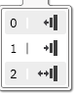
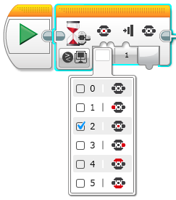
How to Use a “Wait for Button Press” Block
Wait Block – Click on the bottom left corner and select Brick Buttons – Compare – Brick Buttons
This slide is animated.
Droids recommend #2 (bumped) – most reliable
You can choose any button except the off button

Slide 5
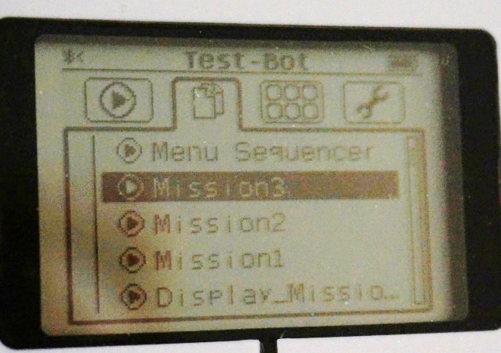
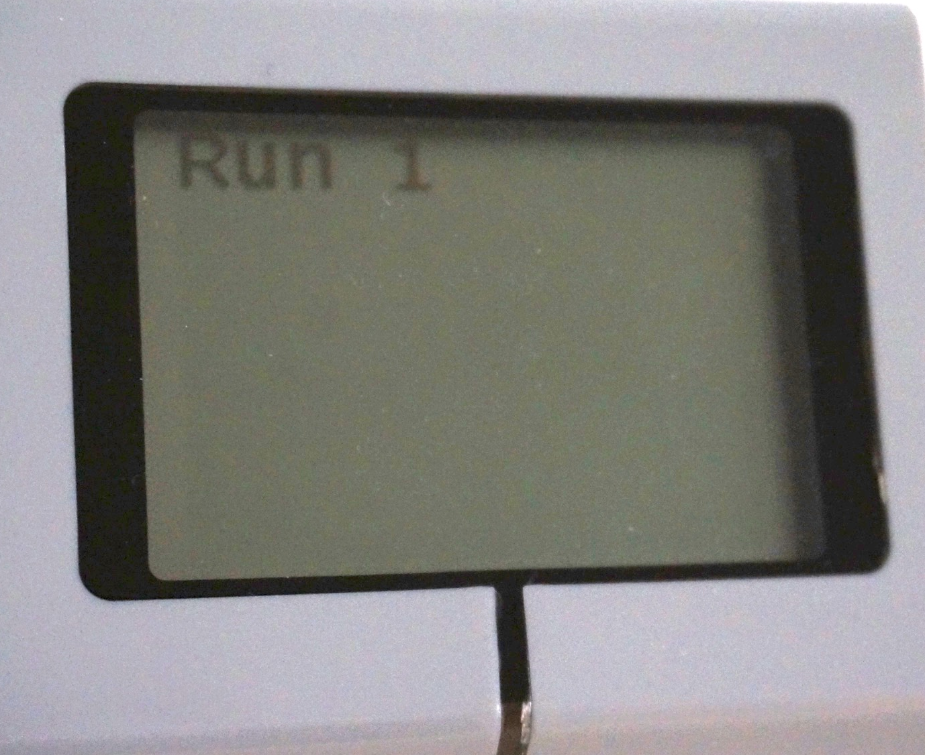
What is a Sequencer and Why Use one?
A sequencer is a program that puts your missions in the order you choose. It is sometimes called a Master Program or a Menu System.
Advantages: You will not need to search for the program in a jumble of programs on the brick. This will save you time on your runs.
Disadvantages: You will not be able to re-run each program easily with a basic sequencer (check our more advanced Menu System lesson)
Programs on brick
Sequencer

Slide 6
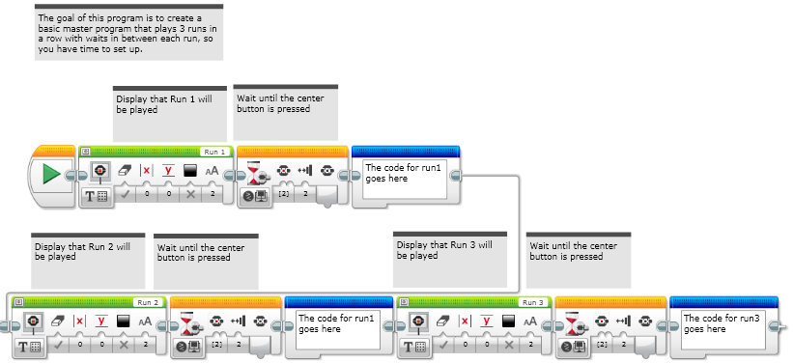
Step 1: Create A “Dummy” Sequencer
Create a Sequencer that waits until you press the button to play the (next) actions. This will also display which mission will be played next. “Dummy” just means that you don’t have your actions yet.

Slide 7
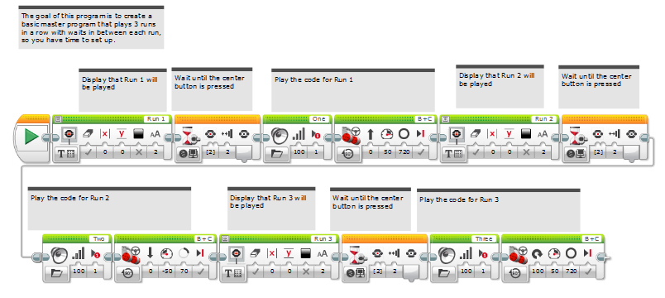
Step 2: Add Actions
Copy and paste each of your actions after each button press. Note: these missions just move and turn (don’t really do much!). Replace with your own code.
This sequencer code is set up for 3 actions (add/remove as needed)

Slide 8
Discussion Guide
What did this sequencer allow you to do? Why is this useful?
It let you run one action on your robot after another. On the EV3 Brick, it can be hard to locate your programs. This ensures that multiple programs you have written will be in a sequence.

Slide 9
CREDITS
This tutorial was created by Sanjay Seshan and Arvind Seshan from Droids Robotics.
More lessons are available at www.ev3lessons.com
Author’s Email: team@droidsrobotics.org
This work is licensed under a Creative Commons Attribution-NonCommercial-ShareAlike 4.0 International License.

