Slide 1


Intermediate Lesson: Intermediate Menu System
By Droids Robotics

Slide 2
Lesson Objectives
Learn how to create a menu that lets you select between actions
Learn how to use your brick buttons as sensors

Slide 3
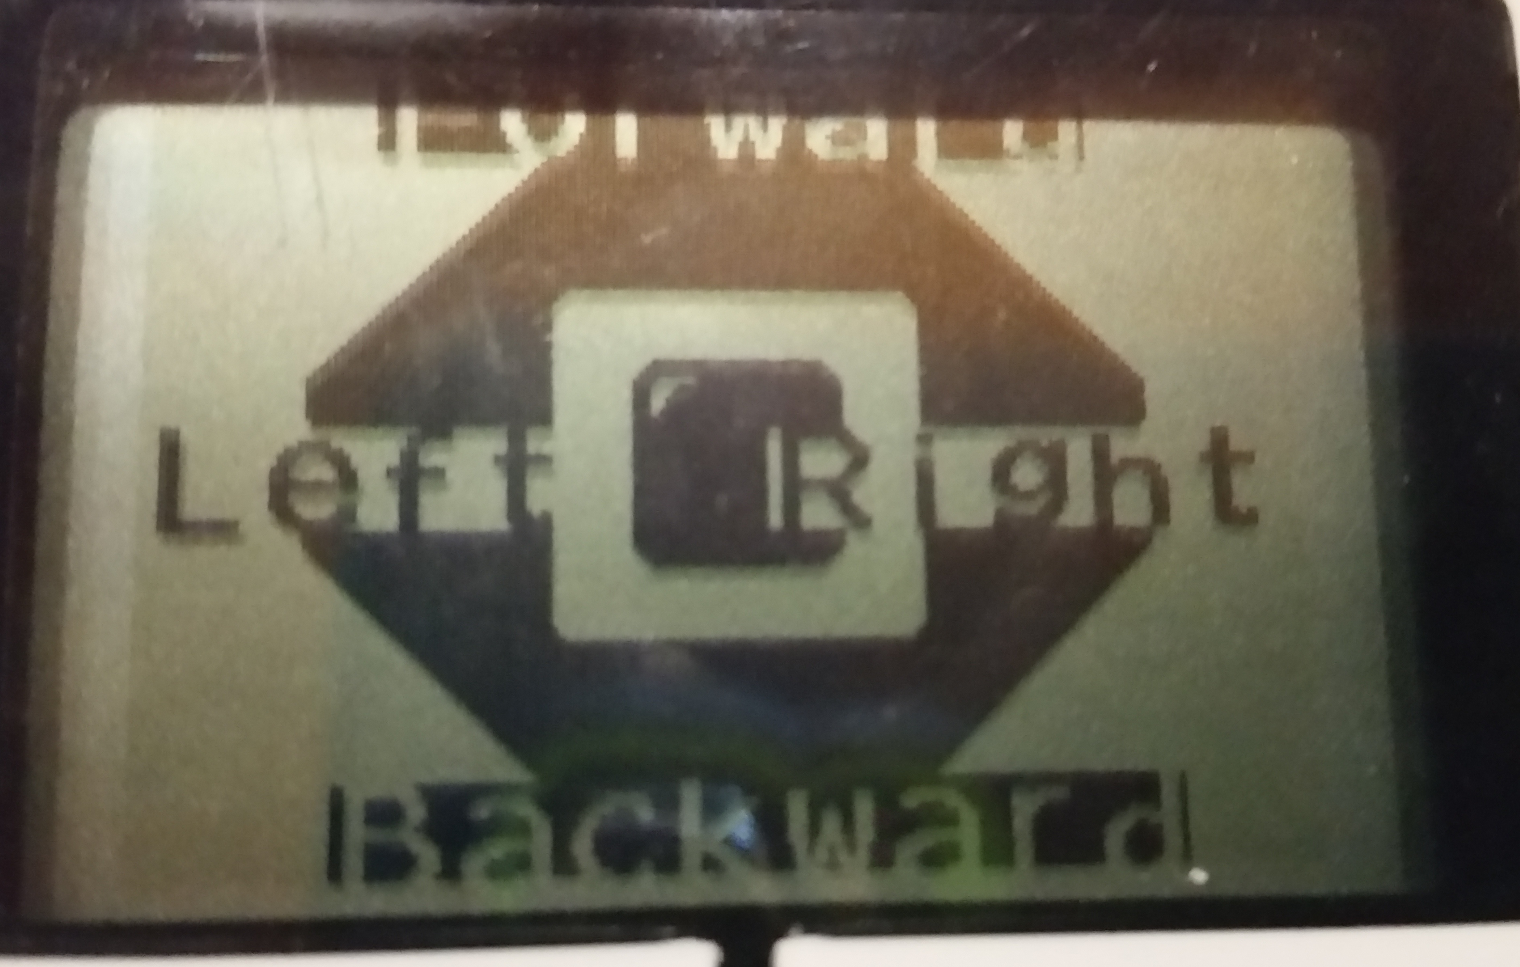
Why a Menu
A menu is an organized way to easily perform actions based on which button you press
You will need to know how to use the buttons on the brick as “sensors” and you will need to use display blocks to make a useful screen menu
In the image, the actions are 4 movements – go forward, backward, left and right

Slide 4
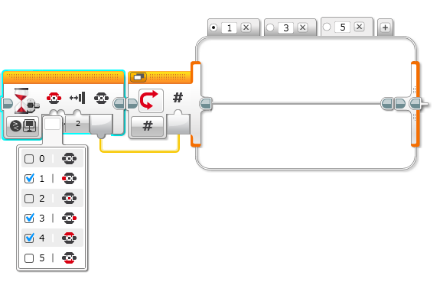
New Tool: Using the Button ID
It can also tell you which button was pressed and you can take different actions based on the
Wait for button press blocks will halt the program until one of the chosen buttons is pressed

Slide 5
Steps/Pseudocode
Display the actions on the screen so that the user knows which button performs which actions
Wait for the user to press a button
Based on the button press, run the code for the appropriate action
Go back to 1
Challenge: Based on the above pseudocode, try to make a menu system that lets you perform 4 actions of your choice based on the button pressed

Slide 6
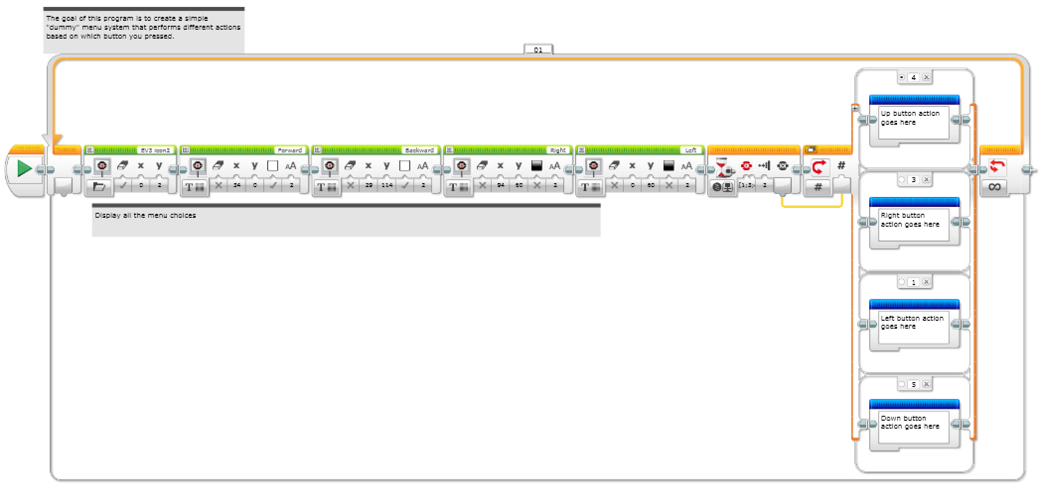
Step 1: Create an “Empty” Menu System
Create a menu system without any code put in

Slide 7
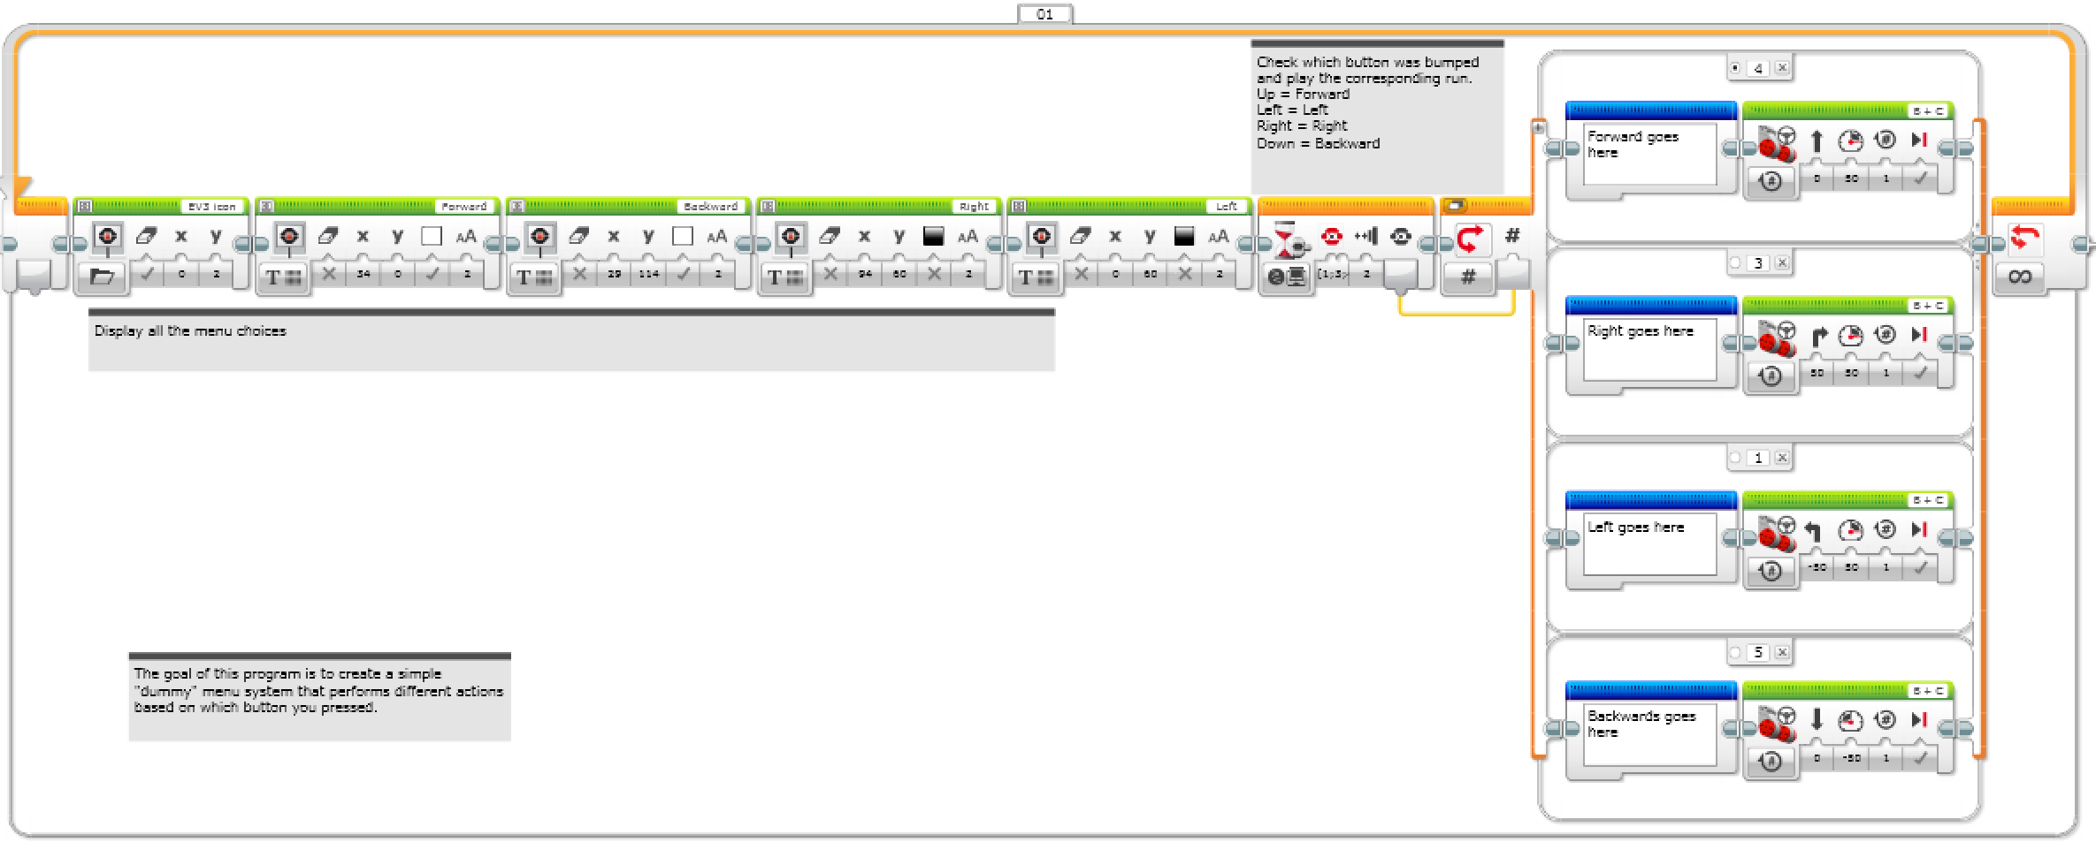
Step 2: Add Actions
Add actions to each switch option.

Slide 8
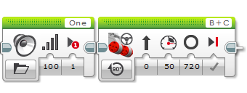
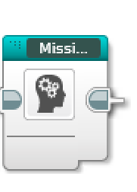
Step 3a: Convert Actions into My Blocks
You need to convert long set of actions into its own My Block
If you don’t know how to make a My Block, see the Intermediate lesson on My Blocks

Slide 9
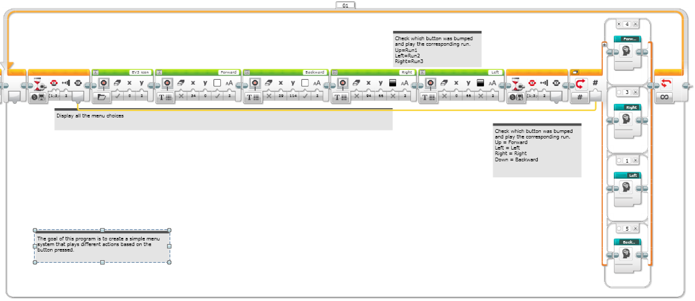
Step 3b: Add Actions
Here, complex actions have been made into My Blocks.

Slide 10
Next Steps with Mission Sequencers
The ideas in this lesson can be adapted to help you build a mission sequencer for First Lego League. Sequencers are useful because they:
Allow you to skip missions if you are short of time
Allow you to repeat failed missions
Allow you access missions quickly (find them easily)

Slide 11
CREDITS
This tutorial was created by Sanjay Seshan and Arvind Seshan from Droids Robotics.
More lessons are available at www.ev3lessons.com
Author’s Email: team@droidsrobotics.org
This work is licensed under a Creative Commons Attribution-NonCommercial-ShareAlike 4.0 International License.

