Slide 1


Intermediate Programming Lesson: Alternative Line Following Techniques
In
By FLL Team 1920 Baker’s Dozen

Slide 2
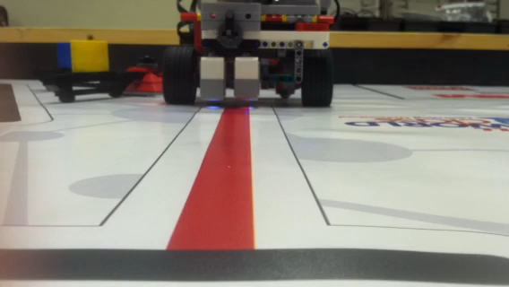
Technique: Line straddling
Line straddling is when you use two light sensors next to each other to follow a line
Advantages:
reduces “fish tailing” (the wiggle of the back of the robot
Disadvantages:
Will be harder to square on a line since the sensors are closer together
Watch video to see line straddling in action

Slide 3
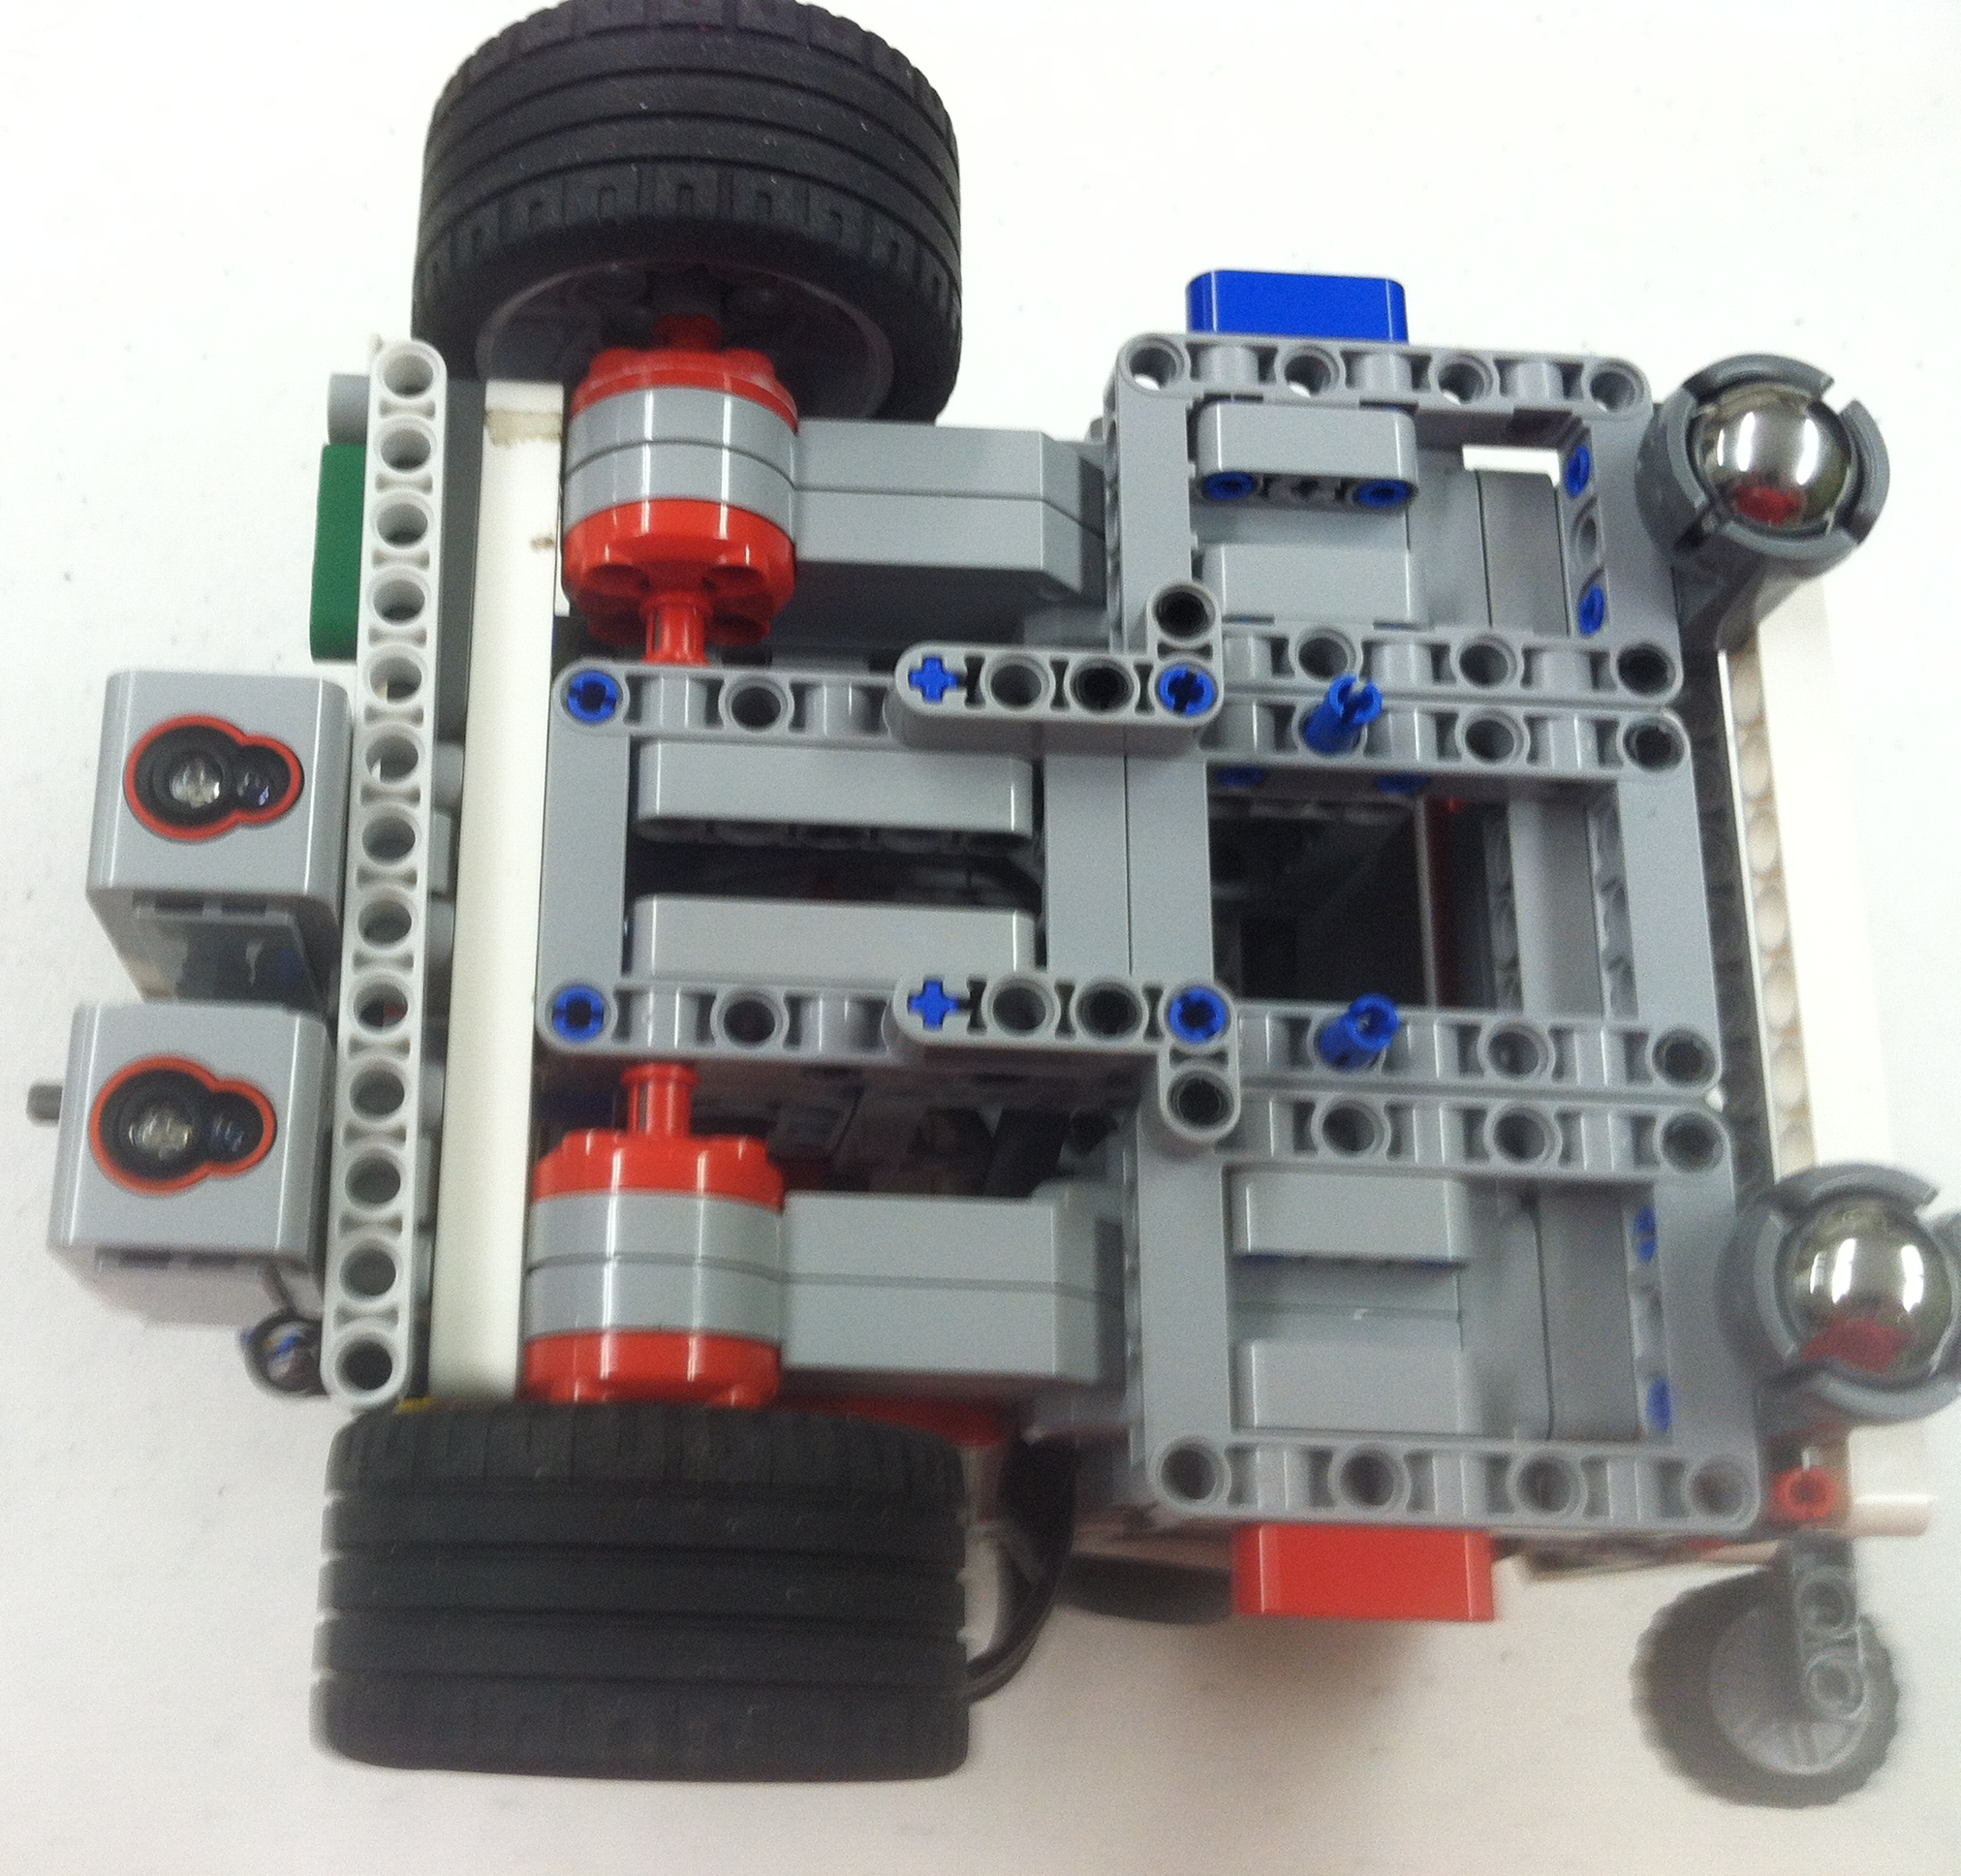
Line Straddling: Tips for success
Placement of the two color sensors are very important
In the picture on the right, we have a beam placed so you can see how far apart to place your sensors.

Slide 4
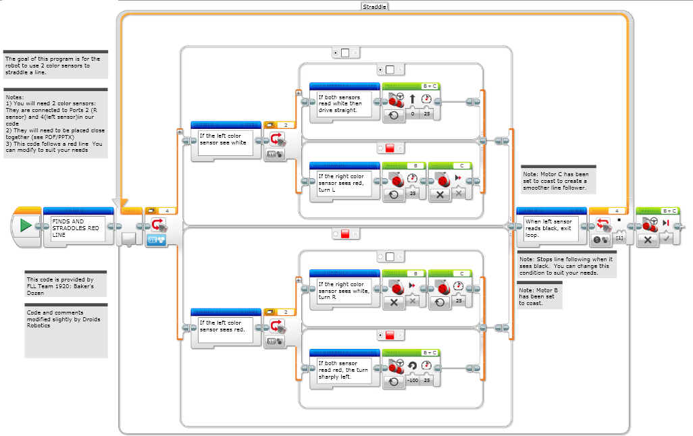
Line Straddling Code

Slide 5
Credits
This lesson was compiled and slightly modified by EV3Lessons.com/Droids Robotics to fit the format of other lessons.
The video, photograph and code for Line Straddling were created and shared by FLL Team 1920, Baker’s Dozen
More lessons are available at www.ev3lessons.com
This work is licensed under a Creative Commons Attribution-NonCommercial-ShareAlike 4.0 International License.

