Slide 1


INTERMEDIATE PROGRAMMING Lesson
My Blocks Overview
Step-by-Step Visual Guide to Creating a My Block with Inputs with Outputs
By: Droids Robotics

Slide 2
Lesson Objectives
Learn how to make custom blocks in the EV3 Software (My Blocks)
Learn why a My Block is useful
Learn to construct a My Block with Inputs and Outputs

Slide 3
What is a My Block?
A My Block is a combination of one or more blocks that you create that can be grouped into a single block
My Blocks are basically your own custom block in NXT or EV3
Once a My Block is created, you can use it in multiple programs
Just like any other block in EV3, My Blocks can have both inputs and outputs
The two blocks above are examples of My Blocks:
Move_Inches tells the robot to move the number of inches we input
Turn_Degrees tells the robot to turn the amount we input

Slide 4
Why should you bother?
Because of My Blocks, your missions will look like this…
Instead of this….
This makes your code easier to read and easier to modify!!!

Slide 5

When do you use a my block
Whenever the robot is going to repeat an action inside your program
When code is repeated in a different program
Organize and simplify your code
Example: You have 2 different versions of a robot run in FLL and the first half of both of them are identical, then making the first half of the code into a My Block allows you to “clean up your code” in both programs.

Slide 6
DISCUSSION: What makes a useful my block
Note: Making My Blocks with inputs and outputs can make them far more useful. However, you need to be careful not to make the My Block too complicated.
Question: Look at the list of three My Blocks below. Which ones do you think are useful for a team to use?
1) Move2Inches (Moves the robot two inches)
2) MoveInches with an inches and power input
3) MoveInches with inches, power, angle, coast/brake, etc. inputs
Answer:
Move2Inches may be used often but you will be forced to make other My Blocks for other distances. This will be hard to update or fix later on.
MoveInches with inches, power, angle, coast/brake, etc. might look more useful but most of the inputs might never be used in any mission.
MoveInches with inches and power as inputs is probably the best choice for most teams.

Slide 7
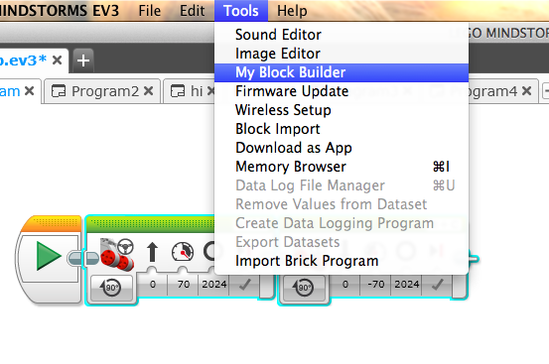
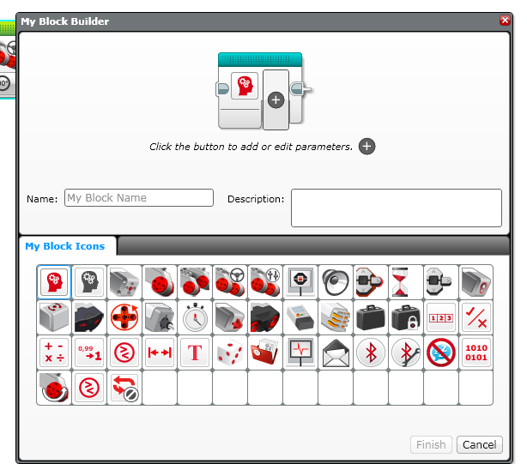
SUMMARY: How to make a my block
Step 1: Select the blocks you think you will reuse. Go to Tools and Pick My Block Builder
Step 2: Pick a name and icon and set inputs & outputs
Step 3: You can use your block anytime – found in the turquoise tab
The next few slides show the step-by-step process of creating
a My Block with Inputs and Outputs

Slide 8
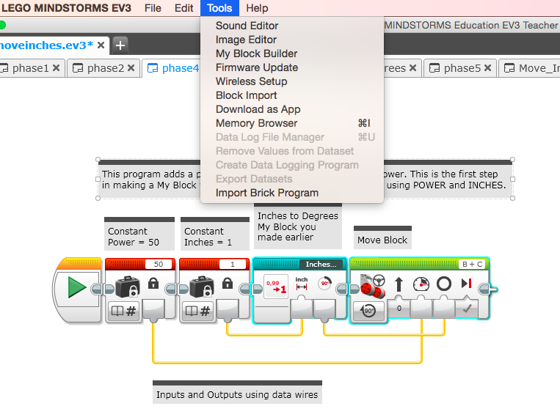
Highlight Blocks and Pick My Block Builder in Menu
Note: Do not highlight the constants.
Inputs/Outputs will be auto created based on wires coming into/out of the highlighted code. In this example you get 2 inputs, 0 outputs.

Slide 9
Highlight Blocks and Pick My Block Builder in Menu
You will be able to set up the parameters for the 2 inputs inside the My Block Builder. You can add more inputs/outputs as needed.

Slide 10
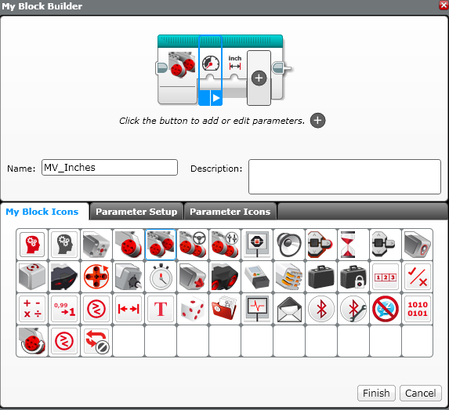
Name Block & Pick ICON

Slide 11
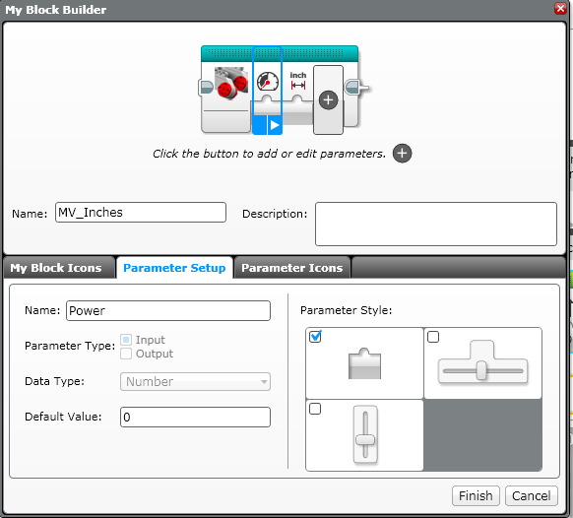
Define Input 1: NAME, Type, STYLE
1
2
3
5
4
5

Slide 12
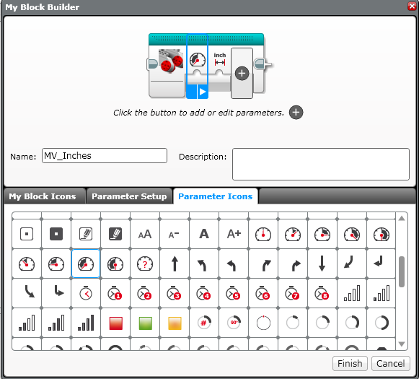
PICK an Icon of your choice

Slide 13
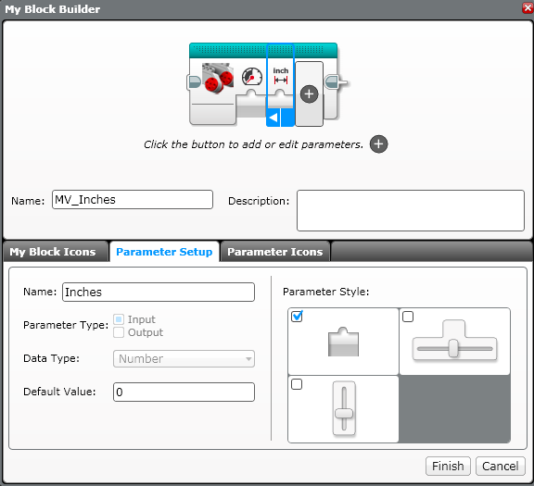
DEFINE INPUT 2: NAME, Type, STYLE
1
2
5
3
4

Slide 14
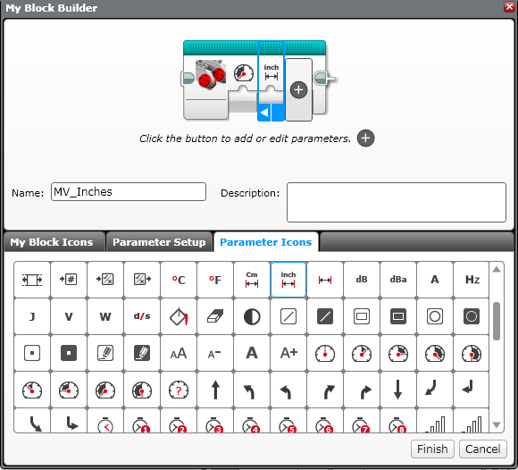
PICK AN ICON

Slide 15
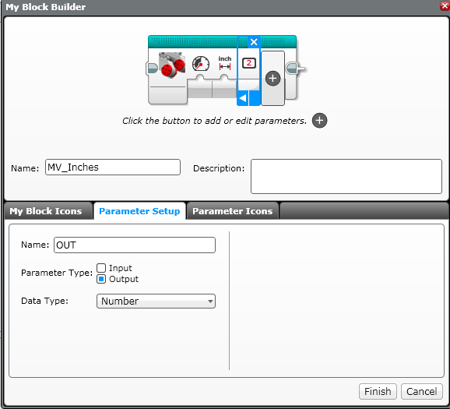
Adding more inputs/outputs
Click on “+” to add more inputs or outputs.
Click on “x” to delete inputs/outputs that you create. Note: You cannot delete auto-created inputs/outputs

Slide 16
DEFINE OUTPUT PARAMETERS
If you have an output, define the parameters of the output now
1
2
3
4

Slide 17
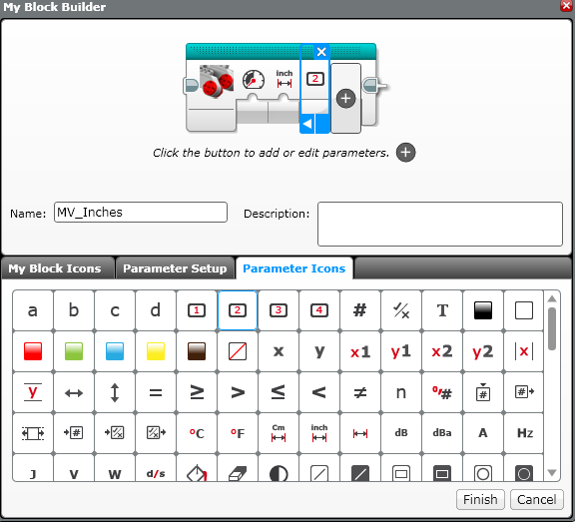
PICK AN ICON

Slide 18
Click on the FINISH Button

Slide 19
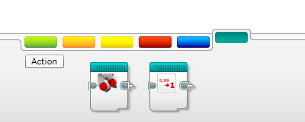
My Block in Turquoise Tab
You can use this new My Block in any of your code!

Slide 20
CREDITS
This tutorial was created by Sanjay Seshan and Arvind Seshan from Droids Robotics.
More lessons are available at www.ev3lessons.com
Author’s Email: team@droidsrobotics.org
This work is licensed under a Creative Commons Attribution-NonCommercial-ShareAlike 4.0 International License.

