Slide 1


Parallel Beams
INTERMEDIATE EV3 PROGRAMMING LESSON
By Droids Robotics

Slide 2
Lesson Objectives
Learn what a parallel beam is and how to use them
Learn when you might use parallel beams

Slide 3
What are Parallel Beams?
Parallel beams allow you to run two or more blocks at the same time.
In First Lego League, they are mostly often used when you have one of more attachment arms connected to motors and you want to turn these arms while the robot is moving to complete a mission
Robot lifting up hoops and driving forward.

Slide 4
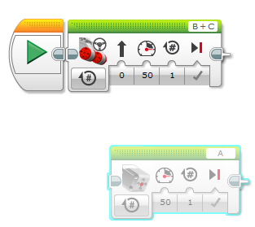
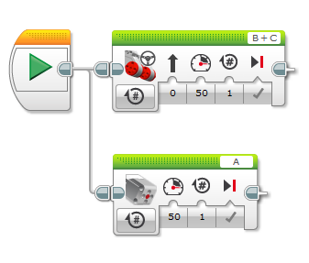
How Do I Make a Parallel Beam?
To create a parallel beam click and drag on the bump on the right center of any block and release once you hover over the inverted bump on the left center side on a block.
Note: Blocks before the split will run one at a time. After the split blocks on the two “beams” will run at the same time

Slide 5
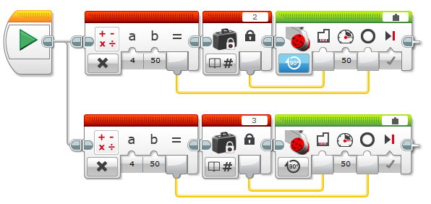
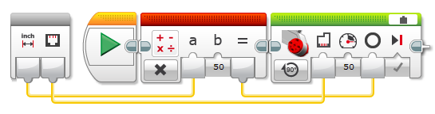

Parallel Beams and My Blocks
Here is a simple program that moves both wheels of our robot forward
If you run it, our robot moves forward by about 4 inches
To simplify it, we can make the below My Block (Motor_Inches) that moves the selected motor forward

Slide 6
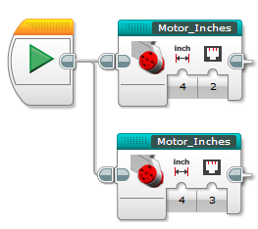
Parallel Beams and My Blocks
BE CAREFUL WHEN YOU USE PARALLEL BEAMS AND MY BLOCKS
Using the Motor_Inches My Block, we can convert the program on the bottom left to the one on the bottom right
If you run the program, the robot does completely different things!!!!!
The code on the right moves one wheel 4 inches and then moves the other wheel 4 inches. This causes the robot to spin around in one direction then the other
The code on the left moves both wheels 4 inches at the same time. This makes the robot move forward.
Lesson: EV3 does not let you run two copies of the same My Block at the same time

Slide 7
Challenge
Can you write a program that uses parallel beams that have to move and pick up an object at the same time?

Slide 8
Credits
This tutorial was created by Sanjay Seshan and Arvind Seshan from Droids Robotics.
Author’s Email: team@droidsrobotics.org
More lessons at www.ev3lessons.com
This work is licensed under a Creative Commons Attribution-NonCommercial-ShareAlike 4.0 International License.

