Slide 1


BEGINNER EV3 PROGRAMMING Lesson
Topics Covered:
Moving Straight
By: Droids Robotics

Slide 2
Lesson Objectives
Learn how to make your robot go forward and backwards
Learn how to use the Move Steering block
Learn how to read sensor values using Port View

Slide 3
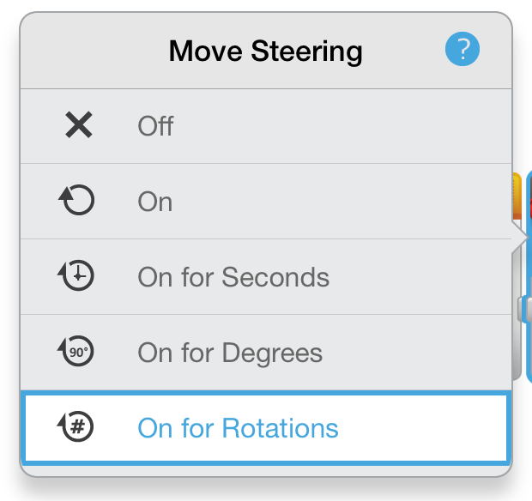
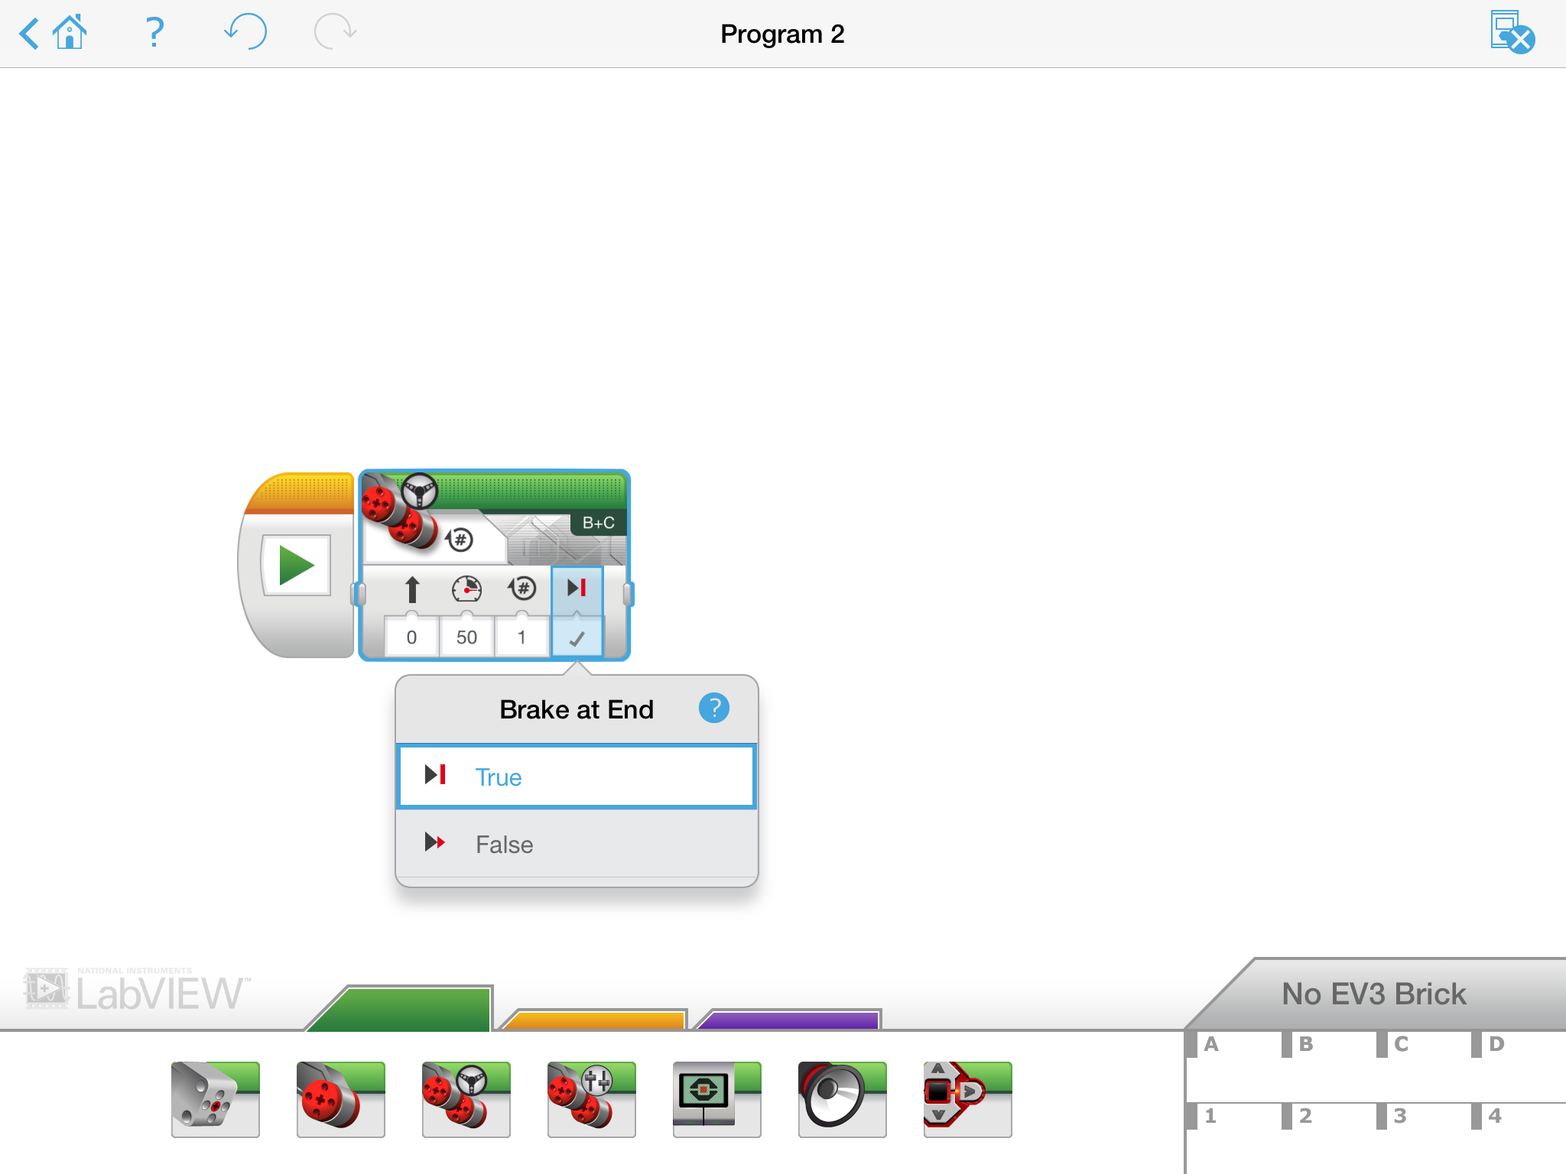
Move STEERING Block
B
C
Mode of operation
Brake/Coast
Steering: Straight or turn
Power/Speed
Duration/Distance

Slide 4
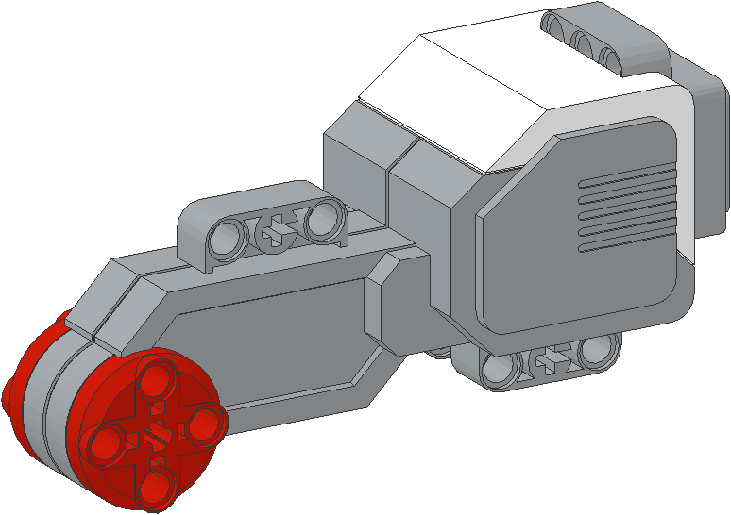
NEGATIVE & POSITIVE POWER: BACKWARD & FORWARD
Negative Power = Backwards
Positive Power = Forward

Slide 5

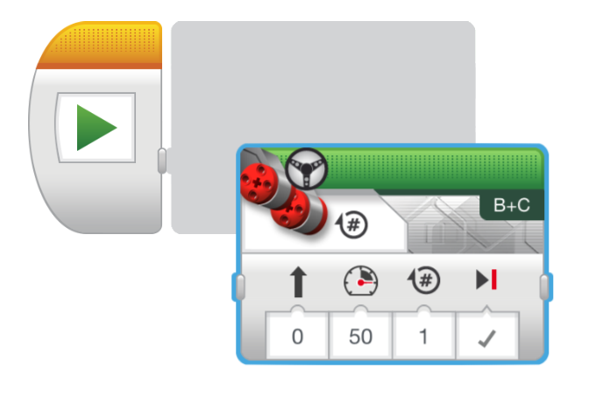
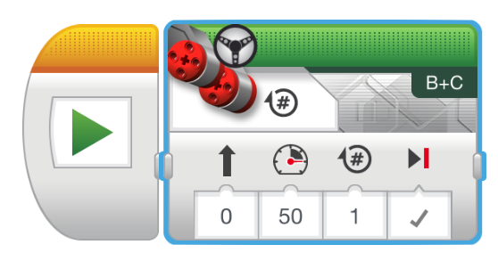
HOW do you Move Straight?
STEP 1: Green Block Tab, Click and hold Move Steering and drag to programming area
STEP 2: Drop next to the Start Block (green arrow)

Slide 6
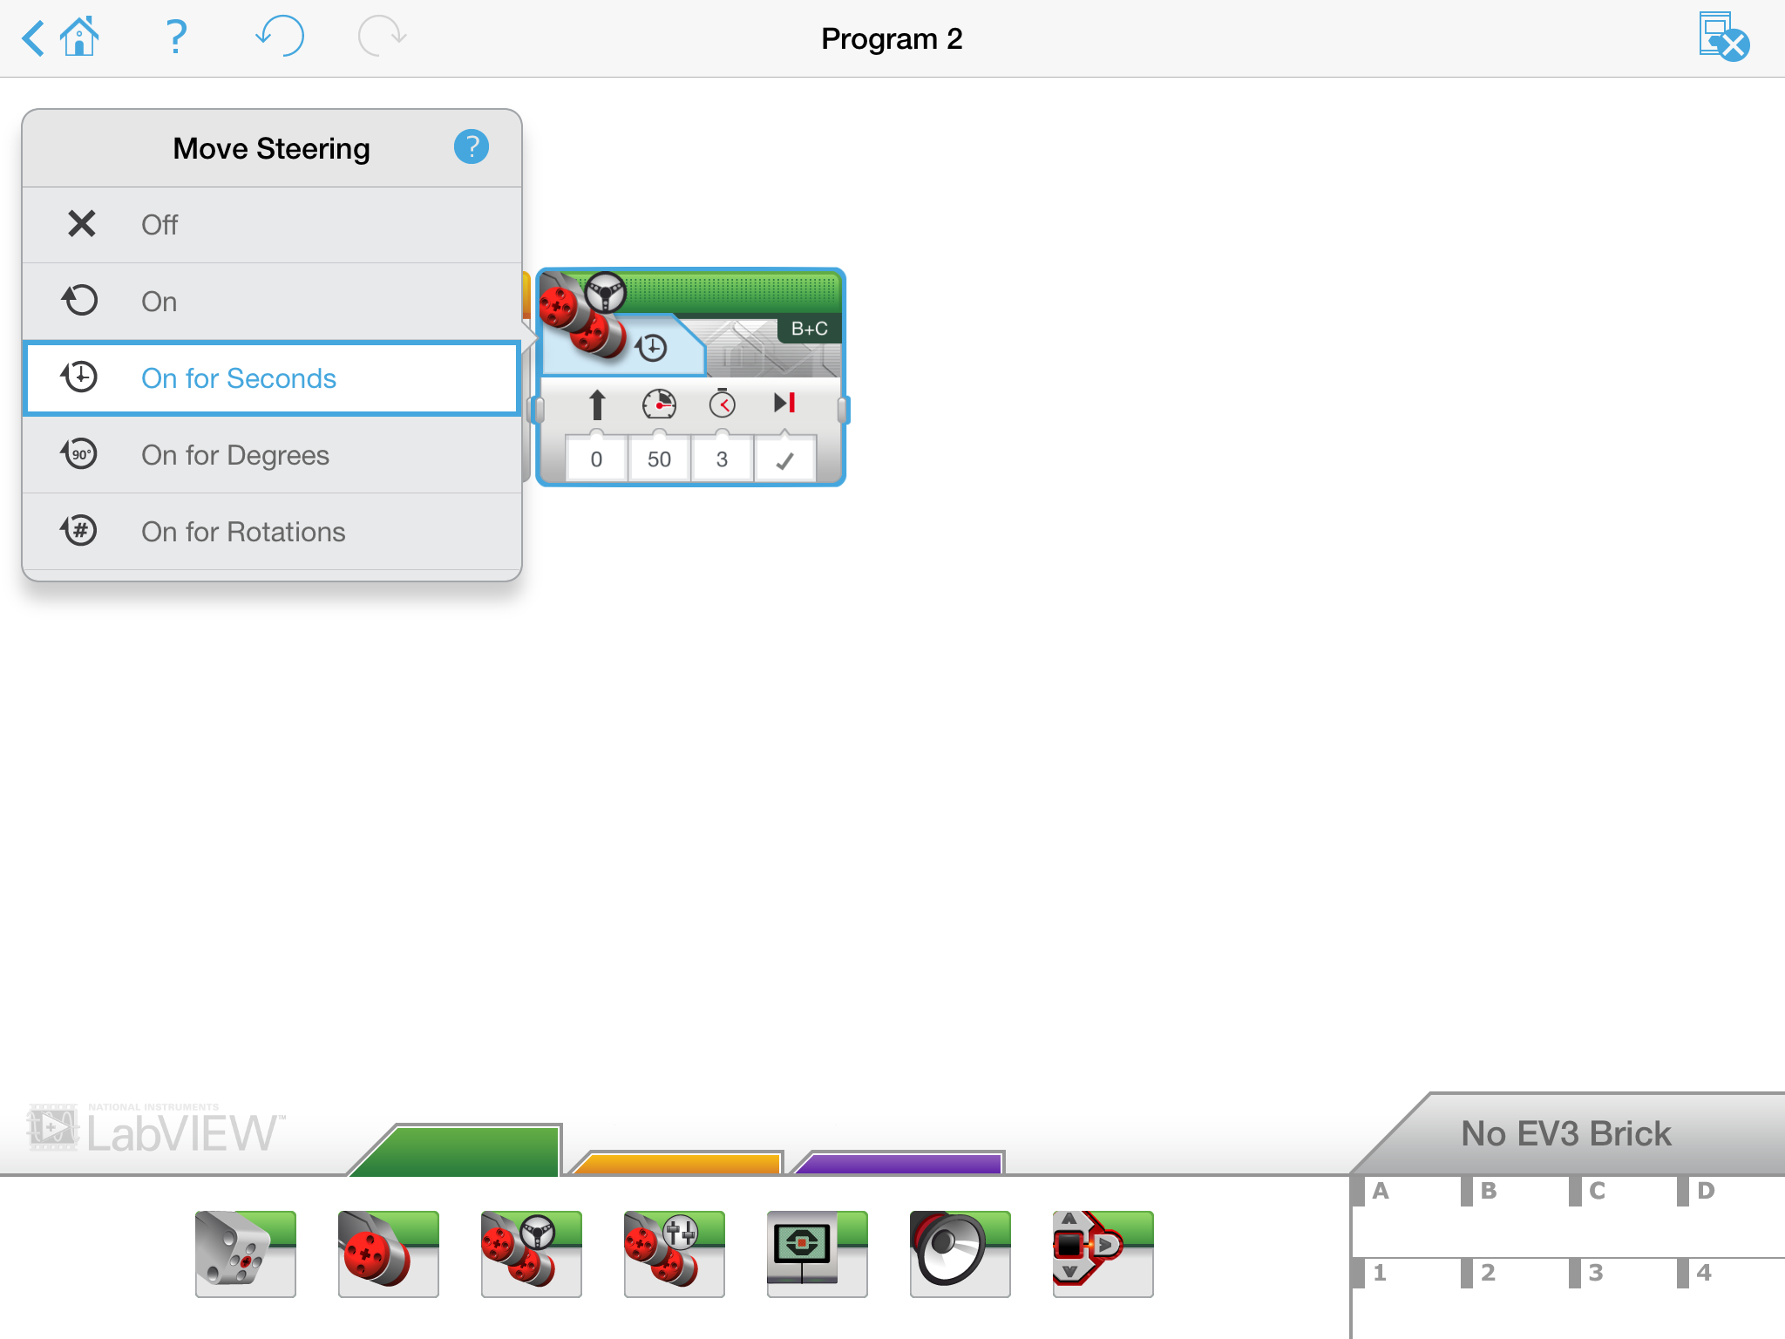
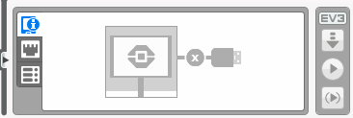
CHALLENGE 1: Move Straight (3 SECONDS)
Step 3
STEP 1: Green Block Tab, Click and hold Move Steering and drag to programming area
STEP 2: Drop next to the Start Block (green arrow)
STEP 3: Select Options. Move “3 Seconds”
STEP 5: Download to EV3 (instructions on next page)
Step 4
Step 5

Slide 7
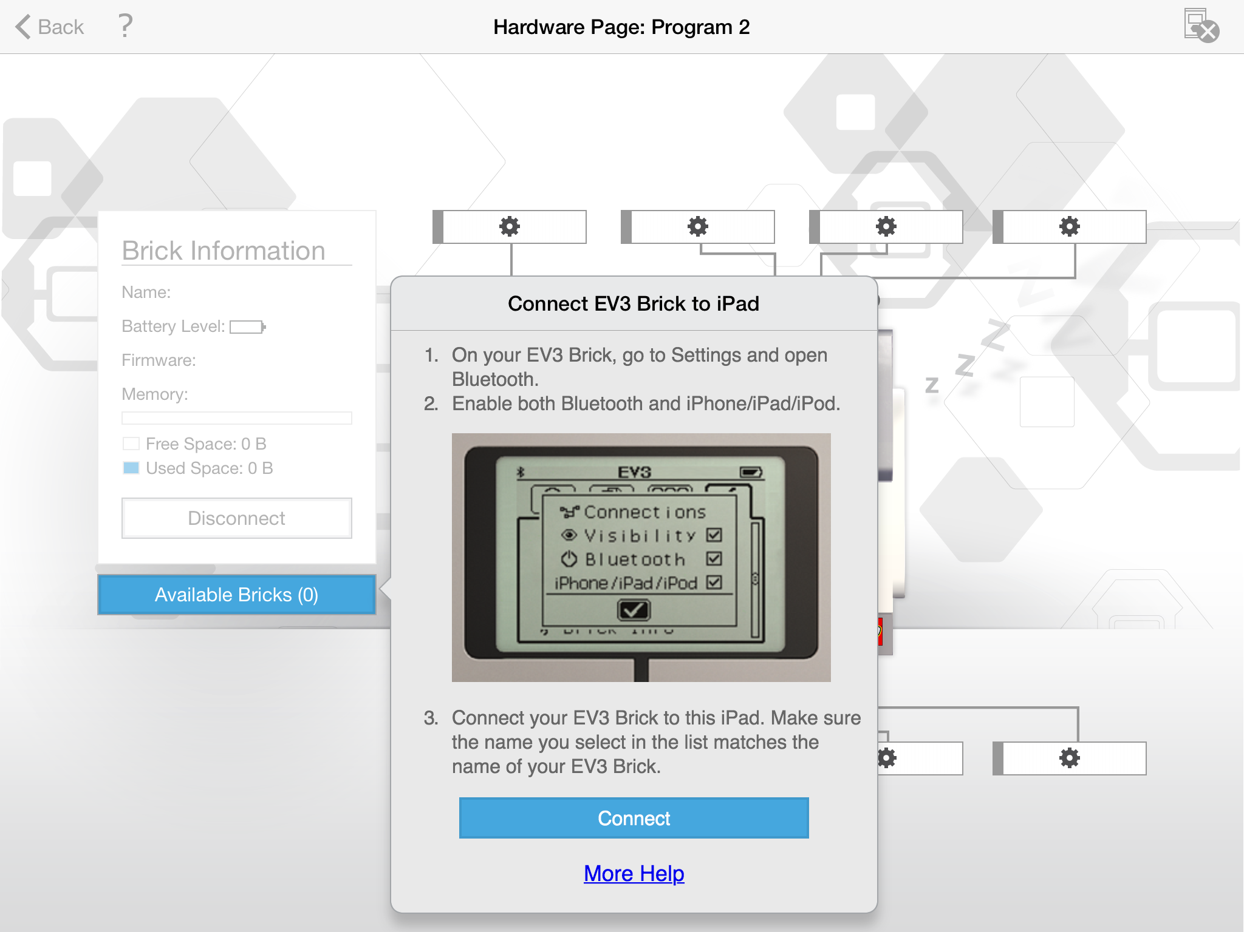
Connecting to your robot
Tap on “No EV3 Brick”
Choose Connect

Slide 8
Teacher instructions
Split up class into groups as need
Give each team a copy of the Move Straight Challenge Worksheet
Challenge Details are on Slide 8
Discussion Page Slide 9
Challenge Solution on Slide 10
A Better Way on Slide 11

Slide 9
Move Straight: Seconds vs. degrees vs. rotations
FINISH
CHALLENGE: Move your robot forward from the start line to the finish line (1) and back to the start (2).
Try mode SECONDS, DEGREES or ROTATIONS and adjust duration/distance
Try different speeds
1
2
B
START
C

Slide 10
MOVE STRAIGHT discussion
Did you guess and check a lot?
Yes. Programming with seconds, rotations and degrees using guess and check takes a lot of time and effort.
Did changing the speed matter?
Yes. When you move in seconds your speed will matter.
Do you think the wheel size will matter? Why?
Wheel size affects degrees/rotations.
Do you this the battery level will matter? Why?
When you move in seconds, battery levels change the power.

Slide 11
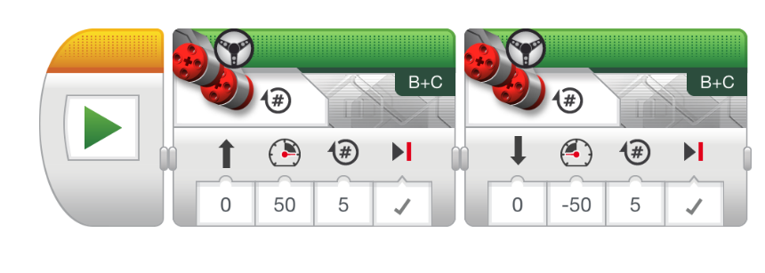
CHALLENGE SOLUTION
This would be changed for degrees or seconds
There is a better way (go to slide 11) to solve this challenge

Slide 12
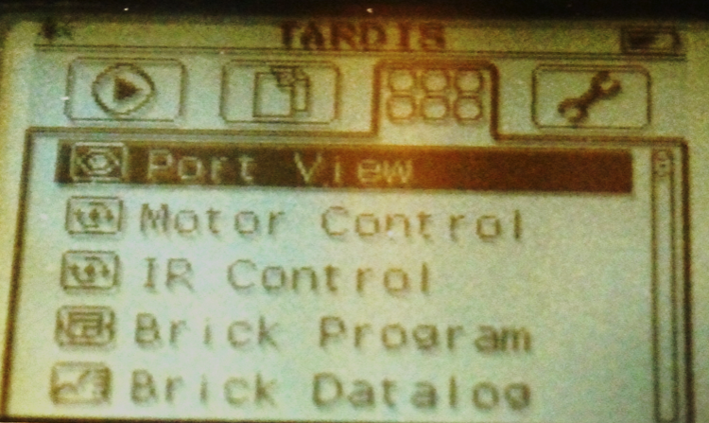
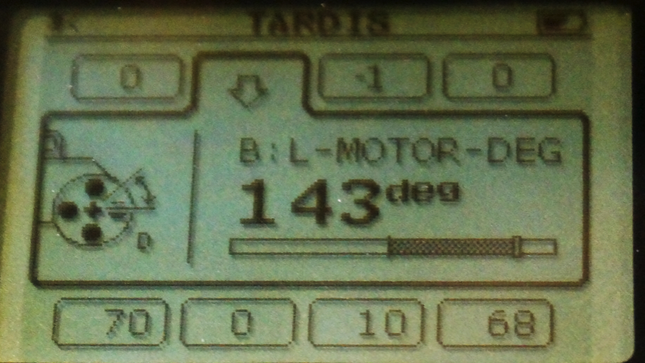
SOLUTION: Use Port View
Try “port view” on brick (on Brick Apps tab)
Move your robot with your hand from your start line to your end line
Read how many degrees your robot moved
Use this number in the Move Steering Block to move the correct distance.

Slide 13
CREDITS
This tutorial was created by Sanjay Seshan and Arvind Seshan from Droids Robotics.
More lessons are available at www.ev3lessons.com
Author’s Email: team@droidsrobotics.org
This work is licensed under a Creative Commons Attribution-NonCommercial-ShareAlike 4.0 International License.

