Slide 1


BEGINNER EV3 PROGRAMMING Lesson
Topics Covered:
Turning
By: Droids Robotics

Slide 2
Lesson Objectives
Learn to turn the robot a desired number of degrees
Learn the differences between Spin and Pivot Turns
Learn how to program two different type of turns
Learn to write pseudocode

Slide 3
PIVOT Vs. SPIN Turns
180 Degree Pivot Turn
Notice where the robot ends in both pictures after a 180 degree turn.
In the Spin Turn, the robot moves a lot less and that makes Spin Turns are great for tight positions. Spin turns tend to be a bit faster but also a little less accurate.
So when you need to make turns, you should decide which turn is best for you!
B
End Position
Motor
B Moves
C
B
Start Position
C
180 Degree Spin Turn
Start Position
End Position
B
B
Motors
B and C Move
C
C

Slide 4
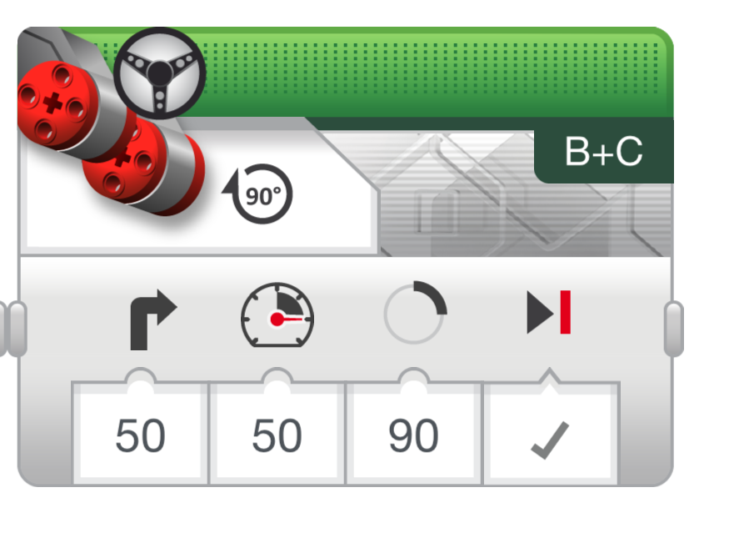
How to Make Pivot and Spin turns
Steering Value
50 | -50 | 100 | -100
Pivot Turn Right | Pivot Turn Left | Spin Turn Right | Spin Turn Left
B
B
B
B
C
C
C
C
Move Steering Block
Change Steering value here

Slide 5

MAKING A Pivot turn for 90 DEGREES
?
B
B
C
C
Program your robot to turn 90 degrees....Does the robot actually turn 90 degrees if you just pick 90 degrees for distance?
Ans. NO! Solution on next page

Slide 6
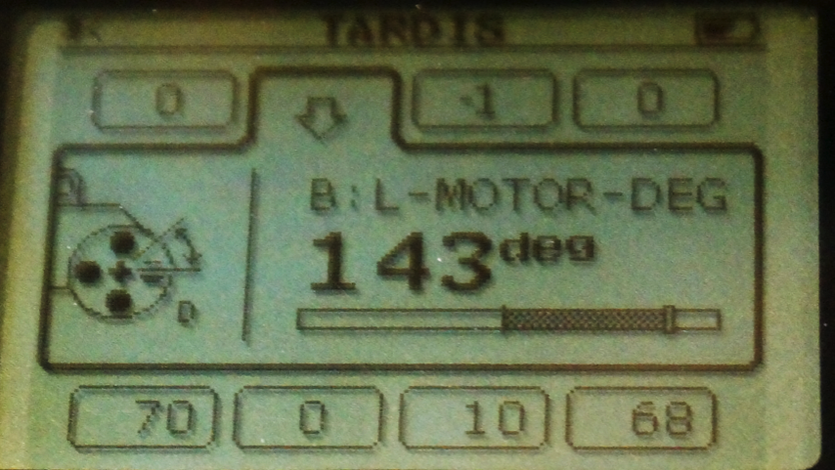
how do you make the robot turn 90 degrees?
Ans. Try using the port view to measure the turn and then input the correct number of degrees.

Slide 7
TEACHER INSTRUCTIONS
Split up class into groups as need.
Give each team a copy of the Turning Challenge Worksheet.
Challenge Details are on Slide 8
Discussion Page Slide 9
Challenge Solution on Slide 10

Slide 8
TURNING CHALLENGES
Challenge 1
Your robot is a baseball player who has to run to all the bases and go back to home plate.
Can you program your robot to move forward and then turn left?
Use a square box or tape
Challenge 2
Your robot baseball player must run to second base, turn around and come back to first.
Go straight. Turn 180 degrees and return to the same spot.
Second Base
B
B
Start and End position
C
First Base
C

Slide 9
CLASS Discussion GUIDE
Did you try PIVOT and SPIN turns? What did you discover?
Pivot turns were fine for Challenge 1, but for Challenge 2, if we used Pivot turns, we were farther away from the base.
What situations would one work better than the other?
Spin turns are better for tight turns (places where there is not enough space) and you stay closer to your original position.
What is PSEUDOCODE? Why do you think programmers find it useful? (pseudocode is from the worksheet)
Pseudocode allows programmers to write out their code in plain English before you code in a programming language. It lets you plan and think before you sit down to code. It lets you share your ideas with others you are working with in a common language.

Slide 10
CHALLENGE SOLUTIONS
Challenge 1
You probably used a combination of move steering to go straight and do pivot turns to go around the box.
Challenge 2
You probably used a spin turn because it is better for tighter turns and gets you closer to the starting point!
Second Base
B
B
Start and End position
C
First Base
C

Slide 11


TURNING An Attachment ARM, not just the wheels
Attach a medium motor to Port A or a large motor to Port D as needed.
Move Steering vs. Motor Block
For moving your wheels you should use a Move Steering Block that syncs both wheel motors (see intermediate lesson called Move Blocks to learn about sync)
For moving your attachment your arm, you use either a Medium Motor Block or a Large Motor Block because you don’t need to sync your motors.
Medium Motor Block
Large Motor Block

Slide 12
CREDITS
This tutorial was created by Sanjay Seshan and Arvind Seshan from Droids Robotics.
More lessons are available at www.ev3lessons.com
Author’s Email: team@droidsrobotics.org
This work is licensed under a Creative Commons Attribution-NonCommercial-ShareAlike 4.0 International License.

