Slide 1


BEGINNER EV3 PROGRAMMING Lesson
Topics Covered:
EV3 Basics
Introduction to the EV3 Brick and Software
By: Droids Robotics

Slide 2
Lesson Objectives
Learn how the EV3 brick operates
Learn about the main components of the EV3 software

Slide 3
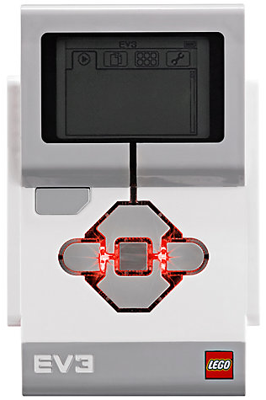
The “Brick” Buttons
1 = Back Undo Stop Program Turn robot off
2 = Centre Button Select options Run Program Turn robot on
3 = L, R, Up, Down Navigate menus
1
3
3
2
3
3

Slide 4
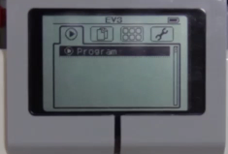
The “Brick” Screen
Tabs on Screen
Run Recent Find programs you ran recently
2. File Navigation Find all programs by project
3. Brick Apps Port views
4. Settings Bluetooth, Wifi, Volume
1
2
3
4

Slide 5
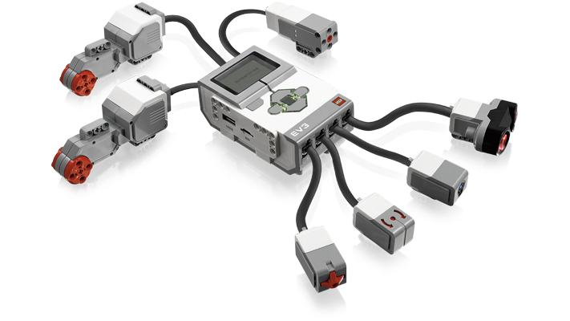
Ports, Sensors, motors
Ports A, B, C, D = Motors
Default setup assumes Right Motor in C, Left Motor in B
B
Default setup
Front
C
Ports 1, 2, 3, 4 = Sensors

Slide 6
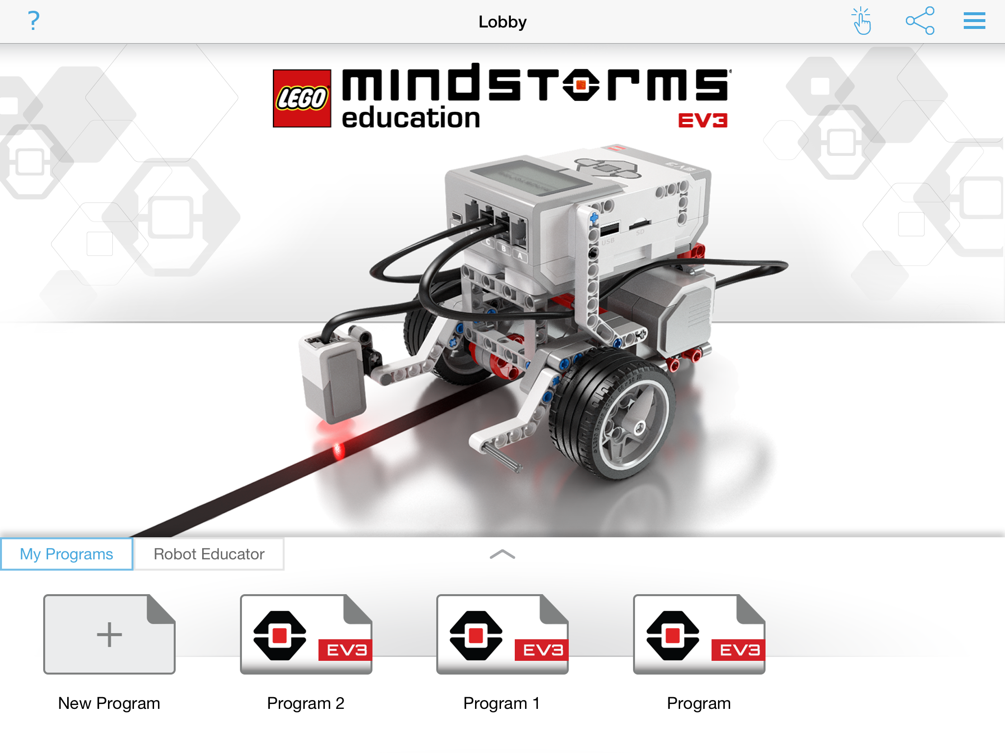
EV3 Software
Open Saved Program
Open New Program

Slide 7
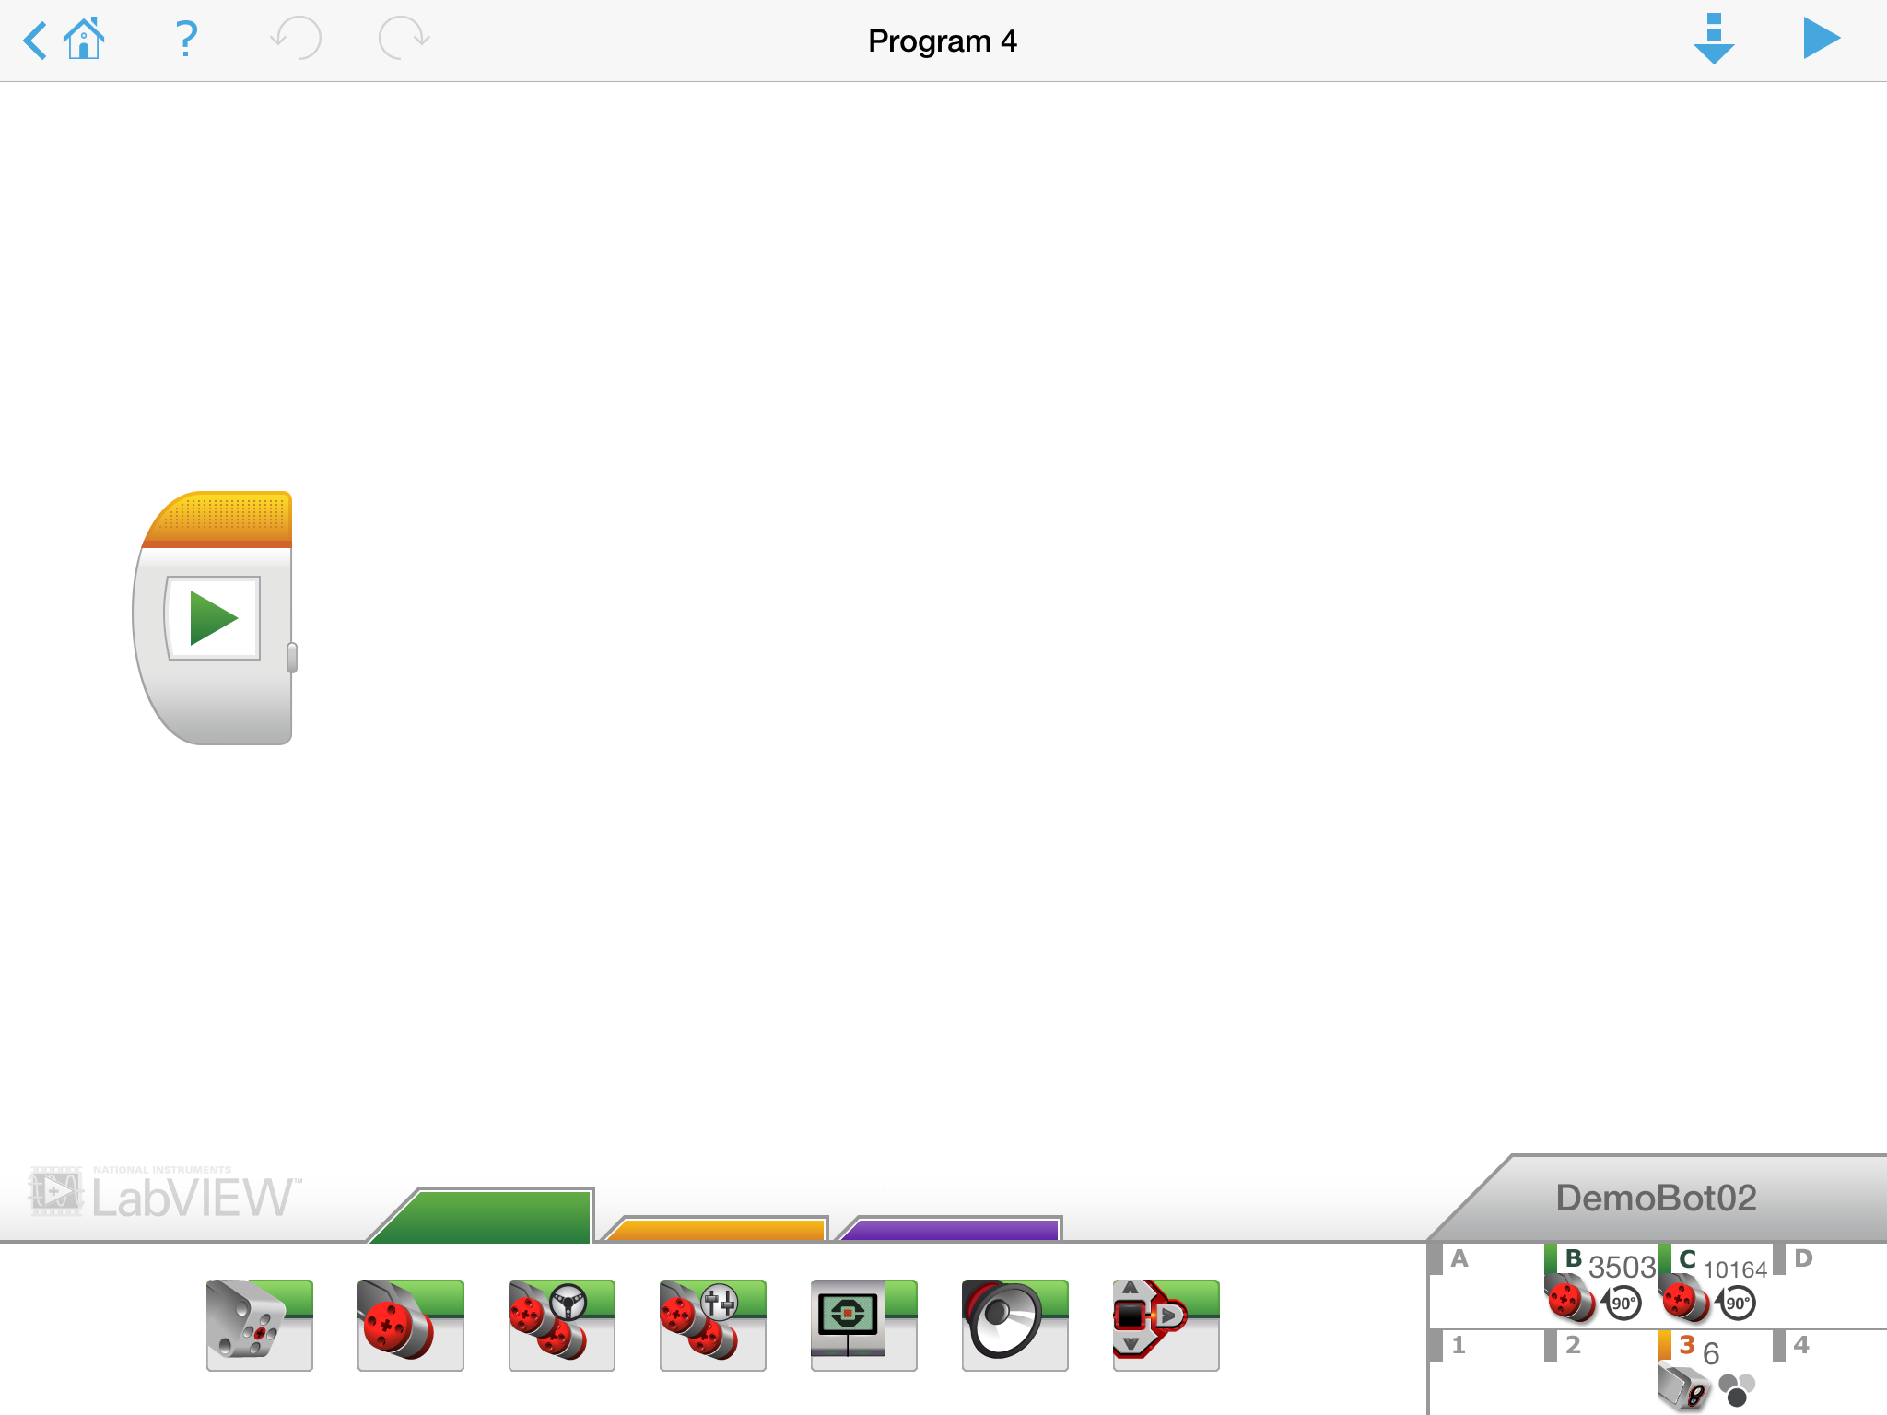
EV3 Software: Programming screen
Download & Play
Programming Area or Canvas
Programming Blocks in
3 Coloured Tabs
Brick Status

Slide 8
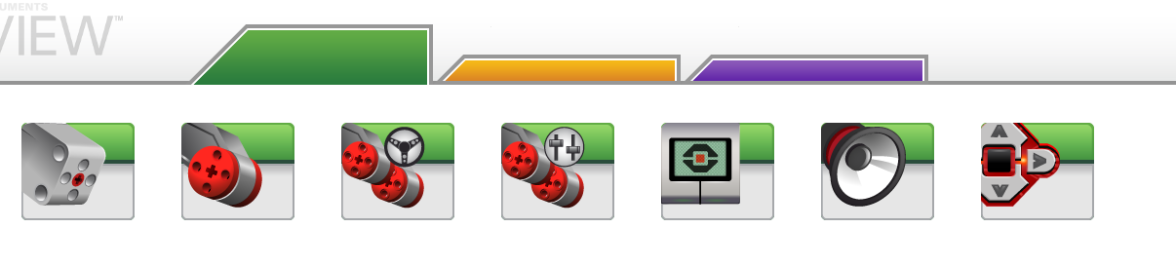
EV3 Blocks: Coloured Tabs
ACTION BLOCKS
Move, Large & Medium Motor, Display…
FLOW BLOCKS
Start, Wait, Loop, Switch, Loop
Comments:
Green, Orange, and Purple
1
2
3
1
2
3

Slide 9
CREDITS
This tutorial was created by Sanjay Seshan and Arvind Seshan from Droids Robotics.
More lessons are available at www.ev3lessons.com
Author’s Email: team@droidsrobotics.org
This work is licensed under a Creative Commons Attribution-NonCommercial-ShareAlike 4.0 International License.

