Slide 1
Robot DESIGN Lesson
Gyro Sensor Positioning

Slide 2
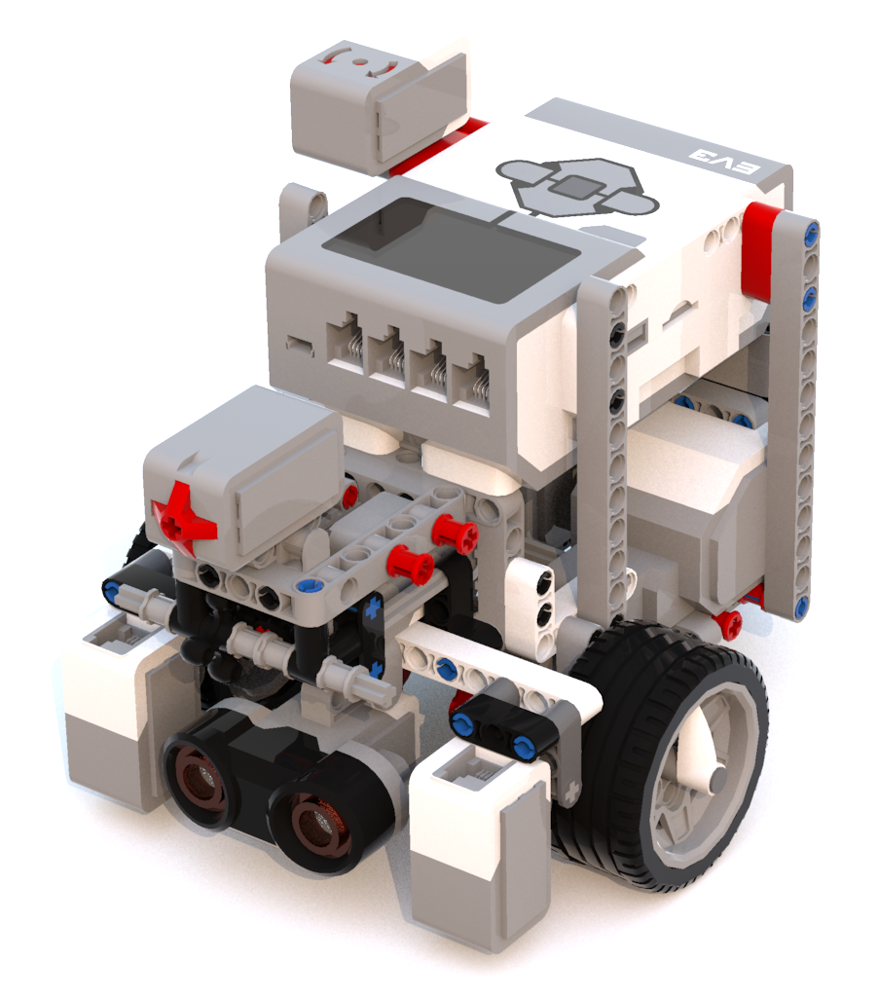
How Many Gyros should your robot have?
Myth:
Having two gyro sensors will cancel out drift
Unfortunately, this is not true. Therefore, placing two sensors on your robot to cancel drift will not work.

Slide 3
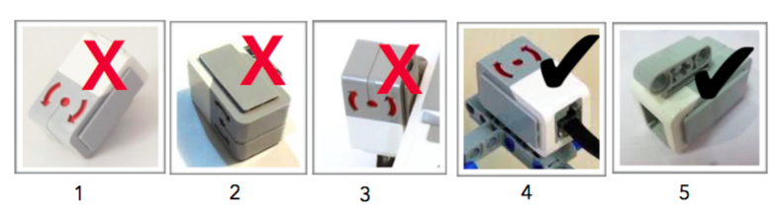
WHERE SHOULD THE GYRO SENSOR BE PLACED?
Myth:
The gyro needs to be low to the ground and at the center of the robot
The gyro sensor can be placed any where on the robot.
However, there are some angles that do not work for the gyro (see image below)
Angular
Sideways
Straight up or down
Parallel to the ground
Upside down (but still parallel to the ground)

Slide 4
Sample Installations of the gyro
In this robot, the Gyro Sensor is prominently visible
It is still parallel to the ground

Slide 5
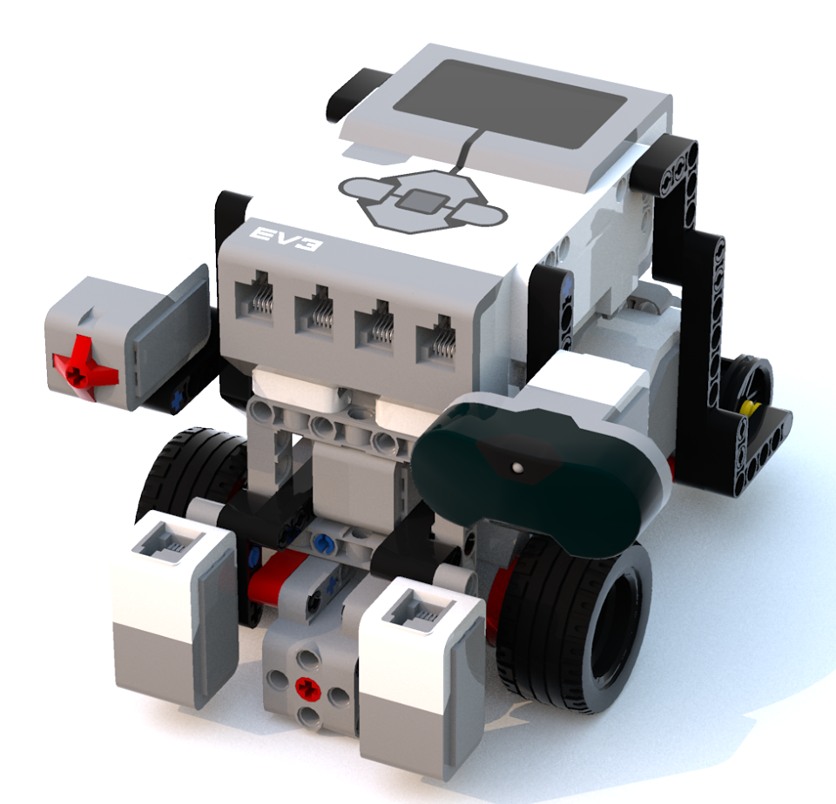
Sample Installations of the gyro
In this robot, the Gyro Sensor is barely visible and under the brick
It is still parallel to the ground
Tip: Place the sensor where you have space on the robot (somewhere hidden away is fine as you do not really need access to it once you connect it).

Slide 6
Credits
This tutorial was created by Sanjay Seshan and Arvind Seshan
More lessons at www.ev3lessons.com
This work is licensed under a Creative Commons Attribution-NonCommercial-ShareAlike 4.0 International License.

