Slide 1

Droids Robotics Workshop

Slide 2
Overview
Introductions – Core Value Activity
What makes a good presentations
Robot design basics
Programming

Slide 3
Core Values
Each team has one piece of cardboard
In 5mins decorate your piece with information about you and your team (things you like, where you are from, etc.)
Work together to come up with the words & pictures that mean most to your team
Each team will have 1 min to present to everyone else

Slide 4
Research Project Presentations
Learning how to make good presentations is important
We have examples from award-winning teams to inspire you
As you watch each clip think about what that team did well
Remember that presentation is only 1/3 of the Research component!

Slide 5
Robot Design
Base robot
Outer wall
2 shielded color sensors
Caster wheel
Well balanced/solid construction
Compact design
Attachments
Easy on, easy off
Motorized
Passive

Slide 6


Programming Lesson: Improving Robot Reliability in FLL
In
By Droids Robotics

Slide 7
Common Sources of Problems
Problem | Impact
Alignment in base varies from run to run | Each run is different and missions sometimes work.
Robots don’t travel straight or turn exactly the same amount | It is hard to predict the robot location exactly.
Errors accumulate as you travel | Missions far from base fail often. It is hard to do many missions on the same run.

Slide 8
Starting Points in Base are Critical
FLL teams need to figure out where to start in base
Jigs: a LEGO ruler/wall that your robot can align against them in base
Same start each time: pick one spot and start there no matter what the mission for easy starts
Inch marks: Use the inch marks to pick a starting spot for each run
Words: Base has words. If you aren’t near an inch mark, pick a word or letter to start on.
Even better, try to find a way to align the robot using other techniques (see next page)
Use a jig
Use marks

Slide 9

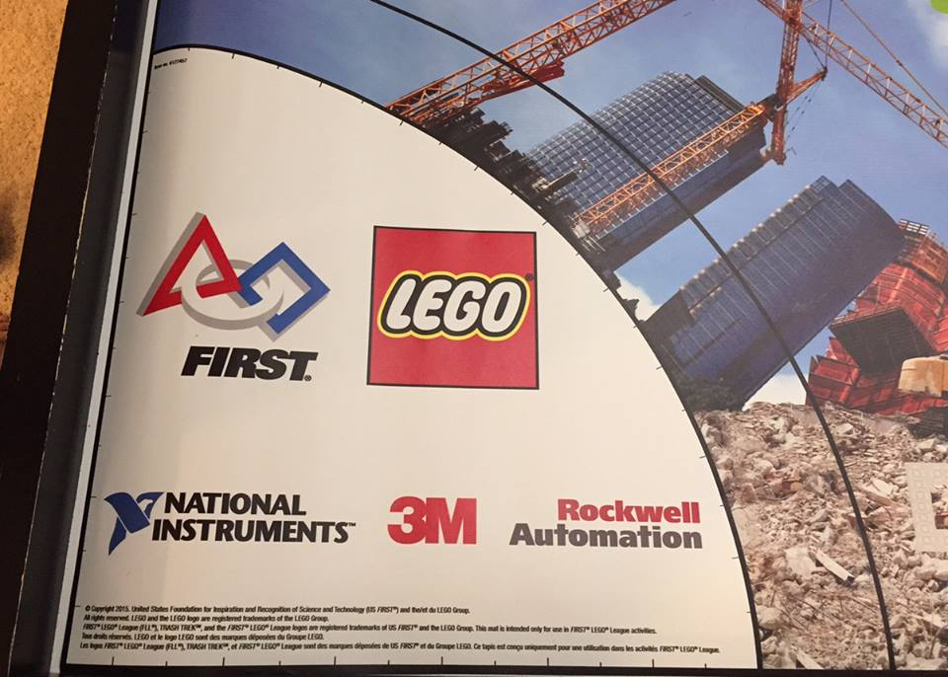
Trash Trek Has a Circular Base!
Use a jig

Slide 10
Robot Doesn’t Travel Straight & Errors Accumulate Over Time
By the time you get to the far side of the table, you are no longer in the right position
Solution: Repeat alignment techniques multiple times in a run for better reliability (see next slide)
Mission Model 1
Mission Model 2

Slide 11
Where are you on the FLL table?
Consider these alignment strategies that are commonly used:
Align on walls – deliberately back into a wall to straighten out (note: You may stall doing this. See the Advanced: Stall Detection Lesson)
Square/Align on lines –If you are moving angled, you can straighten out whenever you see a line. (See Advanced: Squaring Lesson)
Move until a line – travel until you find a line so you know where you are on the mat (See Beginner: Color Sensor)
Align on a mission model – Mission models that are stuck in one place can be used to align against
Back into walls
Square on a line
Align on a mission model
Mission Model

Slide 12

Navigation on the Trash Trek Mat
Align on a mission model
Square on lines
Follow lines
Ride walls
Until you see black

Slide 13
Other Factors in Reliability
Battery level
If you program your robot when the battery level is low, it won’t run the same when fully charged
Motors behave differently with low battery
Using sensors makes you not as dependent on battery
Motors and sensors don’t always match
Some teams test motors, sensors and wheels to make sure that they match
You will never get a perfect match so we recommend use other techniques and accept that they will be different

Slide 14
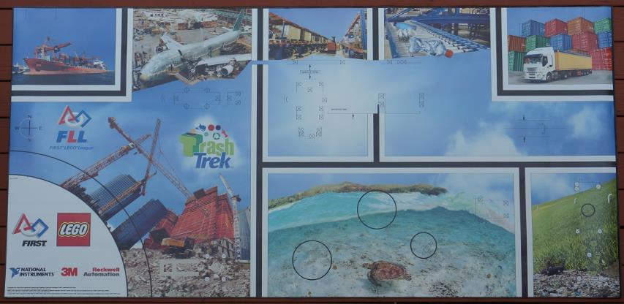
Programming
Trash Trek Mat
Lines
Intersections
Teach you…
Squaring on Lines
Proportional Line Following

Slide 15


Squaring or Aligning on a Line
EV3 PROGRAMMING LESSON
By Droids Robotics

Slide 16

Why Align on a Line?
Aligning on a line helps the robot navigate
Robots get angled as they travel farther or turn (the error accumulates)
Aligning on a line can straighten out a robot.
Aligning can tell a robot where it is when it has to travel far
Example Mission: What if your robot must deliver an object to the far end of the FLL table. Do you think your robot can travel across the FLL table and continue to be straight?

Slide 17
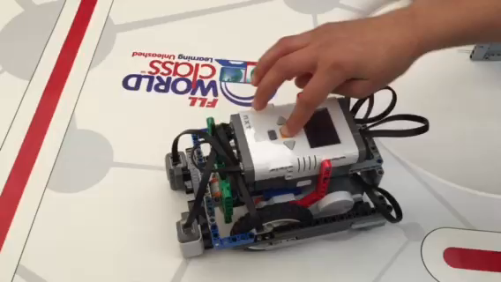
Challenge
Pseudocode:
Start both motors
Stop one motor when the sensor on the corresponding side sees the line (use parallel beams)
Stop moving the second motor when the sensor on that side sees the line (use parallel beams)
This technique will still have the robot a little crooked. We will not be covering parts of the Squaring on a Line lesson because half the teams in the room do not have the background. You will need to finish the lesson at home.
Challenge: Make the robot straighten out (align/square off) on a red line (see video)

Slide 18
Tip: What are Parallel Beams?
Parallel beams allow you to run two or more blocks at the same time.
In First Lego League, they are mostly often used when you have one of more attachment arms connected to motors and you want to turn these arms while the robot is moving to complete a mission
Robot lifting up hoops and driving forward.

Slide 19
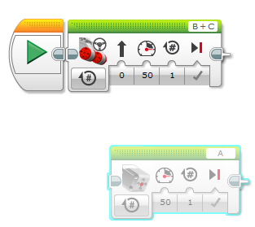
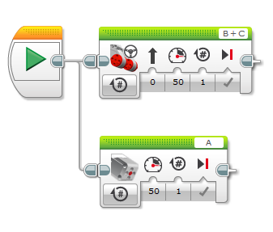
How Do I Make a Parallel Beam?
To create a parallel beam click and drag on the bump on the right center of any block and release once you hover over the inverted bump on the left center side on a block.
Note: Blocks before the split will run one at a time. After the split blocks on the two “beams” will run at the same time

Slide 20
Challenge
Pseudocode:
Start both motors
Stop one motor when the sensor on the corresponding side sees the red line (use parallel beams)
Stop moving the second motor when the sensor on that side sees the red line (use parallel beams)
This technique will still have the robot a little crooked. We will not be covering parts of the Squaring on a Line lesson because half the teams in the room do not have the background. You will need to finish the lesson at home.
Challenge: Make the robot straighten out (align/square off) on a red line (see video)

Slide 21
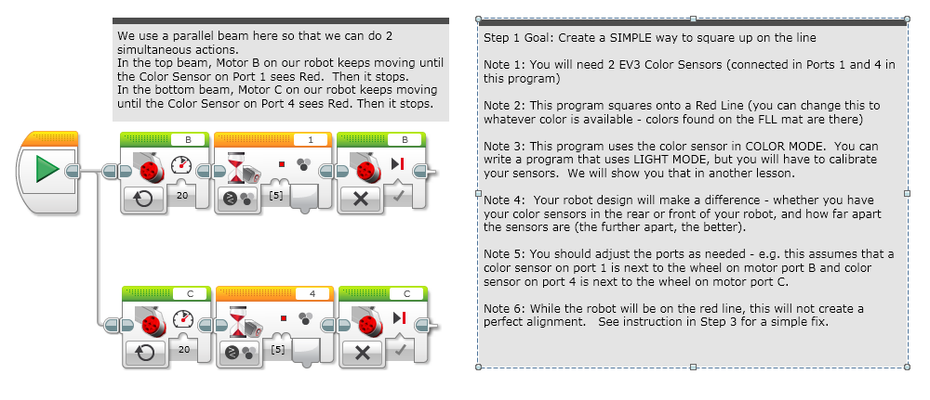
Solution Step 1: Moving Until Line

Slide 22
Next Lesson
Challenge: Every team write the best line follower that you can
Test your line follower on the mat
Explain how your line follower works to the other teams

Slide 23
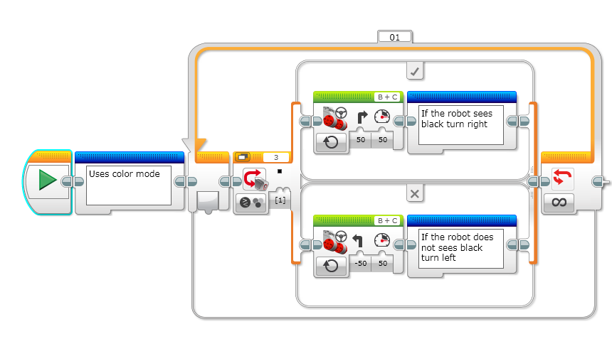
Basic Line Follower
Notes:
Right side

Slide 24
Proportional Line Follower
EV3 PROGRAMMING LESSON
By Droids Robotics

Slide 25
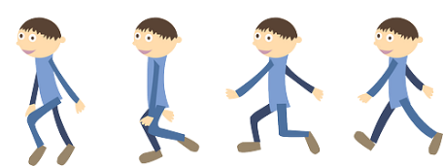
Learn and Discuss Proportional Control
On our team, we discuss “proportional” as a game.
Blindfold one teammate. He or She has to get across the room as quickly as they can and stop exactly on a line drawn on the ground (use masking tape to draw a line on the floor).
The rest of the team has to give the commands.
When your teammate is far away, the blindfolded person must move fast and take big steps. But as he gets closer to the line, if he keeps running, he will overshoot. So, you have to tell the blindfolded teammate to go slower and take smaller steps.
You have to program the robot in the same way!

Slide 26
Why Proportional Control?
What does proportional mean?
The robot moves proportionally – moving more or less based on how far the robot is from the target distance
For a line follower, the robot may make a sharper turn if it is further away from the line
Proportional Control can be more accurate and faster

Slide 27
What Proportional Control Looks Like
The Pseudocode for every proportional control program consists of two stages:
Computing an error → how far is the robot from a target
Making a correction → make the robot take an action that is proportional to the error (this is why it is called proportional control). You must multiply the error by a scaling factor to determine the correction.
Compute Error
Make Correction

Slide 28
Pseudocode
Application | Objective | Error | Correction
Line Follower | Stay on the edge of the line | How far are our light readings from those at line edge (current_light – target_light) | Turn sharper based on distance from line
Gyro Turn | Turn to a target angle | How many degrees are we from target turn | Turn faster based on degrees remaining
Dog Follower | Get to a target distance from wall | How many inches from target location (current_distance – target_distance) | Move faster based on distance

Slide 29
Finding Target Light Reading
MEASURING THE LIGHT VALUE:
The program use the EV3 Color Sensor in Light Sensor mode
You will need to measure the light value in between black and white
Note: If you are an Advanced Team, you can learn to write a calibration program. We will not be teaching it today because we have a mixed level group.
PORTS:
The Color Sensor is connected to Port 3.
Please change this for your robot.
WHICH SIDE OF THE LINE:
Please take note of which side of the line the code is written for

Slide 30
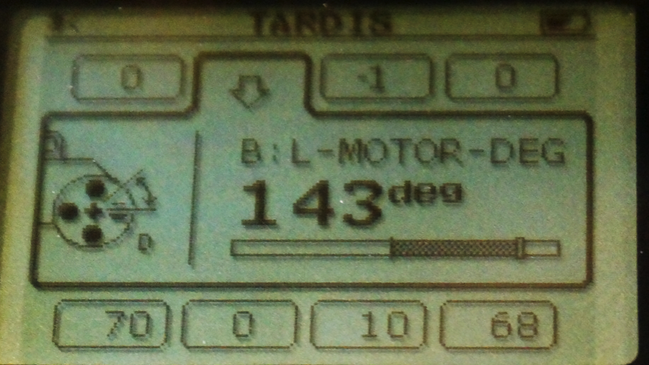
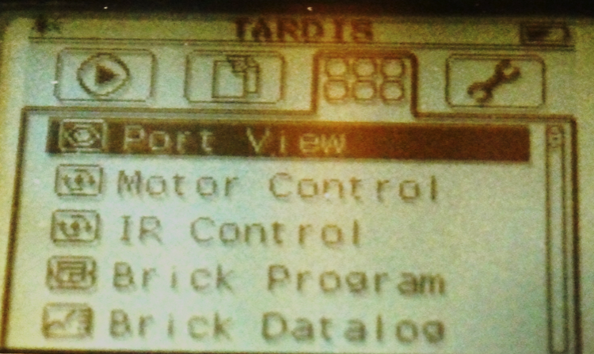
SOLUTION: Use Port View
Try “port view” on brick (on Brick Apps tab)
Place your robot on the line
Navigate to the right sensor port
Take the light value
Try placing your robot on white also.

Slide 31
How to measure the value between black and white
Place your robot on BLACK. Write down the value.
Place your robot on WHITE. Write down the value.
ADD the two values and divide by 2. ((a+b)/2)

Slide 32
Challenge: Proportional Line Follower
Challenge 4: Can you write a proportional line follower that changes the angle of the turn depending on how far away from the line the robot is?
Pseudocode:
Reset the Rotation sensor (Only required for line following for a total distance)
Compute the error = Distance from line = (Light sensor reading – Target Reading)
Scale the error to determine a correction amount. Adjust your scaling factor to make you robot follow the line more smoothly.
Use the Correction value (computer in Step 3) to adjust the robot’s turn towards the line.

Slide 33
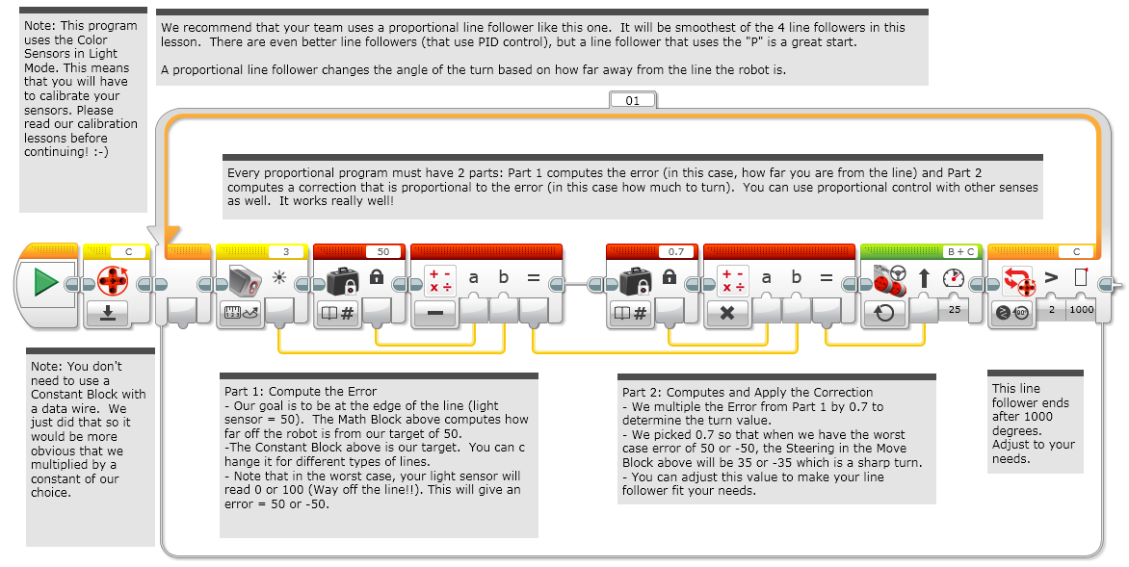
Solution: Proportional Line Follower

Slide 34
Credits
This tutorial was created by Sanjay Seshan and Arvind Seshan from Droids Robotics.
Author’s Email: team@droidsrobotics.org
More lessons at www.ev3lessons.com
Full lessons at EV3Lessons.com
This work is licensed under a Creative Commons Attribution-NonCommercial-ShareAlike 4.0 International License.

