Slide 1
PROPORTIONAL ULTRASONIC WALL FOLLOWER

Slide 2
Objectives
Learn how to use proportional control with the ultrasonic sensor to follow walls
Prerequisites: Data Wires, Proportional Control, Loops, Math Blocks, Sensor Blocks

Slide 3
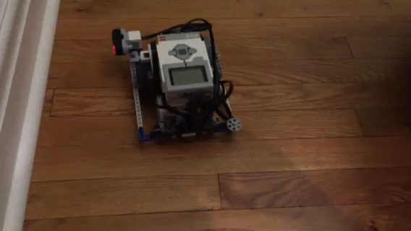
Challenge: Proportional Wall Follower
Challenge: Write a wall follower program that uses the ultrasonic sensor and proportional control
STEP 1: (Calculate the error) Subtract the target distance from the Ultrasonic value.
STEP 2: (Apply the correction) Use the error from the previous step as the steering in a Move Steering block. You may need to multiply the error by a magic number to make your robot smoother
STEP 3: Repeat the above steps in a loop
Play the video to see how the robot should move
Do you notice any differences from the wall followers in the Intermediate Ultrasonic Wall Follower Lesson?

Slide 4
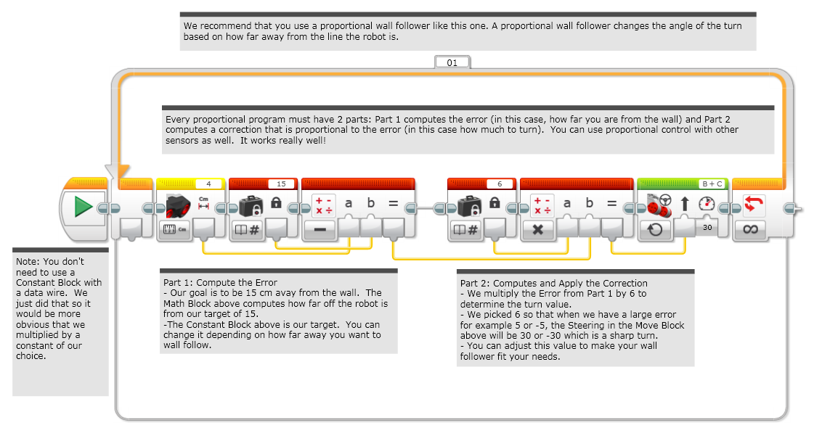
Challenge Solution

Slide 5
Credits
This tutorial was created by Sanjay Seshan and Arvind Seshan from Droids Robotics.
More lessons are available at www.ev3lessons.com
Author’s Email: team@droidsrobotics.org
This work is licensed under a Creative Commons Attribution-NonCommercial-ShareAlike 4.0 International License.

