Slide 1

BEGINNER PROGRAMMING LESSON
Common P-Brick Problems & Solutions

Slide 2
LESSON OBJECTIVES
Learn how to update the software
Learn how to update the firmware

Slide 3
Brick doesn’t Turn ON
Check battery contacts
Sometimes, the battery contacts have bene bent
Remove rechargeable battery or AA batteries and straighten out contacts.
Reinsert battery

Slide 4
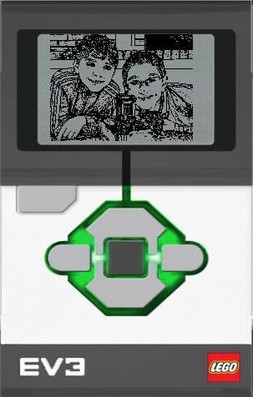
BRICK IS STUCK in START MODE
Remove and reinsert battery
Hold down center and right button together until you see “Updating”
Connect Brick to Computer an update firmware again

Slide 5
Button is stuck
Remove battery
Unscrew four black screw
Reposition the button so it makes a contact
Screw back the case

Slide 6
How to delete files on the brick

Slide 7
How to delete files on the brick
Back, Center, Left
Screen goes black, release back
See “Mindstorms, release other two

Slide 8
CREDITS
This tutorial was created by Sanjay Seshan and Arvind Seshan
More lessons are available at www.ev3lessons.com
This work is licensed under a Creative Commons Attribution-NonCommercial-ShareAlike 4.0 International License.

