Slide 1
ROBOT DESIGN LESSON
Building a Robot for Our Lessons

Slide 2
EV3Lessons works with all robots!
You can use any EV3 robot you wish with EV3Lessons.com because we teach you program the EV3 regardless of the model you build. You will just have to modify the challenges to suit your robot.
If sensors need to be in a particular location for a lesson, we usually let you know
We do provide a robot design for the #45544 Set (DroidBot) and #31313 (DroidBot Jr). We usually test our lessons using this design.
You can also consider using the EV3 Educator model from the #45544 set, as well as the Riley Rover by Dr. Damien Kee as an alternative.

Slide 3
DroidBot
This robot was designed to be used with our lessons
It uses only pieces in one base EV3 Edu set (#45544) plus one additional color sensor (for the line squaring lesson)
The optional handle is useful for classroom/camp use
You can add a temperature sensor, an infrared sensor, and a sound sensor to complete particular lessons
Build instructions are available on the Robot Design Page

Slide 4
DROIDBOT Jr
This robot was designed to be used with our lessons
The handle is useful for classroom/camp use
It uses only pieces in the base EV3 Retail set (#31313)
You can add a second color sensor, a gyro sensor, an ultrasonic sensor, a temperature sensor, and a sound sensor to complete particular lessons
Build instructions are available on the Robot Designs page.

Slide 5
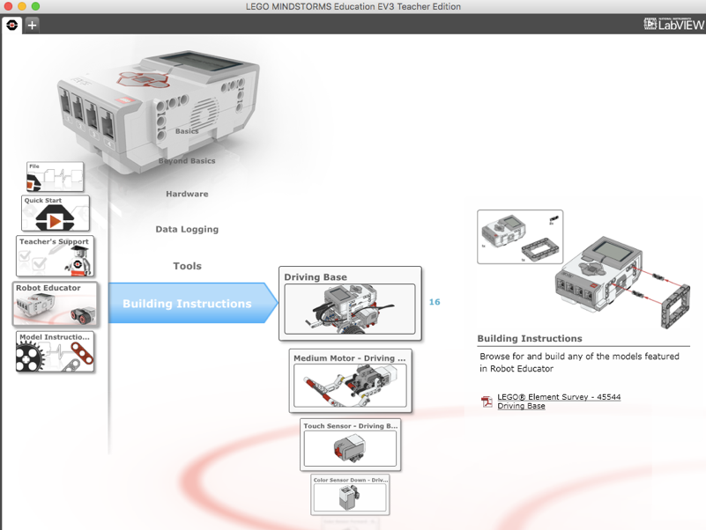
EV3 ROBOT EDUCATOR
The base robot design in the EV3 Edu set (#45544) will work for majority of our lessons without any changes
Remember to install the color sensor facing down for the line follower lessons
You will need to add a second color sensor for our Line Squaring Lesson
Additional sensors (e.g. infrared) can be added to this design as needed.
Build instructions are available on the EV3 Edu software and comes printed with the #45544 kit

Slide 6
RILEY ROVER BY DAMIEN KEE
This robot is a quick build robot by Dr. Damien Kee
If you are short on time for your class, you can build this robot and still use EV3Lessons materials
Add or move sensors as needed
A link to this robot is provided on our Robot Designs page under “Contributed”

Slide 7
Credits
This tutorial was created by Sanjay Seshan and Arvind Seshan
More lessons at www.ev3lessons.com
This work is licensed under a Creative Commons Attribution-NonCommercial-ShareAlike 4.0 International License.

