Slide 1

How to Use EV3 Lessons

Slide 2
OVERALL STRUCTURE
Beginner Lessons: These lessons will teach you to move and turn the robot, use the sensors, and use loops and switches.
Intermediate Lessons: These lessons introduce more advanced programming techniques such as My Blocks, variables, parallel beams, calibration and math/logic blocks.
Advanced Lessons: These lessons assume that you are comfortable using all the blocks in the EV3 environment. The advanced lessons teach you to more sophisticated programs such as menu systems, proportional line followers, squaring on lines and stall detection techniques.
Beginner Lessons are designed to be done in order. Intermediate and Advanced Lessons may be done out of order. Lessons usually mention specific pre-requisites when needed.
If you print the lessons out, make sure to return to the site often to check the date on the bottom of the page to make sure you have the latest version of the lesson.
To be notified of updates, new lessons and more, go to Contacts.

Slide 3
Lesson Structure
Each lesson starts with a list of objectives and ends with a challenge
In most lessons, we provide hints in the form of Pseudocode. Students who need a hint should look at the Pseudocode.
We provide a challenge solution as well (both as a screenshot as well as in EV3 Code)
A discussion guide is included after the challenge that will help understand the main objectives
Many lessons have companion worksheets for students. More will be added over time.

Slide 4



PROGRAMMING LESSONS
Beginner | Intermediate | Advanced
Build a Base Robot Introduction to Brick/Software Moving Straight Port View Pseudocode Turning Displaying Text and Graphics Touch Sensor Color Sensor Loops Switches Ultrasonic Sensor Basic Line Follower Moving an Object Basic Sequencer Final Challenge | Brick Buttons as Sensors Data Wires My Blocks with Inputs and Outputs Moving with My Blocks Turning with My Blocks Color Line Follower with My Blocks Infrared Sensor Debugging Move Blocks Reliability Color Sensor Calibration Variables Logic Operations and Decision Making Parallel Beams | Parallel Beams Synchronization Arrays Proportional Control Proportional Line Follower Proportional 2 Color Line Follower Ramping Up Gyro Sensor Gyro Sensor Turns Gyro Move Straight and Wall Follow Squaring on Lines Stall Detection Menu System Data Logging

Slide 5
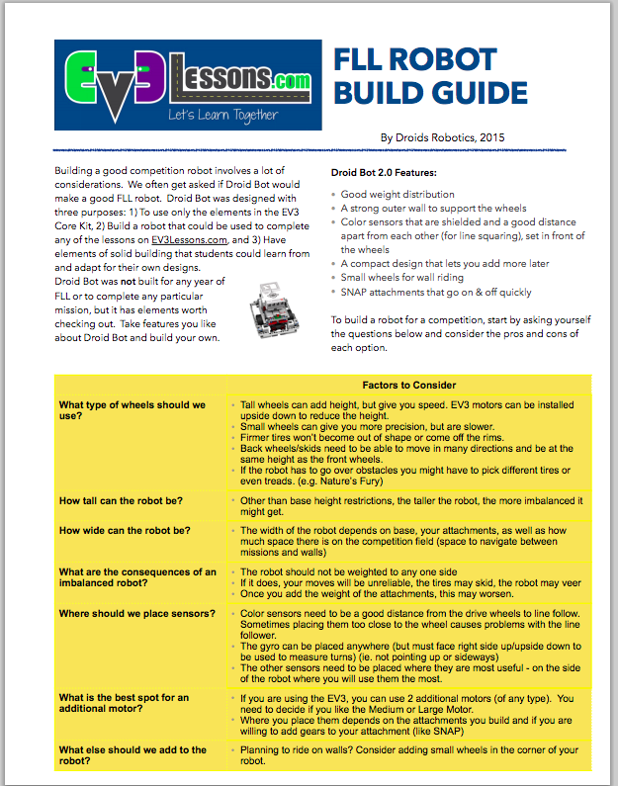
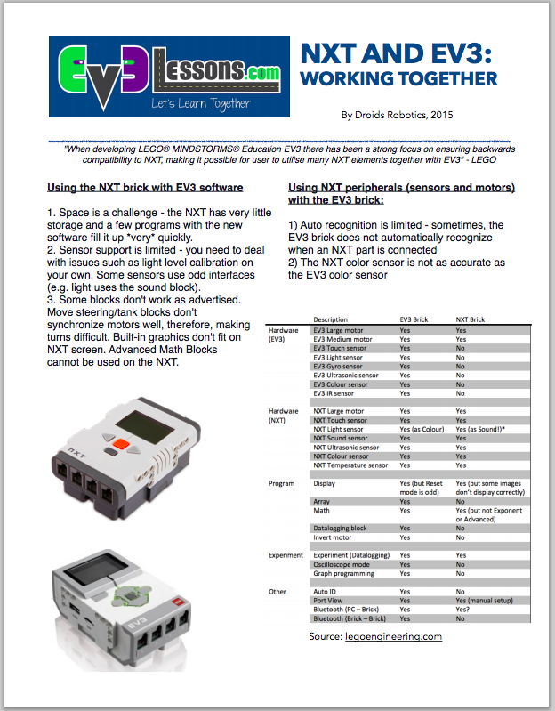
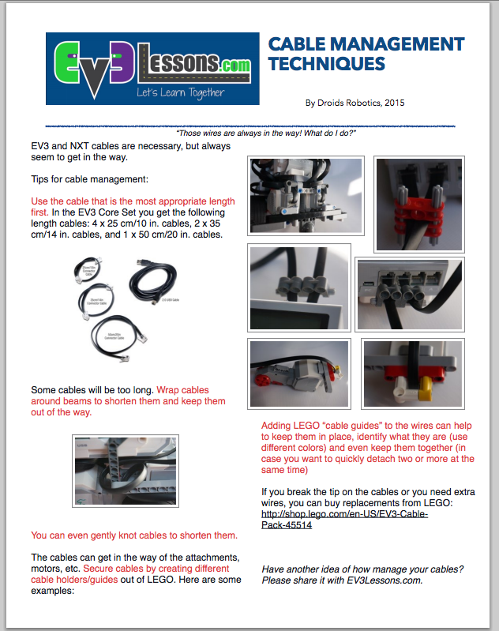
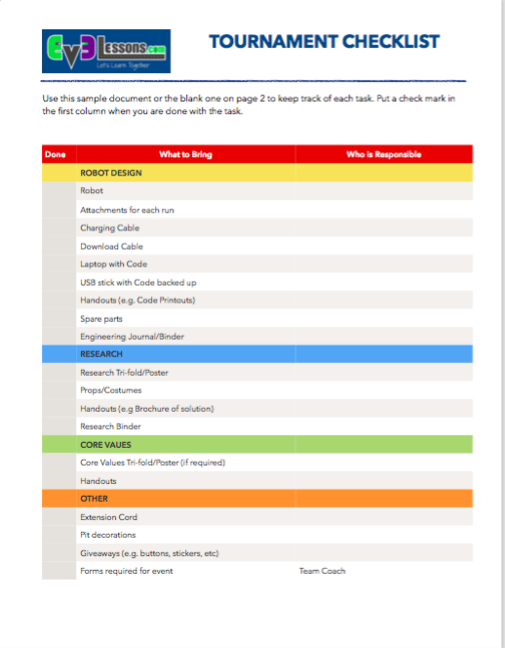
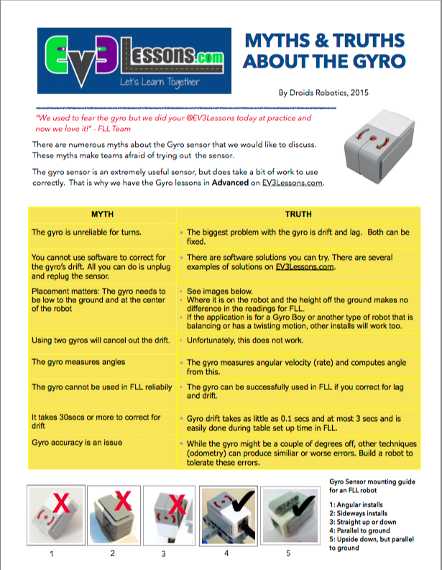
Quick guides
These provide quick information on a variety of useful topics. Use them as you need – as handouts or as discussion guides
Cable Management 1
Cable Management 2
FLL Robot Build Guide
Using Gears with the EV3
One Minute Line Follower
Using Sensors: Move Until
Color Sensor: Shielding and Calibration
My Blocks
Myths & Truths About the Gyro
Truth About Turns: Pivot Turns
Using Comments to Improve Code
Engineering Notebook and Sample
LEGO CAD & Robot Build Instructions
Robot Game Strategy, Strategy Deck
Mission Planning Worksheet
Learning FLL Runs
Edu vs. Home Edition Software
EV3 and NXT Compatibiltiy
Updating Software/Firmware Home Edition
Updating Software/Firmware Edu Edition
LEGO Organization Systems
Roles and Responsibilities
Tournament Checklist

Slide 6
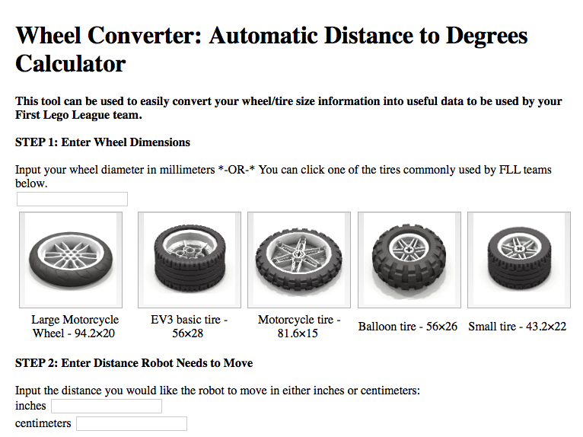
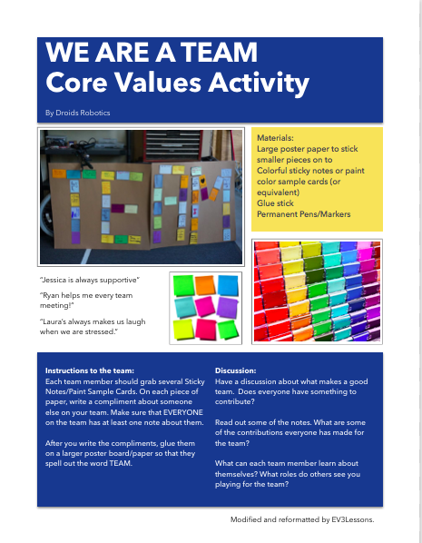

RESOURCES
The resources page contains lots of useful material for FIRST LEGO League teams:
Trash Trek Scorer
Interctive Sketch Planner
Wheel Converter
Core Value Activities
….

