Slide 1


BEGINNER EV3 PROGRAMMING Lesson
Picking Up and Moving an Object
By: Droids Robotics

Slide 2
Objectives
Learn how to program a robot to move an attachment arm – a powered attachment
Learn how to make useful attachments

Slide 3
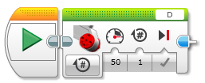
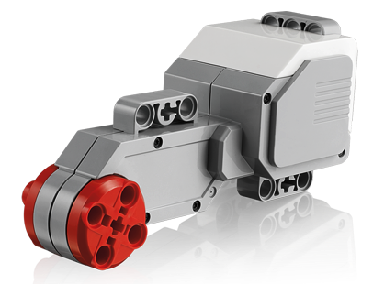
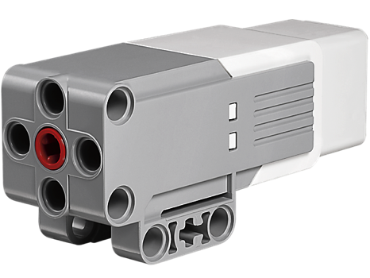
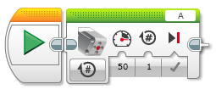
New Tool: Motor Blocks
You can use the Large EV3 Motor or the Medium EV3 Motor for attachment arms
Move Steering vs. Motor Block
For moving your wheels you should use a Move Steering Block that syncs both wheel motors (see Intermediate lesson called Move Blocks to learn about sync)
For moving your attachment your arm, you use either a Medium Motor Block or a Large Motor Block because you don’t need to sync your motors.
Large Motor Block
Medium Motor Block

Slide 4
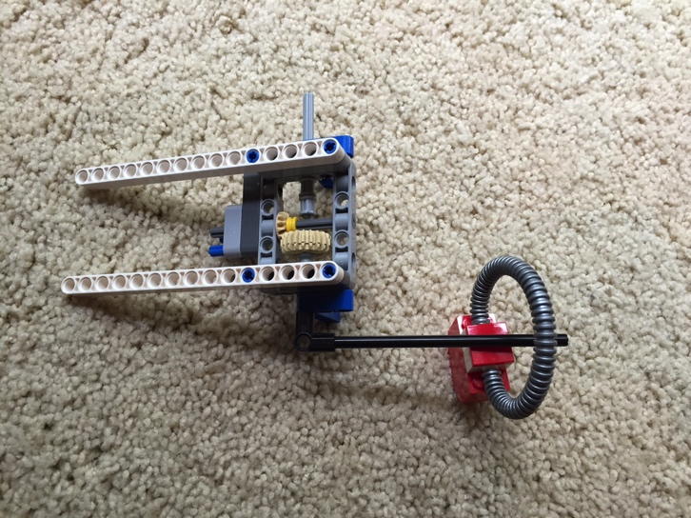
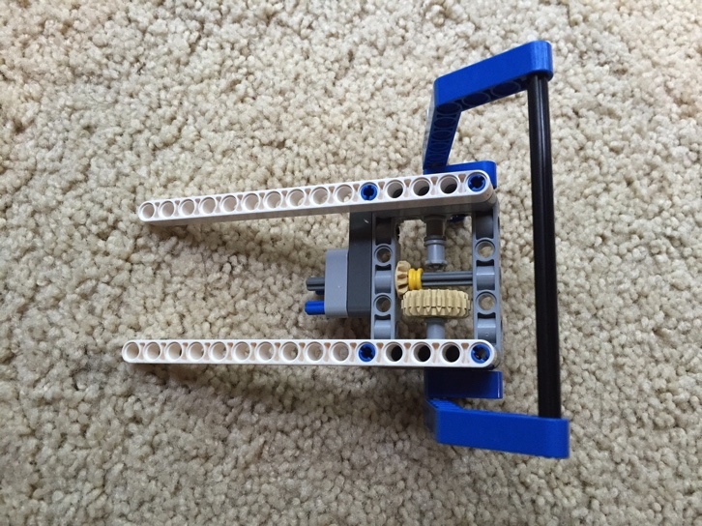
Using a Medium Motor
Attach a medium motor to Port A or a large motor to Port D as needed
This is a generic set-up for the EV3
Construct an attachment that can pick up or grab a hoop (object)
Look at the two examples on the right. They use the DroidBot’s SNAP attachment
DroidBot’s build instructions are available on the Robot Design page of EV3Lessons.com

Slide 5
Pick Up and Move Object Challenge
From the start line, move up to the black line
Pick up the object and bring it back to the start line
You can have the robot turn to come back or simply move backwards
You can make the object a cube to grab (as in the Core EV3 kit) or an item with a loop on top depending upon the pieces you have available.

Slide 6
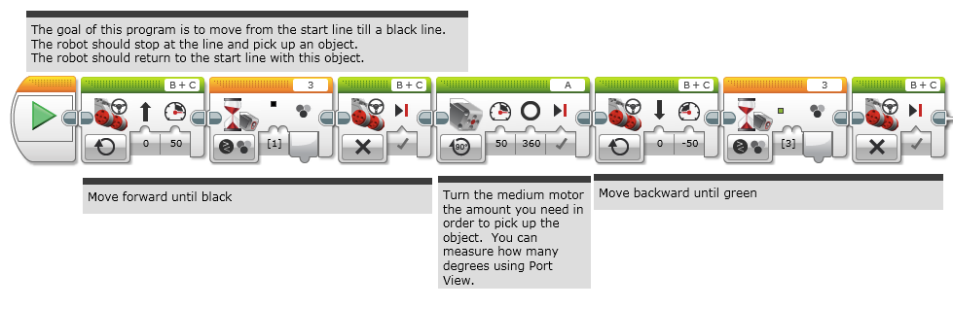
Challenge Solution

Slide 7


Trip to the Grocery Store
1. Start at Home and drive to the grocery store
2. Have your robot turn and backup/reverse into the parking space
3. Stop to pick up groceries
4. Return home using the short cut
2
1
3
4

Slide 8
The next few slides have tips on making attachments for FIRST LEGO League

Slide 9
Powered and Passive Attachments
Passive vs. Powered
Passive attachments are sometimes more reliable (KISS principle)
Powered attachments may be more complicated to attach
Power sources
Pneumatics – relatively powerful, but need to pump up in advance and be careful regarding pressure and leaks
Rubberbands – compact and easy to use but can get lost/wear out over time
Motors – can control in software and reusable across many missions but physically large

Slide 10
Attachment Tips
Reduce errors/time wasted by avoiding adding/removing attachments. Design attachments that can stay on for entire time.
See Droids Robotics Food Factor run on YouTube for example of very few additions across multiple runs
Removing attachments may be easier, less error-prone than adding them
See Droids Robotics Senior Solution run on You Tube for example of removing most complex attachments, but not adding more
Reduce space and complexity of attachments by building attachments that can work for multiple missions
See forklift attachment used in Droids Robotics Nature’s Fury run (You Tube) for its use in multiple missions

Slide 11
Attachment Tips Continued
Use reliable and easy-to-add mechanisms to connect to motors/robot
Avoid hard to add/remove pins
Connecting directly to motor can be more reliable (avoids gear slip, etc.) but takes longer
Using gearing mechanisms to connect to motor can make it easy to add attachment but the connection may not be as reliable
Use gears to deliver power to where you need it on the robot and in the direction that you need it
Look at various LEGO sets for inspiration on how to connect gears
Look at books by Isogawa to learn about gearing

Slide 12
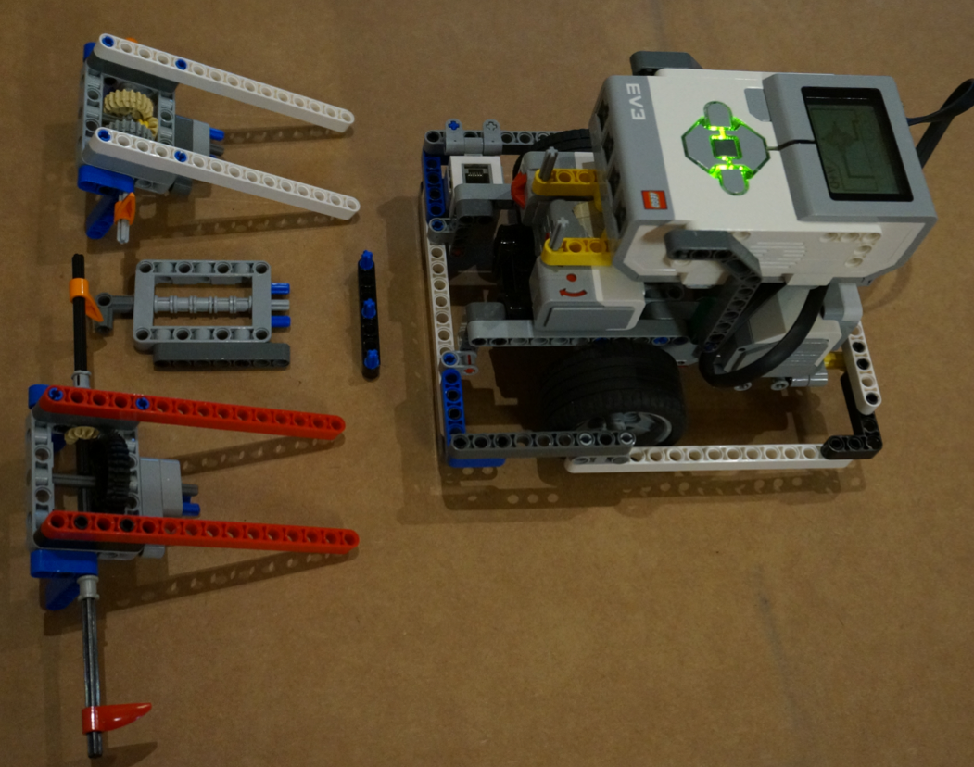
S.N.A.P Attachments for Droid Bot
Some features to notice:
Swappable: Easy to put on and take off
No Problem: Strong, reliable connection to motor (hard to remove accidently)
Attachments with Power: Reliable gearing mechanisms to increase or decrease the power of the attachment
Gearing mechanisms to deliver power to either side of the robot

Slide 13
Next Steps
Now that you know how to move an arm on a robot, can you move the arm while moving?
Check out the Parallel Beams lesson in Intermediate and Advanced
Refer to the Move Blocks Lesson in Intermediate to learn more about the differences between Move Steering and Motor Blocks

Slide 14
Credits
This tutorial was created by Sanjay Seshan and Arvind Seshan from Droids Robotics.
Author’s Email: team@droidsrobotics.org
More lessons at www.ev3lessons.com
This work is licensed under a Creative Commons Attribution-NonCommercial-ShareAlike 4.0 International License.

