Slide 1


BEGINNER EV3 PROGRAMMING Lesson
Good Coding Practices: Start with Pseudocode
By: Droids Robotics

Slide 2
Lesson Objectives
Learn what pseudocode means
Learn why you use pseudocode
Learn to write pseudocode for a common task
Learn how to plan programs for First Lego League

Slide 3
What is Pseudocode?
Robots follow directions that people give them. They need detailed, step-by-step instructions to complete a task.
It is a set of detailed notes that the programmer can use to write the code when they are ready.
It is not written in any particular programming language. Pseudocode can be in part English and part code.
Pseudocode allows the programmer to communicate his/her plan with others
Pseudocode is detailed enough to create the actual code

Slide 4
Why is Pseudocode Important?
A great way to learn the importance of good pseudocode is to try writing instructions for something simple:
How to make a sandwich, how to decorate a cake, how to plant a seed, etc.
Students should write the instructions and then the teacher should follow them.
Then compare the results.
Some examples of student responses for a peanut butter and jelly sandwich:
Student 1 wrote: “Put the peanut butter on the bread”. So the teacher placed the entire jar on the slices of bread.
Student 2 wrote: “Take bread and spread the peanut butter on it”. So the teacher spread peanut butter on the entire loaf.
Student 3 wrote: “Take 2 slices of bread and spread peanut butter and jelly on them”. So the teacher spread peanut butter and jelly on both sides of both slices.
Communicating instructions well is important! ☺

Slide 5

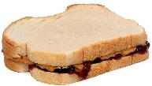
Sandwich Pseudocode Solution
Take exactly two pieces of bread.
Take one piece of bread that is not covered with peanut butter on any side and use a knife to spread peanut butter on one side
Take a second piece of bread that is not covered with jelly on any side and use a knife to spread jelly on one side
Place the jelly side of the second piece of bread against the peanut butter side of the first piece of bread.
Place the combined pieces of bread on plate

Slide 6
Writing Pseudocode for a Robot
1) Write down the goal of the program. What does the robot have to do?
2) Think about how the robot will achieve this goal. What are the specific steps?
3) Write down each step the robot will take. Start with Step 1 and continue on.
4) Make sure you write down if the robot has to repeat a task.
5) Does the robot keep doing this task forever or does it end?

Slide 7
Sample Pseudocode for a Challenge
Goal: Robot needs to go once around a square box. It starts at the line and faces north. It will end on the line facing north.
Step 1: Go forward 10 inches
Step 2: Turn left 90 degrees
Step 3: Repeat steps 1 and 2 three more times
You can write this pseudocode on a piece of paper or even in a comment block inside the EV3-G code.
Use the pseudocode to program the solution
N

Slide 8
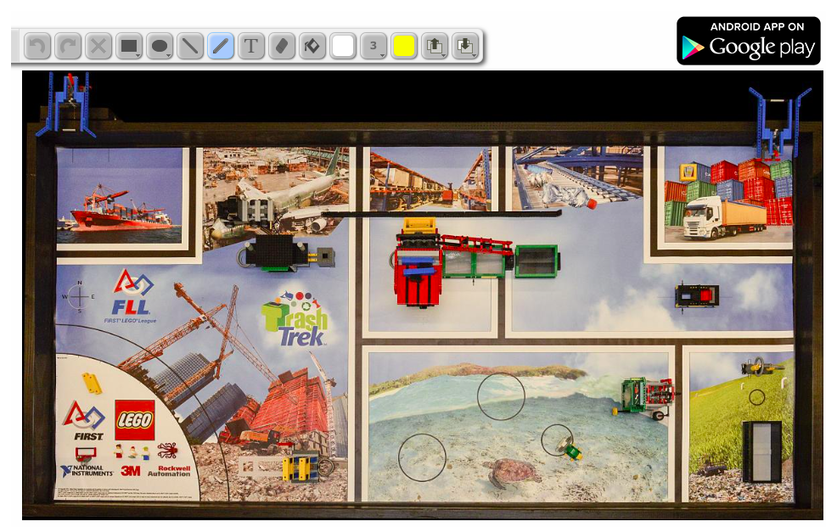

Pseudocode in First Lego League
Step 1: Use a tool such as our Interactive Sketch Planner (available on the Resources page) to plan your runs.
The goal is to plan out where your robot will travel each time it leaves the base area.
Step 2: Use a tool such as our Mission Planning Worksheet (available on the Quick Guides Page) to write your pseudocode for the runs.

Slide 9
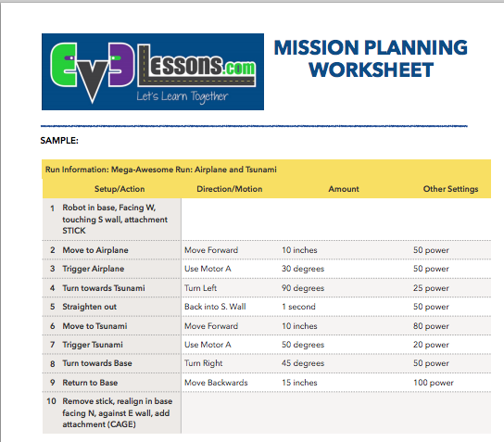
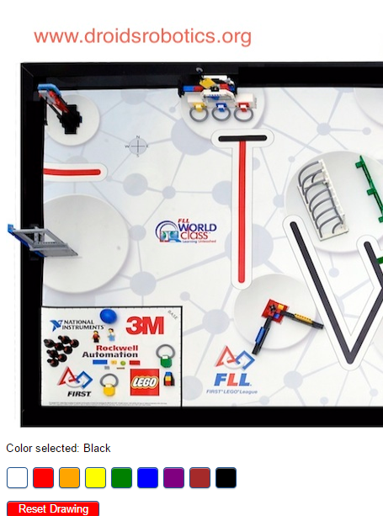
Sample for First Lego League
Both these tools are available on EV3Lessons.com

Slide 10
Credits
This tutorial was created by Sanjay Seshan and Arvind Seshan from Droids Robotics.
Author’s Email: team@droidsrobotics.org
More lessons and resources are available at www.ev3lessons.com
This work is licensed under a Creative Commons Attribution-NonCommercial-ShareAlike 4.0 International License.

