Slide 1


BEGINNER EV3 PROGRAMMING Lesson
Topics Covered:
Review Questions
By: Droids Robotics

Slide 2
Review 1: MOVE STRAIGHT
What block is used to move straight: Motor Steering or Move?
What tab can I find Motor Steering in?
How do you get a robot to move backwards?
What is port view?

Slide 3
Review 1 ANSWERS
What block is used to move straight: Motor Steering or Move?
Move Steering
What tab can I find Motor Steering in?
Green Tab
How do you get a robot to move backwards?
Use negative power
What is port view?
On the brick menu where you can view sensor readings

Slide 4
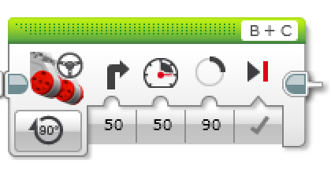
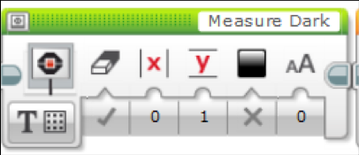
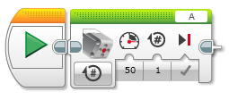
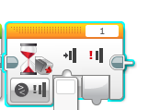
REVIEW 2:
1) What is each Block called?
2) Where do you find it?
3) What does it do?
4) When do we use it?
A
B
D
C
E

Slide 5
REVIEW 2 Answers:
Block A
Move Steering
First Tab
Moves both motors
Moving Straight
Block B
Display Block
First Tab
Print to the Screen
To see which part of the program your robot is running
Block C
Loop
Second Tab
Play a part of your code again and again
Moving around a box
Block D
Medium Motor Block
First Tab
Rotate a medium motor
Moving an attachment arm
Block E
Wait Block
Second tab
Waits until time or sensor reading before moving on in the code
Moving until a line, touch sensor, ultrasonic, and other sensors.

Slide 6
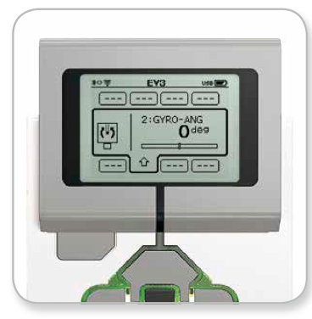
REVIEW 3
Turns: Spin and Pivot
Port View: Sensor readings on the brick
B
Spin (used in tight spaces)
C
B
Pivot
C
Wait Block:
Wait for a sensor reading (touch, ultrasonic, color) or time
Move until line, Move until touch

Slide 7
Review 4
1) What are the two types of turns?
2) Which type of turn do you use in tight places?
3) Where do you go on your brick to get sensor readings such as “what color the robot sees” and “how many degrees the robot moved”?
5) What block do you use to repeat an action?
6) What block would you use to select between two different actions based on a sensor reading?
7) To program using a sensor and perform an action UNTIL a sensor is activated (black line seen, touch pressed), what block do you use?

Slide 8
REVIEw 4 Answers
1) What are the two types of turns?
Pivot and Spin
2) Which type of turn do you use in tight places?
Spin
3) Where do you go on your brick to get sensor readings such as “what color the robot sees” and “how many degrees the robot moved”?
Port View
5) What block do you use to repeat an action?
Loop
6) What block would you use to select between two different actions based on a sensor reading?
Switch
7) To program using a sensor and perform an action UNTIL a sensor is activated (black line seen, touch pressed), what block do you use?
Wait For

Slide 9
CREDITS
This tutorial was created by Sanjay Seshan and Arvind Seshan from Droids Robotics.
More lessons are available at www.ev3lessons.com
Author’s Email: team@droidsrobotics.org
This work is licensed under a Creative Commons Attribution-NonCommercial-ShareAlike 4.0 International License.

