Slide 1

BEGINNER PROGRAMMING LESSON
Common EV3 Issues

Slide 2
LESSON OBJECTIVES
Learn solutions to common brick-related issues

Slide 3
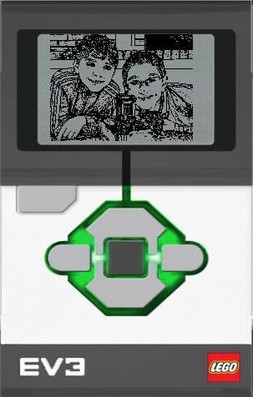
My BRICK IS FROZEN
If your EV3 Brick suddenly gets frozen, you will need to reset your EV3 Brick.
Hold down the Back, Center, and Left buttons on the EV3 Brick.
When the screen goes blank, release the Back button.
When the screen says “Starting,” release the Center and Left buttons.
Be sure you update your firmware if you have not done so to avoid future issues with your brick
If your robot does not go to the EV3 menu after the reset, refer to slide 4 in this presentation.
Refer to Video from Hands on Technology: https://youtu.be/PzMoL5shrJw

Slide 4
BRICK REPEATEDLY STUCK DURING BOOT/STUCK DURING FIRMWARE UPDATE
Method 1: (Brick is on and stuck)
Hold down the Back, Center, and Right buttons on the EV3 Brick.
When the EV3 Brick restarts, release the Back button.
When the screen says “Updating,” release the Center and Right buttons
Update your firmware again using your USB cable
Source: Text from EV3 User Guide, Image from Legoengineering.com

Slide 5
BRICK REPEATEDLY STUCK DURING BOOT/STUCK DURING FIRMWARE UPDATE
Method 2: (Must be able to access battery easily)
1) Remove and reinsert battery
2) When the brick is off, hold down Center and Right button together until you see “Updating”
3) Update your firmware again using your USB cable
Source: Text from “Recovery from Failed Firmware Update”, STEMRobotics (Randy Steele), Image from Legoengineering.com

Slide 6
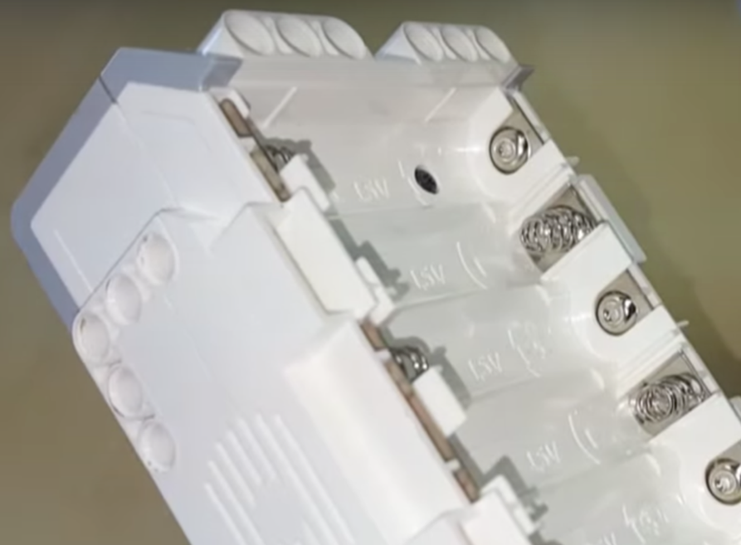
Fully Charged Battery, but the Brick doesn’t Turn ON
Check battery contacts
Sometimes, the battery contacts in the brick have been bent
Remove rechargeable battery or AA batteries and straighten out contacts.
Reinsert battery
Refer to video by Hands on Technology
https://youtu.be/za9bJ2nwloo
Image credit: Hands on Technology

Slide 7
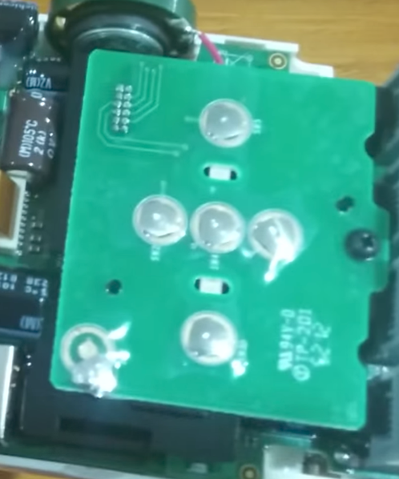
MY “off” Button is stuck
If you want to fix it yourself….
There is little piece of curved metal under each brick button. This must have moved out of place.
Remove battery
Unscrew four black screws
Reposition the button so it makes a contact
Screw back the case
You might want to call LEGO Customer Service instead
Refer to video by Damien Kee
https://youtu.be/NNoutMLxmJ0
Image credits: Damien Kee

Slide 8
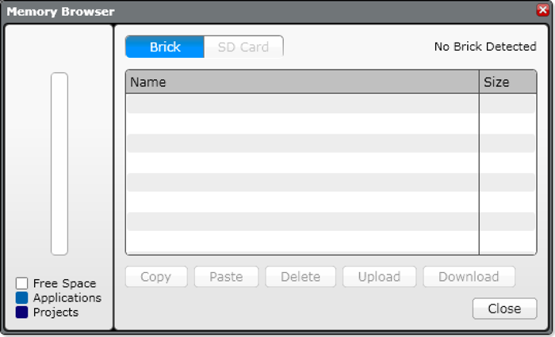
I deleted my program, but it’s still on the brick
Can I retrieve a program from the brick if I have lost the code on my computer?
Unfortunately, if you lost the program on your computer, there is no way to get an editable program (in EV3-G) off the brick and back to your computer.
What about the Upload button in Memory Browser?
It will let you get a copy of a compiled (binary) version of your program. However, you will not be able to view or edit the program in your EV3 software again.
Always back up your programs!

Slide 9
CREDITS
This tutorial was created by Sanjay Seshan and Arvind Seshan
More lessons are available at www.ev3lessons.com
This work is licensed under a Creative Commons Attribution-NonCommercial-ShareAlike 4.0 International License.

