Slide 1

Doing Background Research
By BAYOU bUILDERS & NeXt Gen

Slide 2
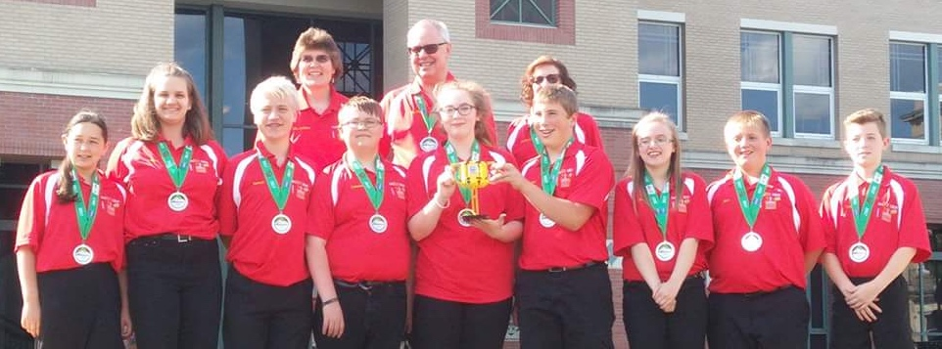
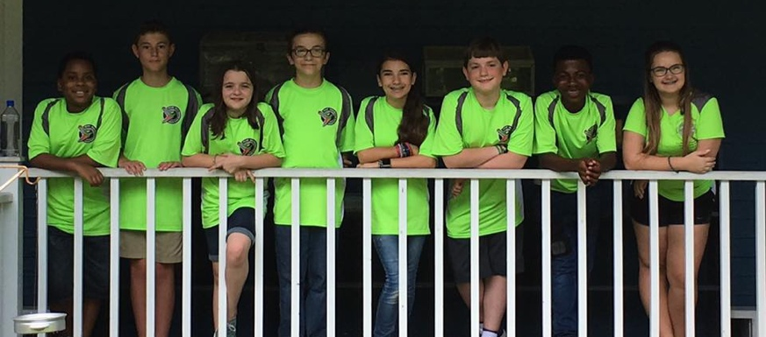
About Us
NeXT Gen are a middle school team from Garrett County, Maryland with 13 years in FIRST LEGO League (including competing in International Tournaments).
They have won first place in 2013 Global Innovation Award. They also won Top 20 GIA Semi-Finalist in 2017 for innovative solution, BeeHaven.
In addition, they won first Place Innovative Solution at Mountain State Invitational in 2017.
Bayou Builders are a 10-person, community-based team in Hammond, Louisiana.
They have won the Champions’ award every year and attended the North American Open as well as World Festival. In 2017, they were also nominated for the Global Innovation Award from Louisiana.

Slide 3
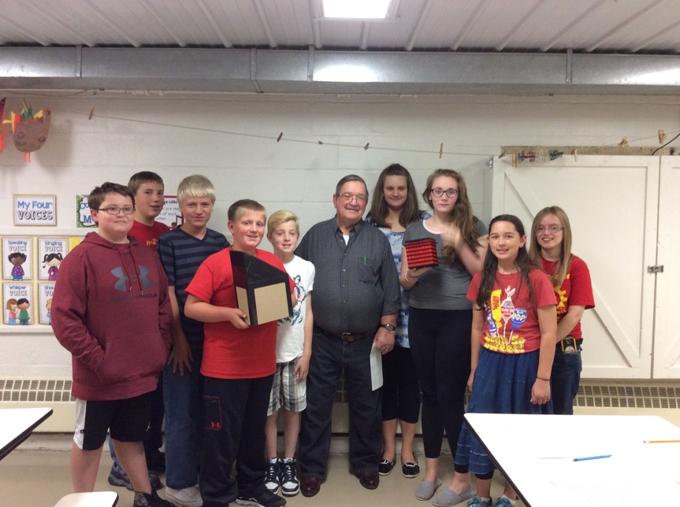
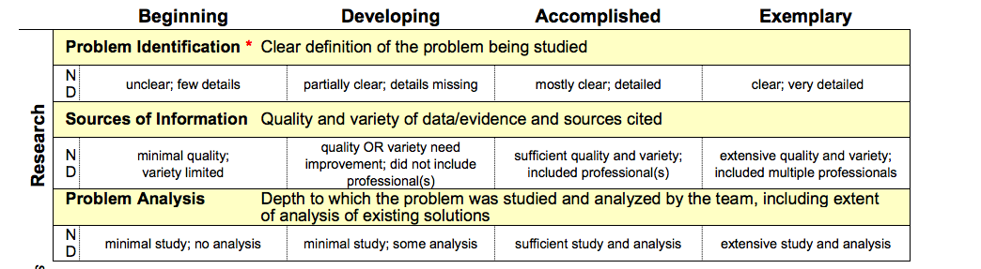
Types of Sources
Use a variety of sources including websites books, magazines, reports, professionals
Go on fieldtrips
Collect your own survey data
Remember that all sources need to be cited
Shared by: NeXT GEN

Slide 4
Creating a Bibliography
Creating a team bibliography can be helpful
Allows a team to easily find the resources again if additional information is needed.
Bibliographies can also be handed to the judges to show research.
Tips:
Google Drive: Share your resources with your team using Google Sheets
Annotated Bibliography: An annotated bibliography that describes briefly what each website or other source taught us is very helpful in remember the sources
Shared by: NeXT GEN

Slide 5
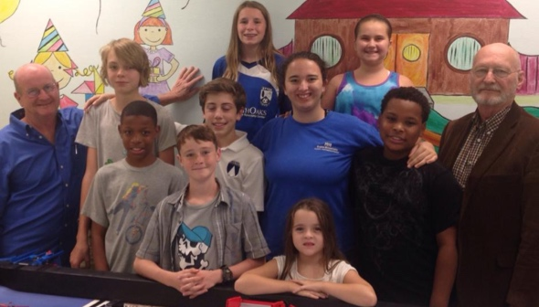
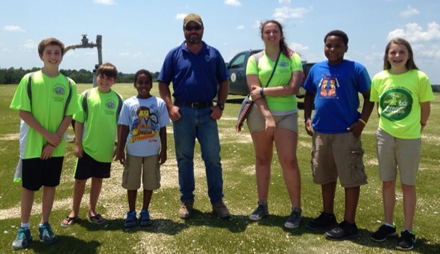
Going on Fieldtrips
Sometimes fieldtrips to local companies and organizations are possible
Fieldtrip destinations are based on the problem you are studying or the solution you have come up with.
In World Class, we decided to create a computer-based math game to help students practice different math facts while also learning a piece of music. We ended up identifying a local software design company through the white pages. We called them up and ended up meeting with them at their company to pitch our game and learn more about how to implement it.
In Trash Trek, we had heard that the glass we set out to recycle is only collected brought to our local MRF (recycling facility) and is then reloaded and brought to a landfill. We got the contact information for the plant manager for our MRF and then asked our coaches to make the call and set up at tour.
In Animal Allies, we sent an email to the Water Quality Specialist at the New Orleans Aquarium to learn more about their water filtration system for their large exhibit tanks.
Shared by: Bayou Builders

Slide 6
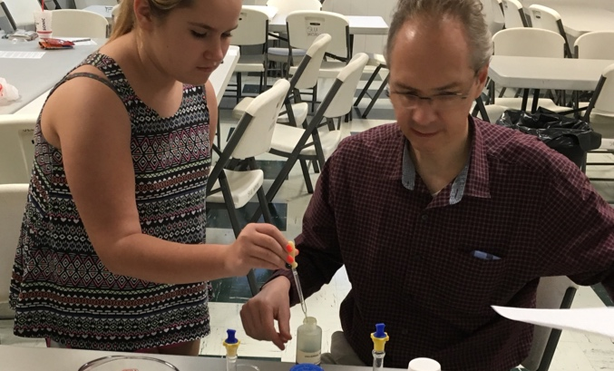
Talking to Experts
Brainstorm potential professionals who might know about the subject/problem.
Do Internet searches for local professionals
We refer to our local Chamber of Commerce directory, University directory and other state environmental and business bureaus.
Develop an initial email to send out to these professionals, explaining who we are, what FLL is and what information we are hoping to learn.
Experts don’t have to be near you: In Animal Allies, we Skyped with one chemistry professor and met with another to get a better understanding of pH.
You might run into professionals at a community outreach who can help you: Last March we presented our FLL project at the Louisiana Green School Summit. While there we met specialists from the New Orleans Sewage & Water Treatment program who have become a great contact for us and have helped us meet more people in our area.
Shared by: Bayou Builders

Slide 7
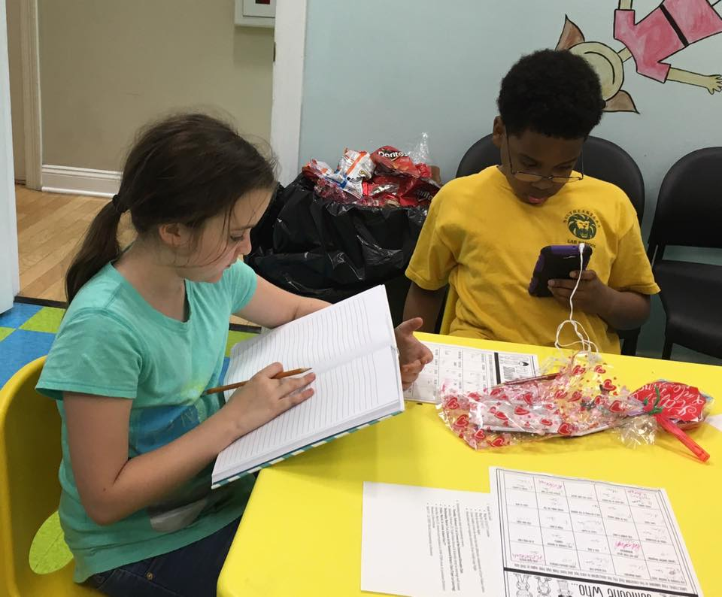
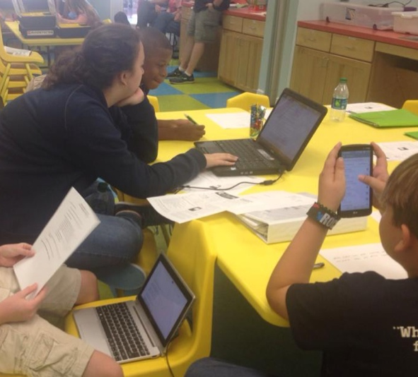
Doing Research Online
We do a lot of initial Google searches to see what is out there.
Do web searches and get information from reputable sources
Tips for finding reputable sources:
Our first rule is to utilize “.gov” websites first.
When we are researching other websites, it is our next goal to make sure any information gained is also supported by at least two other websites.
We will also often look to different university websites that also provide educational content.
We try to steer clear of Wikipedia since it can contain a lot of opinion rather than straight facts.
We will also often present any information gained from this Internet research with the professionals we are in contact with to see if they also confirm and agree with the information.
Shared by: Bayou Builders

Slide 8
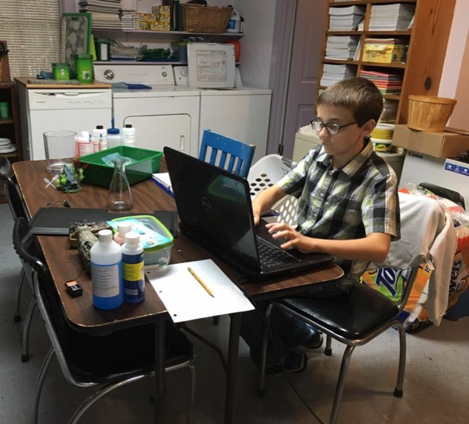

Surveys
In the past, we have also developed surveys using Survey Monkey.
We did this with Animal Allies to learn from teachers how they care for class aquariums.
Tips for developing a survey
Brainstorm Questions: Brainstorm questions that will help define your problem and help develop a plan for developing our project
Keep the survey short and to the point: Our goal was to keep the survey answer time to about a minute or so to increase honest participation.
Share the Survey: We sent out survey out through social media and different educational sites. Include an explanation as to who you are and what you are hoping to accomplish to different educational sites. We also send an email link to the survey to our local school board, area schools and through two different university systems.
Shared by: Bayou Builders

Slide 9
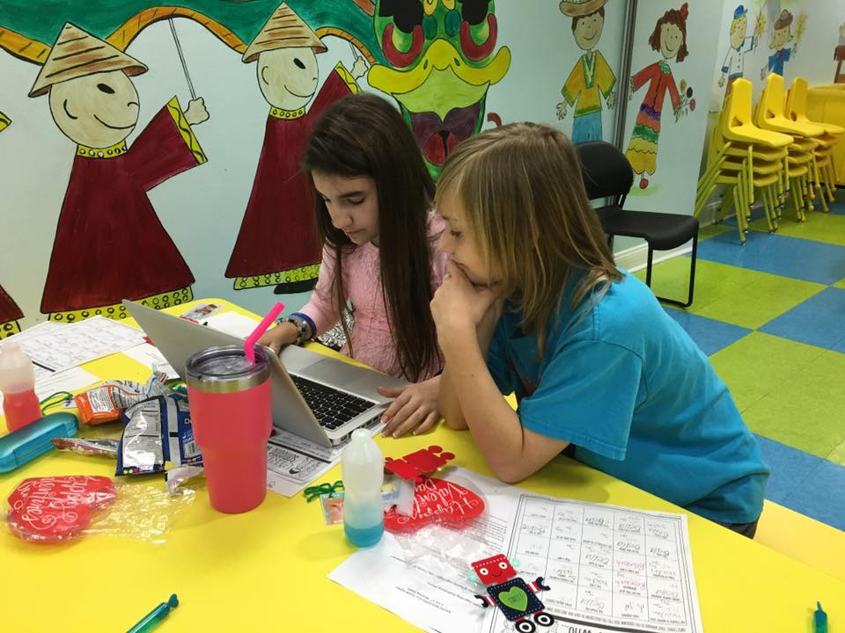
Next Step
Once a solution is identified and developed, you need to do research to ensure that it’s original and practical.
See the next lesson about developing an Innovative Solution by Team Phoenix.
Shared by: Bayou Builders

Slide 10
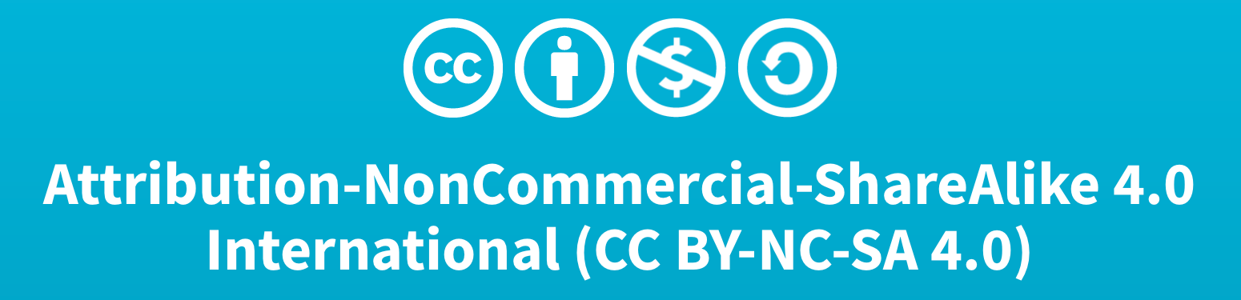
Credits
This lesson was written by Bayou Builders FLL Team #4043 (www.bayoubuilders.org) and Team 3659 NeXT GEN (Facebook:Garrett County FIRST LEGO League Team 3659).
It has been shared with permission with EV3Lessons.com

