Slide 1

Global Innovation Awards
By Team 3659 NeXt Gen

Slide 2
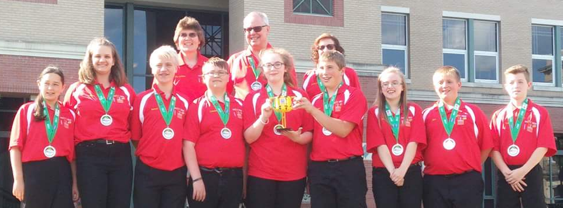
About Us
We are a middle school team from Garrett County, Maryland. We have been a team for about 13 years and have competed at several international tournaments.
We won the Global Innovation Award during the Senior Solutions 2012-2013 season for our innovative solution, the Gramma Jamma.
In the Animal Allies 2016-2017 season, we were one of the top twenty Global Innovation Award Semi-Finalists (20 out of 29,000 teams) for our innovative solution, BeeHaven
At Mountain State Invitational in 2017, we won the Innovative Solution Award. We have a provisional patent on the BeeHaven and have already sold 20 BeeHavens .
You can contact us through our Facebook page, Garrett County First Lego League Team 3659.

Slide 3
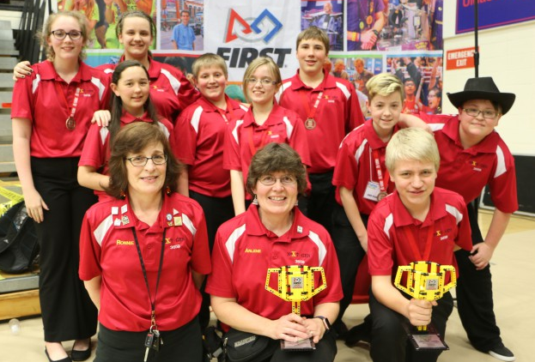
Nomination for GIA
Most regions nominate their top-ranked team in the Innovative Solution Award from their State/Championship event.
We were nominated from the Maryland State Championship at University of Maryland Baltimore County. We found out that we were nominated when our coach received an email from FIRST.
If you need more information about how your team can be nominated for the first LEGO League Global Innovation Award, visit https://www.firstinspires.org/robotics/fll/global-innovation

Slide 4
Application Process
After nomination, we had to fill out an application which was due at the end of March.
The application would be judged to determine whether we were one of the twenty semi-finalists in the world for the Global Innovation Award. If so, we would be invited to the Global Innovation Award Event in Washington, D.C. in June.
There are four categories in the application: Problem Identification, Innovation, Solution Development, and Implementation.
We also had to write a Team Description and a Public Innovative Solution Description to be listed on the FIRST LEGO League Global Innovation Award website. These are not reviewed by judges, but it is helpful to find out about the other teams and their solutions.

Slide 5
Understanding the GIA Rubric
There are four sections on the rubric Global Innovation Award Rubric,
Problem Identification: Clear definition of the problem being studied
The team has to clearly explain the problem they chose to solve. However, it must be detailed enough to understand why it is a problem.
Innovation: Degree to which the team’s solution makes life better by improving existing options, developing a new application of existing ideas, or solving the problem in a completely new way
The team needs to explain why their solution is original, innovative, and will have a large impact on others.
Image Credit: https://garrettcountyschools.org/public-information/news/2017/05/local-youth-recognized-for-innovation-as-first-lego-league-global-innovation-award-presented-by-xprize-semi-finalist

Slide 6
Understanding the GIA Rubric
Solution Development: Use of a systematic process to develop the solution, where alternative solutions are considered and narrowed, the chosen solution is evaluated and improved, feasibility of process solutions assessed (Exemplary: Clear, very detailed)
The team needs to know the entire process of how the solution was developed, how they took into consideration experts/professionals’ feedback and used it to improve their solution, how they’ve tested the solution, why the solution is better than existing solutions, and if the solution is more expensive than existing solutions why it is worth the extra expense.
Implementation: Consideration of factors for implementation (such as cost, ease of manufacturing, etc.) (Exemplary: Original solution/application with the potential to add significant value)
The team has to know the cost of the solution, how they would manufacture the solution, the cost of manufacturing the solution, and what their marketing plan is. This is also where patents come into play. Do they have a provisional patent for their solution? Will they consider a full patent?

Slide 7
Understanding the GIA Rubric
A unique section on the FIRST LEGO League Global Innovation Award rubric:
Motivation to Implement: Team demonstrates motivation to implement (clear idea of a next step(s) to make a reality; or consultation with a professional for advice beyond production, such as business, marketing, design, etc.; or demonstrates strong desires to see the end user’s problem improve with this solution (This section is just checked by the judges if the team demonstrated the skill)
The team must be committed to following through with their marketing plan and the continuation of their project for possibly years. Research about marketing, provisional patents, and patents. Discuss how far the team is willing to go with their project.

Slide 8
Application: Problem Identification Category
For the Problem Identification Category of the application, there are two sections:
Overview: Describe the problem and why you are trying to solve it (200 words max)
Cleary describe the problem they are trying to solve, the reason why the team is trying to solve that problem, and why it relates to the team. This does not include any information about the solution.
Detailed Description: Describe the solution, how it works, how it solves the problem (300 words max)
The team needs to explain what their solution is, but it must be understandable by the judges. It’s not too technical because there are is a max of 300 words. Make every word count. This is one of the most difficult descriptions. Look at what the team has to include and include those parts but save the other parts that don’t have to be in this description for somewhere else in the application.

Slide 9
Application: Innovation Category
For the Innovation Category of the application there aren’t any sections, the team has 500 words maximum to explain how their solution solved the problem in a new way and/or improved on existing solutions in a meaningful way.
Include existing solutions and why they don’t work, why the team’s solution works, what makes their solution work, what makes their solution innovative, and who benefits from their solution.
This is where listing at least three innovative features of their solution helps. By innovative features, we mean what makes the team’s solution their solution? How is it different from any of the other existing solutions?
Once the team has their innovative features listed, use those as the frame of the description. Then, the team can break it up into multiple paragraphs. We also recommend using the scientific method. Include the hypothesis which uses if and then statements.

Slide 10
Application: Solution Development Category
For the Solution Development Category of the application, the team has 500 words maximum to describe how they developed their solution, the steps they followed to narrow, evaluate, and verify their solution; and how they improved their solution after receiving feedback from experts/professionals. This is where we really recommend using the scientific method as the frame for the description. Include the following:
The problem
How the team researched the problem and existing solutions
The hypothesis
How the team built and modified their prototypes
How the team tested their prototype(s) and hypothesis by experimenting
What the team plans on doing next to improve their solution

Slide 11
Application: Implementation Category
For the Implementation Category of the application, the team has 500 words maximum to describe how their solution will be implemented, what factors did they considered (cost, materials, manufacturing, market research, how they determined feasibility, their marketing plan, whether or not they will get a provisional patent, and would they consider getting a full patent for their solution.
We recommend, once the team determines the cost of their solution, asking experts/professionals who could use the solution what they think of the cost, whether it’s too expensive or if it is worth the cost or if they would buy it.
Discuss as a team who the target market (customers) would be and research.
Research and/or speak with experts/professionals in manufacturing, marketing, and patents.
Research the difference between provisional patents and patents.
Learn about how to apply for provisional patents and patents.

Slide 12
Public Website Descriptions
As part of the application, teams create descriptions, that will not be evaluated by the judges. The descriptions of the 20 semi-finalists are published on the FIRST LEGO League Global Innovation Award website
Team Description: Brief description of your team, no personal information (500 words max)
Write a description of the team, where they’re from, what they’ve done as a team this season, what they enjoy about FLL, really anything about the team they want to share with others.
Public Innovative Solution: Description of the problem and how your innovative solution solves it (300 words max)
Briefly describe the problem, why they chose it, what their solution is, and how it solves the problem.

Slide 13
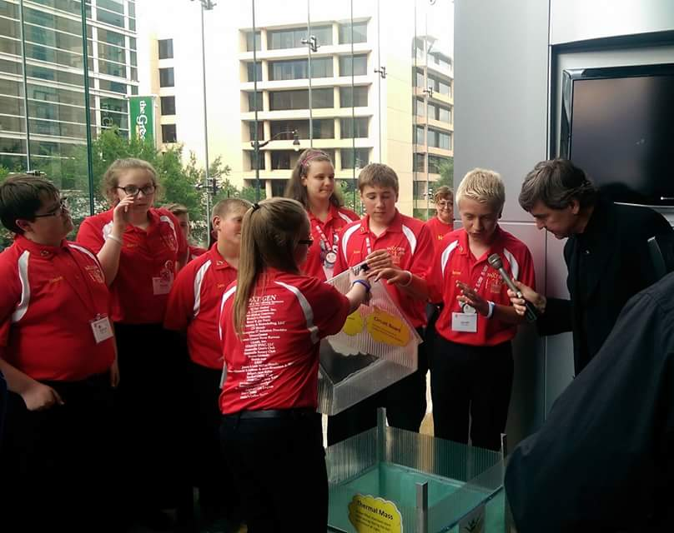
Semi-Finalist
If the team is chosen as one of the top twenty Global Innovation Award semi-finalists in the world, they are invited to attend the Global Innovation Award Event in Washington, D.C. where they will compete to win the Global Innovation Award.
The team will need to create a five minute presentation to the judges and fill out an Engineering Change Notice form.
The Engineering Change Notice form is where the team lists all the changes they’ve made to their solution. They can include the changes since they were nominated from their championship event or they can include all the changes since they first developed their solution.
Judging will last fifteen minutes. Judges have ten minutes to ask questions.
It is suggested that if a team is selected as a semi-finalist, that the team get a provisional patent on their solution since information about the team’s solution will be listed on the Global Innovation Award website.

Slide 14
Judging
We highly recommend that the team creates a new presentation for the Global Innovation Award judging since there is a different judging rubric. The team has one judging session. We also got to present our presentation in front of all the other teams and visitors.
For the Global Innovation Award presentation, we recommend again writing a script. We also recommend basing the script off of the rubric. Make sure to use key words from the rubric like clear and innovative.
If the team has a prototype, which at this stage they should, they need to bring it! If they can’t bring the full scale prototype, create a smaller scale prototype or model. They need to have something to show the judges that demonstrate how the solution works.
We suggest getting a provisional patent. The judges will ask if the team has one.

Slide 15
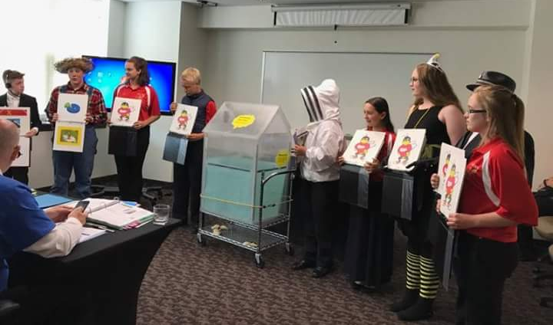
Judging
The presentation needs to cover everything on the rubric and everyone on the team needs to participate even while answering questions.
The Global Innovation Award Event is more formal than most FIRST LEGO League events, but the team needs to be memorable to the judges. Do something unique for the presentation. Be creative. Figure out a way to make the judges remember the team.
Show the judges that the team is motivated to follow through with the project.
The presentation needs to be organized in a way that makes sense to the judges. For example, don’t talk about the solution then tell them the problem. Identify the problem first, then talk about the solution.

Slide 16
Judging Tips
We recommend having a “captain” who helps direct questions and makes sure everyone answers a question.
This does mean the captain needs to know what everyone feels comfortable talking about.
The captain does have to answer a question, too.
Just because there is a captain for a judging session, does not mean that the team has an overall captain. On our team, we don’t have a team captain because we feel that everyone is equally important and valued.
The captain is someone who knows how to make sure everyone has a chance to participate.

Slide 17
Judging Tips
The team needs to have points about their project to talk about if they have extra time.
Highlight the innovative aspects of the project.
Bring testing data.
Show the data and explain what it meant.
Focus on how the team improved their solution.
Define how the team plans on implementing their project and taking it to market.
The team has been doing this project for almost a year. They know everything there is to know about it. Everyone on the team should be able to explain every detail of their project since it started.
Don’t be afraid to restate what has been said. Sometimes it helps the judges if it is re-worded.

Slide 18
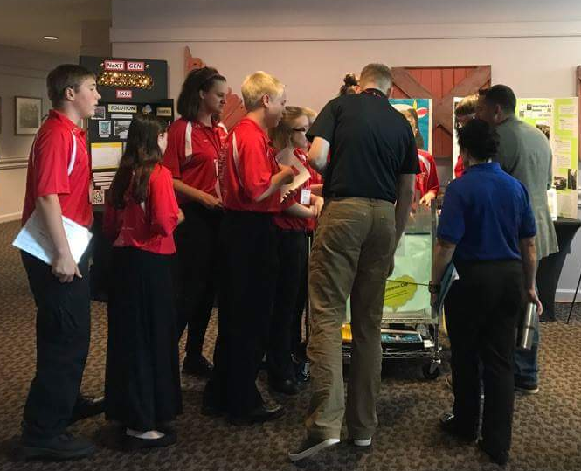
Pit Area Judging
The team will also have a pit area judging.
This is where judges who haven’t seen their presentation but were informed about their project come to the pit area and ask questions about the team’s project.
Everyone from the team should be there during the pit area judging.
Be inviting, bring the judges into the pit area. It’s a good idea to have a display board that includes the list of innovative features of the solution, an example of the testing data, photos of the solution, etc. It’s something that if the team members need something to talk about they can simply look at and get ideas of what to say next.
Show the judges the prototype/model.
Everyone needs to answer a question.
Don’t let the judges walk away without knowing everything about the team’s project.

Slide 19
Engineering Change Notice
For the Engineering Change Notice form, include several drawings of the team’s solution. Describe the changes and how they improved the solution.
The Engineering Change Notice form is basically about the team’s solution development.
Think back to every change that was made which is why it is helpful to track the changes that were made while the team was developing their solution.
Explain why they made those changes.

Slide 20
Provisional Patent
A provisional patent is a patent that lasts for one year.
A provisional patent protects an idea. However, it is not the same as a full patent.
When writing a provisional patent application, think about those innovative features, the features that make the team’s solution their solution. Include a drawing of your solution.
Don’t get too specific. Don’t mention using a specific material unless it’s absolutely crucial.
If before that year is up the team decides that they want to get a full patent, the date they submitted their provisional patent is essentially the starting date of when their solution became protected. This is useful if someone submits a provisional patent or patent that is covering the same thing the team is because if the team submitted their provisional patent before they did than the team was the first to protect that idea. Therefore, the team’s idea is protected and they cannot get a patent on the same thing the team did.
You can learn more about provisional patents and patents at https://www.uspto.gov/patents-getting-started/patent-basics/tyoes-patent-applications/provisional-application-patent

Slide 21
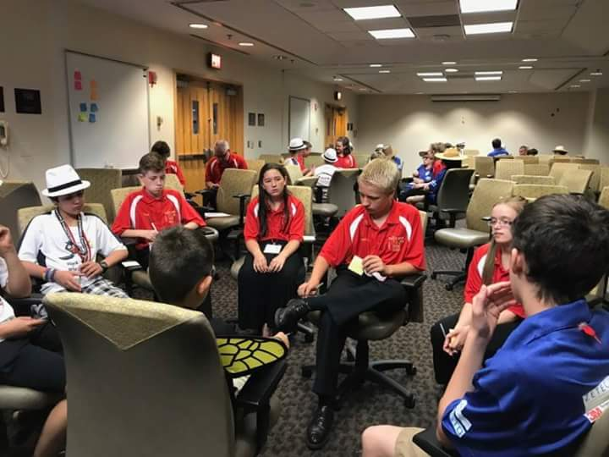
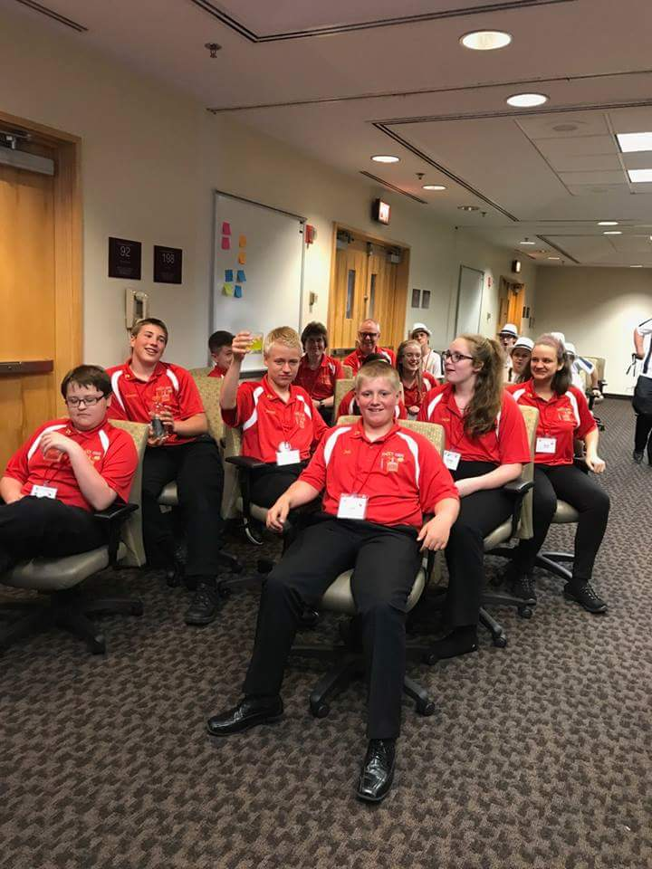
Global Innovation Award Event
The Global Innovation Award Event was a three day long event in June. For the first night, we set up our pit areas and had a dinner where we met teams from across the world.

Slide 22
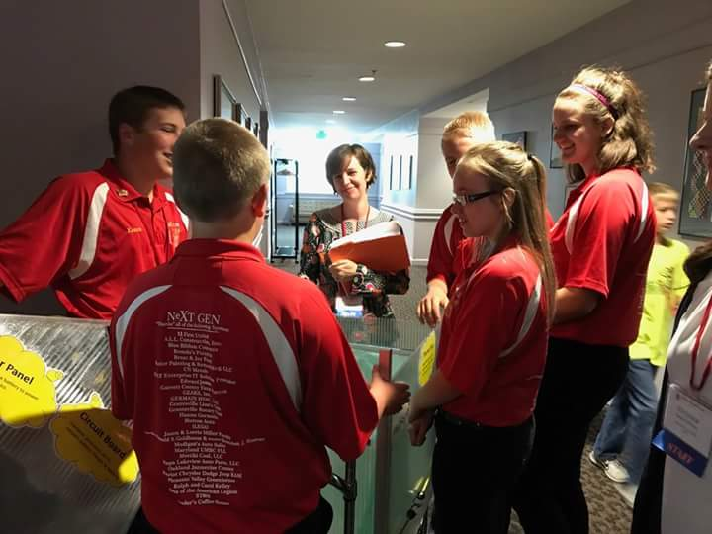
Global Innovation Award Event
For the second day, we attended multiple workshops where speakers talked about their businesses, patents, and marketing. We also did some fun activities to get to know the other teams. We had judging that day. Afterwards, we visited the United States Patent and Trademark Office to learn about patents. Dean Kamen, the founder of FIRST, gave a speech as well.

Slide 23
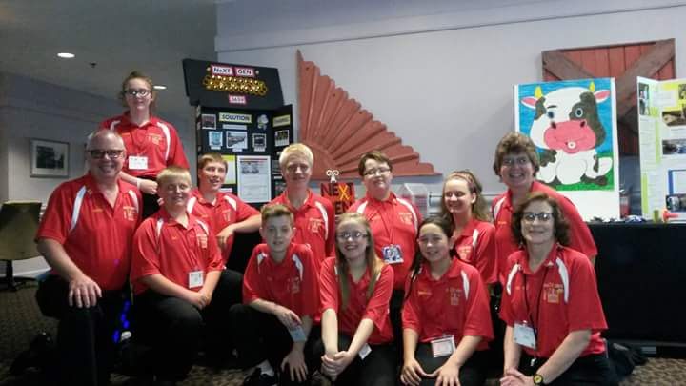
Global Innovation Award Event
For the third day, we attended some workshops. We became Innovation Ambassadors. We then traveled to the Shakespeare Theater where they announced the winner of the Global Innovation Award.

Slide 24
GIA First Place Winner 2013
“WINNING TEAM, NeXT GEN – The “Gramma-Jamma” is an assistive device that helps seniors pick up pills or other small objects that are difficult to retrieve with a conventional claw or magnetic-type device. The “Gramma-Jamma” is based on the same technology being used to produce universal grippers for robotic manipulators.”
Source: http://www.businesswire.com/news/home/20130618006831/en/Kid-Inventors-Win-20000-Prize-Creating-Device

Slide 25


Credits
This lesson was written by Team 3659 NeXT GEN. It has been shared with permission with EV3Lessons.com

