Slide 1
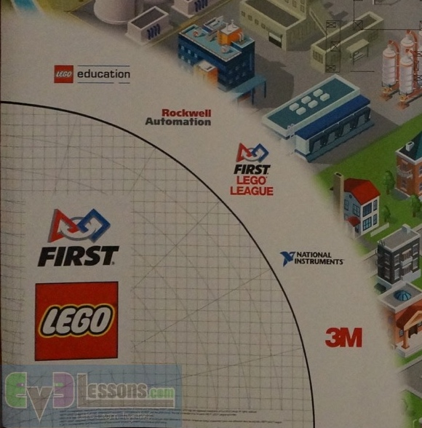
Sample Run: Run Name
Robot Position: Facing N, on LEGO
What goes on: ”T-arm”
What goes off: Nothing
Other reminders:
Run 1:
Robot Position:
What goes on:
What goes off:
Other reminders:
Run 2:
Robot Position:
What goes on:
What goes off:
Other reminders:

Slide 2
Run 3:
Robot Position:
What goes on:
What goes off:
Other reminders:
Run 4:
Robot Position:
What goes on:
What goes off:
Other reminders:
Run 5:
Robot Position:
What goes on:
What goes off:
Other reminders:

