Slide 1
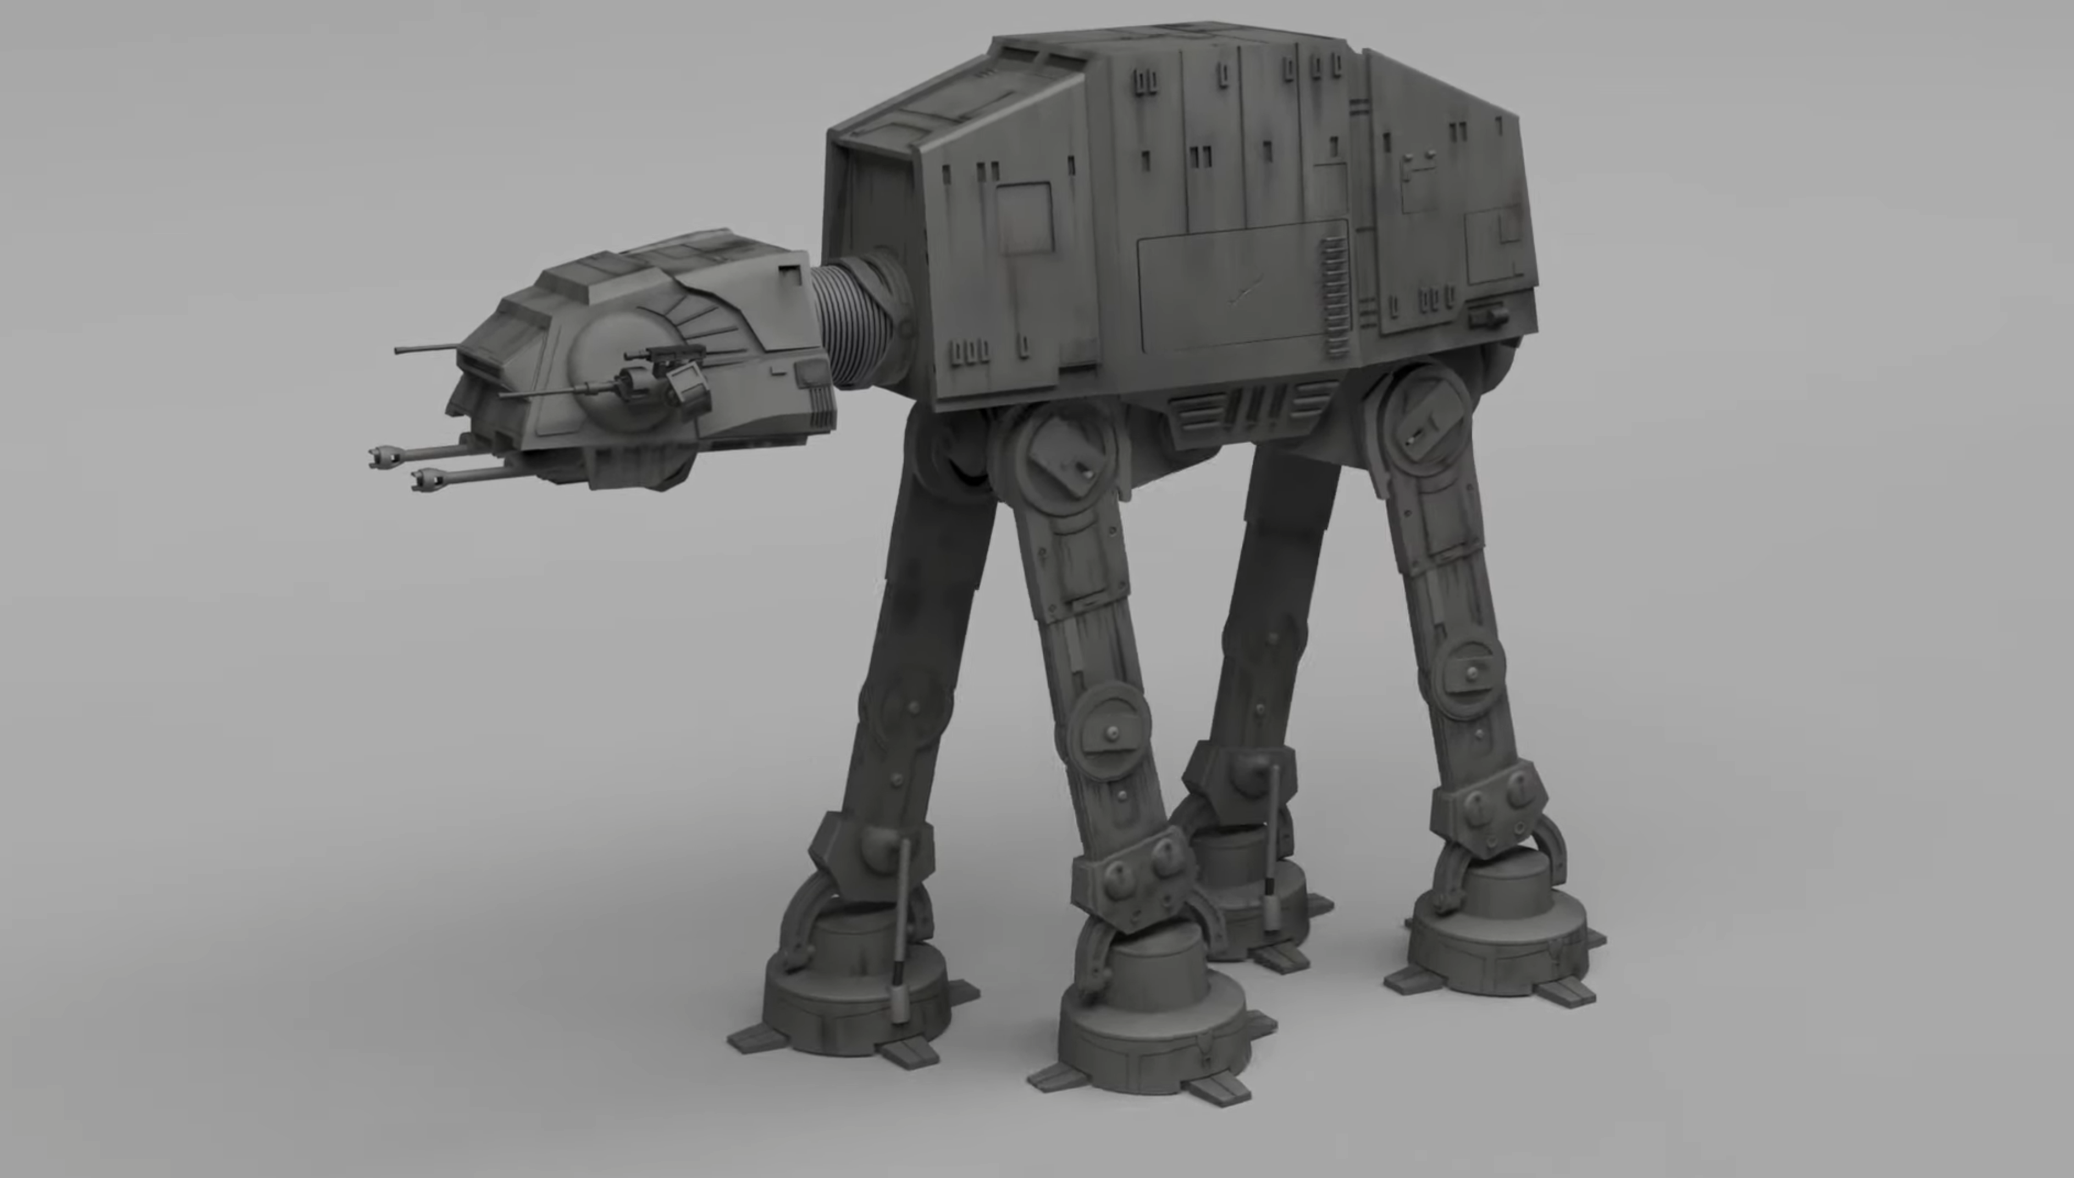
A
B
E
F

Slide 2





$$motor_position$$
Final position
$$360$$
$$180$$
Initial position
$$t[ms]$$
$$T$$

Slide 3



$$motor_position$$
Air
Ground
$$360$$
$$180$$
$$t[ms]$$
$$\frac{T}{4}$$
$$\frac{T}{2}$$
$$\frac{3T}{4}$$
$$T$$

