Slide 1
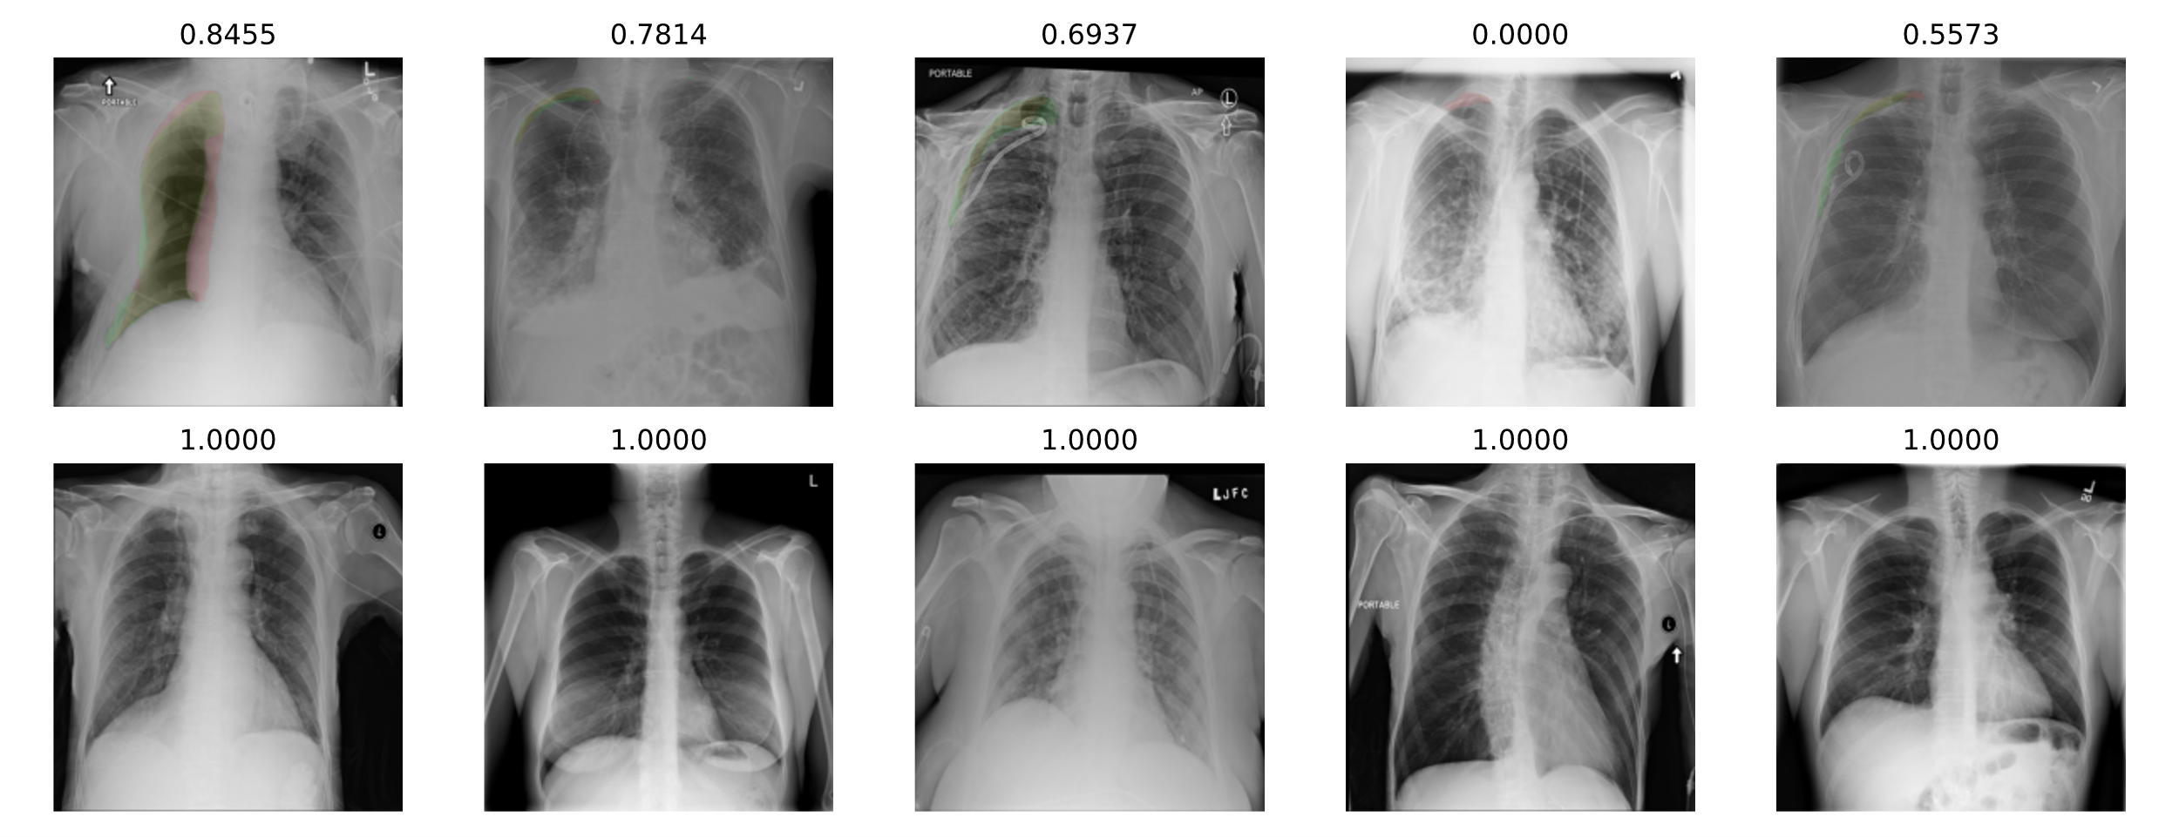
Dice Coefficient:
Positive
Dice Coefficient:
Negative

