Slide 1
Steganography

Slide 2
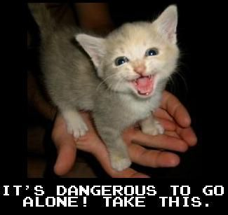
What is it?
Hide in plain sight
Security through obscurity
Can be used with or instead of encryption algorithm

Slide 3
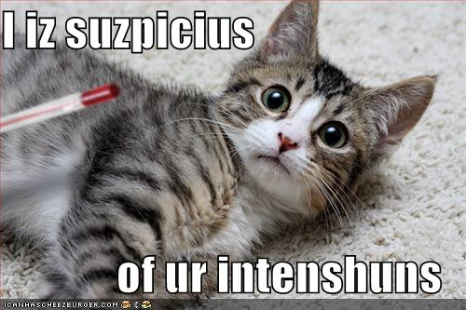
Why to use it
Not suspicious
Encryption illegal
Just for fun

Slide 4
How it works
Most common form: rar in jpeg
  Ending signature in jpeg
  Put stuff after ending signature
Other obfuscation

Slide 5
How to do it in linux
Get jpeg of something inane
Get rar filled with incriminating info
Concatenate the two
  Eg: cat serious.rar >> silly.jpeg

Slide 6
How to detect it
Find headers (0x526172211A0700)
Open file in compression program
  Ex: unrar x silly.jpeg

Slide 7
How to avoid detection
Delete rar header
Encrypt data and remember offset
Use secure internet connection

