Slide 1

LILY
Smart Living
The White Knights
Notes:
To use this title animation slide with a new image simply 1) move the top semi-transparent shape to the side, 2) delete placeholder image, 3) click on the picture icon to add a new picture, 4) Move semi-transparent shape back to original position, 5) Update text on slide.

Slide 2
Smart Virtual World Assistant to be with you
for enhancing your life with digital enrichment ….

Slide 3
INTRODUCTION
Implementing smart solutions for the daily life. Imparting the digital world with experience of Augmented Reality….
Your daily life activity is with LILY now
Our assistant come out of the screen to you to solve all your activity with us …..
Revealing a smart life being with you ….
Don’t worry digital world is with you

Slide 4
SMART
Build your future with tech
Augmented Reality
Embedding the virtual entity assistant to Real world life
Machine learning
Giving personal suggestions
Personal guidance
Artificial Intelligence
Focus on action words for instant actions

Slide 5
AUGMENTED REALITY ASSIST
The life time assistant to float around real world with you
….Any where….
….Any time….

Slide 6
Cool features
1
2
3
4
Will continue
AI CHAT
FRIEND
AUGMENTED ENTITIES
VIRTUAL TOUR
PERSONALISED
SUGGESTIONS
Reference : The basics you can find anywhere 5 Steps To Successful Storytelling Published on April 5, 2014 Featured in: Marketing & Advertising

Slide 7
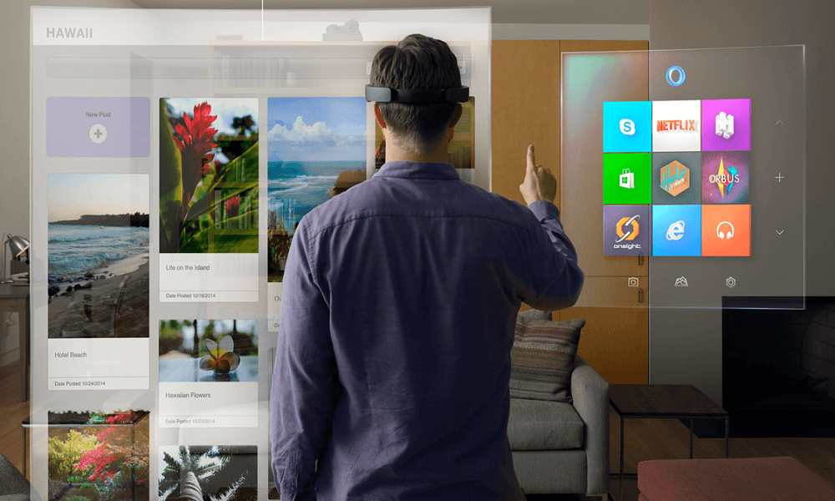
1
AUGMENTED
WORLD
CONNECTING REAL WORLD WITH VIRTUAL WORLD

Slide 8
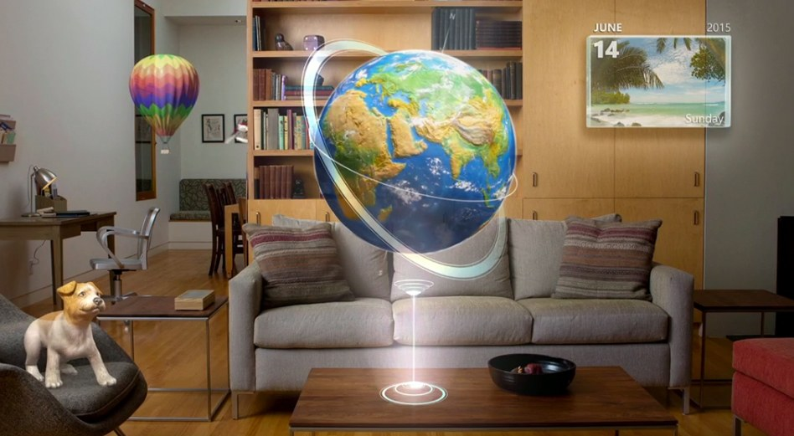
2
PERSONALISED
EXPERIANCE
THROUGH MACHINE LEARNING WE MAKE IT FOR YOU

Slide 9

3
A I CHATBOT
WITH IBM WATSON API WE BRING YOU THE REAL TIME INTERACTION
Notes:
Tip:
When using complex image as full-bleed background add a transparency (70%-90%) fill layer to give contrast to text.

Slide 10

4
VIRTUAL TOUR
We let you to be in the
Virtual world through
WRLD SDK

Slide 11
LILY Smart Living
THANK YOU
The White Knights

