Slide 1

Parsing text in Clojure and then doing something (useful) with it
Martin Bertolino – July 2016

Slide 2
Goals
Baseline on parsers and parsing, grammars, parser generators
Demo some Clojure code for parsing text
Show a real world use case with considerable development improvements…
6+ months of development time down 6 weeks and decreasing.
Minimize development errors due to diverging sources of truth.
Notes:
First time presenting these materials.
Some internal informal talks on some of these topics.
Particularly focused on the tooling for the internal legacy platform.
What is the audience?

Slide 3
Outline
Parsers are everywhere
Parsers, grammars, parser generators
Simple every day (built-in) parsing in Clojure
A simple language to define record structures
A hand coded parser in Clojure
instaparse
EBNF for our simple language to define records
A more complex custom language
Conclusions
References and attributions
Notes:
I assume there is some basic knowledge or understanding of Clojure but please ask if you cannot follow some concept.
This talk is partly based on Mark Engelberg’s talk at Clojure West 2014.
The first part of that talk focuses on parsing, grammars, etc. and the second part focuses on the internals of instaparse. See references.
The rest is based on solving a real problem at work for generating C++ code for a legacy platform.
Brief definition of parsers, grammars, and parser generators

Slide 4
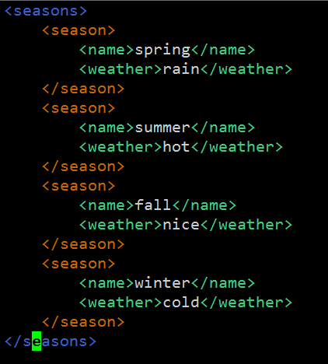
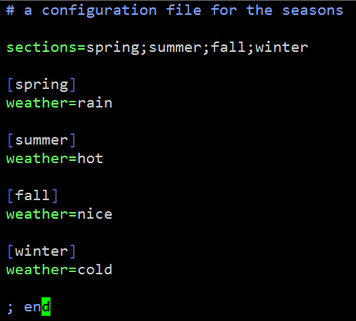
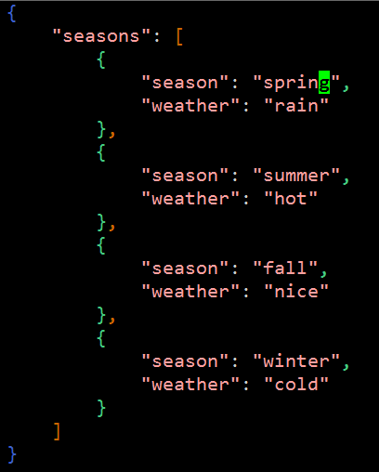
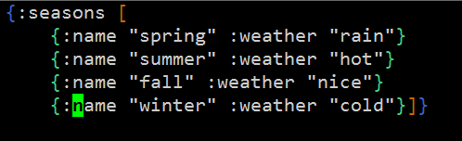
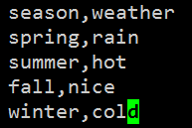
Notes:
We encounter little languages and parsers for them everywhere, xml, json, csv, ini, edn…

Slide 5
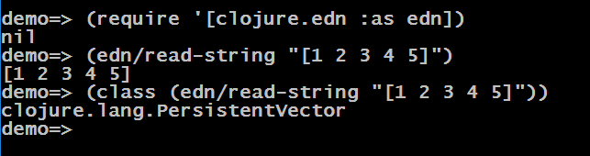
Parsers, grammars, parser generators
A parser is a function that takes text or a string as input and returns a data structure:
parser: string → data-structure
The resulting data structure is sometimes referred to as an abstract syntax tree or AST.
Notes:
We encounters parsers in every day programming.
json, xml, csv, ini files, etc.
Every language we use on a regular basis has one or more parsers.
The Clojure reader is a parser that read Clojure forms and produces a data structure that is then passed to the compiler/evaluator.

Slide 6
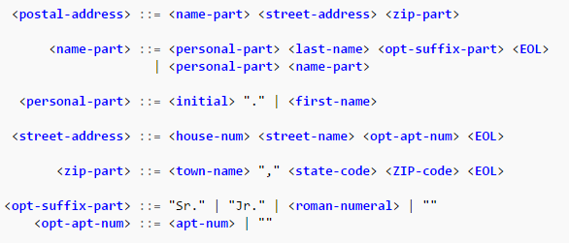
Parsers, grammars, parser generators
Context Free Grammars (CFGs) can be used to formally describe a language
They contain rules on what are the valid strings and structures of a given language
A popular notation for CFGs is Backus-Naur Form (BNF) and it variants
EBNF – Extended Backus-Naur Form
ABNF – Augmented Backus-Naur Form
More at http://bfy.tw/6o06
Notes:
Think of grammars as the rules that determine if a given text/string/program has a valid syntax for the language.
The grammar determines the valid combinations of symbols, keywords, constants, numbers, etc.
EBNF and ABNF variations. We will use EBNF in this talk.

Slide 7
Parsers, grammars, parser generators
A parser generator is a function that takes a grammar of some sort as input and returns a parser.
parser-generator: grammar → (string → data-structure)
They are also known as compiler-compilers or compiler-generators.
One of the original parser generator tools were Lex and Yacc that were part of the early Unix environments. Flex and Bison are the GNU equivalents.
ANTLR is a popular JVM based parser generator that can then generate parsers for other languages and runtimes.
instaparse is the parser generator for Clojure (or the JVM) and the focus of this talk
Notes:
Parser generators have been around for while
Parser combinators is another popular approach in functional languages to create a parser a as a composition of functions that consume the chars/tokens from the input and build he abstract syntax tree along the way. You can write parsers with combinators as a culmination of understanding monads which is definitely out of scope from this talk!
Why no go with Java and ANTLR wihch are definitely more popular? To create some angst and irritation in the corporation and use something different.
Being able to test stuff on the REPL is very very useful.

Slide 8
Simple every day (built-in) parsing in Clojure
clojure.edn
(edn/read-string end-string)
clojure.data.json
(json/read-str json-string)
clojure.data.xml
(xml/parse-str xml-string)
clojure.data.csv
(csv/read-csv csv-string)
Notes:
As in most languages and platforms there are built-in parsers for common text encodings and syntaxes.

Slide 9
Demo: stlclj.simple
Notes:
Show some code from (ns stlclj.simple)
Highlight the concept of going from (structured) text to a data structure

Slide 10
A simple language to define records
v
v
Record
Root Block
Child Block
v
v
v
v
I
I
v
Child Block
v
v
Child Block…
I
Notes:
Just a graphical version of the simple record definition language.
It is sort of a tree structure where nodes can have values and references to other node (types)
No reason why this could not be represented at a JSON or XML document, or a Clojure data structure

Slide 11
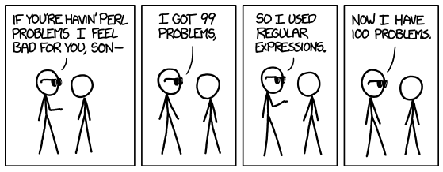
A hand coded parser
Notes:
So what happens when there is no parser for the syntax or language you need to parse?
Let’s say someone decided that the existing languages were not good enough.
For example the pseudo CDA bar format
Show a simple recursive parser for the pseudo CDA in simple.txt.
No error handling, hard to follow.
Talk about edge cases, no values, no records.
Remember the original parser definition parser: string → data structure

Slide 12
Demo: stlclj.hcp
Notes:
Show some code from (ns stlclj.hcp)
Highlight the concept of going from (structured) text to a data structure
Problems with this code:
Hard to match the structure of the language with the structure of the code
Error handling is poor, non existent
Creating a more resilient and robust parser will take a lot more development time
Tokenizer: seq<char> -> seq<token>

Slide 13
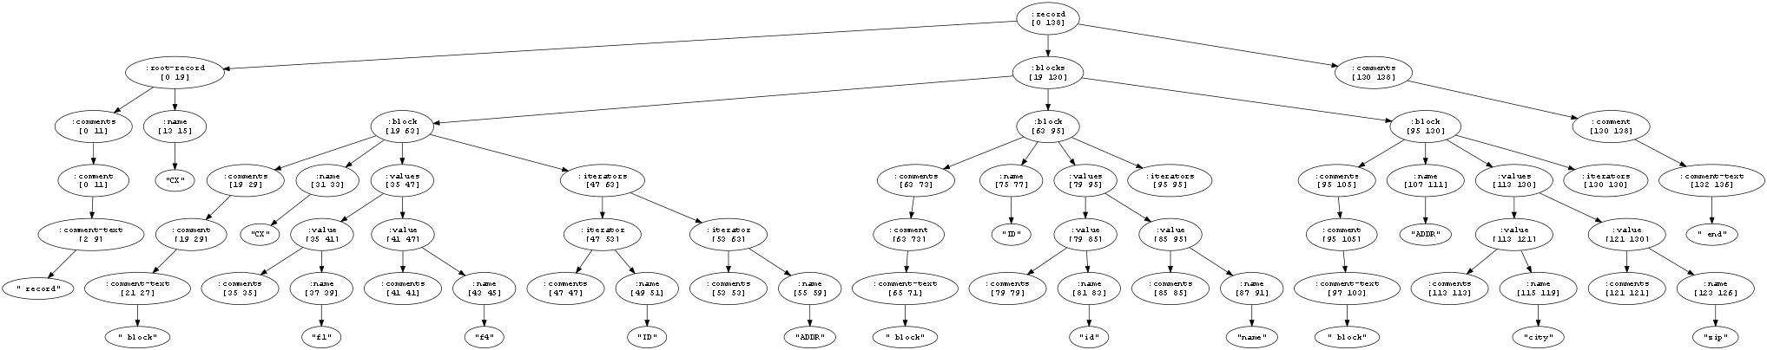
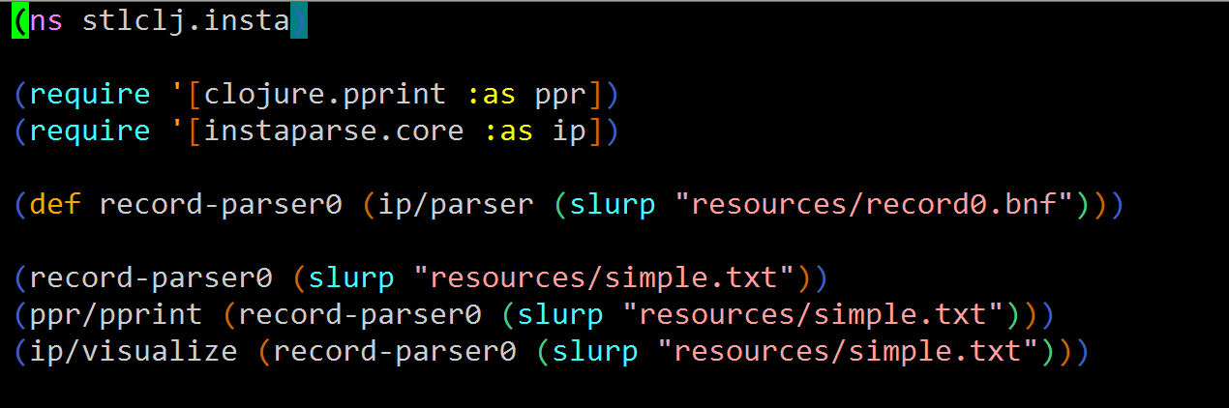
instaparse
What if context-free grammars were as easy to use as regular expressions?
Notes:
Instaparse is a parser generator for clojure.
It an probably also be used from other JVM languages as well but I have not tested it.

Slide 14
(* production rules *)
record = root-record blocks comments
root-record = comments "r" "|" name eol
blocks = block*
block = comments "b" "|" name eol values iterators
values = value*
value = comments "v" "|" name eol
iterators = iterator*
iterator = comments "I" "|" name eol
comments = comment*
(* terminal symbols *)
comment = "##" comment-text eol
comment-text = #"[^\r\n]*"
name = #"[a-zA-Z][0-9a-zA-Z\+-_]*"
eol = #"[\r\n]+"
Notes:
EBNF for our simple language to define records
Walk through the whole tree
Kind of feels like defining regular expressions
In some way this was engelberg’s goal for instaparse., as easy as regexps

Slide 15
Demo: stlclj.insta
Notes:
Show some code from (ns stlclj.insta)
Show the concept of additional information that was captured. “r”, “b”, “v”, “I”, “|”, eol, ws,
Show how it is possible to suppress information that will not be needed using the <> syntax
Show the different data structure captured after the suppression.
Show how things can fail and how it shows errors.
Show the visualization capabilities and the tree structure.

Slide 16
A more complex custom language
Combine rules – C++ code that combines a record coming from the factory (input) and a persisted (repository) record
Observational data model – never lose any data
Think persistent data structures and/or Datomic
Legacy platform implemented in C++
C++ code generator based on instaparse
Data architecture annotations to guide code generation
Notes:
Talk about data exchanges. This is a very specific platform, fast ingestion and fast delivery.
Describe the ‘legacy’ exchange (not the email one) platforms.
Describe how new repos are built and the similarities with the lambda architecture, batch layer/views and real time layer views.
Remember the syntax for records we saw before?
Show a simple ‘data architecture’
Show an ‘annotated data architecture’
Show processing of it and transformation to it is easier to work with
Show C++ code generation
Talk about the original code and how it was hard to keep in sync with the data architecture
Show the JSON generation
Show the original and the transformed data structure (reference to engelberg’s talk)
Mention the engelberg’s steps: create -> hide -> transform
Figure out the grammar
Figure out what to hide
Manipulate the tree into something that fits the problem

Slide 17
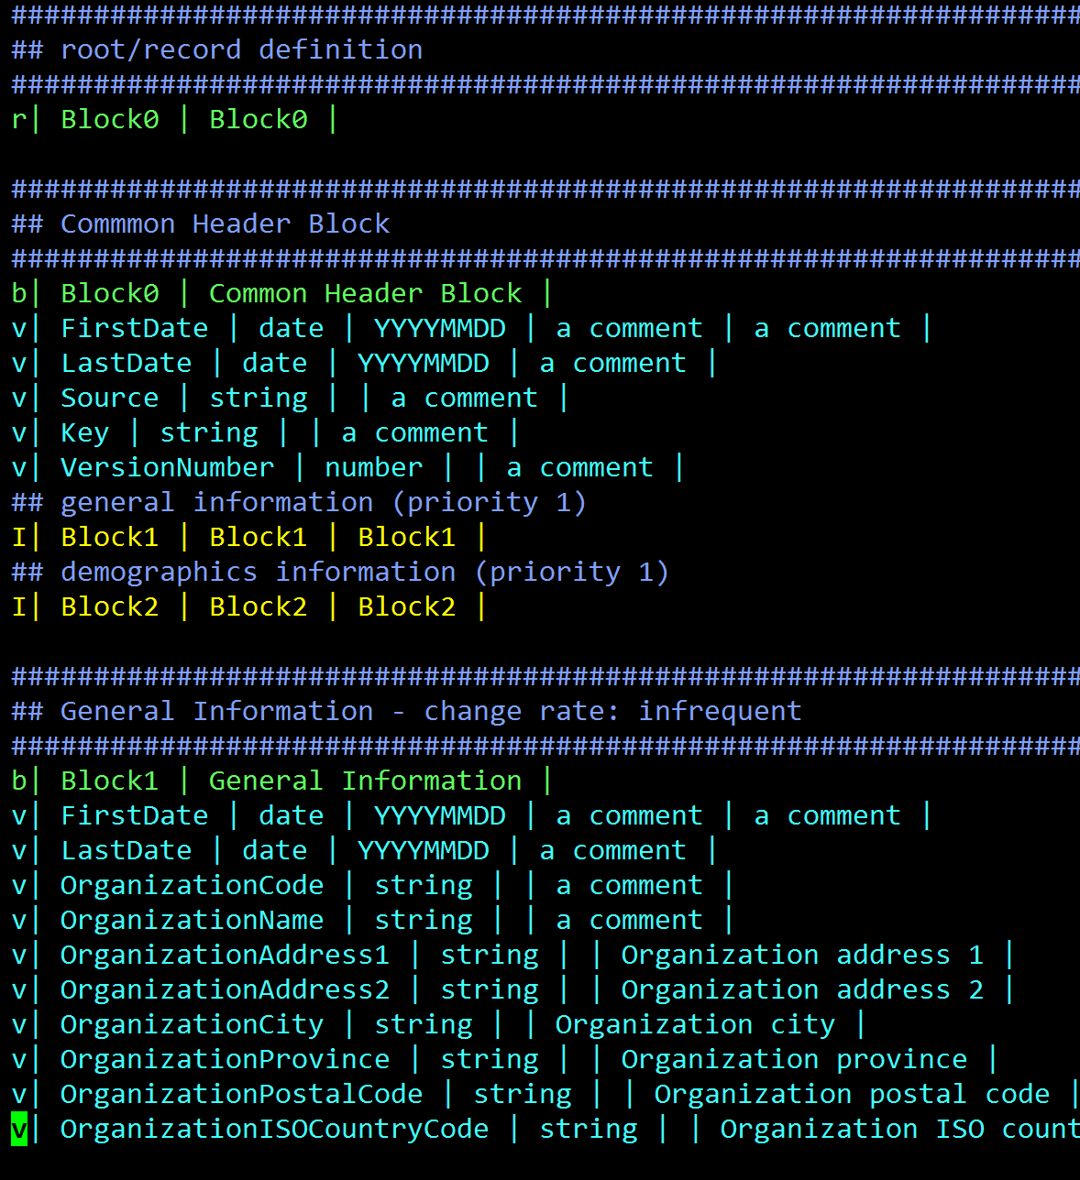
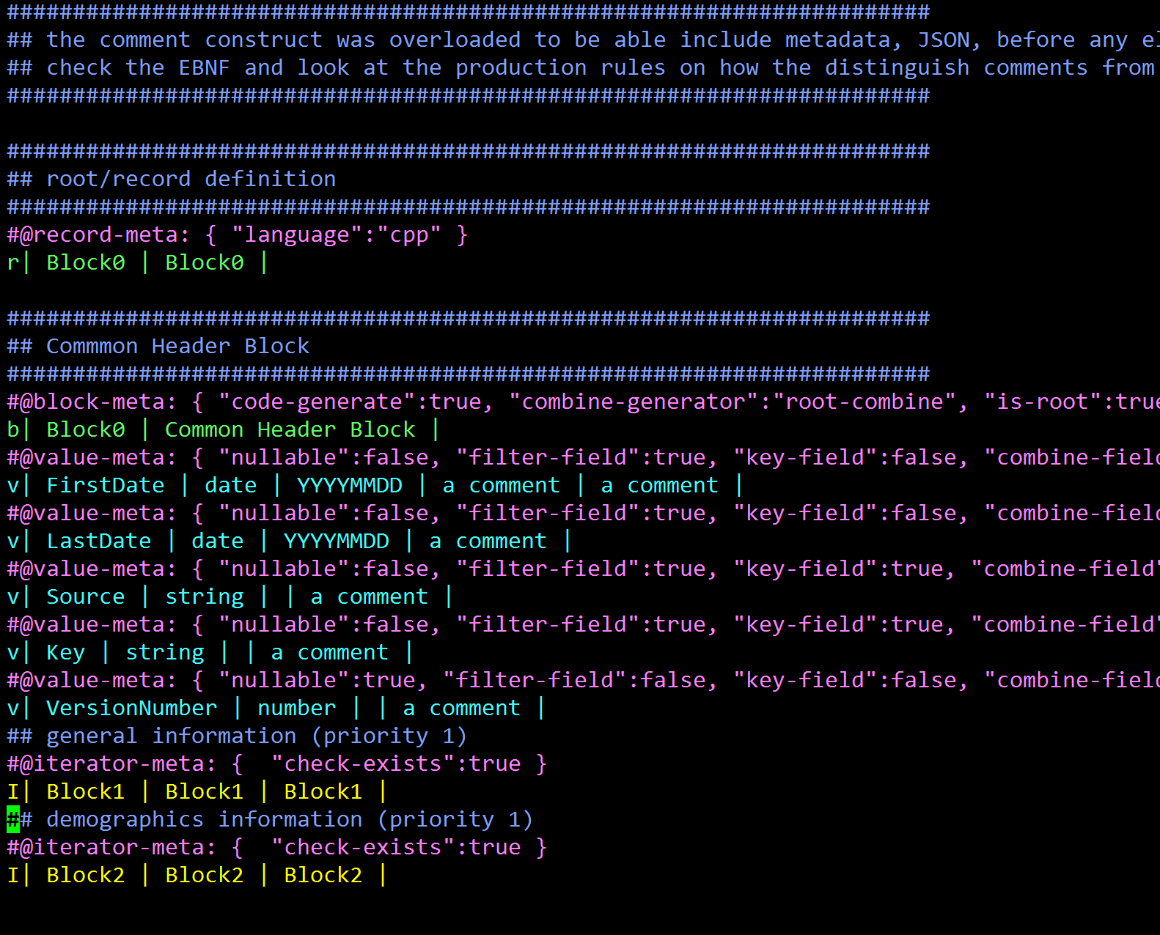

Slide 18
Demo: stlclj.cepcda
Notes:
Remember the 3 steps: create -> hide -> transform
Figure out the grammar
Figure out what to hide
Manipulate the tree into something that fits the problem
Original C++ code was not very good, nothing that clojure could help with, lots of hard coding and repetition.
Show the old C++ code and the new C++ code
Show the need to keep them synchronized between the CDA and the C++ code
Show how small the clojure code is, sub 300 lines of code, including the grammar.
Need metrics on LOCs…

Slide 19
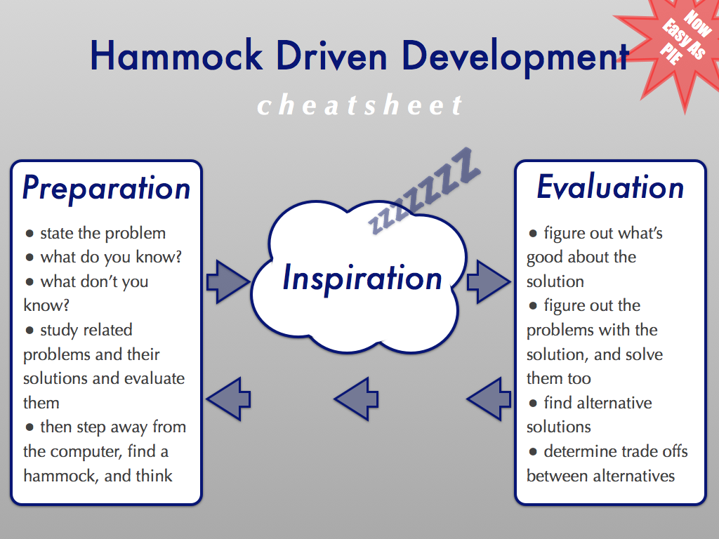
Conclusions
More manually written code is not always the answer!
Think if there are better ways to solve a given problems
Think if there are better tools to solve your problem
Multiple sources of truth are problematic
They will get out of synch
Consider designing/using domain specific languages (DSLs) to future proof the functionality related to your business
Ease the move from legacy platforms to newer ones
New code generated approach cuts down development time from 6+ months to ~6 weeks
Initial code generator and generic/refactored combine rules took 6 weeks to develop by 2 people…with a considerable amount of hammock time!
Notes:
Talk about the future work planned.
Come up with some scaffolding tools like leinigen
See if you can come up with DSL for the business that you are in. We can now use the same approach from country to country
Looks for patterns in your code and see if it can be refactored and the variations extracted as metadata
This project was a good opportunity to introduce clojure into the organization with a low risk project. The tool can be replaced something more mainstream if need be.
Other opportunities:
1) Create documentation
2) Enforce (suggest) patterns and best practices
3) Syntax checking/linting
4) Duality with JSON/JSON schema, produce the CDA as an output instead of input and use more common tooling
5) Code generate for the new platforms (Cassandra/Spark/Scala)

Slide 20
References and attributions
XKCD
https://xkcd.com/1171/
Context Free Grammars
https://www.cs.rochester.edu/~nelson/courses/csc_173/grammars/cfg.html
Instaparse
https://github.com/Engelberg/instaparse
Instaparse Presentation from Clojure West 2014
https://youtu.be/b2AUW6psVcE
Growing a Language With Clojure and Instaparse
http://gigasquidsoftware.com/blog/2013/05/01/growing-a-language-with-clojure-and-instaparse/
Should I use a parser generator or should I roll my own custom lexer and parser code?
http://programmers.stackexchange.com/q/17824
Hammock Driven Development - Rich Hickey
https://youtu.be/f84n5oFoZBc
https://data-sorcery.org/2010/12/29/hammock-driven-dev/

Slide 21
Other stuff

Slide 22
Context Free Grammars Concepts
Terminal symbols
Numbers, strings, names, symbols, whitespace, newlines, comments, etc.
Production rules
Restrictions on how other rules and terminal symbols can be combined in a legal sequence
A starting production rule – usually, but not necessarily, denoted as S
Alternation – A | B
A and B could be terminal symbols or other production rules
Concatenation A B
A and B could be terminal symbols or other production rules
Notes:
Mention that terminal symbols are usually the values produced by the tokenizer.
Production rules determine valid combinations of terminal symbols and other production rules.

Slide 23
EBNF Syntax Guide
Category | Notations | Example
Rule | : := ::= = | S = A
End of rule | ; . (optional) | S = A;
Alternation | | | A | B
Concatenation | whitespace or , | A B
Grouping | () | (A | B) C
Optional | ? [] | A? [A]
One or more | + | A+
Zero or more | * {} | A* {A}
String terminal | "" '' | 'a' "a"
Regex terminal | #"" #'' | #'a' #"a"
Epsilon | Epsilon epsilon EPSILON eps ε "" '' | S = 'a' S | Epsilon
Comment | (* *) | (* This is a comment *)
Notes:
Mention that terminal symbols are usually the values produced by the tokenizer.
Need to read on and better understand Epsilon in order to be able to explain it!
Epsilon is the empty string, a way to represent nothing/empty in the grammar. Useful for when an empty program is a valid program.

Slide 24
A simple language to define record structures
Records have one root block/segment
A block/segment can have (scalar) values
A block/segment can have iterators which are references to other block definitions for its structure
Record
Block/segment
Values
Iterators
Block/segment
Values
Iterators
Notes:
Show simple.txt file and mention that this is a simplified version of the actual syntax from the legacy C++ platform to define data structures.

