Slide 1
Welcome to Will Sykes Games
A quick introduction to what I do

Slide 2
Going indie
For many years I worked with large companies such as Sony and Microsoft.
After leaving Sony I worked with UsTwo on the wonderful “Monument Valley”
I realised that I could become an ‘indie’ and work for myself
I did!
https://www.youtube.com/watch?v=Lhlpi3JqOIM

Slide 3
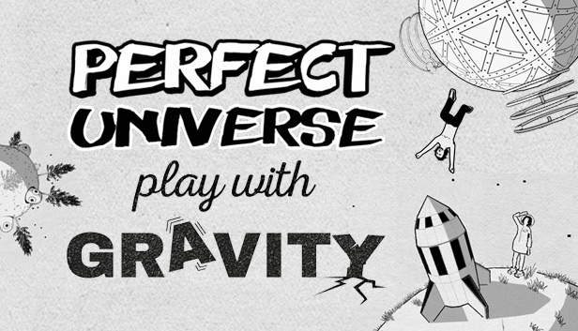
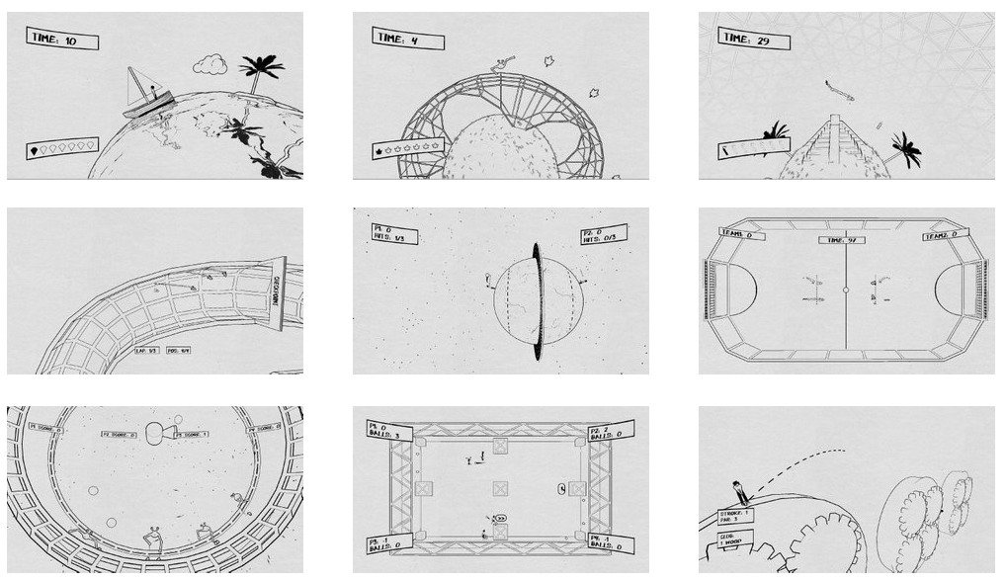
Perfect Universe
Gravity themed game collection
3 single player games
6 local multiplayer games
Novel NPR art style
Published on PC and PS4

Slide 4
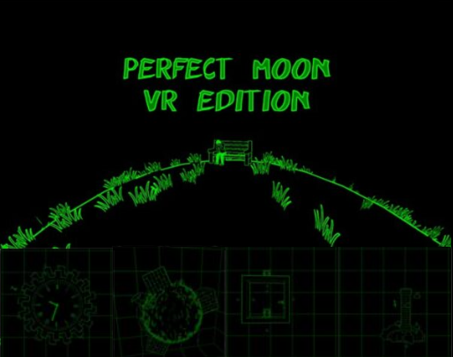
Perfect Moon VR
Early VR game (Gear VR)
Made based on Perfect Universe (2 weeks)
100% free
Strangely made me lots of money!

Slide 5
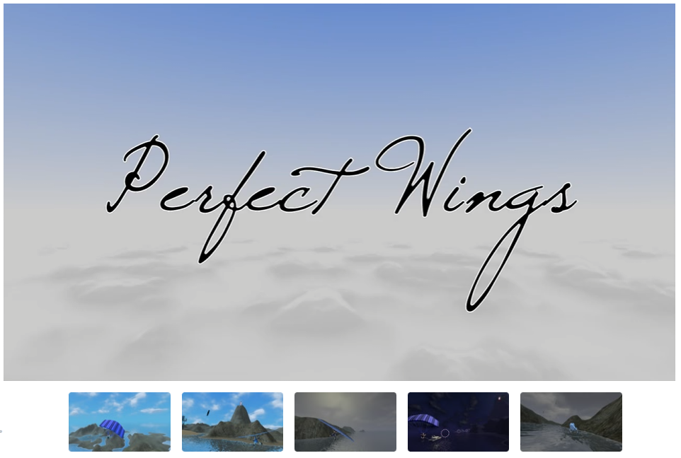
Perfect Wings
Flight sim
Early VR game (Gear VR)
Helicopter, microlight, skydiving, parascending
Did not make me money, lets never speak of it again :)

Slide 6

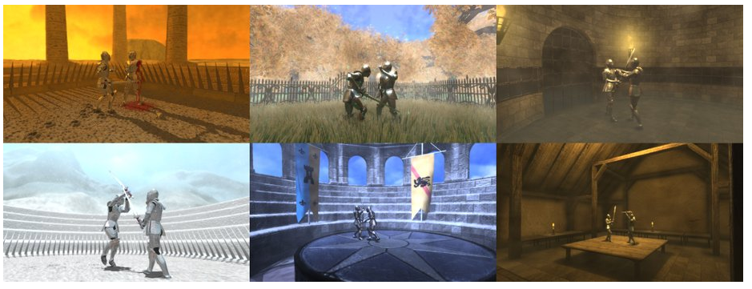
Endless Knight
Single and local multiplayer
Fighting game
You can cut arms and legs off and keep fighting
Very very silly

Slide 7
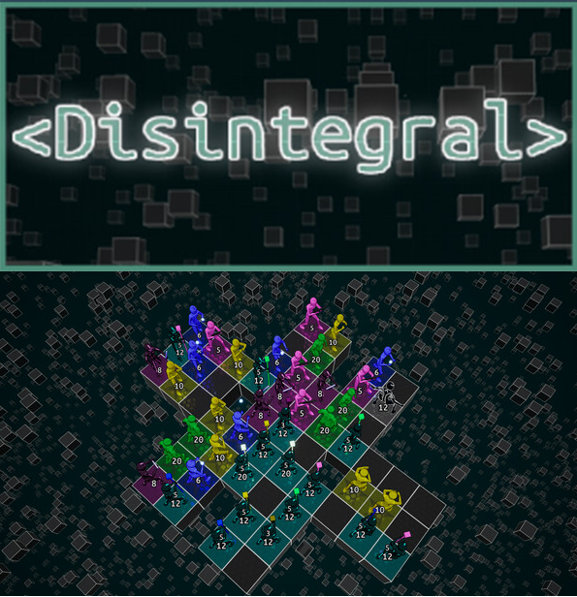
Disintegral
Turn based hand to hand combat game
I didn’t find time to market it (yet) due to teaching
My favourite self published game so far

Slide 8
Animal party
A game we can make in a short time and keep updating!

Slide 9
Audience
We want to make a game with broad appeal
We don’t want to including anything that might offend anyone
We want some characters to give the game identity
ANIMALS!
  Liked, inoffensive, fun, young and old appeal

Slide 10
Games
We need a game with small enough scope that we can make it in a short time
We need the game to be “complete” enough to put on steam
We may want to revisit the project in future years
Party game! (collection of mini games)

Slide 11
The following ideas are NOT final
Lets design these together!

Slide 12
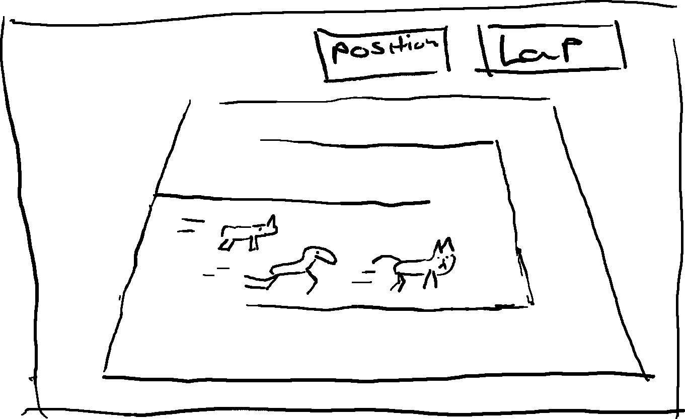
Game 1: Animal race
Single screen
2-4 players
Each player a different animal
Race around track
5? laps
Multiple tracks
Ideas for depth required

Slide 13
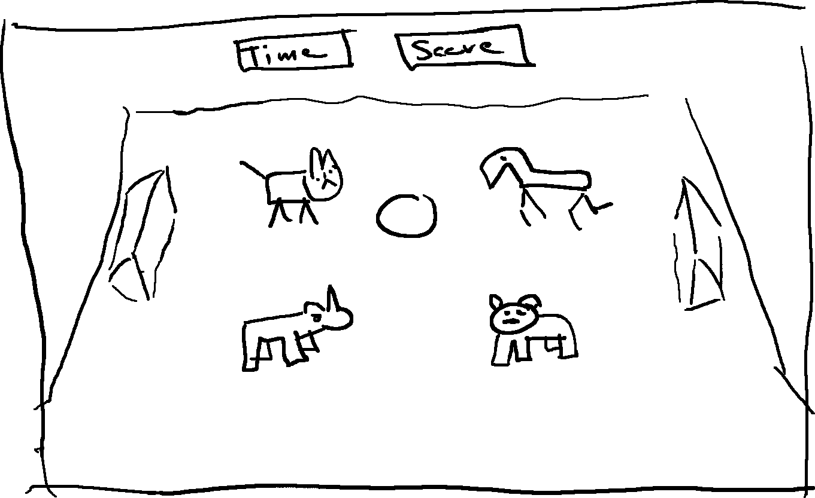
Game 2: Animal ball
2 a side football
Each player controls a different animal
Ball is controlled by running into it (it just bounces away)
Ideas for depth or different pitches?

Slide 14
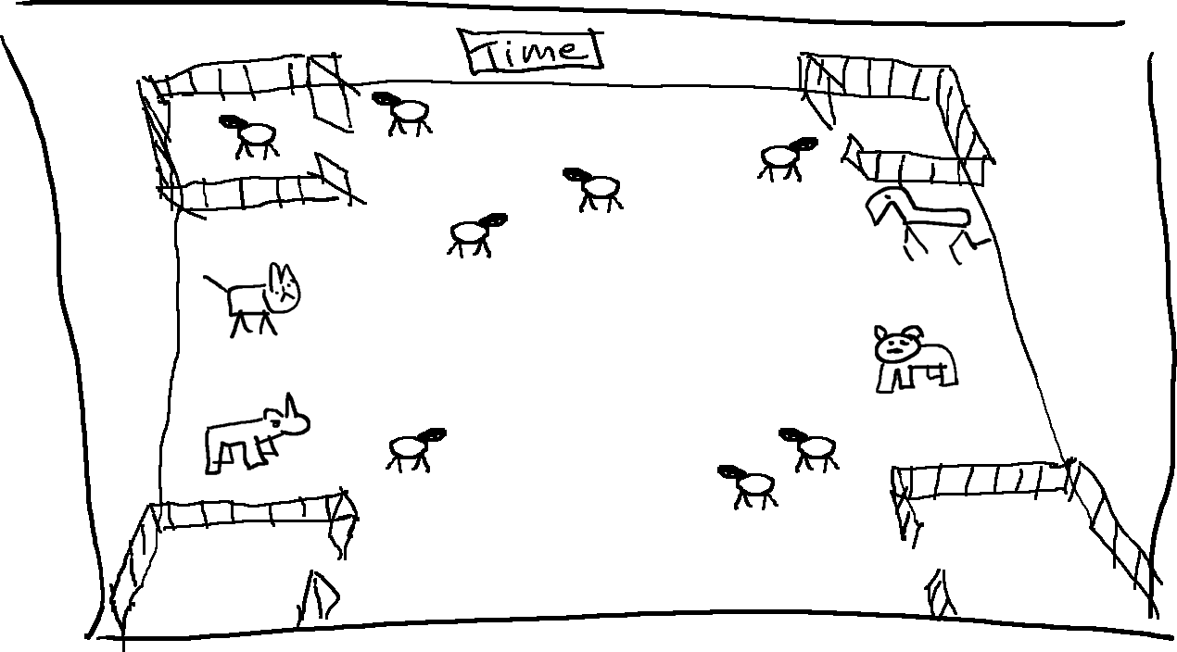
Game 3: herding
The screen is full of sheep which run away from players
4 players (each a different animal)
Try to get sheep into you own pen
Most sheep in pen when time runs out wins

Slide 15
Company structure
Will Sykes games does not often hire more than a single specialist at once.
This process is new and experimental!
I will take the roles of:
  Art director
  Tech director
  Lead designer
  Anything not covered by you (perhaps sound?)

Slide 16
Work plan
We will work in sprints
I will assign each of you tasks to complete in time for the next sprint (we will meet each week like this)
You will work remotely (but are welcome to ask questions via the teams chat)
In total you are expected to do 70 hours
I am expecting to run 4-5 sprints
At the end of our time together I will take what we have and attempt to finish of the project and publish on Steam
If we are not able to create a complete enough product for Steam, that’s ok with me (but it wont be published)
If the project is published, it will be free

Slide 17
Things to do!
Get the prototype code set up on your machine
Play with prototype to get ideas
Design:
  HUD
  Frontend/Menu
  Game flow/UX
    Unlock/progression
  Flesh out existing designs
    more depth, pickups? stamina? Jumps?
  new mini game designs
Level Design
  Prototype more tracks (white box)
Art:
  final art for existing tracks
  more/better animals
  more/better animations
  Character concept sketches
Code:
  Complete prototypes for racing,animal ball, herding
Sound:
  Music, SFX
Promotion!
  Trailer videos
  social media posts

Slide 18
Sprint 1
finalise design for project
Everyone able to get and submit to the Git
Work out what each person is going to work on
Aim to be able to “play” something next week!

