Slide 1
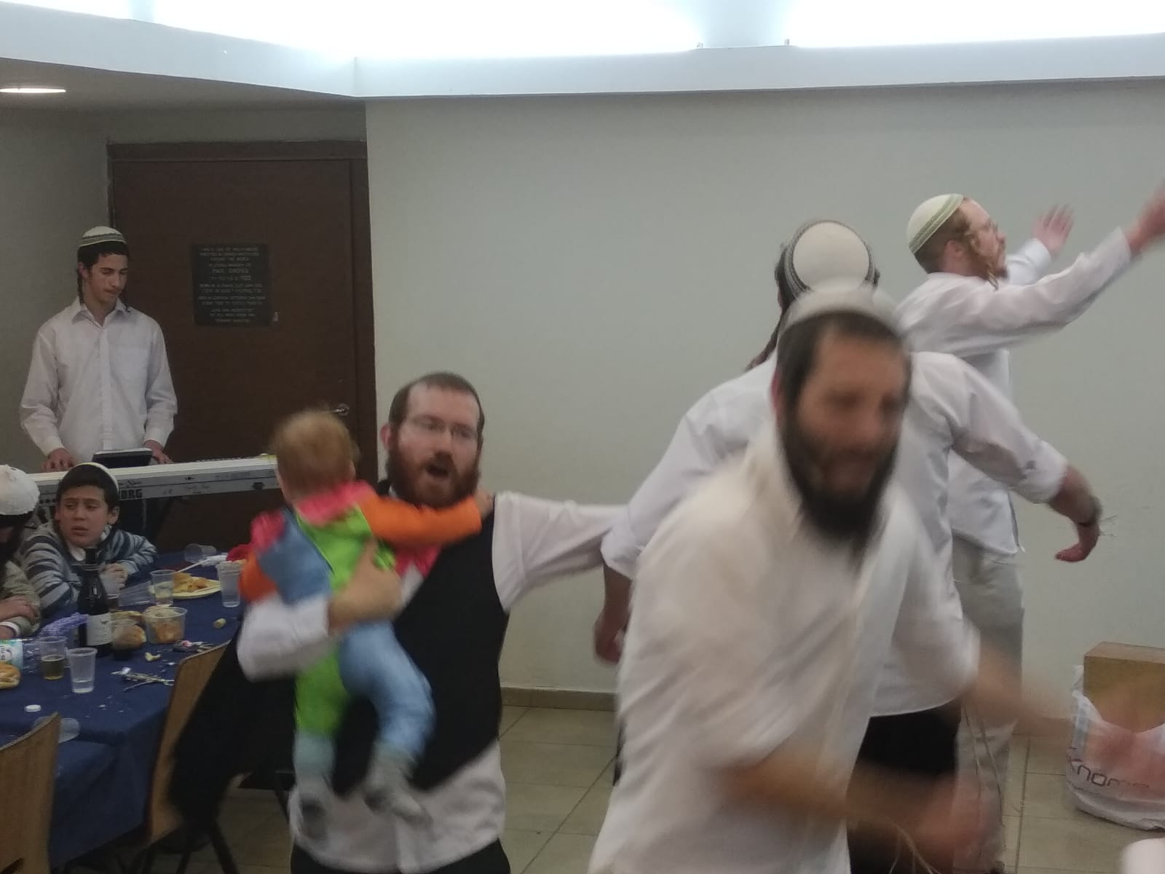
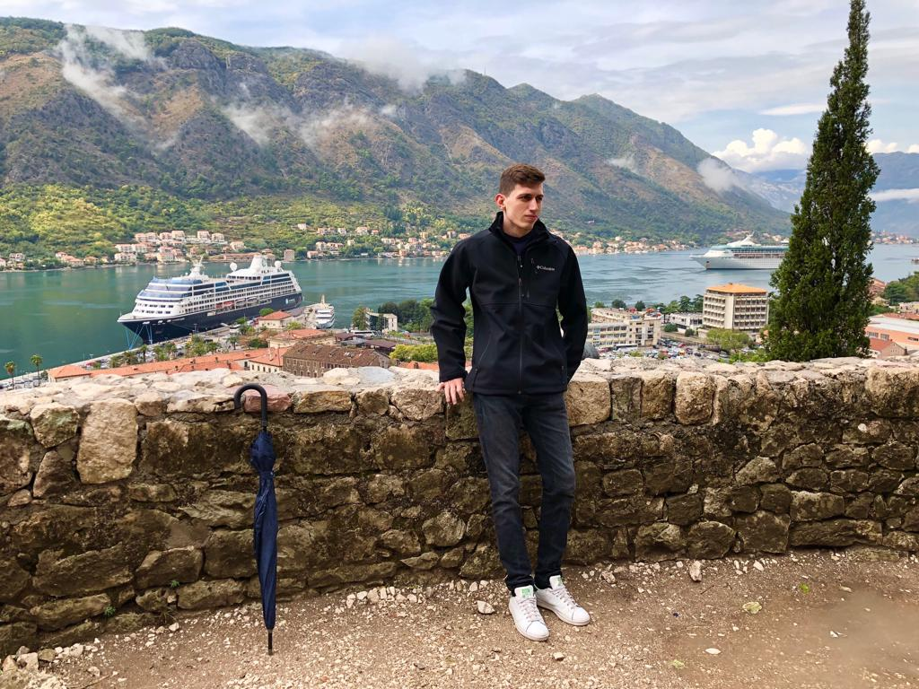
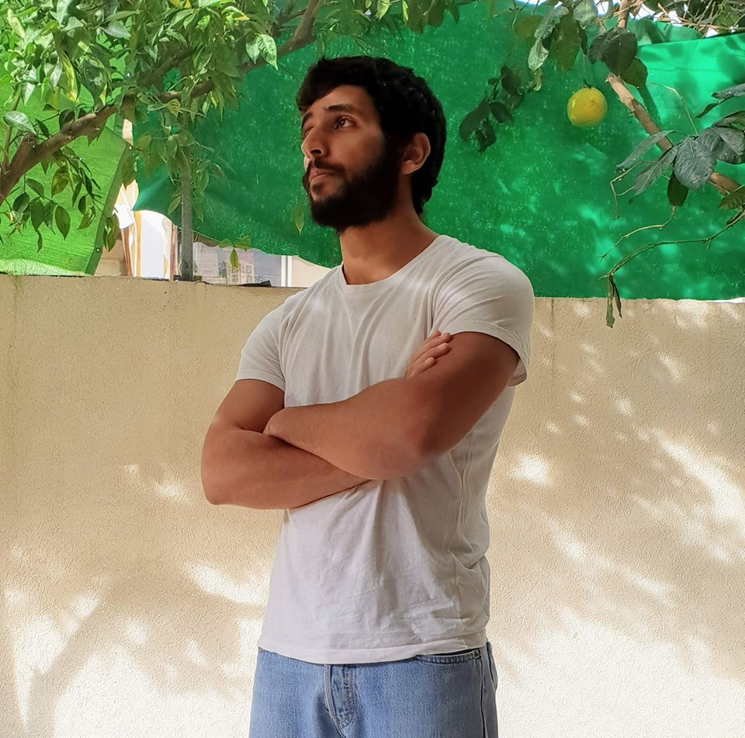


InstaFeedback
Agenda
The community of people who makes their living by posting to Instagram is growing exponentially
So why don’t we help them?
~16B
Posts
~2B
USERS
1.2M
EARNING MONEY
www.InstaFeedback.com
Notes:
© Copyright PresentationGO.com – The free PowerPoint template library
1

Slide 2
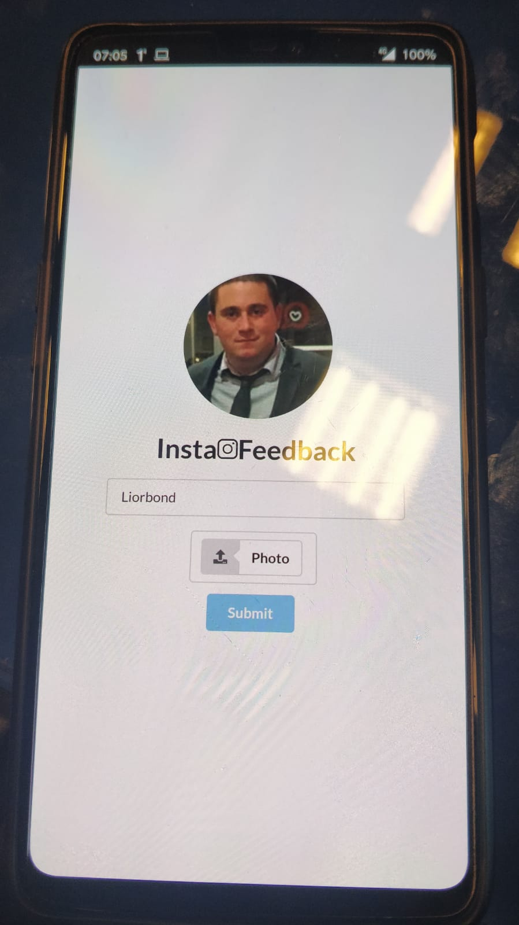
SOME PRACTICES WILL BE NICE
www.InstaFeedback.com
Notes:
© Copyright PresentationGO.com – The free PowerPoint template library
1

