Slide 1
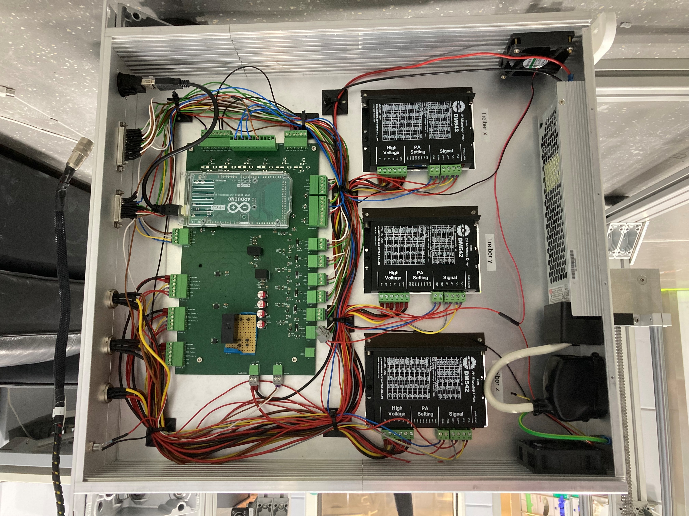
Fan (not used)
Driver for Stepper Motors
Main PCB
LED „Power“
230VAC in
(Fixed error)
Connector Motors XYZ
Power Supply
36V, 350W
Connector Remote Control
Connector Limit Switch
Arduino Mega
USB Connector µC

