Slide 1
Type Hints In Python 3.5+

Slide 2
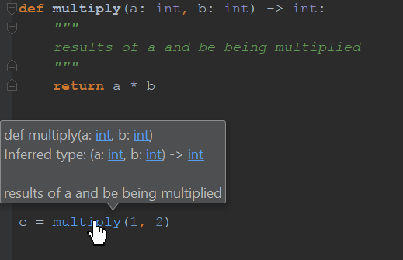
What are type hints?
Hints at the class type for function arguments and variables

Slide 3
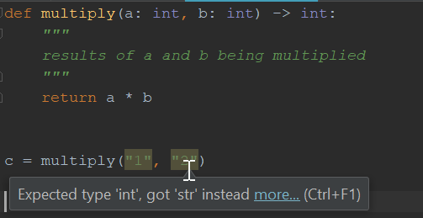
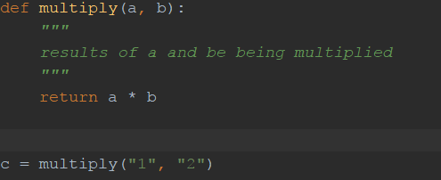
Some Reasons To Use Type Hints
Code Readability
I’m dumb and IDEs let me stay that way

Slide 4
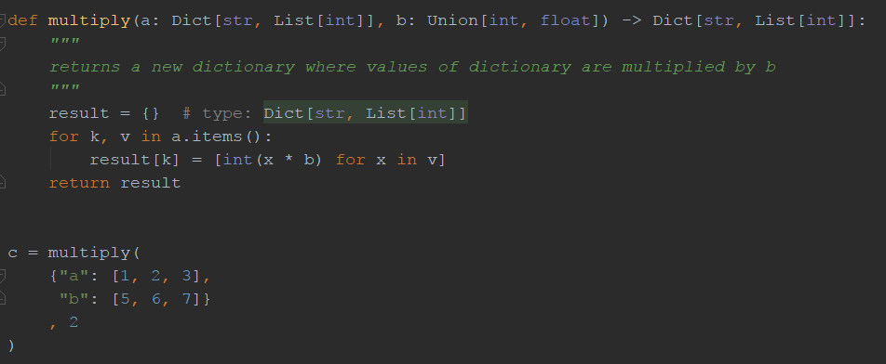
Basic Usage
Unions, Dictionaries, Lists, Oh My!

Slide 5
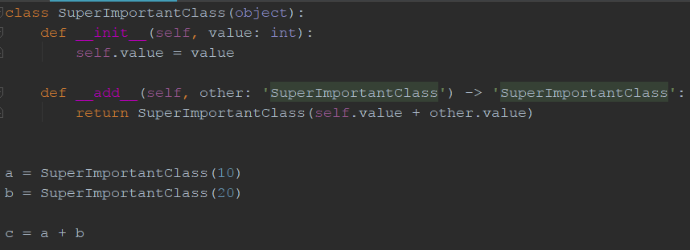
Other Usages
Self-Referential Classes

Slide 6
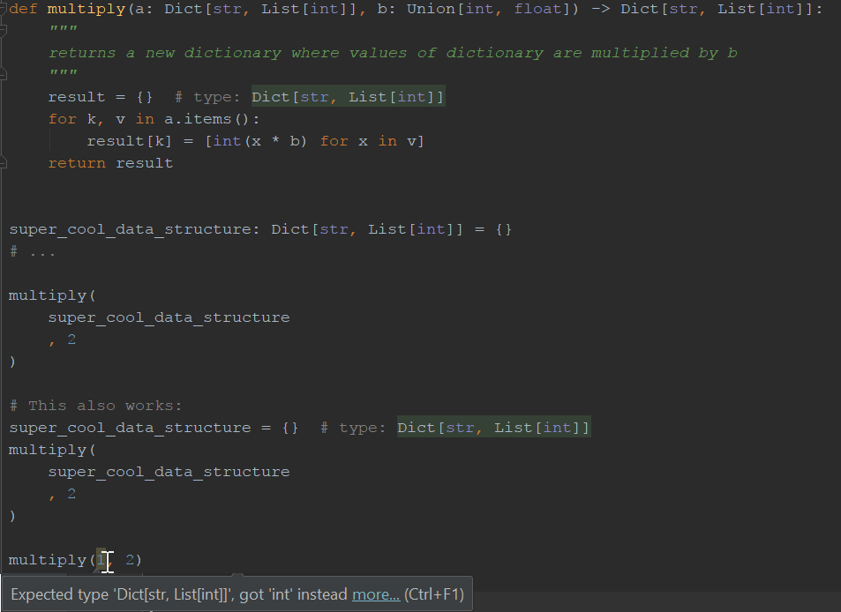
Python 3.6 Additions (PEP 526)

