Slide 1

Containers in WI-HPC
https://apptainer.org/

Slide 2
Introduction
Alex Harral - Linux Systems Administrator for ~7 months
Working under Jeff Fahnoe
Alongside other System Admins and Help Desk
Focus on HPC and Shared File System (Isilon)
Thank you to those for helping test:
Sandra Deliard - Wiggle Tools
Sen Guo - Testing
Priya - VISPR

Slide 3

What is a container?
A container is a standard unit of software that packages up code and all its dependencies, so the application runs quickly and reliably from one computing environment to another.
Also called an image
E.g. Docker

Slide 4
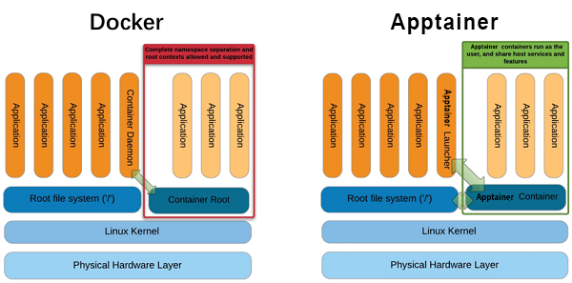
Apptainer vs. Docker
Apptainer specifically designed for HPC systems
Containers are immutable
You are the same user in the container as you are outside

Slide 5
Why Should I Use Apptainer?
Portable and publishable software environments
BYOE (Bring your own environment)
Able to install software without IT
Reproducibility of scientific results - Ease of sharing
Security and ability to verify

Slide 6
Using Apptainer
Used by compute resources (nodes)
Do not run on head nodes, please use interactive or scheduled job
Use the module load apptainer command to use
apptainer --help for a list of all commands

Slide 7
Pulling Images
The pull command is used to download an image in the .sif file format
Pulls the container/image and saves as file
The latest image for ubuntu (ubuntu_latest.sif)
a .sif file is the container
:latest is known as a tag (specified versions)
apptainer pull docker://ubuntu:latest

Slide 8
Pulling Images Cont.
Registries/Libraries
Docker Hub - https://hub.docker.com/
Singularity Cloud Library - https://cloud.sylabs.io/library
Biocontianers - https://biocontainers.pro/
Nvidia NGC - https://catalog.ngc.nvidia.com/
Possibly our own in the future (share among labs)

Slide 9
Interacting with Images
Once an image is “pulled” and the .sif file exists, you can interact with it
Use the shell, run, or exec command
# Shells into container
apptainer shell ubuntu_latest.sif
Apptainer> cat /etc/os-release
# Executes command within container
apptainer exec ubuntu_latest.sif cat /etc/os-release
# Runs default container command (see Definition file %runscript)
apptainer run ubuntu_latest.sif

Slide 10
Building Images
You may ”build” your own images with definition files
This can be used to build upon existing images (Wiggle Tools Example)
apptainer build my_image.sif my_recipe.def

Slide 11
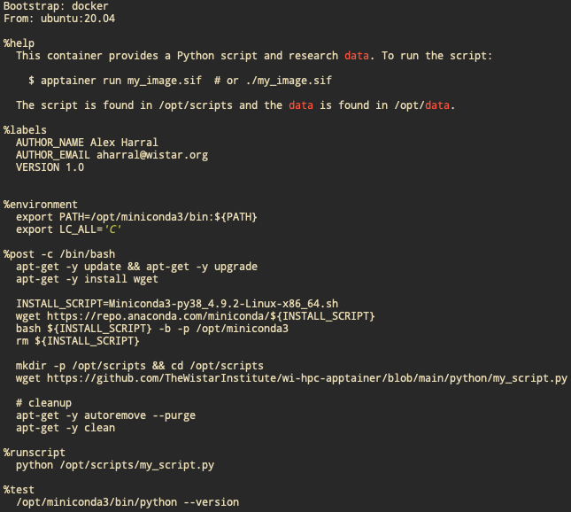
Example Definition File

Slide 12
Publishing Images
Best way to save your container, images, and definition files
Contributing to the scientific community
Can pull your container/image whenever you want
Requires an account on Sylabs Library and/or Docker Hub
Ensure you are signing and verifying containers
***Do not include Wistar IP or sensitive data

Slide 13
Other Notes
Containers are “immutable”
Changes made within the container are NOT saved on close
Updates to containers made in the definition file and rebuilt
Or via overlay
--nv flag to enable GPU support
as well as requesting GPU resources (e.g. --gres=gpu:1)
CUDA driver version must match the host GPU
E.g. tensor flow example

Slide 14
Other Notes Cont.
Your lab share will be available within containers by default. Same path /wistar/<lab share name>
Modules will not be available inside containers (module load)
https://hpc.apps.wistar.org/guide/containers

Slide 15
Best Practices
Do NOT use apptainer commands on the head nodes. Instead, request resources/schedule a job.
Store .sif images in your home folder, not your lab share.
Publish your images for ease of use and to save space in your filesystem.
Refer to the Apptainer documentation for best practices and examples.
Install packages, programs, data, and files into operating system locations (not mounted locations)
If you are still having issues, please email the IT Help Desk at helpdesk@wistar.org

Slide 16
Questions?

Slide 17
Learning Resources
HSF Introduction to Apptainer/Singularity
Apptainer Documentation
Why you should use Apptainer
CIQ - Apptainer: Deep Dive, Use Cases, and Examples
WI-HPC Documentation Website Containers Page
Never Install Locally

