Slide 1
Monad Transformers for the Easily Confused

Slide 2
Github Repo:
https://github.com/TheWizardTower/monadTransformers

Slide 3
My friends have horrible senses of humor.

Slide 4
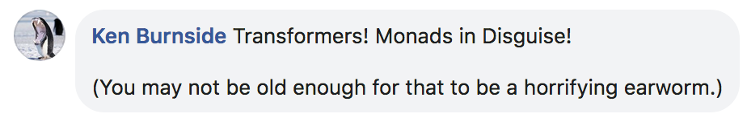

Slide 5
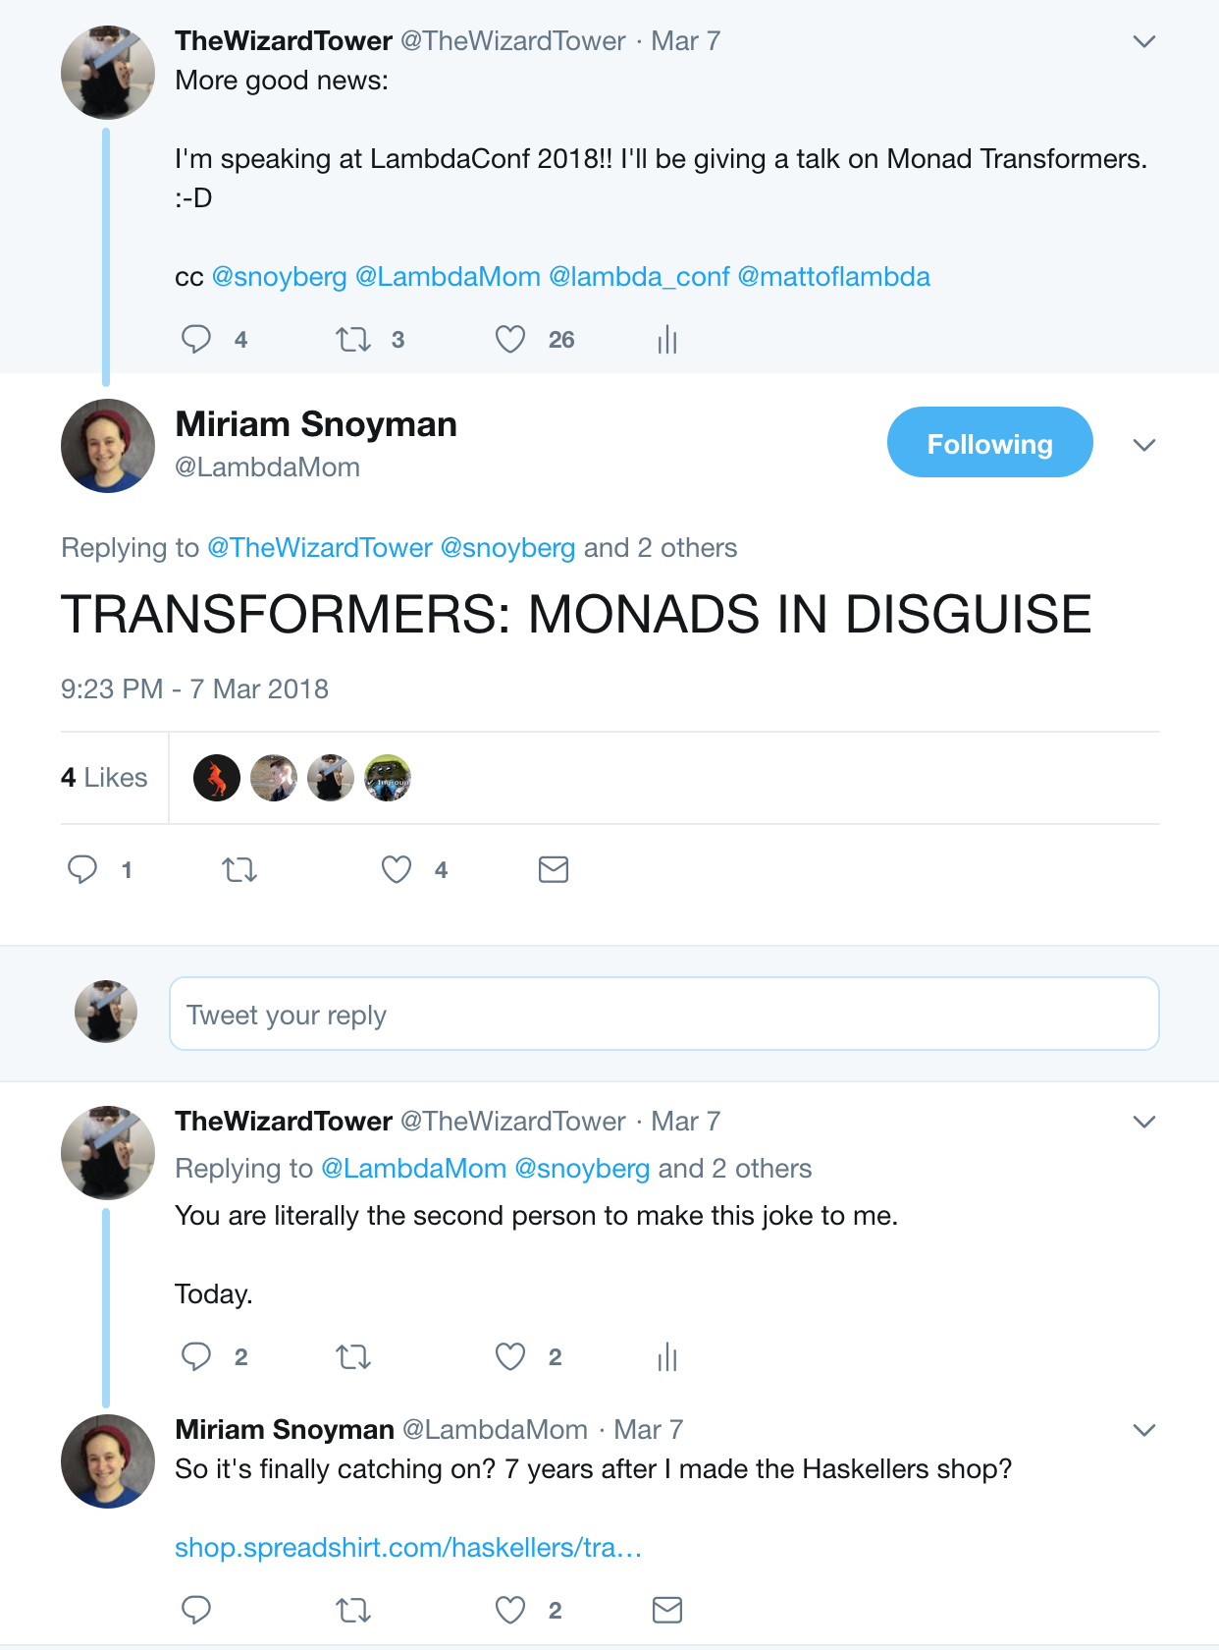

Slide 6
A word to begin
Don’t fret if this talk doesn’t make the lightbulb go off.

Slide 7
A word to begin
Don’t fret if this talk doesn’t make the lightbulb go off.
A lot of this is sitting with the concepts for a while and letting them stew.
It’s a lot like learning Algebra or Calculus for the first time. You have to give yourself time to make the cognitive leaps.

Slide 8
A word to begin
Be patient! Keep trying!

Slide 9
Talk Summary
Monad Transformers Transform Monads
...but how?

Slide 10
Talk Summary
Monad Transformers Transform Monads
We’re going to review Monoid, Functor, Applicative, and Monad laws, then see if we can figure out a way to get to what MTs do for us.

Slide 11
Monoids
"associative, binary operations with an identity."
Source: http://hackage.haskell.org/package/base-4.11.1.0/docs/Data-Monoid.html

Slide 12
Monoids -- Associative
Associative operatons mean that:
(a <op> (b <op> c)) == ((a <op> b) <op> c)

Slide 13
Monoids -- Binary
Binary operations are operations that take two values, and produce a result.

Slide 14
Monoids -- Binary
Binary operations are operations that take two values, and produce a result.
To illustrate, exponentiation and absolute value are examples of unary operations.

Slide 15
Monoids -- Binary
Binary operations are operations that take two values, and produce a result.
To illustrate, exponentiation and absolute value are examples of unary operations.
Binary operations include addition, subtraction, multiplication, division, list concatenation, and more.

Slide 16
Monoid -- With Identity
Monoidal operations must have an identity value, such that
a <op> id == a == id <op> a

Slide 17
Monoid -- With Identity
Monoidal operations must have an identity value, such that
a <op> id == a == id <op> a
Examples include 0 for addition, or the empty list for list concatenation.

Slide 18
Functors
Functors obey two laws

Slide 19
Functors
Functors obey two laws
fmap id = id

Slide 20
Functors
Functors obey two laws
fmap id = id
fmap g . fmap h == fmap (g . h)

Slide 21
Applicative

Slide 22
Applicative
pure id <*> v = v -- Identity
pure f <*> pure x = pure (f x) -- Homomorphism
u <*> pure y = pure ($ y) <*> u -- Interchange
pure (.) <*> u <*> v <*> w = u <*> (v <*> w) -- Composition
(source: https://en.wikibooks.org/wiki/Haskell/Applicative_functors )

Slide 23
Applicative
Obviously, there’s a lot going on, so let’s unpack these one by one.

Slide 24
Applicative -- Identity
pure id <*> v = v -- Identity
Much like the first functor law, this asserts that pure id does not distort the function in any way.
“Is your applicative instance doing sneaky things, Y/N?”

Slide 25
Applicative -- Homomorphism
pure f <*> pure x = pure (f x) -- Homomorphism

Slide 26
Applicative -- Homomorphism
pure f <*> pure x = pure (f x) -- Homomorphism
Remember the second functor law?

Slide 27
Applicative -- Homomorphism
pure f <*> pure x = pure (f x) -- Homomorphism
Remember the second functor law?
fmap g . fmap h = fmap (g . h)

Slide 28
Applicative -- Interchange
u <*> pure y = pure ($ y) <*> u -- Interchange

Slide 29
Applicative -- Interchange
u <*> pure y = pure ($ y) <*> u -- Interchange
This becomes clearer with a concrete example.

Slide 30
Applicative -- Interchange
*Main> pure ($ 5) <*> Just (+10)
Just 15
*Main> Just (+10) <*> pure 5
Just 15
*Main> (pure ($ 5) <*> Just (+10)) == (Just (+10) <*> pure 5)
True

Slide 31
Applicative -- Interchange
(source: https://stackoverflow.com/questions/27285918/applicatives-interchange-law )

Slide 32
Applicative -- Interchange
Referencing the typeclassopedia, we find:
"Intuitively, this says that when evaluating the application of an effectful function to a pure argument, the order in which we evaluate the function and its argument doesn't matter."
(source: https://wiki.haskell.org/Typeclassopedia#Laws_2 )

Slide 33
Bonus Round!
u <*> pure y = pure ($ y) <*> u -- Interchange
Why ($ 5) ?

Slide 34
Bonus Round!
u <*> pure y = pure ($ y) <*> u -- Interchange
Why ($ 5) ?
Let’s ask GHCi

Slide 35
Bonus Round!
*Main> :t ($ 5)
($ 5) :: Num a => (a -> b) -> b
*Main>

Slide 36
Bonus Round!
We can rewrite
($ 5)
Even GHC agrees!
Into:
(\f -> f 5)

Slide 37
Bonus Round!
*Main> :t (\f -> f 5)
(\f -> f 5) :: Num t1 => (t1 -> t2) -> t2
*Main>

Slide 38
Bonus Round!
*Main> :t (\f -> f 5)
(\f -> f 5) :: Num t1 => (t1 -> t2) -> t2
*Main>
*Main> :t ($ 5)
($ 5) :: Num a => (a -> b) -> b
*Main>

Slide 39
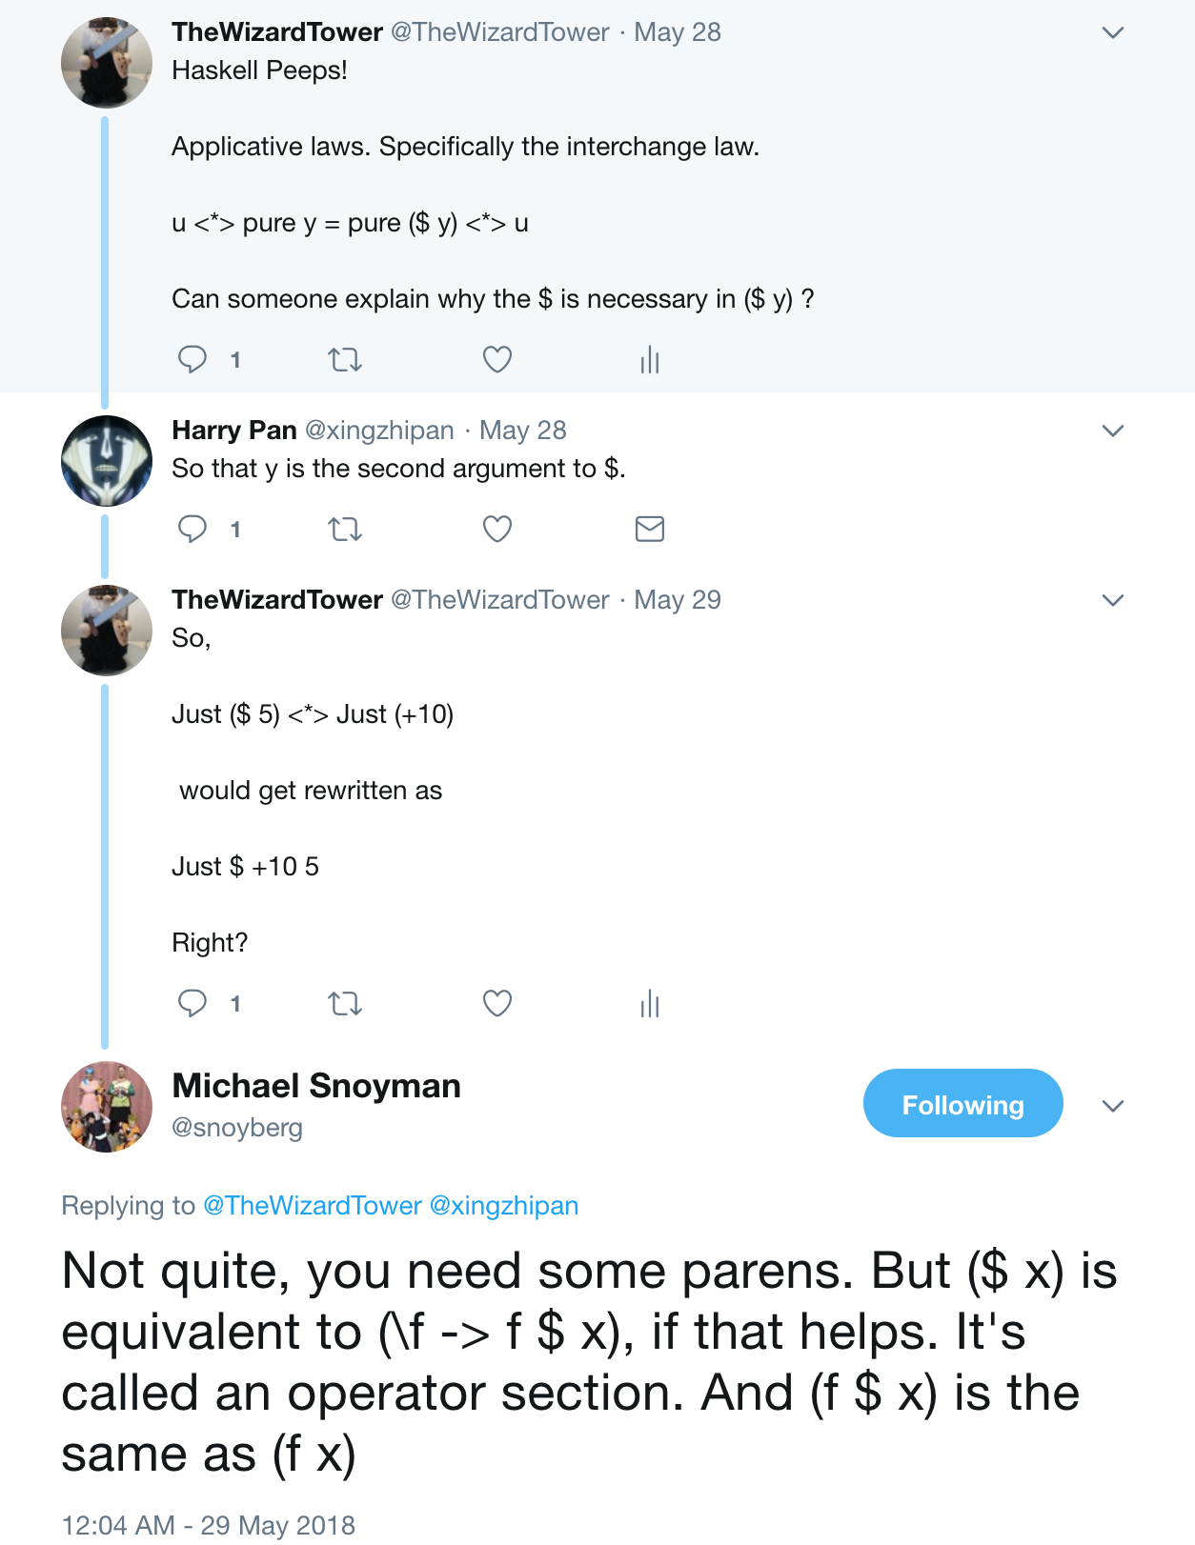
Bonus Round!

Slide 40
Applicative -- Composition
pure (.) <*> u <*> v <*> w = u <*> (v <*> w) -- Composition

Slide 41
Applicative -- Composition
pure (.) <*> u <*> v <*> w = u <*> (v <*> w) -- Composition
Again, concrete examples will make this clearer

Slide 42
Applicative -- Composition
*Main> pure (.) <*> Just (+10) <*> Just (+20) <*> Just 30
Just 60
*Main> Just (+10) <*> (Just (+20) <*> Just 30)
Just 60
*Main> (pure (.) <*> Just (+10) <*> Just (+20) <*> Just 30) == (Just (+10) <*> (Just (+20) <*> Just 30))
True

Slide 43
Applicative -- Composition
Let’s walk through that again.

Slide 44
Applicative -- Composition
(pure (.) <*> Just (+10) <*> Just (+20)
becomes
Just (+20 . +10)

Slide 45
Applicative -- Composition
Just (+20 . +10)
Adding back the <*> Just 30 :
Just (+20 . +10) <*> Just 30

Slide 46
Applicative -- Composition
Just (+20 . +10) <*> Just 30
is simplified down to
Just 60

Slide 47
Monad

Slide 48
Monad
Must be burritos
Must be delicious
Can swap out burrito type with monadic burrito actions

Slide 49
Monad
(okay, okay)

Slide 50
Monad
return a >>= k = k a -- left identity
m >>= return = m -- right identity
m >>= (\x -> k x >>= h) = (m >>= k) >>= h -- associativity

Slide 51
Monad -- Left Identity
return a >>= k = k a
*Main> return 5 >>= (\x -> Just (x + 5))
Just 10
*Main>

Slide 52
Monad -- Right Identity
m >>= return = m
*Main> Just 5 >>= return
Just 5
*Main>

Slide 53
Monad -- Associativity
m >>= (\x -> k x >>= h) = (m >>= k) >>= h

Slide 54
Monad -- Associativity
*Main> let f = (\x -> Just (5 - x))
*Main> return 5 >>= f
Just 0
*Main> return (-5) >>= f
Just 10

Slide 55
Monad -- Associativity
*Main> let g = (\x -> Just (10 - x))
*Main> return 5 >>= f >>= g
Just 10
*Main> return 5 >>= g >>= f
Just 0

Slide 56
Monad -- Associativity
*Main> Just 5 >>= (\x -> f x >>= g)
Just 10
*Main> (Just 5 >>= f) >>= g
Just 10
*Main>

Slide 57
Monad -- Remix
return >=> m = m -- left identity
m >=> return = m -- right identity
(f >=> g) >=> h = f >=> (g >=> h) -- associativity

Slide 58
Monad -- Remix
return >=> m = m -- left identity
m >=> return = m -- right identity
(f >=> g) >=> h = f >=> (g >=> h) -- associativity
(source: https://wiki.haskell.org/Monad_laws )

Slide 59
A Closer Look at >>=
Courtesy of Category Theory, we know that >>= can be expressed as
m >>= k = join $ fmap k m

Slide 60
A Closer Look at >>=
*Main> :t (>>=)
(>>=) :: Monad m => m a -> (a -> m b) -> m b

Slide 61
A Closer Look at >>=
(>>=) :: Monad m =>
m a
-> (a -> m b)
-> m b

Slide 62
A Closer Look at >>=
(>>=) :: Monad m =>
m a
-> (a -> m b)
-> m b
*Main> :t fmap
fmap :: Functor f =>
(a -> b)
-> f a
-> f b

Slide 63
A Closer Look at >>=
Remember that m >>= k = join $ fmap k m
*Main> fmap (\a -> Just (a + 10)) (Just (10))
Just (Just 20)

Slide 64
A Closer Look at >>=
*Main> join $ fmap (\a -> Just (a + 10)) (Just (10))
Just 20
*Main> (flip (>>=)) (\a -> Just (a + 10)) (Just (10))
Just 20

Slide 65
A Closer Look at >>=
*Main> join $ fmap (\a -> Just (a + 10)) (Just (10))
Just 20
*Main> (=<<) (\a -> Just (a + 10)) (Just (10))
Just 20

Slide 66
A Closer Look at >>=
*Main> :t join
join :: Monad m => m (m a) -> m a

Slide 67
A Closer Look at >>=
*Main> :t join
join :: Monad m => m (m a) -> m a
There’s an important note here: The monadic contexts you’re joining have to match!

Slide 68
A Closer Look at >>=
*Main> join $ Just $ Just 10
Just 10
*Main> join $ Just Nothing
Nothing
*Main> join $ Just $ Just Nothing
Just Nothing

Slide 69
A Closer Look at >>=
*Main Control.Monad> join [[1],[2],[3]]
[1,2,3]
*Main Control.Monad> join [[[1,2,3],[4,5,6],[7,8,9]]]
[[1,2,3],[4,5,6],[7,8,9]]

Slide 70
*Main> join [Just 10, Just 15, Just 20]
<interactive>:92:7: error:
• Couldn't match expected type ‘[a]’
with actual type ‘Maybe Integer’
• In the expression: Just 10
In the first argument of ‘join’, namely
‘[Just 10, Just 15, Just 20]’
In the expression: join [Just 10, Just 15, Just 20]
• Relevant bindings include it :: [a] (bound at <interactive>:92:1)

Slide 71
Let’s make >>= for IdentityT!

Slide 72
Let’s make >>= for IdentityT!
First step, define our arguments.

Slide 73
Let’s make >>= for IdentityT!
(\a ->
IdentityT (Just (a + 10))

Slide 74
Let’s make >>= for IdentityT!
(\a ->
IdentityT (Just (a + 10))
IdentityT (Just 10)

Slide 75
Let’s make >>= for IdentityT!
*Main> fmap (\a -> IdentityT (Just (a + 10))) (IdentityT (Just 10))
IdentityT (Just (IdentityT (Just 20)))

Slide 76
Let’s make >>= for IdentityT!
IdentityT (Just (IdentityT (Just 20)))
join can’t reduce any part of this -- none of the adjacent monads match.

Slide 77
Let’s make >>= for IdentityT!
IdentityT (Just (IdentityT (Just 20)))
join can’t reduce any part of this -- none of the adjacent monads match.
There is a function that can help, though.

Slide 78
Let’s make >>= for IdentityT!
*Main> :t runIdentityT
runIdentityT :: IdentityT f a -> f a

Slide 79
Let’s make >>= for IdentityT!
*Main> fmap (\a -> IdentityT (Just (a + 10))) (IdentityT (Just 10))
IdentityT (Just (IdentityT (Just 20)))

Slide 80
Let’s make >>= for IdentityT!
*Main> fmap (runIdentityT . (\a -> IdentityT (Just (a + 10)))) (IdentityT (Just 10))
IdentityT (Just (Just 20))

Slide 81
Let’s make >>= for IdentityT!
*Main> fmap (runIdentityT . (\a -> IdentityT (Just (a + 10)))) (IdentityT (Just 10))
IdentityT (Just (Just 20))
Progress! Still not correct, but progress all the same!

Slide 82
Let’s make >>= for IdentityT!
*Main> runIdentityT $ fmap (runIdentityT . (\a -> IdentityT (Just (a + 10)))) (IdentityT (Just 10))
(Just (Just 20))

Slide 83
Let’s make >>= for IdentityT!
*Main> join $ runIdentityT $ fmap (runIdentityT . (\a -> IdentityT (Just (a + 10)))) (IdentityT (Just 10))
Just 20

Slide 84
Let’s make >>= for IdentityT!
*Main> IdentityT $ join $ runIdentityT $ fmap (runIdentityT . (\a -> IdentityT (Just (a + 10)))) (IdentityT (Just 10))
IdentityT Just 20

Slide 85
Let’s make >>= for IdentityT!
*Main> IdentityT $ join $ runIdentityT $ fmap (runIdentityT . (\a -> IdentityT (Just (a + 10)))) (IdentityT (Just 10))
IdentityT Just 20
We did it!

Slide 86
Let’s make >>= for IdentityT!
However, we did it the really really ugly way.

Slide 87
Let’s make >>= for IdentityT!
iTBind :: Monad f =>
IdentityT f a
-> (a -> IdentityT f b)
-> IdentityT f b
iTBind (IdentityT fa) ab = IdentityT $ join $ fmap (runIdentityT . ab) fa

Slide 88
Let’s make >>= for IdentityT!
We can also look at the monad instance for IdentityT in the transformers library!

Slide 89
instance (Monad m) => Monad (IdentityT m) where
#if !(MIN_VERSION_base(4,8,0))
return = IdentityT . return
{-# INLINE return #-}
#endif
m >>= k = IdentityT $ runIdentityT . k =<< runIdentityT m
{-# INLINE (>>=) #-}
fail msg = IdentityT $ fail msg
{-# INLINE fail #-}

Slide 90
Let’s make >>= for IdentityT!
m >>= k = IdentityT $ runIdentityT . k =<< runIdentityT m

Slide 91
Let’s make >>= for IdentityT!
Reminder: *Main> :t (>>=)
(>>=) :: Monad m => m a -> (a -> m b) -> m b

Slide 92
Let’s make >>= for IdentityT!
Reminder V2: We’ve seen =<< before! *Main> :t (=<<)
(=<<) :: Monad m => (a -> m b) -> m a -> m b
*Main> :t (flip (>>=))
(flip (>>=)) :: Monad m => (a -> m b) -> m a -> m b

Slide 93
Let’s make >>= for IdentityT!
(>>=) :: Monad m =>
m a
-> (a -> m b)
-> m b
runIdentityT . k

Slide 94
Let’s make >>= for IdentityT!
(>>=) :: Monad m =>
m a
-> (a -> m b)
-> m b
runIdentityT . k :: (a -> m b)

Slide 95
Let’s make >>= for IdentityT!
(>>=) :: Monad m =>
m a
-> (a -> m b)
-> m b
runIdentityT . k :: (a -> m b)
runIdentityT m

Slide 96
Let’s make >>= for IdentityT!
(>>=) :: Monad m =>
m a
-> (a -> m b)
-> m b
runIdentityT . k :: (a -> m b)
=<<
runIdentityT m :: m a

Slide 97
Let’s make >>= for IdentityT!
(>>=) :: Monad m =>
m a
-> (a -> m b)
-> m b
runIdentityT . k :: (a -> m b)
=<<
runIdentityT m :: m a
:: m b

Slide 98
Let’s make >>= for IdentityT!
(>>=) :: Monad m =>
m a
-> (a -> m b)
-> m b
IdentityT $
runIdentityT . k :: (a -> m b)
=<<
runIdentityT m :: m a
:: IdentityT m b

Slide 99
That’s great, but how do we use it?

Slide 100
That’s great, but how do we use it?
Glad you asked. Let’s build a basic MaybeT computation.

Slide 101
That’s great, but how do we use it?
myPrompt :: String
-> IO String
myPrompt prompt = do
putStr prompt
result <- getLine
return result

Slide 102
That’s great, but how do we use it?
getName :: MaybeT IO String
getName = do
input <- myPrompt "Name? "
if input == ""
then MaybeT $ return Nothing
else MaybeT $ return $ Just $ "Name: " ++ input ++ "\n"

Slide 103
This Does Not Typecheck!
getName :: MaybeT IO String
getName = do
input <- myPrompt "Name? "
if input == ""
then MaybeT $ return Nothing
else MaybeT $ return $ Just $ "Name: " ++ input ++ "\n"

Slide 104
Let’s imagine the function we want.
We want a function that has this type signature:
IO String -> MaybeT IO String

Slide 105
Let’s imagine the function we want.
IO String -> MaybeT IO String

Slide 106
Let’s imagine the function we want.
IO a -> MaybeT IO a

Slide 107
Let’s imagine the function we want.
Monad m => m a -> MaybeT m a

Slide 108
Let’s imagine the function we want.
(Monad m, Control.Monad.Trans.Class.MonadTrans t) =>
m a
-> t m a

Slide 109
SURPRISE! This is called lift
(Monad m, Control.Monad.Trans.Class.MonadTrans t) =>
m a
-> t m a

Slide 110
SURPRISE! This is called lift
*Main> :t lift
lift
:: (Monad m, Control.Monad.Trans.Class.MonadTrans t) =>
m a -> t m a

Slide 111
This typechecks now!
getName :: MaybeT IO String
getName = do
input <- lift $ myPrompt "Name? "
if input == ""
then MaybeT $ return Nothing
else MaybeT $ return $ Just $ "Name: " ++ input ++ "\n"

Slide 112
Let’s make a few more.
getNumber :: String -> MaybeT IO String
getNumber str = do
input <- lift $ myPrompt "Phone number? "
if (length input) /= 7
then MaybeT $ return Nothing
else MaybeT $ return $ Just $ str ++ "Phone Number: " ++ input ++ "\n"

Slide 113
Let’s make a few more.
getStreetName :: String -> MaybeT IO String
getStreetName str = do
input <- lift $ myPrompt "Street Name? "
if input == ""
then MaybeT $ return Nothing
else MaybeT $ return $ Just $ str ++ "Street Name: " ++ input ++ "\n"

Slide 114
Let’s make a few more.
compositionMethod :: MaybeT IO (String)
compositionMethod = getName >>=
getNumber >>=
getStreetName

Slide 115
(Just to prove you can still do this with do-notation)
compAlt :: MaybeT IO (String)
compAlt = do
a <- getName
b <- getNumber a
c <- getStreetName b
return c

Slide 116
That’s great, but how do you run it? It’s not an IO action, it’s a MaybeT IO action.
You use runMaybeT!

Slide 117
allTogetherNow :: IO ()
allTogetherNow = do
result <- runMaybeT compositionMethod
case result of
Just str -> putStrLn str
Nothing -> putStrLn "Failure!"

