Slide 1


Thèse – S13
Christian Wilkinson

Slide 2
TABLE OF CONTENTS
01
02
Summary of objectives
Current work and progress
03
Further work, conclusion, discussion

Slide 3
01
Summary of objectives

Slide 4
Summary of objectives
Developing evolution model with Exoris/Exorem

Slide 5
02
Current work and progress

Slide 6
Current work and progress
Combining EXO-REM/EXORIS results for planate evolution model
Building data sheets from exoris for evolution model (testing rocky and fereous cores)

Slide 7
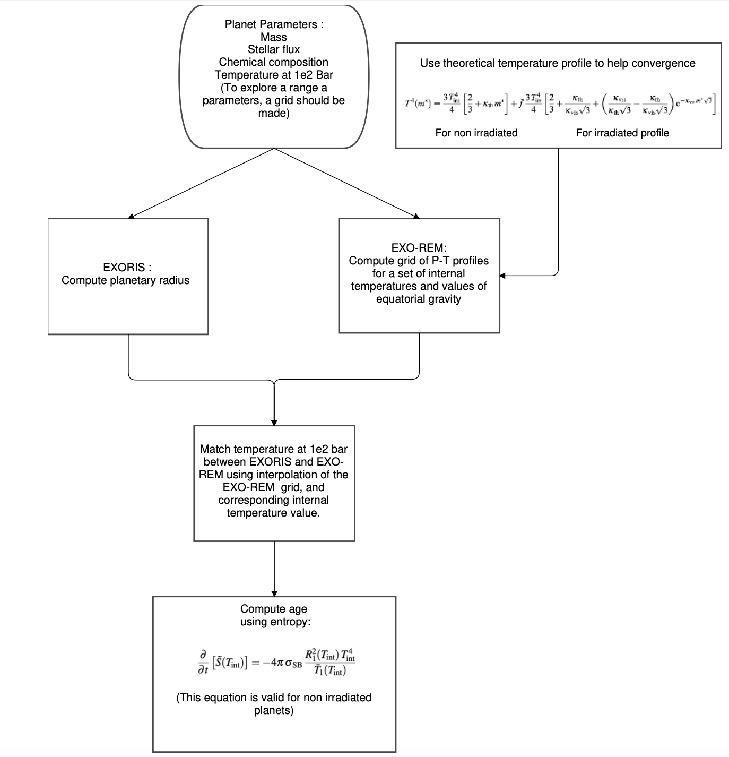

Slide 8
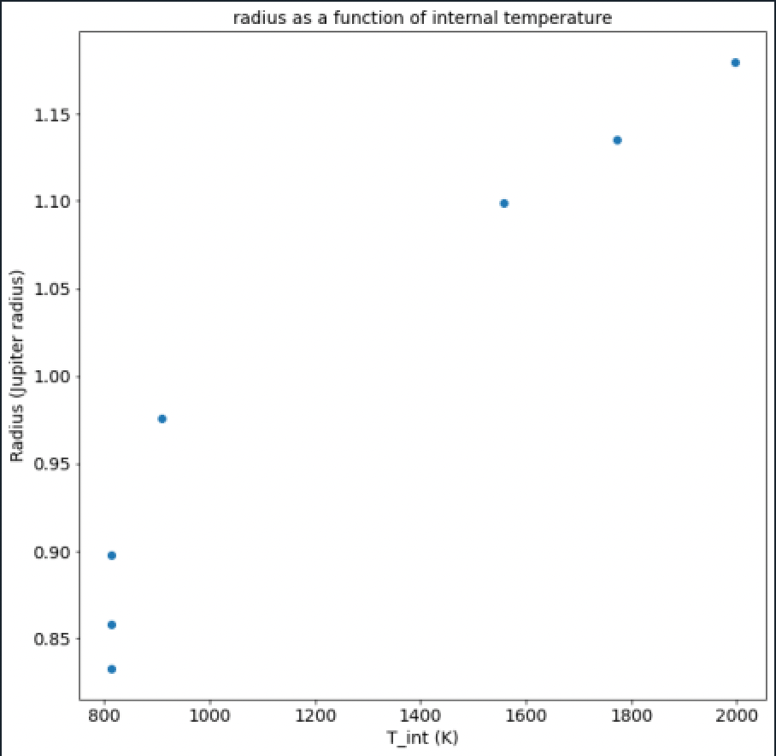
Exorem/Exoris
Problem as lack of data for cooler temperatures

Slide 9
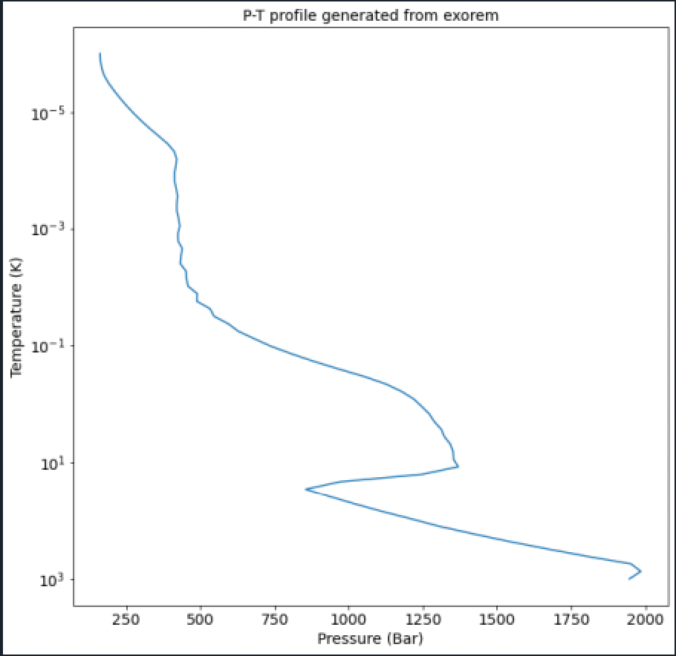
Exorem
Convergence problems

Slide 10
03
Further work, conclusion, discussion

Slide 11
Further work, conclusion, discussion
Finishing temperature evolution of non irradiated planets
Exploring temperature evolution for different kinds of planets (chemical composition, irradiated)

