Slide 1


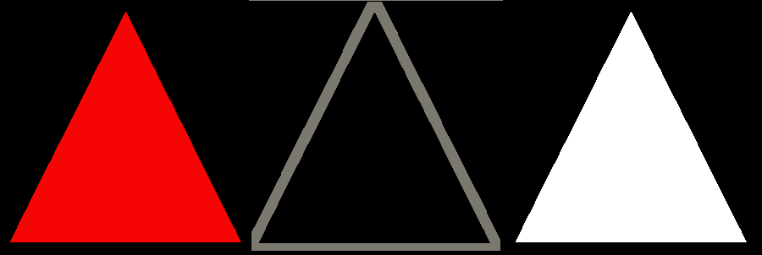





Your Objective
You are trying to build “pyramids” out of combinations of three shapes.
A pyramid has three attributes:
1.Color:
2.Distortion:
warped
red
black
white
3. Mass:
wavy
vanilla
flat
bulky
hollow
All the groups on this page are “pyramids”.

Slide 2

Rules for Combinations
Three shapes make a pyramid...
BUT
for each attribute they must be
all the same or all different.
In other words, you can never say,
“Exactly two are red.”
(or hollow, or warped, for example)
This combination is not a pyramid
Touch < to see examples of good combinations.

Slide 3
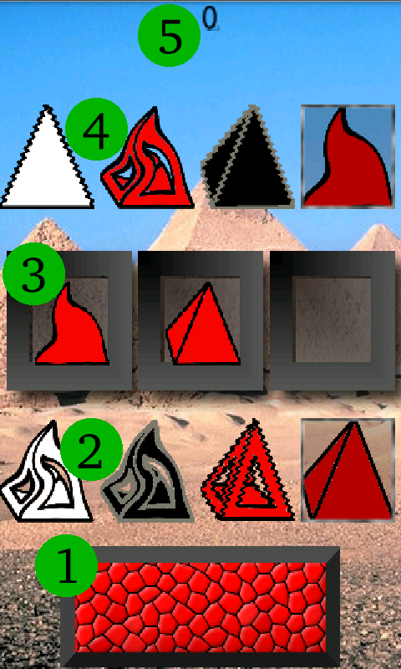
Game Play
Touch the button ⁽¹⁾ when you see a good combination.
Touch shapes on your palette ⁽²⁾ or in the pool ⁽⁴⁾.
Score ⁽⁵⁾ 1 point for a good combo...
-1 point for a miss.
Notes:
The pool changes.
There is no “undo”
High scores win new wallpaper!

Slide 4
About
TYZ's Pyramid was developed by Daniel Kahn. Visit my web site at
tyz.com.
The set theory rule for a “good” combination was first encountered in the awesome card game, SET® by SET Enterprises. If you like Pyramid you will probably like the Official SET® game available from Pockent LLC. on the Android Market.
Pyramid was designed using the 2d game framework introduced in Mario Zuchner's excellent book Beginning Android Games.

