Slide 1
Bacchus Winery
By: Anthony Wright Jr.

Slide 2
Hello, I am Anthony Wright Jr. from Stockton Ca. I am a father of two and I enjoy programming and sciences. I have quite the extensive knowledge in front-end languages and libraries, but this was one of the few database projects. I was not able to work in a group, so I have created this presentation to the best of my abilities!
Anthony Wright Jr.
Introduction

Slide 3
Bacchus Winery
Stan and Davis Bacchus inherited their winery from their father, George, three years ago upon his retirement.
Bacchus Winery grows the grapes needed to make a Merlot, a Cabernet, a Chablis, and a Chardonnay. They have been receiving their supplies; bottles and corks from one supplier, labels and boxes from another, and vats and tubing from a third supplier.
Stan and Davis Bacchus need a way to see and store information to determine the state of the inventory, its distribution and its employees. They would like to incorporate new business methods to help them improve their products and customer service.

Slide 4
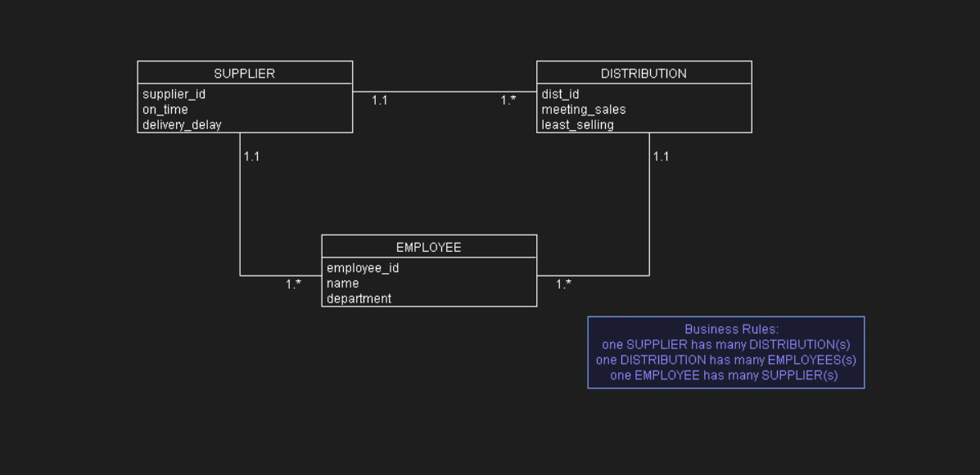
ORD

Slide 5
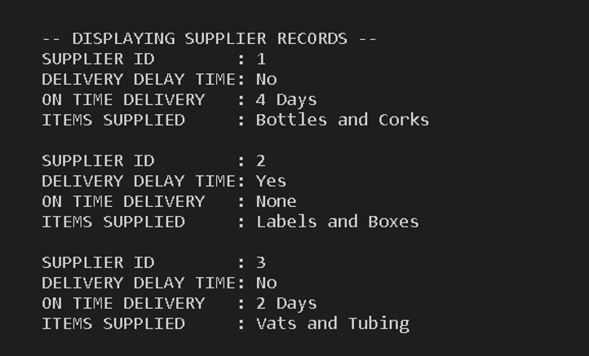
Report for Suppliers
Bacchus Winery is just like any other business who needs to keep track of a reliable and on-time supply.
With this report, Bacchus can see and track which supplies are being delivered and when, discovering a supplier's reliability.
This report provides a layout of a supplier along with what they deliver and an expected delivery time to ensure what should be ordered and when, or if a supplier should be eventually changed for increased efficiency.

Slide 6
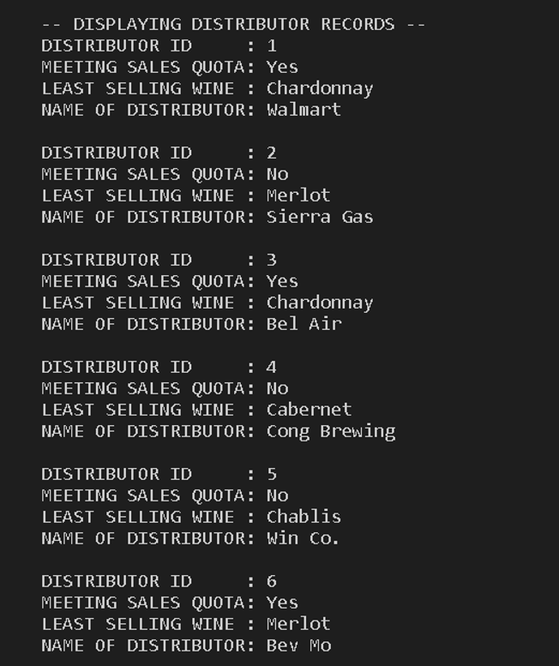
Report for Distributors
Just as any other business, Bacchus Winery needs to keep track of inventory.
This report provides a list of distributors and along with how they are doing.
This can help give insight on which distributor is staying relevant or meeting sales, and which wines they should or shouldn’t sell to make sure profit is retained.

Slide 7
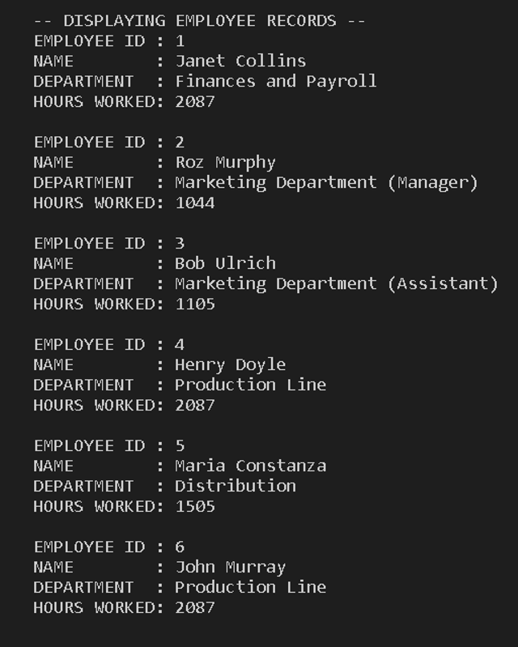
Report for Employees
A business can be defined by its product, but also its employees.
This report provides a layout of which employees worked how many hours throughout the year.
This can provide pivotal information in the possible productivity of the business determining which department and employees should be increased or decreased depending on certain areas of how the business is doing.

Slide 8
End of Presentation
Thank You!

