Slide 1
Event Based Video Analytics
Guided by : Vishal U Parikh

Slide 2
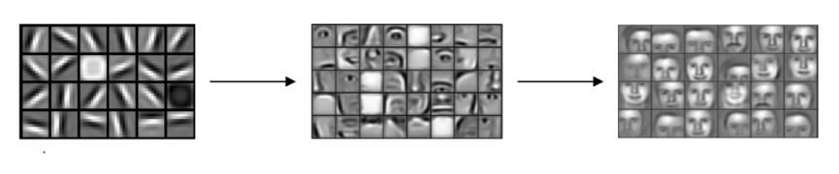
Detection in CNN Layers
Initial layers
middle layers
terminal layers
References : deeplearning.ai - CNN by Andrew Ng

Slide 3
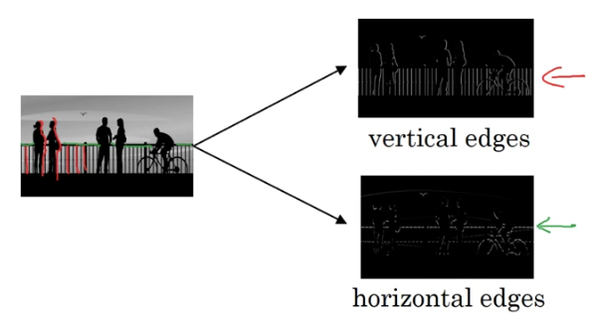
References : deeplearning.ai - CNN by Andrew Ng

Slide 4
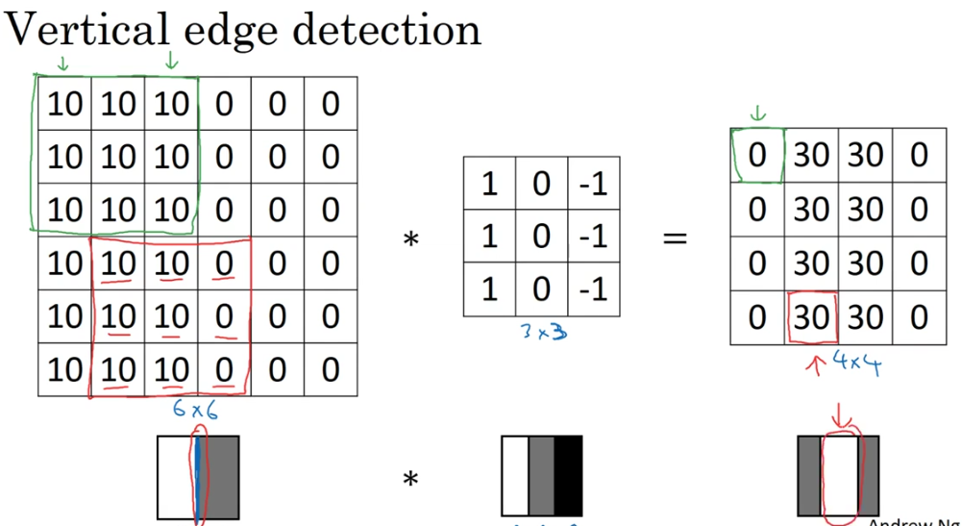
References : deeplearning.ai - CNN by Andrew Ng

Slide 5
Filters(kernel / neuron)
Instead of trying different values, we can let the neural network learn those filters by itself, by starting of with random values and then back propagating the error. This turns out to be more robust.
Output size :
n x n * f x f ⇒ n-f+1 x n-f+1

Slide 6
Padding
Need : --> When filters are applied, the dimension of the output is reduced.
--> The pixels situated in the corners are used much less in the output as compared to the ones in the middle.
Output size :
Padding of p pixels on [n x n] * f x f ⇒ (n+2p-f+1) x (n+2p-f+1)

Slide 7
Contd..
Types : Depending upon padding we have 2 types of convolutions…
Valid - No padding
Same - Pad so that the output size is same as the input size
For output to be same as input : n+2p-f+1 = n
Thus, p=(f-1)/2

Slide 8
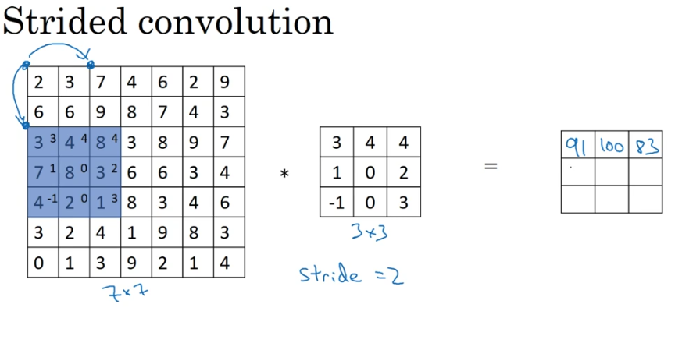
References : deeplearning.ai - CNN by Andrew Ng

Slide 9
Stride
Despite of sliding 1 pixel we can slide by s pixels,which would give the output size as follows :
Output size :
Padding of p[n x n] * stride of s[f x f] ⇒ [(n+2p-f)/s +1] x [(n+2p-f)/s +1]

Slide 10
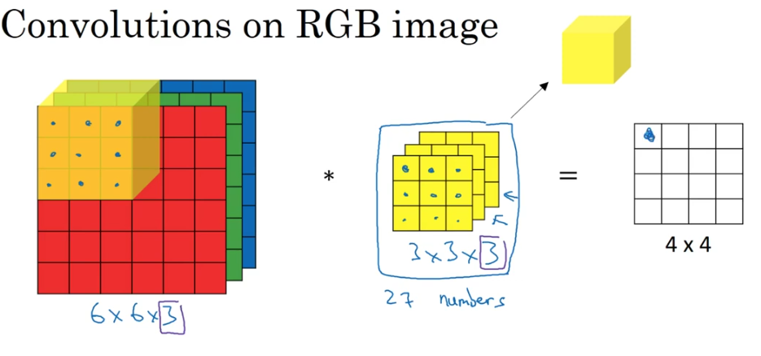
References : deeplearning.ai - CNN by Andrew Ng

Slide 11
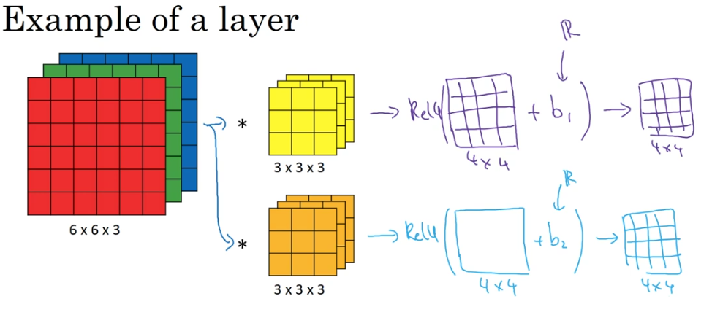
References : deeplearning.ai - CNN by Andrew Ng

Slide 12
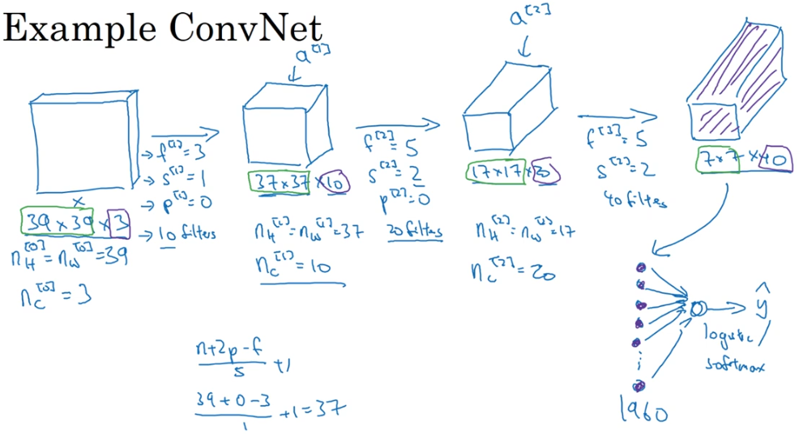
References : deeplearning.ai - CNN by Andrew Ng

Slide 13
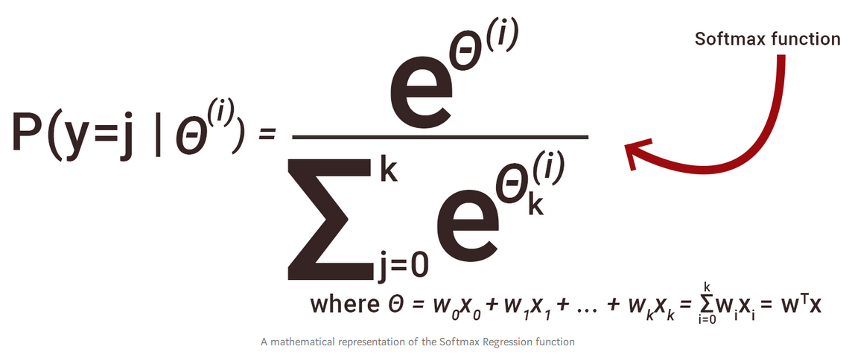
Softmax
The softmax function calculates the probability of each class which when added gives 1.
Formulae :
References : Towards datascience

Slide 14

Logistic
Logistic function gives the probability of the particular class whether the object of that class is present or not. Using Logistic, the addition of the probabilities of all the classes does not add up to 1, because it calculates the probability of individual class.
Formulae :

Slide 15
Types of convolutional network
Convolutional Layer ⇒ (CONV)
Pooling layer ⇒ Pool
Fully Connected layer ⇒ FC

Slide 16
Pooling layer
Why to use Pooling layer :
-- It detects features more robustly
-- makes computational part easier
-- To make network learn faster
-- There are no parameters to learn

Slide 17
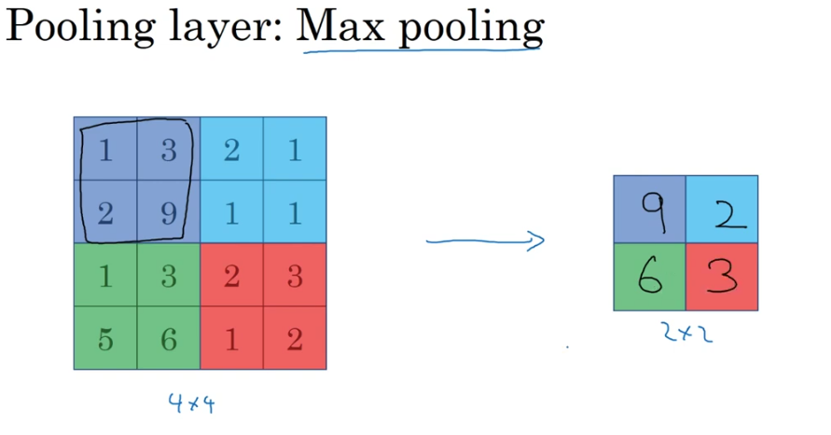
References : deeplearning.ai - CNN by Andrew Ng

Slide 18
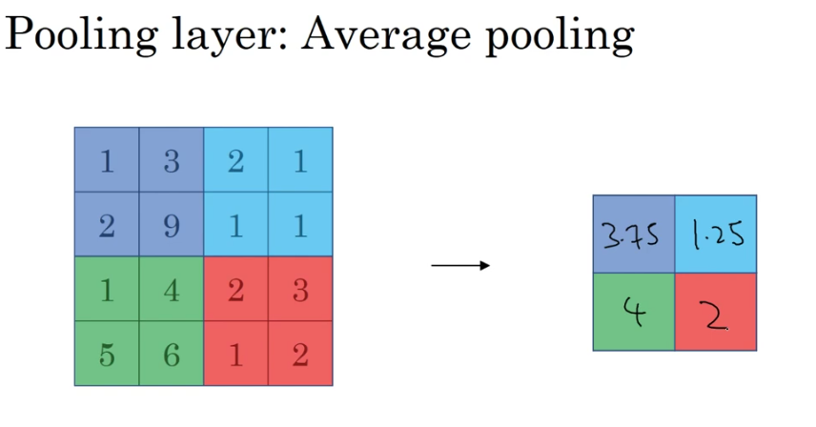
References : deeplearning.ai - CNN by Andrew Ng

Slide 19
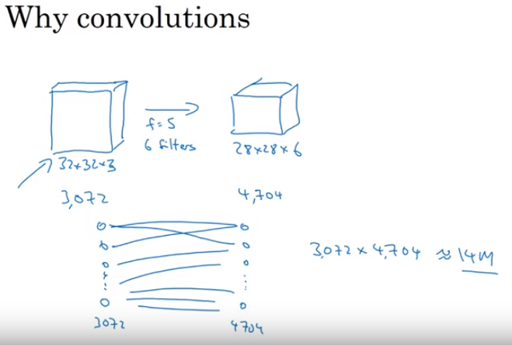
References : deeplearning.ai - CNN by Andrew Ng

Slide 20
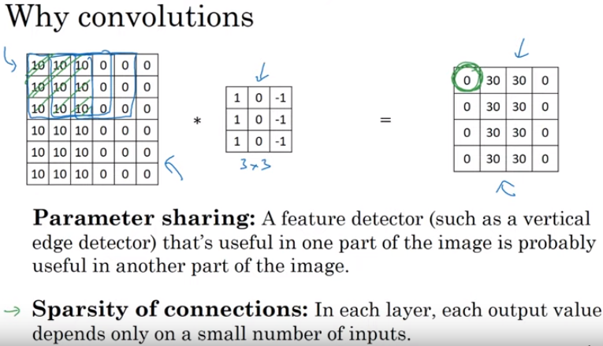

Slide 21
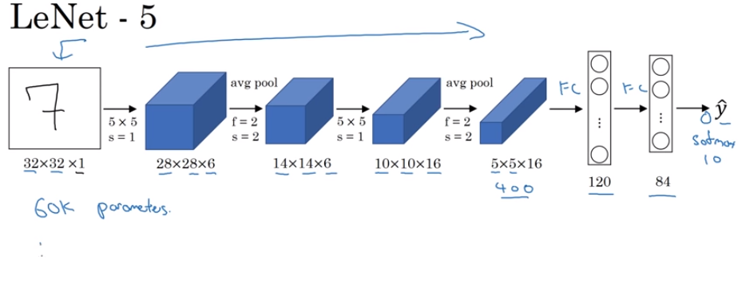
References : deeplearning.ai - CNN by Andrew Ng

Slide 22
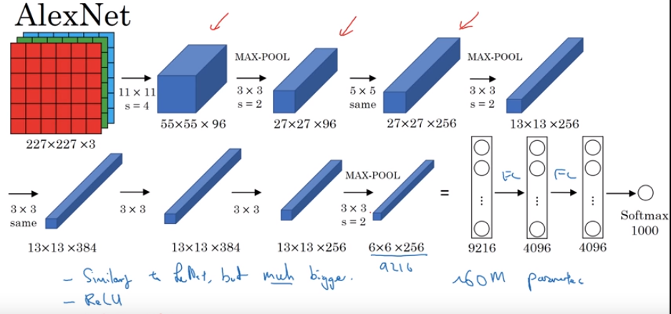
References : deeplearning.ai - CNN by Andrew Ng

Slide 23
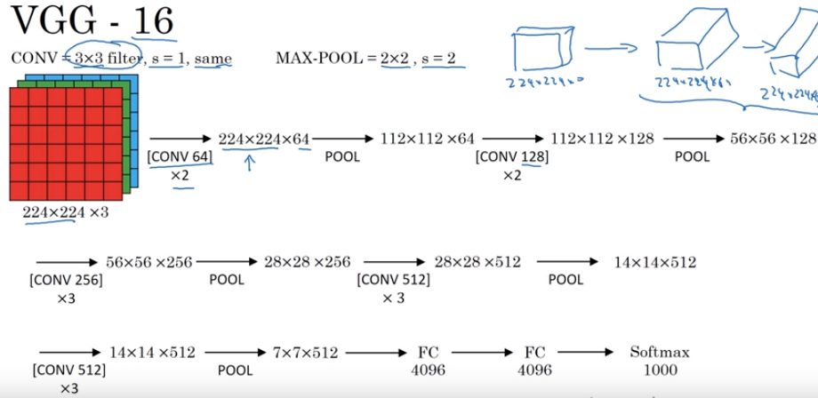
References : deeplearning.ai - CNN by Andrew Ng

Slide 24
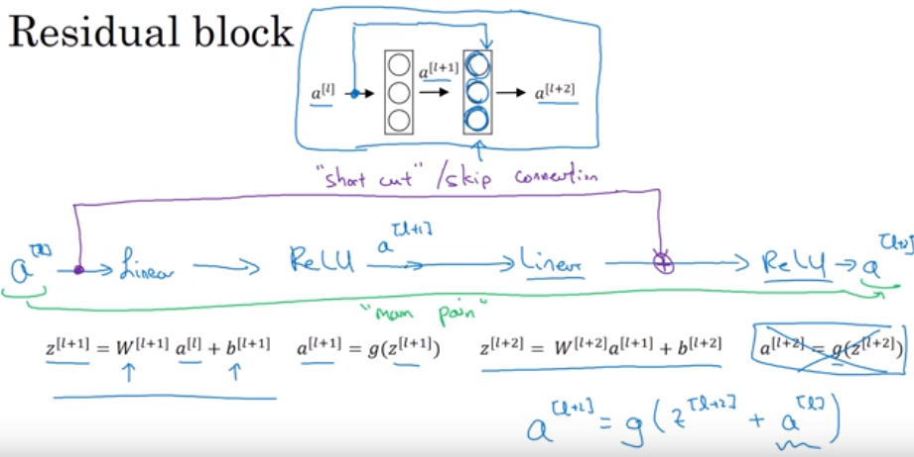
References : deeplearning.ai - CNN by Andrew Ng

Slide 25
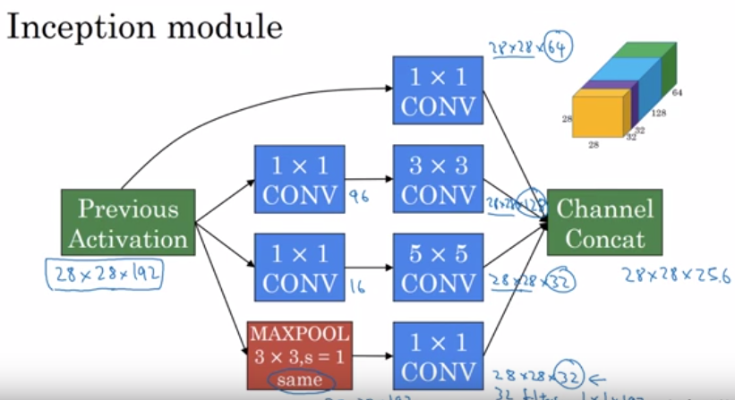
References : deeplearning.ai - CNN by Andrew Ng

Slide 26
A Few Concepts
One By One Convolution
Inception Network
Transfer Learning
Data Augmentation
Object Localisation
Sliding Windows
IOU
Anchor Boxes

Slide 27
Moving Towards the Implementation
The dataset contains 400 human action classes,with at least 400 video clips for each action. Each clip lasts around 10s and is taken from a different YouTube video.
The actions are human focussed and cover a broad range of classes including human-object interactions such as playing instruments, as well as human-human interactions such as shaking hands.

Slide 28
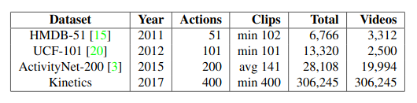
The dataset is made from...
References : https://arxiv.org/pdf/1705.06950.pdf

Slide 29
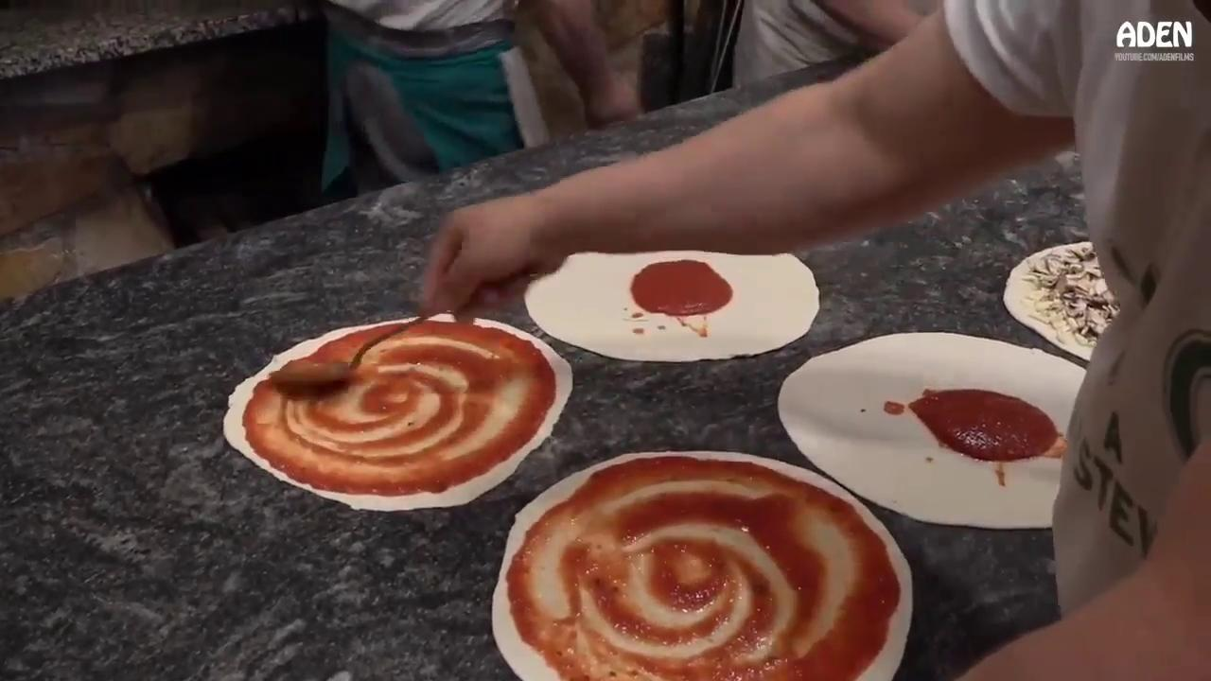
Input video

Slide 30

Output Video

