Slide 1
Calculator
Jesús J. Cantero

Slide 2
Summary
Classes and ID
JavaScript
CSS
Final Aspect

Slide 3
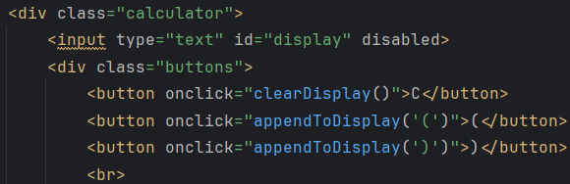
Classes & ID
Calculator= div container of the whole calculator
Buttons= grid to set in order buttons
Button, button:hover, button:active: default types for buttons
ID display: screen where selected buttons are shown

Slide 4
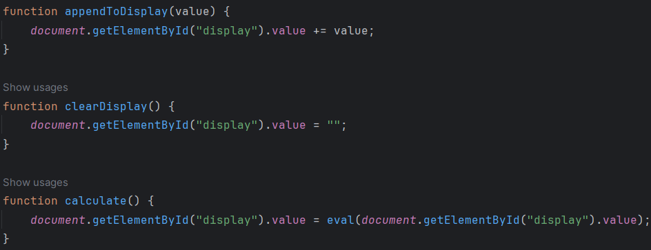
JavaScript
appendToDisplay(value): put the clicked button on the display screen
clearDisplay(): if “C” button is clicked, reset the display
calculate(): do the operation that is on the display when “=“ is clicked

Slide 5
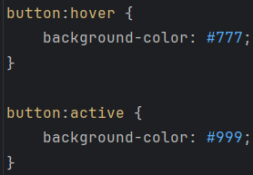
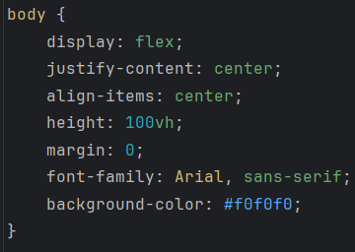
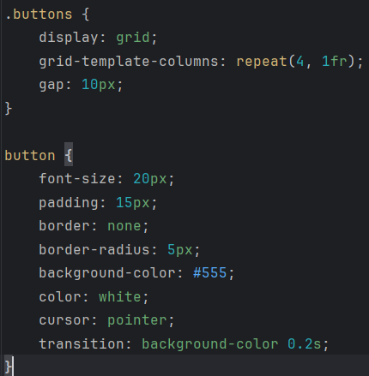
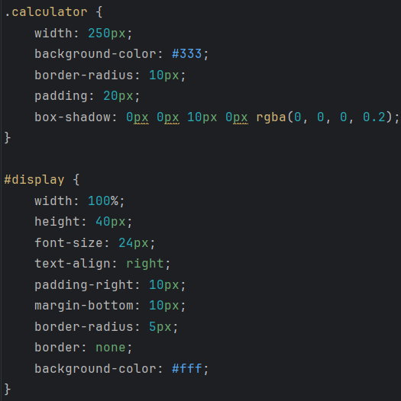
CSS

Slide 6
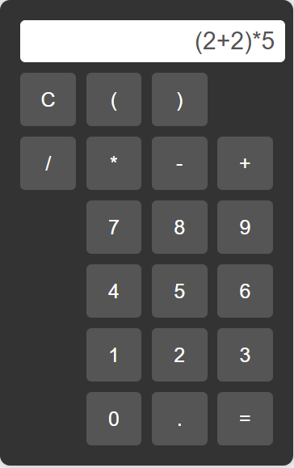

Final Aspect

Slide 7
Thanks!
Jesús J. Cantero
jesusjcl@correo.ugr.es
https://articlejjcl.w3spaces.com/article2.html

