Slide 1
Strings Homework
Jesús José Cantero López
WEB Technologies, ISMA Erasmus Student
jesusjcl@correo.ugr.es

Slide 2
Summary
Random Strings Operations
HTML/CSS
JS
Final Aspect
JavaScript Programs
HTML/CSS
JS
Final Aspect

Slide 3
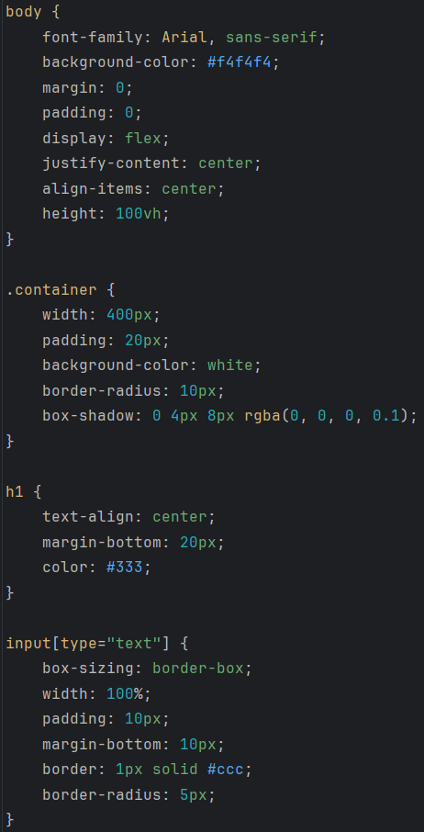
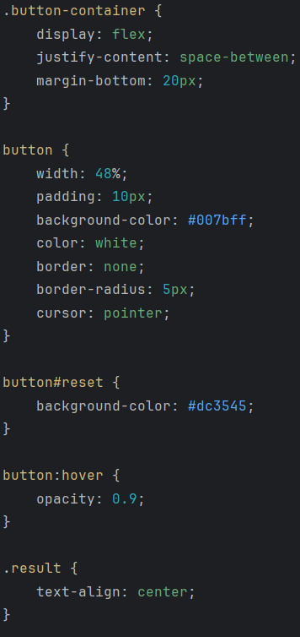
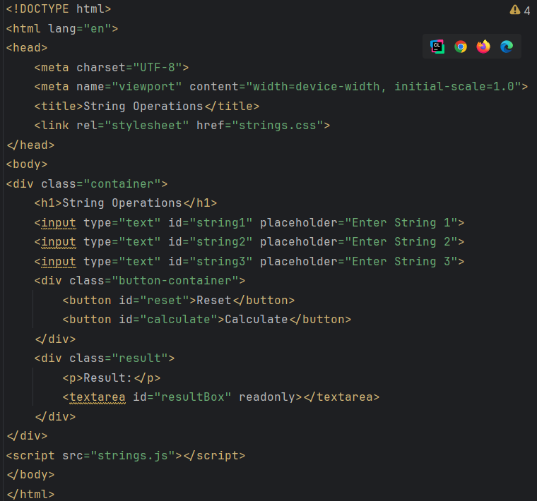
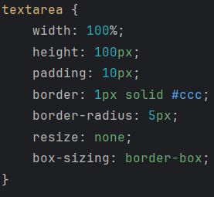
Random Strings Operations: HTML/CSS

Slide 4
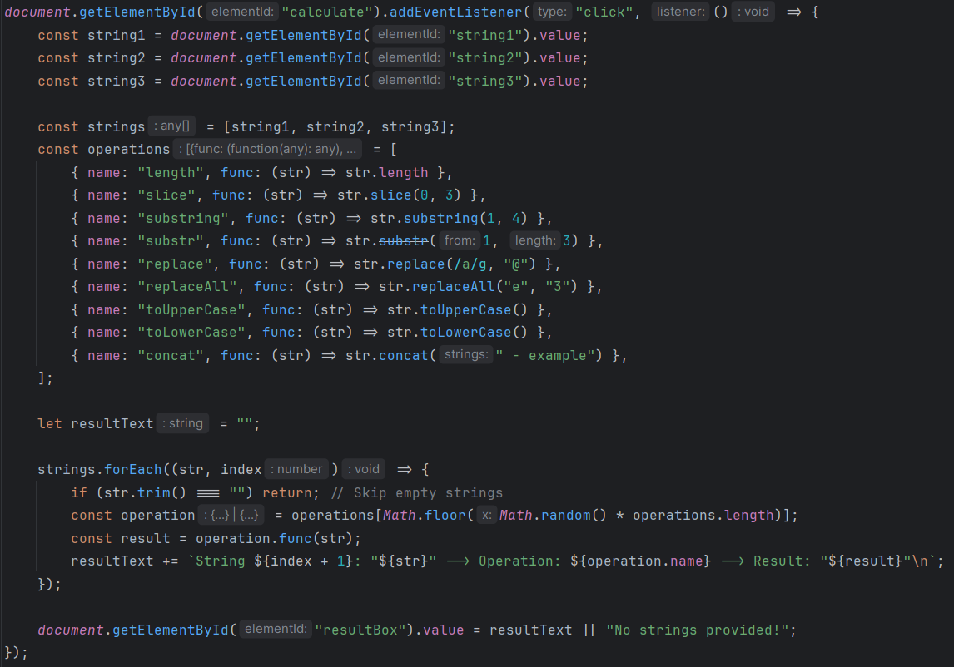
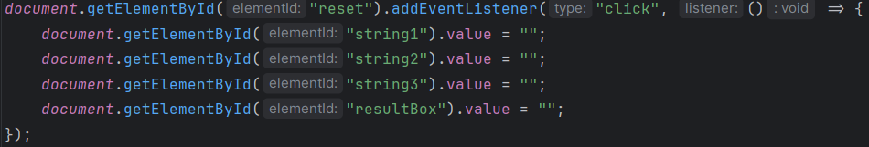
Random Strings Operations: JS

Slide 5
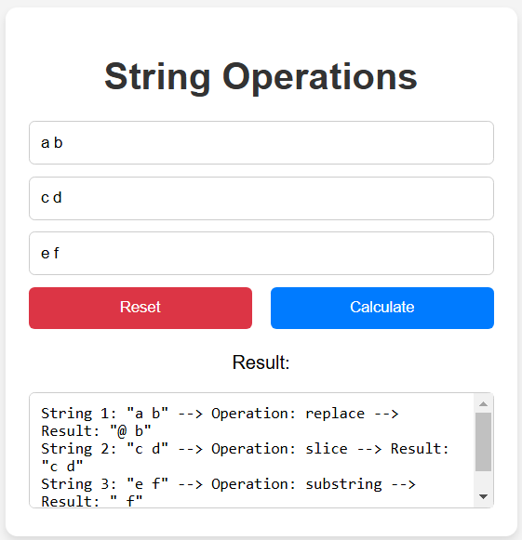
Random Strings Operations: Final Aspect

Slide 6
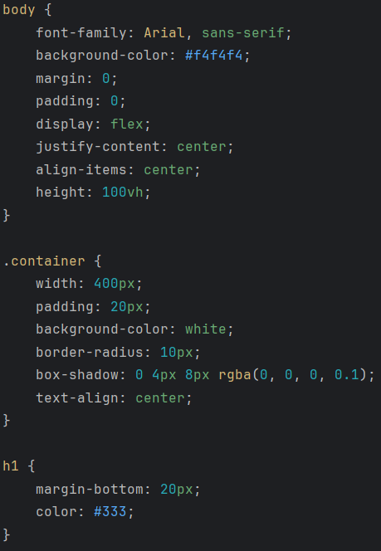
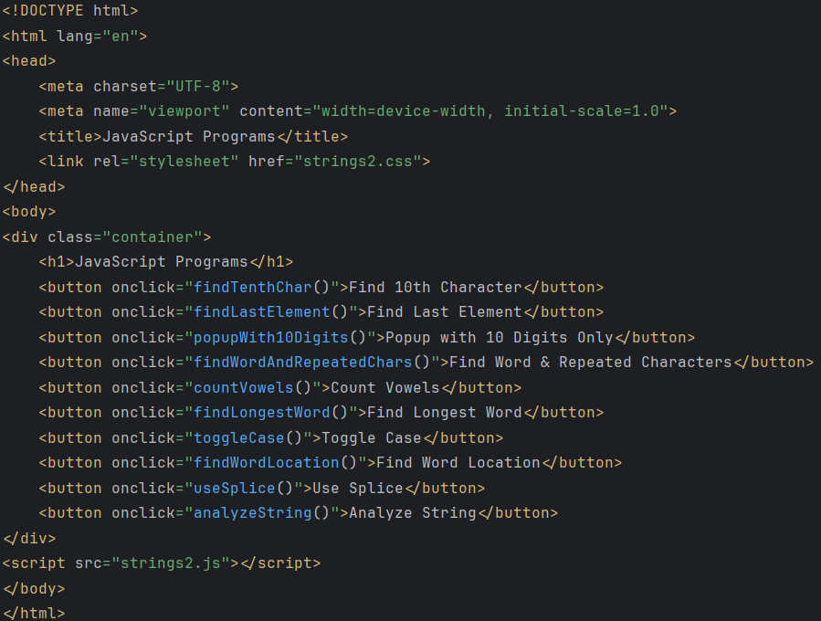
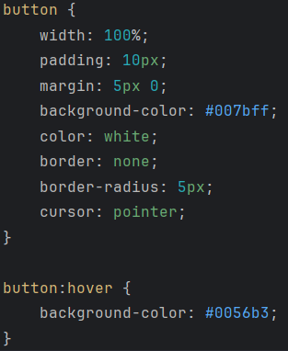
Java Script Programs: HTML/CSS

Slide 7
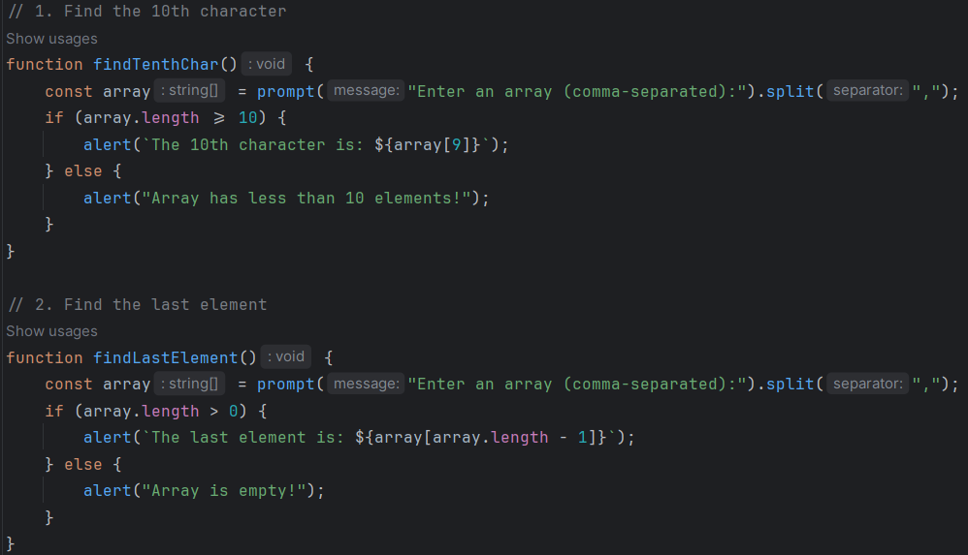
Java Script Programs: JS 1 & 2

Slide 8
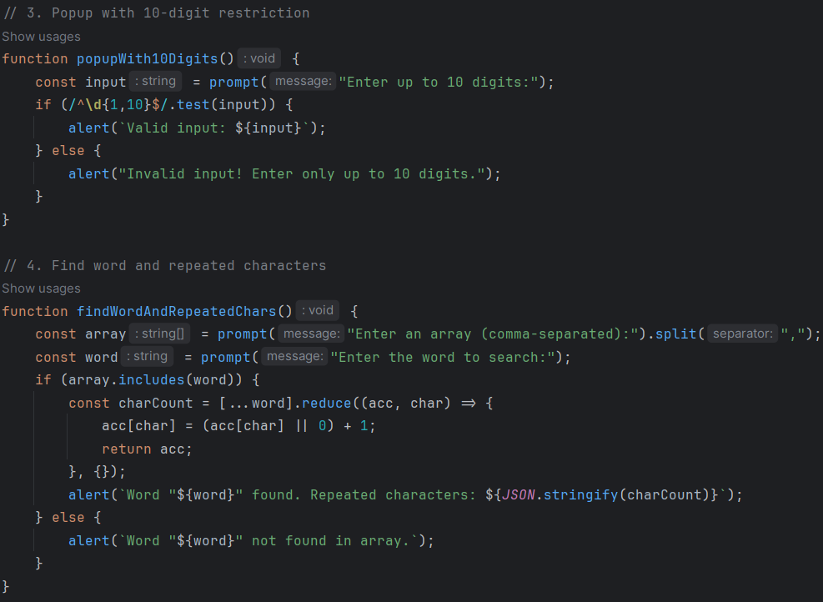
Java Script Programs: JS 3 & 4

Slide 9
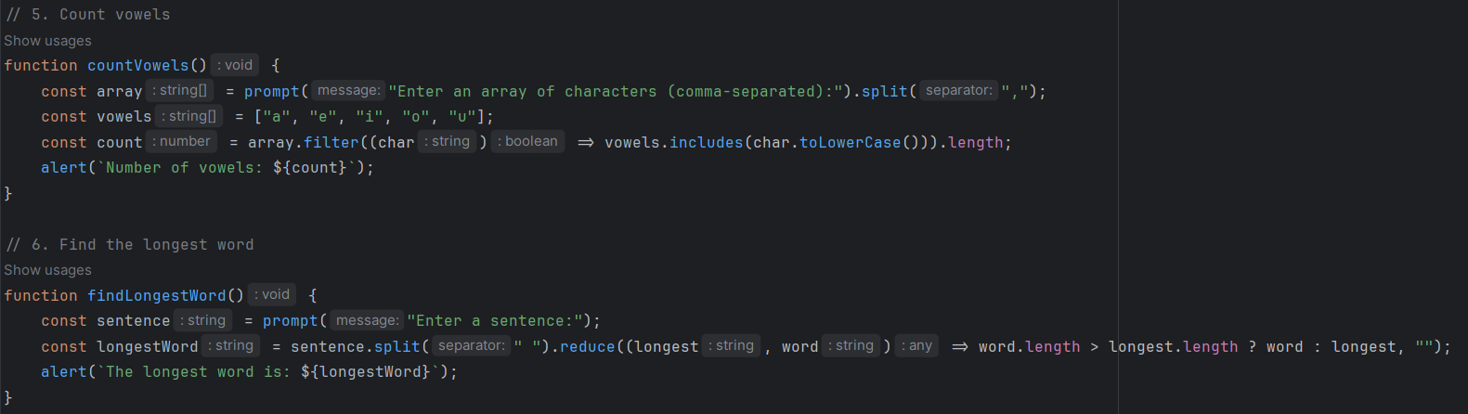
Java Script Programs: JS 5 & 6

Slide 10
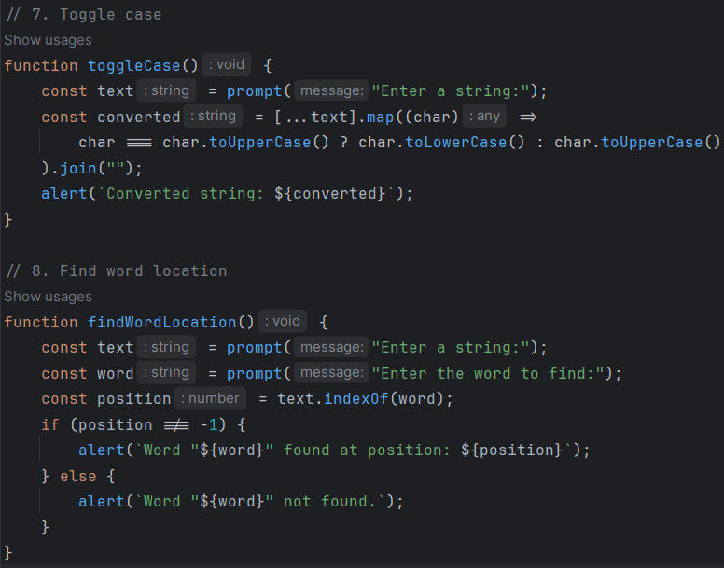
Java Script Programs: JS 7 & 8

Slide 11
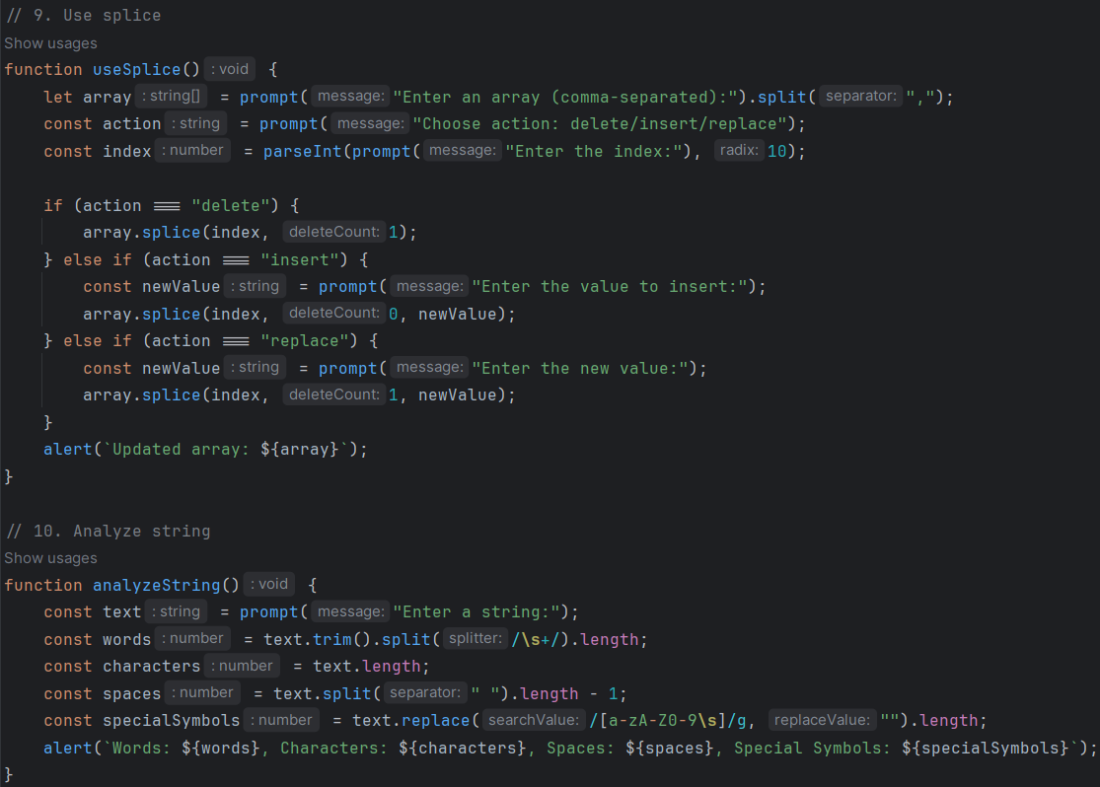
Java Script Programs: JS 9 & 10

Slide 12
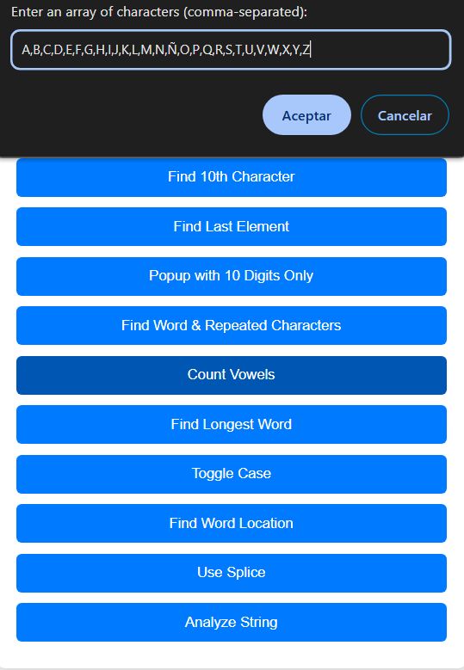
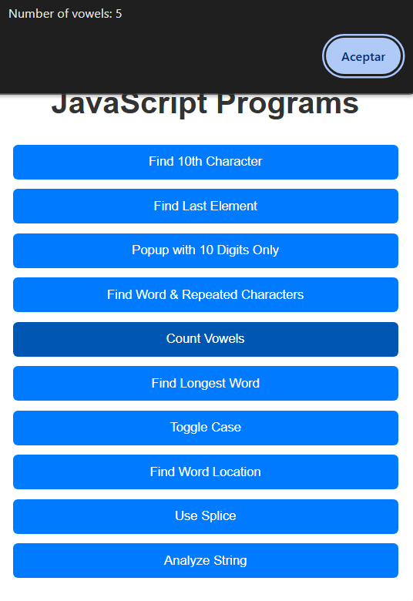
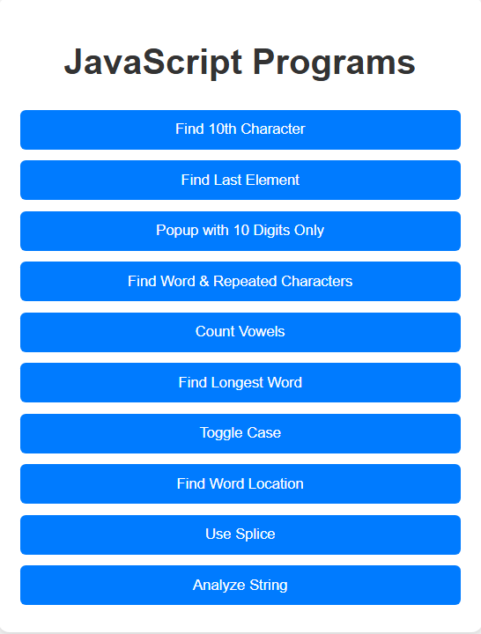
Java Script Programs: Final Aspect

Slide 13
Thank you!
New content updated on: GitHub
Jesús J. Cantero
WEB Technologies, ISMA Erasmus Student
jesusjcl@correo.ugr.es

