Slide 1
Līči website
Jesús José Cantero López
WEB Technologies, ISMA Erasmus Student
jesusjcl@correo.ugr.es

Slide 2
Summary
Introduction
Motivation
Things to implement
Beneficts
Closing

Slide 3
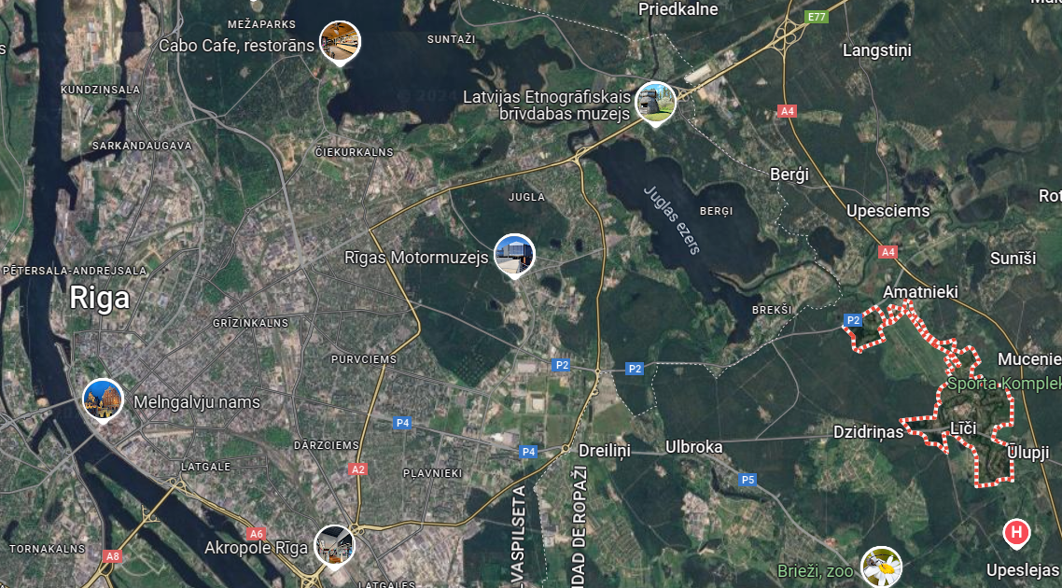
Introduction
Village near Riga (a 16 km del centro de Riga)
Top 3 smallest population in Latvia (recorded)

Slide 4

Motivation
Bring a webpage to the village
Increment the tourism
Let to know the good things Lici has

Slide 5
Things to implement
A modern and simple-to-use webpage
Images of the city
A easy way to check the different types of transport to reach the city
The public transport with schedules the people use there
An example of a tourist route
Info about the city (Population, weather…)

Slide 6
Beneficts
Letting know the things available in the village:
Will attract the attention of tourists
So the population could grow
Could be a new target to stay near the capital, but cheaper
Because of that, Lici could enrich oneself in culture

Slide 7
Thank you
Jesús J. Cantero
WEB Technologies, ISMA Erasmus Student
jesusjcl@correo.ugr.es

