Slide 1
Līči website
Jesús José Cantero López
WEB Technologies, ISMA Erasmus Student
jesusjcl@correo.ugr.es

Slide 2
Summary
Mainpage
Subpages
HTML/CSS (quickview)
Links
Closing

Slide 3
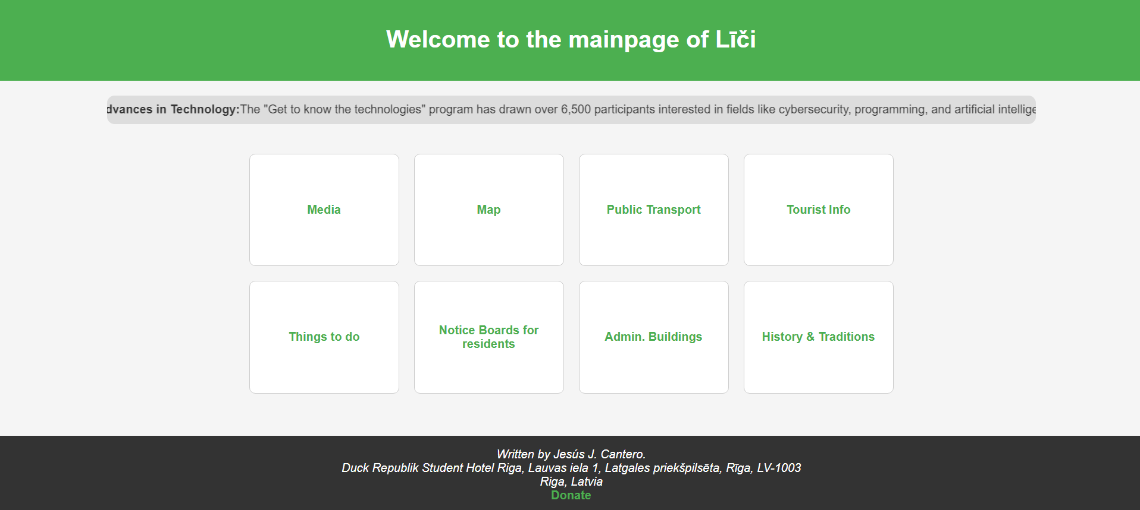
Mainpage

Slide 4
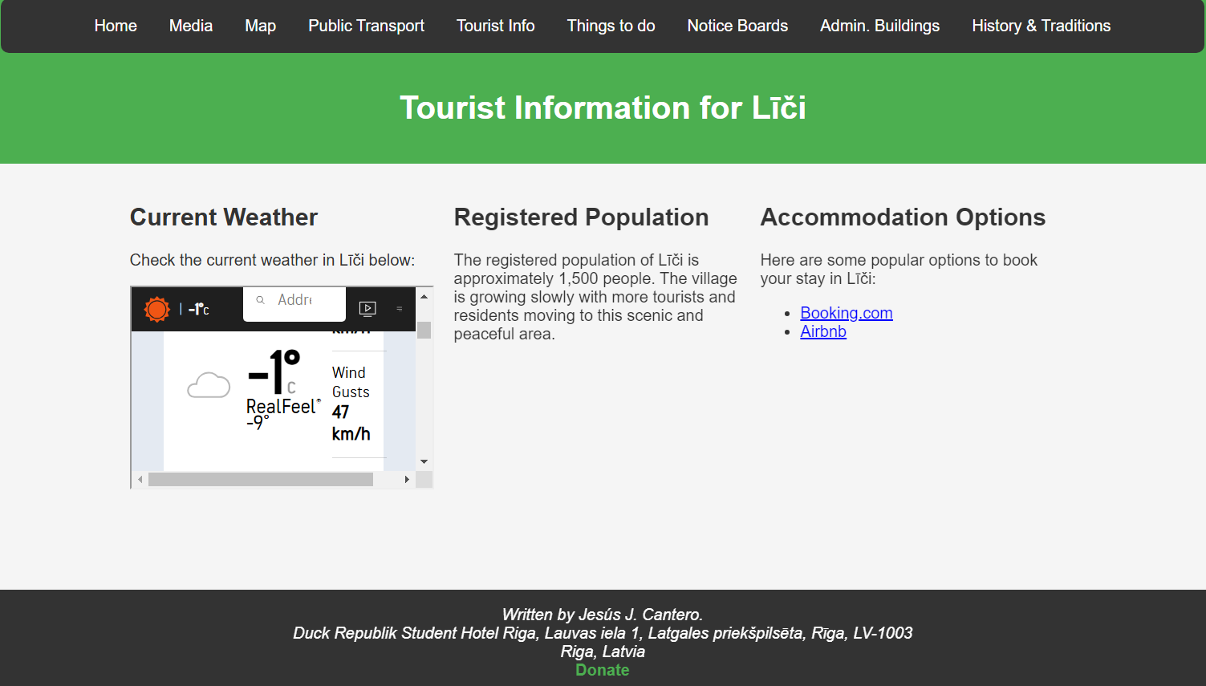
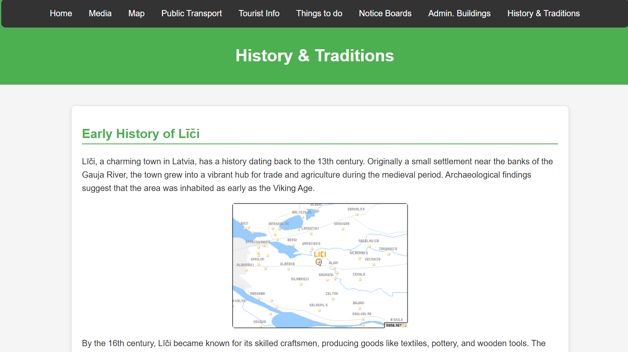
Example of Subpages

Slide 5
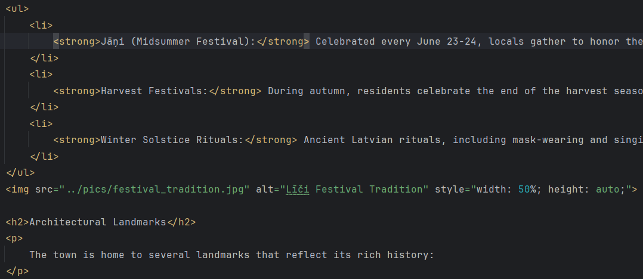
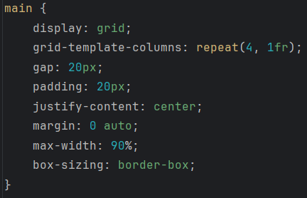
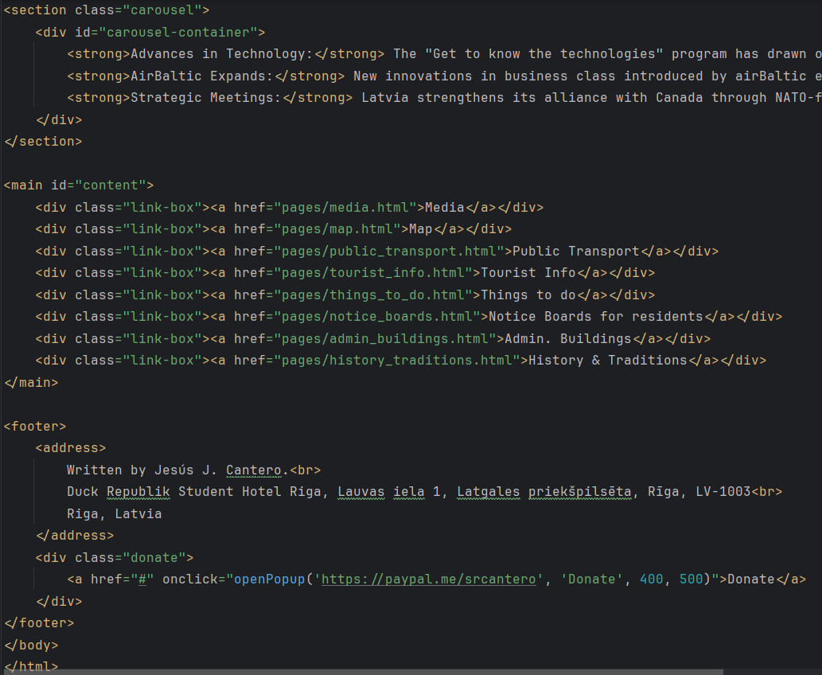
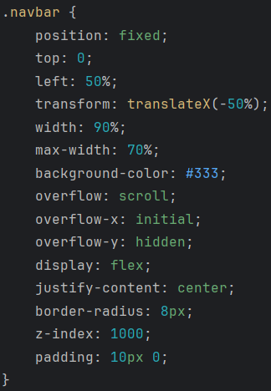
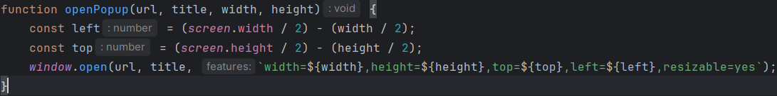
HTML/CSS

Slide 6
Links
Visit Project here
Repository in github here

Slide 7
Thank you
Jesús J. Cantero
WEB Technologies, ISMA Erasmus Student
jesusjcl@correo.ugr.es

