Slide 1
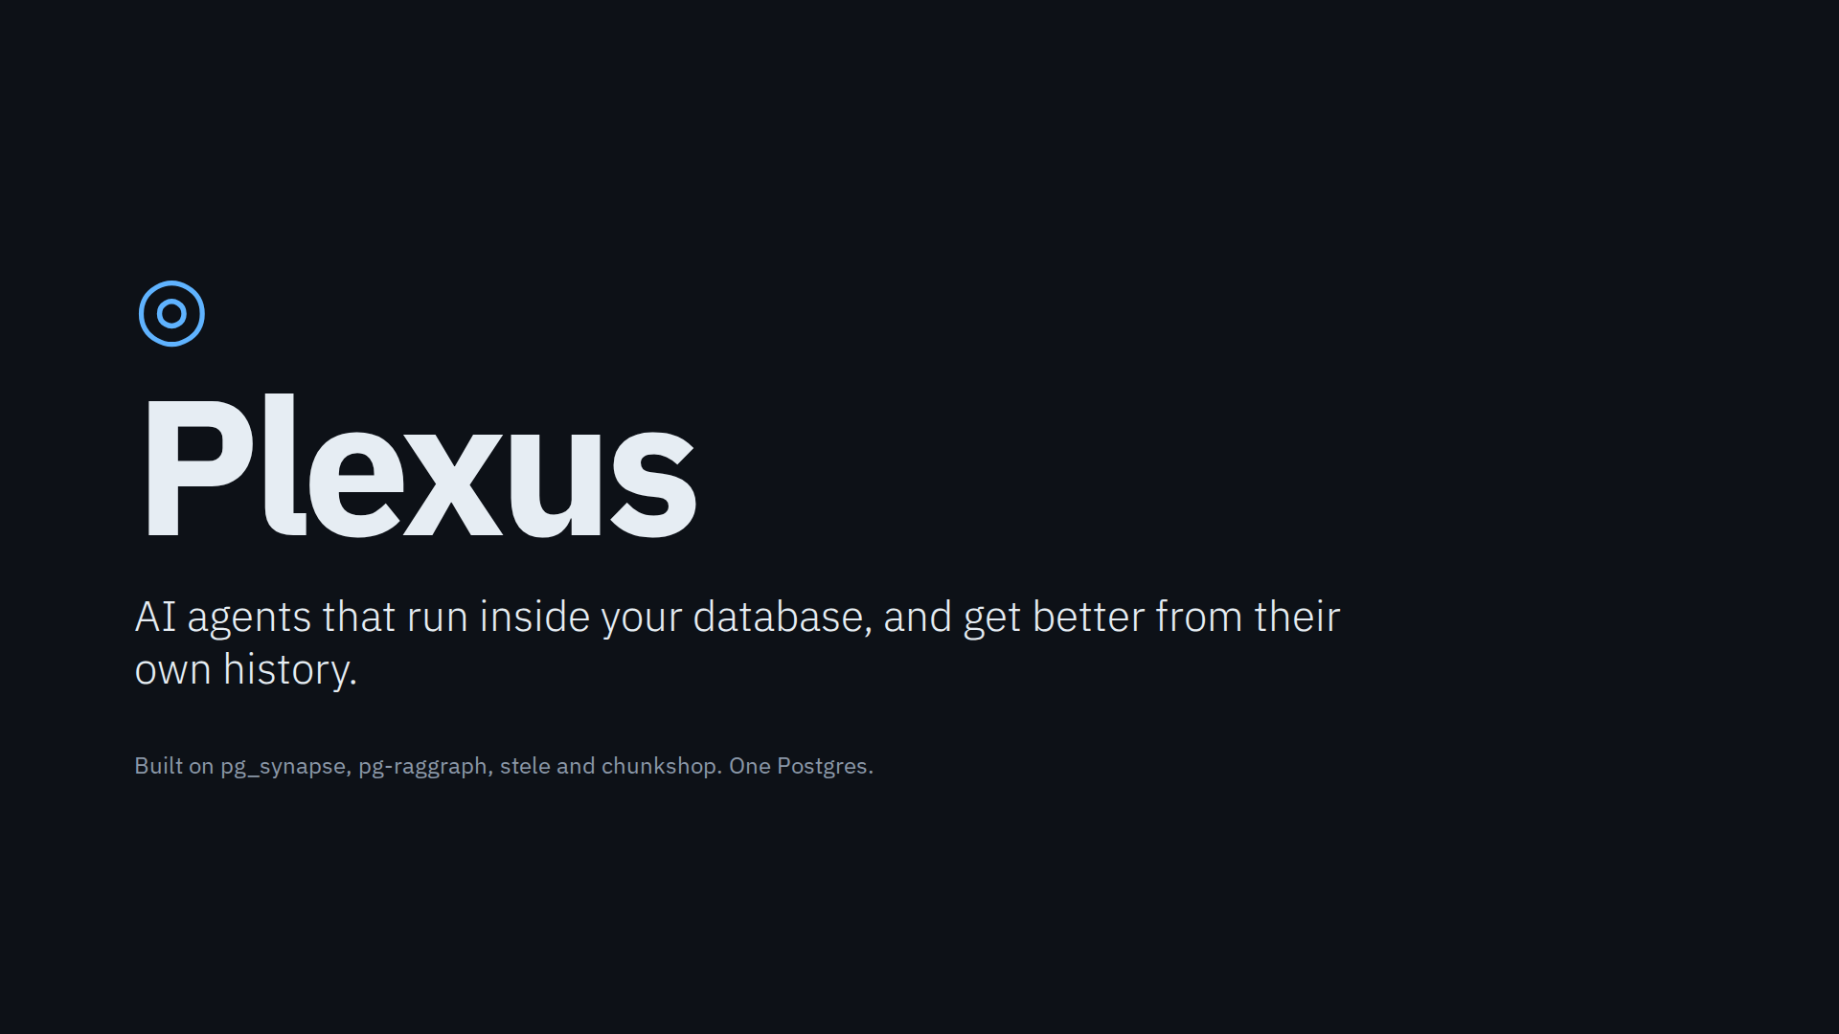
Notes:
Plexus is a demo of one idea: put the agent where the data already lives. Everything you will see runs inside a single Postgres. The only thing outside is the model.

Slide 2
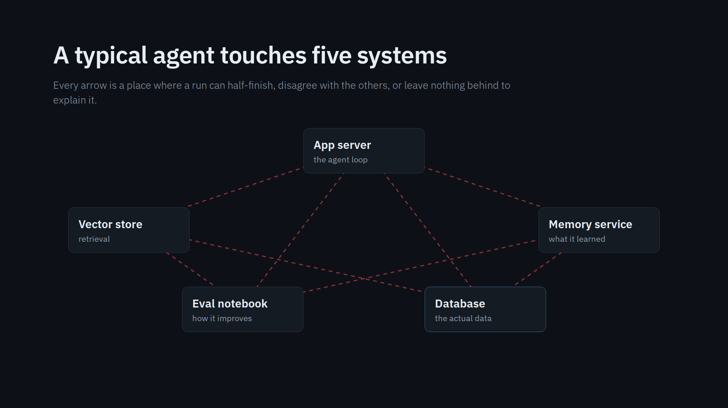
Notes:
This is the shape of almost every agent demo. The agent lives in an app server, retrieval in a vector store, memory in a third service, and improvement in somebody's notebook. Five systems that each keep their own version of what happened.

Slide 3
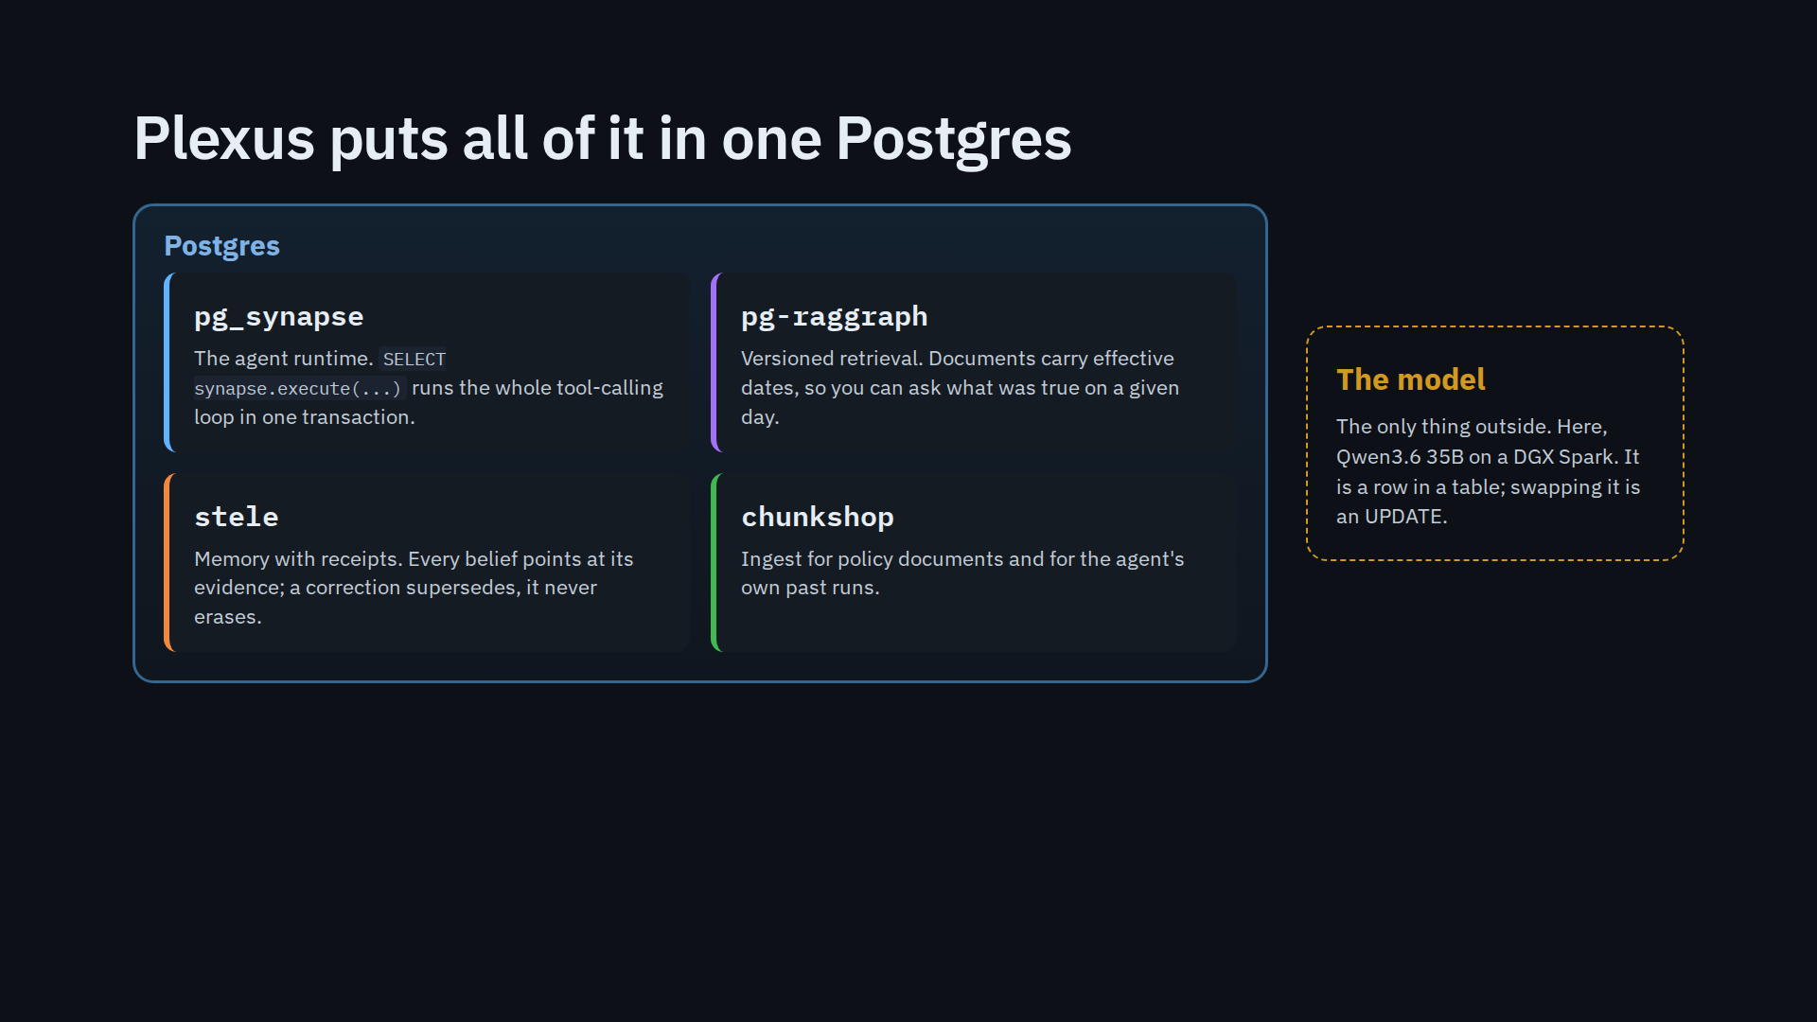
Notes:
Four Postgres pieces. pg_synapse runs the agent, pg-raggraph does time-aware retrieval, stele is memory with evidence, chunkshop ingests. The model sits outside and is just configuration.

Slide 4
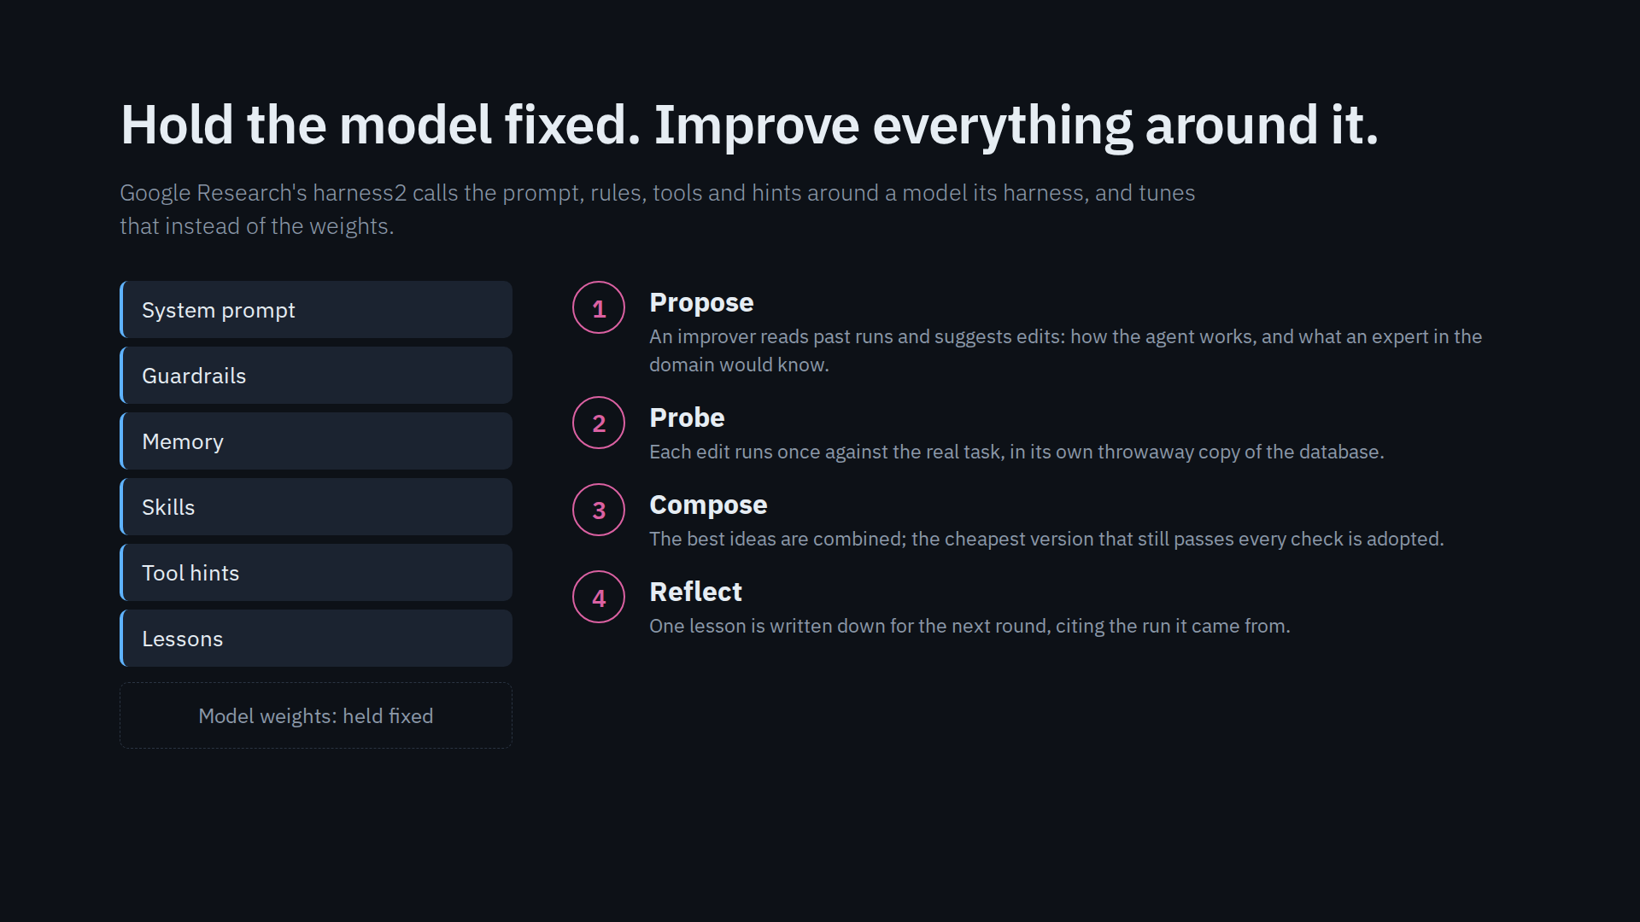
Notes:
This is the part borrowed from harness2. Stop trying to make the model smarter. Treat everything around it as the thing you optimize, and do it with evidence from real runs.

Slide 5
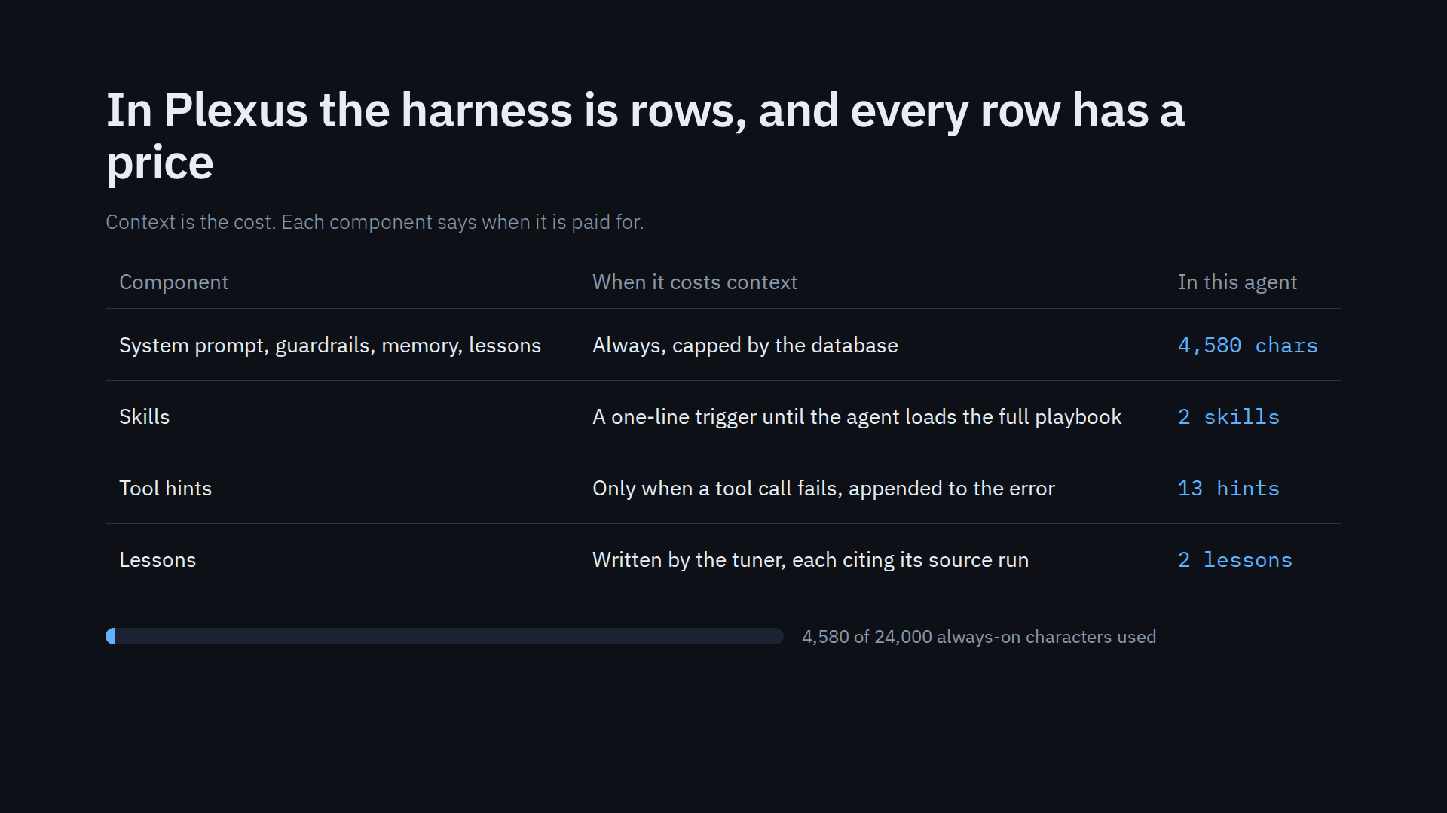
Notes:
Because the harness is data, the database can enforce a budget: always-on context is capped, and the tuner can only adopt an edit that fits. Skills and hints cost nothing until they are needed.

Slide 6
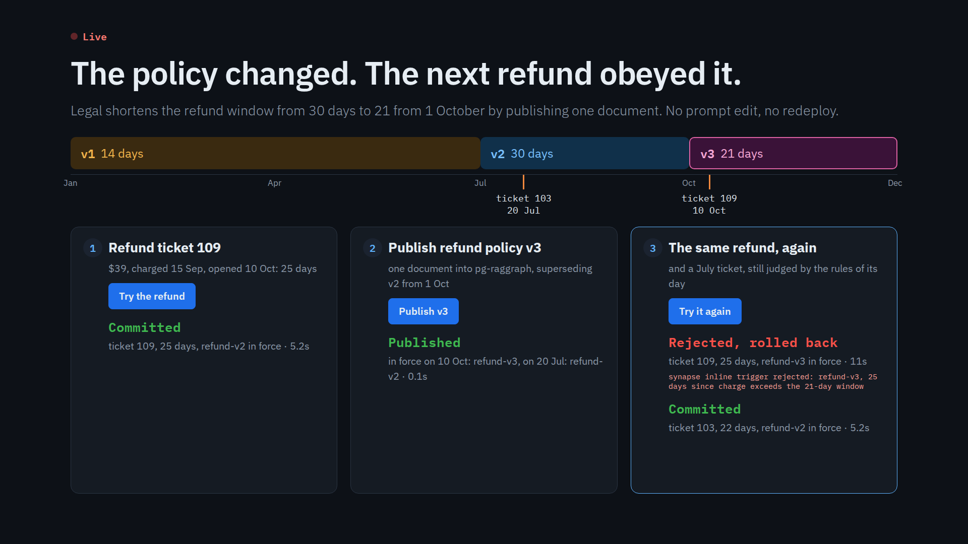
Notes:
Click Try the refund: the agent on the refunds table looks up the policy in force on 10 October, which is v2 with 30 days, and the 25-day refund commits. Publish v3: one document, a tenth of a second. Try it again: same refund, now rejected inside the transaction with v3 as the reason. Ticket 103 from July still gets v2. Each refund takes 5 to 10 seconds because the gate is an LLM call. Reset to v2 afterwards; nothing is left in the tables.

Slide 7
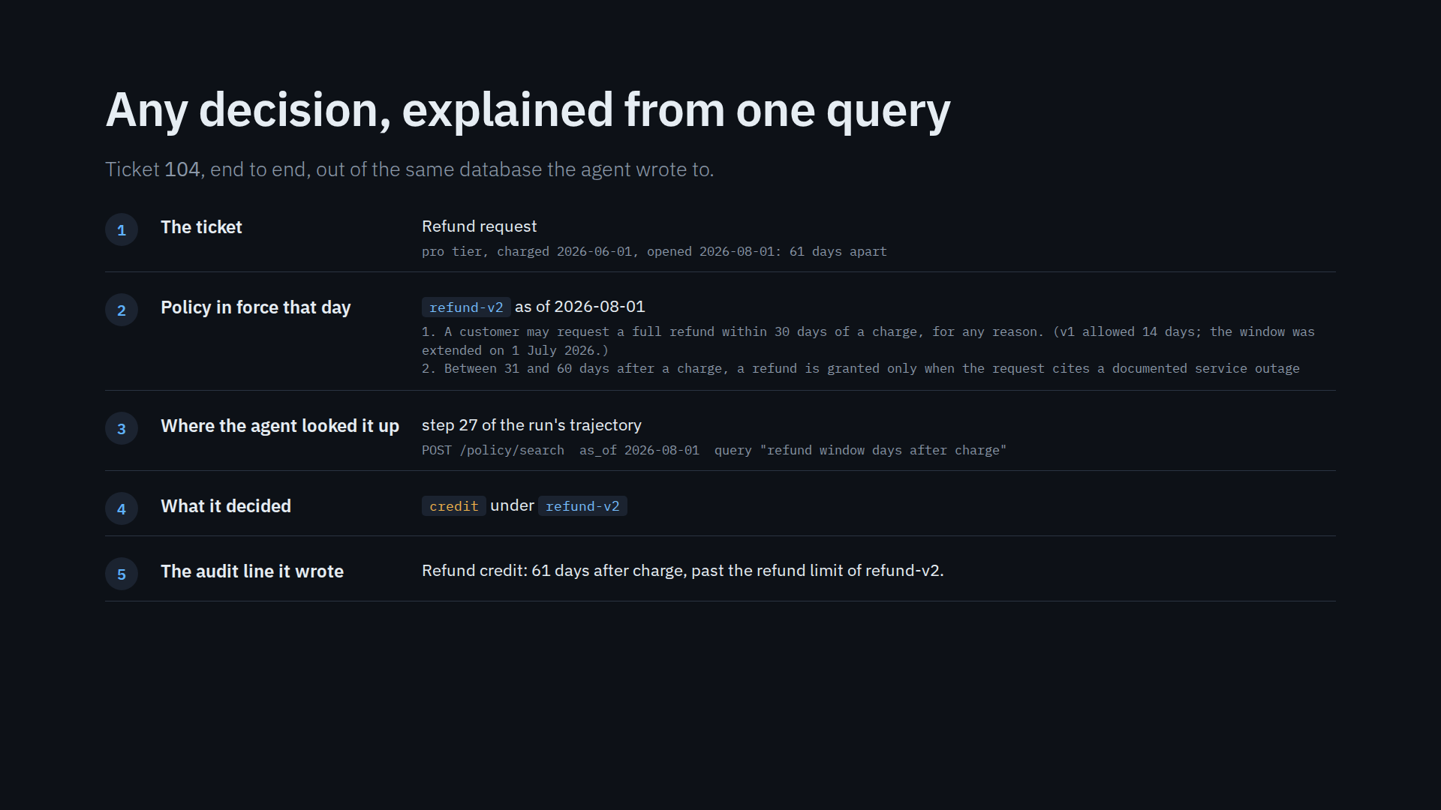
Notes:
This is what you hand an auditor or a customer. The ticket, the policy in force that day, the exact step where the agent looked it up, what it decided, and the audit line. No log search across services.

Slide 8
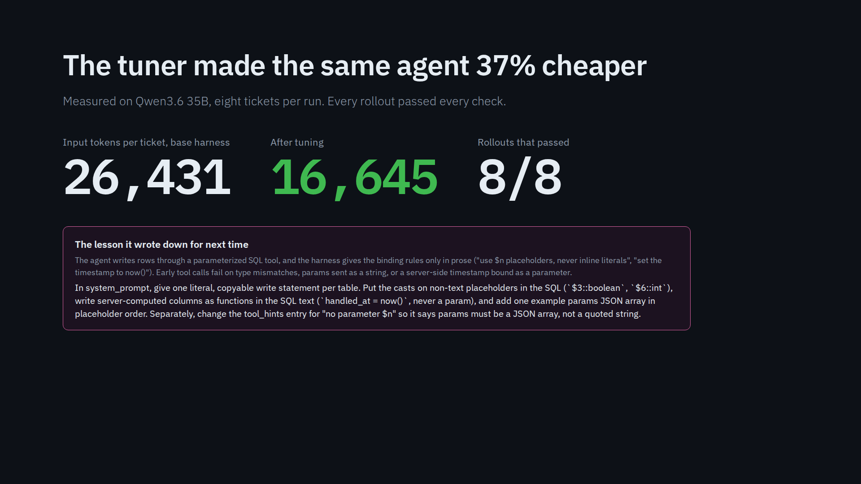
Notes:
The adopted change was readable: instead of describing the SQL rules in prose, the harness hands the agent one copyable statement per table. That stopped the retries on the first write. The tuner also wrote down why, as a lesson for the next round.

Slide 9
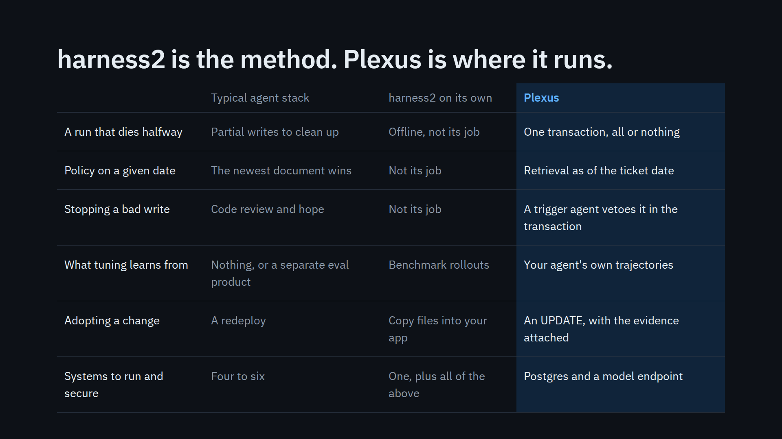
Notes:
harness2 is a good method; this is not a knock on it. It tunes offline and hands you files. Plexus runs the same loop where the work happens, so the result is a transaction, a veto and an update, not a pile of files to wire up.

Slide 10
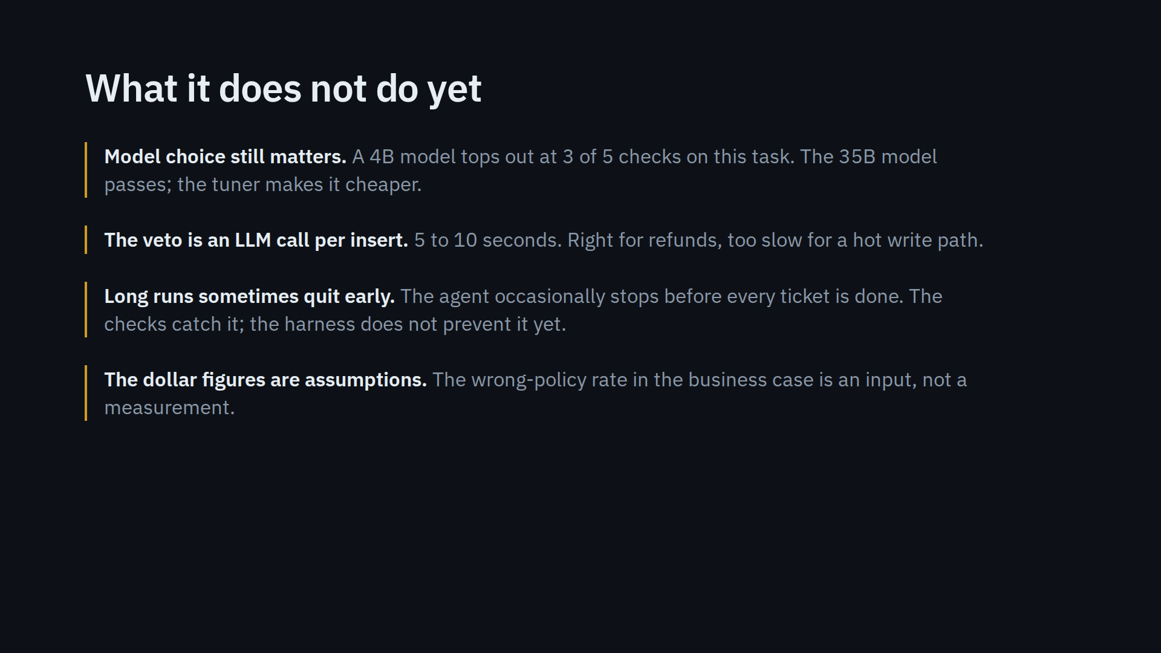
Notes:
Say these before someone else does. Each one is on the roadmap slide that follows.

Slide 11
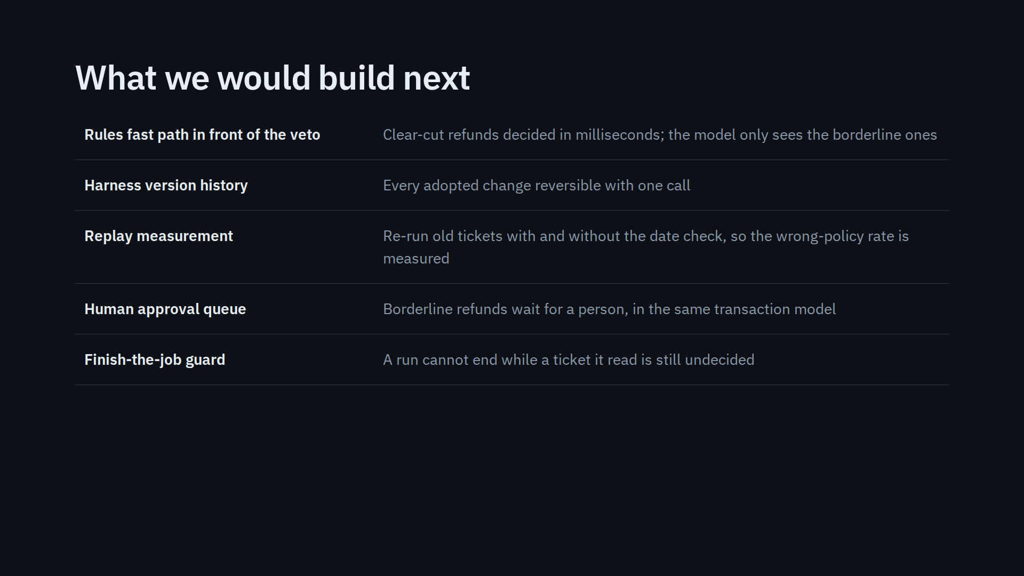
Notes:
Each item closes one of the gaps on the previous slide. None of them needs a new system; they are tables and triggers.

Slide 12
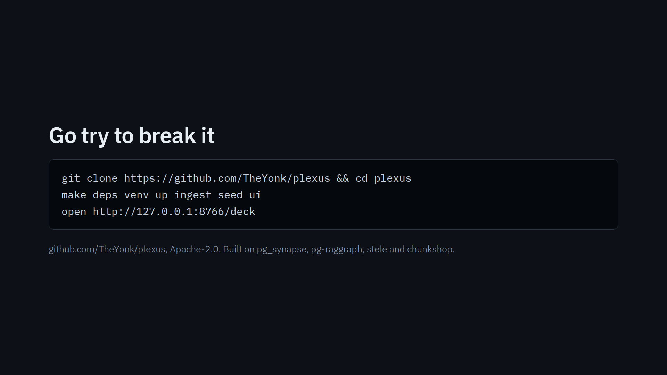
Notes:
Everything in this deck is reproducible from a fresh clone: make deps pulls the four projects at the commits it was tested with. The live slide resets itself.

