Slide 1

Introduction to IT Security
Renaud Dubois – December 2017

Slide 2
Introduction to IT Security
Conceptual approach.. Don't go in bits and bytes.
Straight to the goal & “keep in mind”
Avoid to repeat what you know already

Slide 3
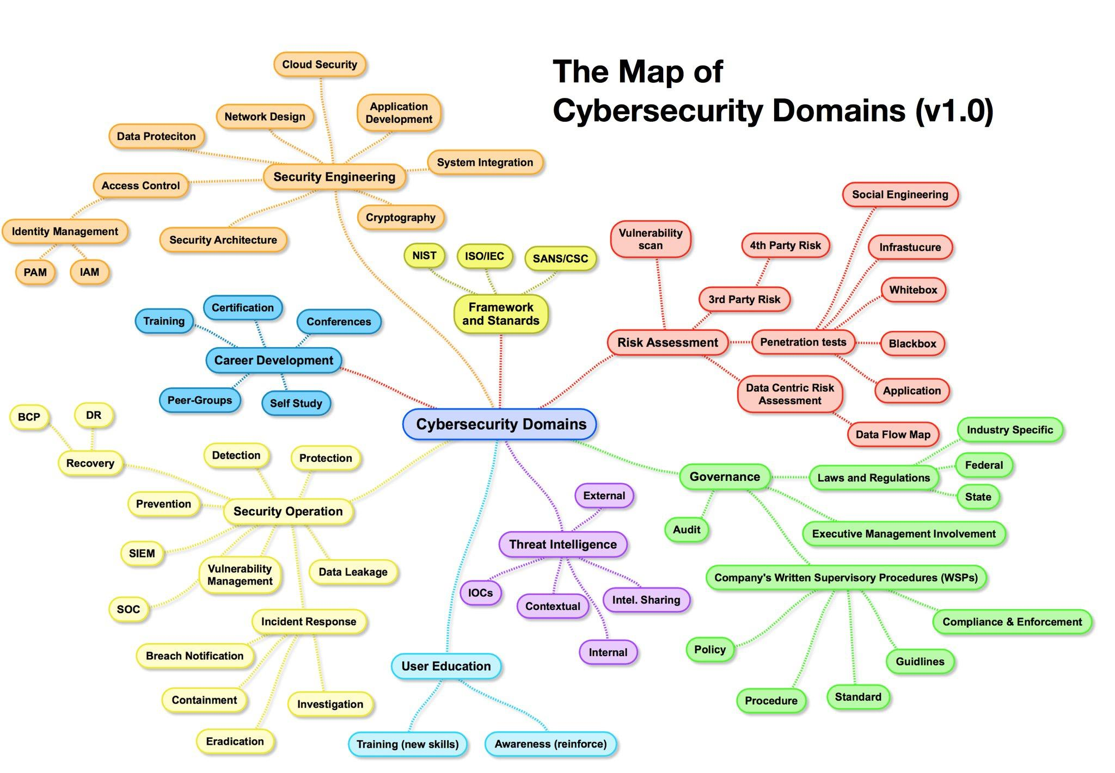
Introduction to IT Security

Slide 4
Introduction to IT Security
10 chapters of the CISSP (Certified Information Systems Security Professional)
Risk Management & Security Management Practices
Access Control Systems & Methodology
Cryptography
Physical Security
Security Architecture & Models
Telecommunications & Network Security
Law, Investigation & Ethics
Business Continuity & Disaster Recovery Planning
Application & Systems Development
Operations Security
The strength of the chain is in the weakest link

Slide 5
Risk Management & Security Management Practices

Slide 6
Risk Management & Security Management Practices
The 3 goals of any information security program:
CIA Triad: Confidentiality, Integrity, Availability
Confidentiality: prevent unauthorized disclosure
Integrity: prevent unauthorized modification,
keep data consistent
Availability: reliable and timely accessible

Slide 7
Risk Management & Security Management Practices
Vulnerability: Weakness in a mechanism that can threaten the confidentiality, integrity or availability of an asset. Defines also the lack of countermeasure (example: un-patched application, lack of way to detect fraud, default password, concentration of responsibilities,..)
Threat: Anything that can exploit a vulnerability, intentionally or accidentally, and obtain, damage, or destroy an asset. (sabotage, fraud & theft, loss of infrastructure, fire, hurricane,..)
Risk: Probability of a threat becoming real and the corresponding potential damage
Exposure: a vulnerability has been exploited by a threat agent (database hacked through an open port on the firewall)
Countermeasure: A measure to mitigate potential losses
Risk = Threat x Vulnerability
Countermeasure

Slide 8
Risk Management & Security Management Practices
Risk management is a systematic process for the controlled taking of known risks to attain approved objectives
Goal of the “Risk Management” = Optimal security at minimal cost
Who is dealing with the risks ? → Senior Management, Board
Who is ultimately responsible for risk? → Management
Management may delegate to departments and business units that shoulder some of the risk but ultimately the senior management is responsible for the companies health and risks.
Risk Management Process
Plan → Collect information → Define recommendations → Management
    Risk Mitigation (implement countermeasures)
    Risk Transference (third party involvement, purchase insurance)
    Risk Acceptance (informed decision – no action taken)
    Risk Avoidance (decide to stop activity)

Slide 9
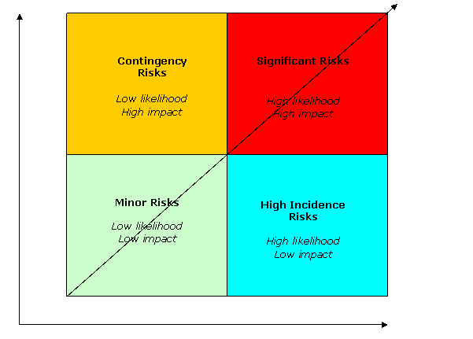
Risk Management & Security Management Practices
Risk Approach
Consequences of occurrences
Impact
Probability of occurrences

Slide 10
Risk Management & Security Management Practices
How to calculate the risks ?
EF: Exposure Factor
ARO: Annual Rate of Occurrence
SLE: Single Loss of Expectancy
ALE: Annualized Loss Expectancy
Asset Value x EF = SLE
SLE x ARO = ALE

Slide 11
Risk Management & Security Management Practices
An e-commerce website has a value of 300.000$. In case of attack on the website, the estimated damage to the company is 40% (loss revenue, liability, costs, confidentiality data corrupted,..)
Asset Value x EF = SLE
300.000$ x 0,4 = 120.000$
Based on the current safeguards, this threat is estimated to happen once in 12 months
SLE x ARO = ALE
120.000$ x 1,0 = 120.000$

Slide 12
Risk Management & Security Management Practices
The goal of the countermeasure is to reduce the potential loss (ALE value after implementation of countermeasure < ALE value before implementation)
ALE for a specific asset is 78.000$ and after implementation of the control, the new ALE is 20.000$ and the annual cost of the control is 60.000$. What is the value of the control to the company ?
78.000$ - 20.000$ = 58.000$
58.000$ - 60.000$ = -2000$ → Not cost beneficial

Slide 13
Risk Management & Security Management Practices
Concept of Defense-in-depth
Never rely upon just one control !
Provide multiple layers of defense that an attacker must compromise before accessing an asset
Compensate the weakness of one layer

Slide 14
Risk Management & Security Management Practices
Concept of Defense-in-depth
Never rely upon just one control !
Provide multiple layers of defense that an attacker must compromise before accessing an asset
Compensate the weakness of one layer

Slide 15
Risk Management & Security Management Practices
Reactive – Alerts that occur at failure
Proactive – Alerts that occur before failure
Predictive – Alerts that trend on a possible failure

Slide 16
Risk Management & Security Management Practices
Concept of Defense-in-depth
Never rely upon just one control !
Provide multiple layers of defense that an attacker must compromise before accessing an asset
Compensate the weakness of one layer

Slide 17
Access Control Systems & Methodology

Slide 18
Access Control Systems & Methodology
Access controls are security features that control
how people can interact with systems and resources
Goal is to protect from un-authorized access
Subject is a person, process or program
Object is a resource (file, printer, database,..)
Access is the data flow between an subject and an object

Slide 19
Access Control Systems & Methodology
Identification: Who am I ? (user id)
Authentication: Prove that I'm who I say I'm
Authorization: What am I allowed to access
Auditing/Accountability: audit logs and monitoring to track the user activity

Slide 20
Access Control Systems & Methodology
Identification identifies an user uniquely (username, UID, email address,..)
Don't share! No group account ! Must be unique for the accountability and responsibility purpose
Standard naming

Slide 21
Access Control Systems & Methodology
Authentication: proving who you say you are:
  Something you know (password)
  Something you have (smart card, token)
  Something you are (biometrics)
  → Strong authentication is a combination of at least 2 factors
  → One factor authentication = username + password
  Sometime also adding “Somewhere you are” (location)

Slide 22
Access Control Systems & Methodology
Biometrics
Unique personal attribute for authentication (1:1) or identification (1:N)
Most expensive
Sophisticated
Enrollment time
Can be based on
  Behavior (signature dynamics) – might change over time
  Physical attribute (fingerprints, iris, retina scans)

Slide 23
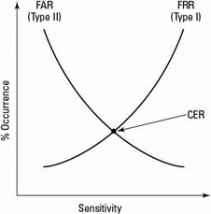
Access Control Systems & Methodology
FRR: False Reject Rate (reject authorized individual)
FAR: False Acceptance Rate (accepts impostor)
CER: Cross Error Rate (FRR = FAR); % value – lowest % is the most accurate
Source: http://flylib.com/books/en/2.930.1.46/1/

Slide 24
Access Control Systems & Methodology
Some examples of biometric types
Fingerprint
Palm Scan
Hand Geometry
Retina Scan
Iris Scan
Keyboard Dynamics
Voice Print
Facial Scan
RFID chips are not biometry !

Slide 25
Access Control Systems & Methodology
Attacks on password
Sniffing
Brute force attacks
Dictionary Attack
Social Engineering
Rainbow tables → defense: hash(password+salt)

Slide 26
Access Control Systems & Methodology
One time password
Only valid once
Secure
Not vulnerable to eavesdropping
Require a token device to generate password
2 types: synchronous or asynchronous

Slide 27
Access Control Systems & Methodology
Memory card
NOT a smart card
Holds information, does not process
Easily copied, not secure

Slide 28
Access Control Systems & Methodology
Smart card
Holds and process information
Can destroyed itself after a threshold of failed login
Can provide two factor authentication

Slide 29
Access Control Systems & Methodology
Attacks on smart card
Fault generation: manipulate environment controls and measure errors (change clock, change electrical signal,..)
Software attack
Side channel: non-intrusive such as measuring the electromagnetic field, the power,..
Microprobing: advanced techniques to remote the protection on the cards circuits (laser, chemical, ultrasonic vibration..)

Slide 30
Access Control Systems & Methodology
Authorization
Default NO access → principle “Need to know”
SSO
  Kerberos: use symetric key cryptology
  SESAME: similar to Kerberos but asymetric key
  SAML & Federation: newer on the market and XML based

Slide 31

Access Control Systems & Methodology
Why do we need federation ?
APP 1
APP 2
APP 3
Login: bob@bob.com
Pwd: bob
Login: bob
Pwd: bob
Login: bob
Pwd: bdsqf2R242!
???

Slide 32

Access Control Systems & Methodology
Then came Active Directory
Login: bob
Pwd: bob!2”4oP)_3
APP 1
APP 2
APP 3
Centralized password policy
I know my password !

Slide 33
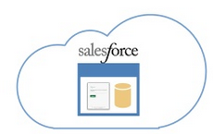

Access Control Systems & Methodology
Then came the cloud apps...
APP 1
APP 2
APP 3

Slide 34
Access Control Systems & Methodology
Centralized identity provider
APP
Service Provider
Identity provider

Slide 35
Access Control Systems & Methodology
IDS allows to detect intrusion and unauthorized access
Different types:
NIDS Network based IDS
HIDS Host IDS

Slide 36
Access Control Systems & Methodology
Network Based IDS
Monitor network traffic ONLY
Watch out for switches (use mirroring) or network tap
Computer or network appliance with NIC in promiscuous mode
Sensors communicate with a central management console
Able to detect botnets on the network segment

Slide 37
Access Control Systems & Methodology
Host Based IDS
Installed on computers
Monitor logs or configuration files
Agent that resides on individual computer
Detect suspicious activities on a system, not a the network

Slide 38
Access Control Systems & Methodology
IDS types
Signature based:
  pattern matching, look for known signature
  Must be updated with new signatures
  Cannot stop 0-day attacks
Anomaly based
  Protocol based
  Statistical anomaly based
  Can detect 0-day attacks
  Very subjective and could have higher rate of false positives

Slide 39
Physical Security

Slide 40
Physical Security
The 5 goals of the Physical Security
Deterrence (prevent)
Delaying
Detection
Assessment
Response

Slide 41
Physical Security
The 4 threats categories
Natural environment (flood, storm,..)
Supply system (power distribution outage, communication interruption,..)
Man-made (unauthorized access, explosion, fraud, vandalism,..)
Political events (strike, bombs, terrorist attack,..)

Slide 42
Telecommunications & Network Security

Slide 43
Telecommunications & Network Security
OSI Model:
Application
Presentation
Session
Transport
Network
Data link
Physical

Slide 44
Telecommunications & Network Security
TCP/IP Model:
Application
Transport (Host to Host)
Internet
Link

Slide 45
Telecommunications & Network Security
Network Security services
Firewall
IDS/IPS
SSL VPN
IPsec VPN
DDoS Defense
Forward Proxy
Reverse Proxy
Authentication
Session Border Controller
SIEM - Security Information & Event Management

Slide 46
Telecommunications & Network Security
Firewall
Enforce network policy
Used to create DMZ
Installed at the perimeter of the network to protect against the external threats
Installed internally to segregate the network into different zones according to the risk profiles of the assets

Slide 47
Telecommunications & Network Security
Stateful firewall
Keeps track of the connections in a table
Allows dynamically the traffic to comeback
Dynamic inspection (ALG) allows complex communications that require dynamic ports to be opened (such as FTP, RSH,..)
Able to define NAT rules
Able to setup VPN tunnels
Redundant firewalls to avoid SPOF

Slide 48
Telecommunications & Network Security
Redundant firewall
Active/passive or active/active
Stateful Synchronisation (ARP cache, session table, fib)
Configuration synchronisation
Exchange of heartbeats
HA link
Link monitoring
Path monitoring (watchdog)

Slide 49

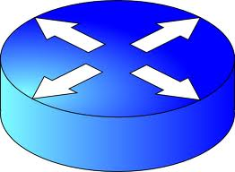
Telecommunications & Network Security
Antispoofing protection
192.168.0.0/24
Internet
eth0
eth1
192.168.3.0/24
eth2
192.168.5.0/24
Firewall routing table:
0.0.0.0/0 via eth1
192.168.0.0/24 via eth0
192.168.3.0/24 via eth2
Firewall rule:
From 192.168.3.1 to 192.168.5.5, allow HTTP

Slide 50
Telecommunications & Network Security
Firewall best practices
Keep the rules simple
Group the rules by category
Avoid the multiplications of “exceptions”
Enable anti-spoofing protection
Avoid to use “ANY” keyword
Use least privilege principles
Enable logging
Regular review of the rules is needed (obsolete, shadowing,..)
Be careful with tunnels or tunneling protocol

Slide 51
Telecommunications & Network Security
Security zones
Segregate the assets of different security levels into security zones or areas
Each zone has its own level of trust (e.g. PCI)
Protect the data center against the outside world, but also against the internal users
Use firewalls to separate the security zones
Use a frontend gateway, located in DMZ, to protect the assets
Intra-zone traffic is typically allowed by default

Slide 52
Telecommunications & Network Security
DMZ
A buffer zone between an unprotected network and a protected network that allows the regulation and the monitoring of the traffic between the two
Hardening of the servers placed in DMZ
Group the servers into different DMZ's following the business needs
Authenticate the users in DMZ

Slide 53
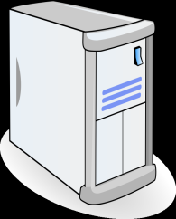


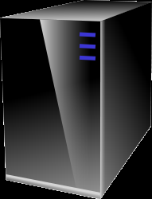

Telecommunications & Network Security
Security zones
DMZ
Internet
Internet to DMZ
Guests
Data Center
Users

Slide 54
Telecommunications & Network Security
Next generation firewalls (NGFWs)
Standard firewall features (NAT, stateful inspection, VPN,..)
IDS/IPS integrated in the firewall
Application awareness
Threat detection and application vulnerability lists
Integrated with AD or captive portal: “user based” and not only “ip based”. Users are now mobile and have multiple workplaces.
SSL decryption

Slide 55
Telecommunications & Network Security
Next generation firewalls (NGFWs)
Evasive applications are able to detect the blocked ports and use port-hopping techniques to bypass the security rules
FIREWALL
Yahoo Messenger
Port 5050 Blocked
Port 80 Open
Bittorrent
Port 6681 Blocked
Skype

Slide 56
Telecommunications & Network Security
Next generation firewalls (NGFWs)
In the past, port 80/443 traffic was clearly classified as web browsing traffic.
Today, it could be:
Salesforce.com → Business application
Gmail → Web Mail
Meebo → instant messaging
Youtube → Media
Conclusion: we need visibility at application (L7) level

Slide 57
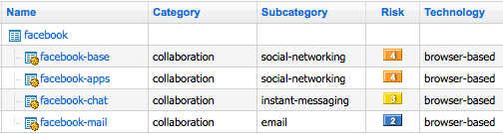
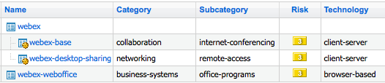
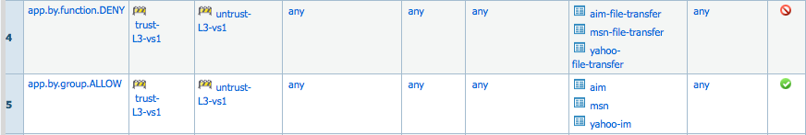
Telecommunications & Network Security
Next generation firewalls (NGFWs)
“Application awareness”

Slide 58
Telecommunications & Network Security
Next generation firewalls (NGFWs)
Able to decode the stream and apply contextual signatures to detect the application
If the traffic is encrypted (e.g. SSL), the firewall must be the SSL endpoint to be able to decrypt the SSL traffic and then detect the encapsulated protocol (e.g. HTTP) and finally the application
Heuristics engine, based on patterns to identify application (used for proprietary end-to-end encryption such as Skype or BitTorrent)

Slide 59
HTTPS - Browser validation
Browser get the web server’s certificate (signed by a CA)
Certificate is signed by a trusted CA ( → no self-signed)
The FQDN (browser address bar) and the URL in the certificates (CN/Alt.) match
Certificate is not expired
Certificate is not revoked
Generation of a symmetric key that is being used to encrypt the HTTP traffic

Slide 60
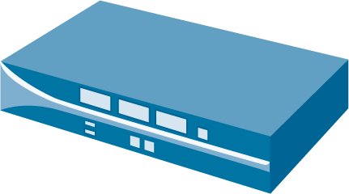
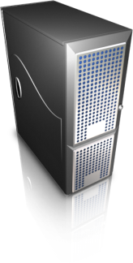

Telecommunications & Network Security
Next generation firewalls (NGFWs)
SSL decryption
Request SSL Connection
Sends Certificate
Server Sends Certificate
External Server

Slide 61
Telecommunications & Network Security
Next generation firewalls (NGFWs)
Not a solution to every problem
Use WAF for web application attacks (XSS, SQL injection, etc) → Don't confuse “application aware” with Web Application Security
Use dedicated email security solution for advanced spam filtering

Slide 62
Telecommunications & Network Security
Next generation firewalls (NGFWs) - bots detection
Bots steal sensitive info
Bots send spam, act as a proxy
Execute DDos & distributed attacks

Slide 63
Telecommunications & Network Security
Example of real attack
An email containing is link to a phishing website is sent
The user accesses the phishing website, enters its credentials
The phishing website sends a malware to the user disguised as a “Security Update”
The user executes the applications. All the data are compromised and the computer is now part of a botnet sending spam and phishing emails

Slide 64
Telecommunications & Network Security
Example of countermeasure on this attack
An email containing is link to a phishing website is sent → The message can be detected as a spam before the user reads the email
The user accesses the phishing website, enters its credentials→ The access to the phishing website can be blocked by a proxy
The phishing website sends a malware to the user disguised as a “Security Update” → The content scanning can prevent malicious content to be downloaded. Moreover, the local antivirus can detect the malware
The user executes the applications. All the data are compromised and the computer is now part of a botnet sending spam and phishing → The bonet can be detected by the IDS/IPS functionality and the flows can be blocked by the firewalls
→ In each case, security administrators are able to be alerted

Slide 65
Telecommunications & Network Security
Network based attacks:
Network as a channel for attacks (viruses, worms, spam,...)
Network as the target of the attack
  Reconnaissance attack (gain info about the network): scanning, sniffing,..
  Unauthorized access (social engineering, clear text password, weak password, misconfiguration,..)
  Session Layer attack (spoofing, session replay, session hijacking,..)
  Denial of Service (Switch MAC address table flooding, STP flapping, TCP SYN flood,...)
  Network service attacks (DNS cache poisoning, Rogue DHCP server,..)

Slide 66
Telecommunications & Network Security
“I will do my home-made encryption algorithm, so I'm sure nobody can decrypt it”
“I will upload this confidential file on a hidden folder of my web server so nobody can find it”
→ YOU ARE WRONG
Security by obscurity is a weak security control
Not a bad idea to keep secrets but nearly always fails when it's the only control
E.g. alternate port binding, hidden folder on a website containing secret information,..

Slide 67
Telecommunications & Network Security
“I'm not in financial or governmental activities, security doesn't concern me”
→ YOU ARE WRONG
Manual attacks
Automated attacks
Servers attack (Internet but also Intranet !)
Clients attack

Slide 68
Telecommunications & Network Security
Principles and “keep in mind”
Defense in Depth
Network segmentation
Least Privilege
Mediated access through gateways and control points
Accountability and traceability
Separation of duties
Industrialized solutions
Out of band management
Strong separation between Production and Non-Production
Encryption is needed but can be maliciously used to bypass network security controls

Slide 69
END

