Slide 1
HOMELESSNESS IN THE
TRANS
COMMUNITY
Zenith Kile (They/Them)
Arkansas Tech University

Slide 2
01
Introduction

Slide 3





The LGBT Community
Lesbian
Bisexual
Non-Men Loving Non-Men
Loving 2+ Genders
Queer
All LGBT+ people
(can be used as unlabeled term)
Gay
Transgender
Non-Women Loving Non-Women
Gender Not Aligned With Your AGAB
(assigned gender at birth)
From Wikimedia Commons, the free media repository
Notes:
Need to work on animations

Slide 4
The LGBT Community
From Wikimedia Commons, the free media repository

Slide 5
The LGBT Community
From Wikimedia Commons, the free media repository

Slide 6
530
Bills that target transgender people

Slide 7
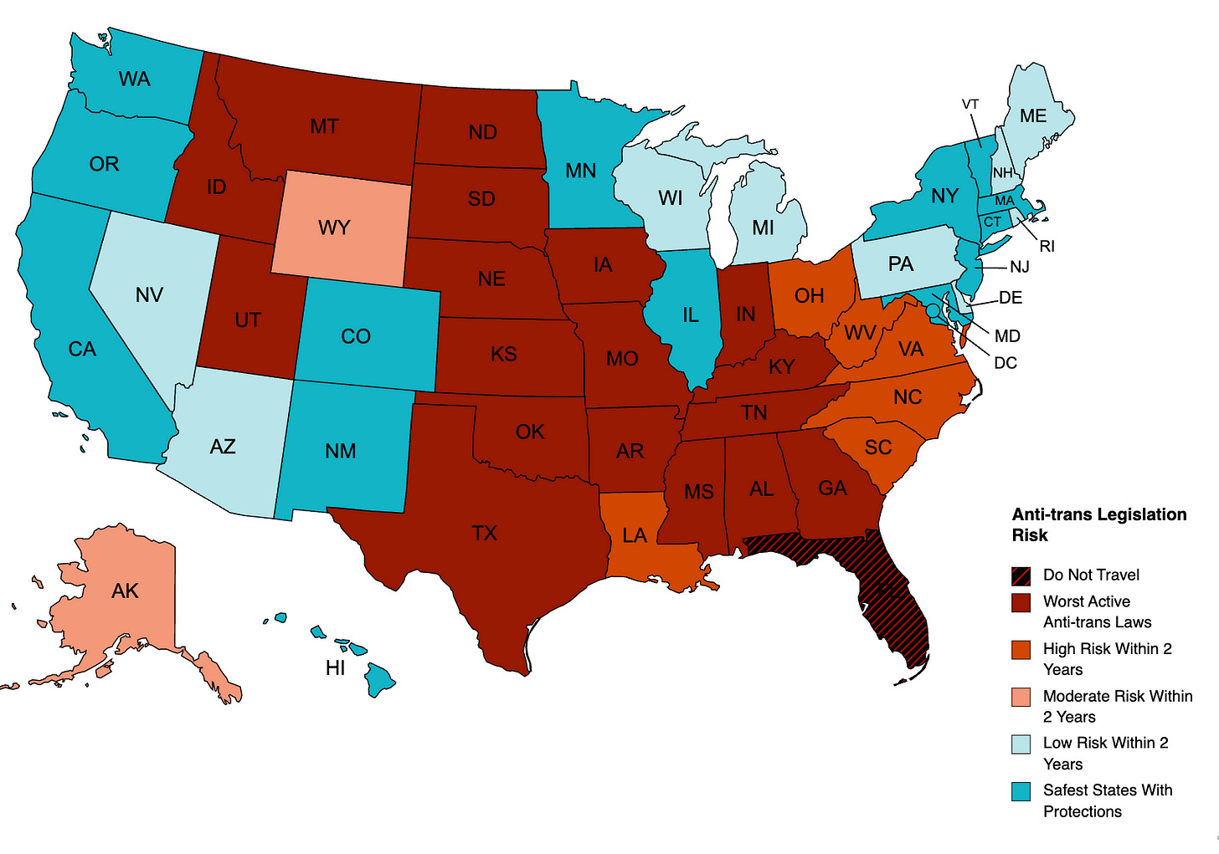
Legislative Map
May Anti-Trans Legislative Risk Map, Erin Reed, Erin in the Morning 2023

Slide 8
How does this relate?
Rumors
Data
High Rate of
Trans Youth Homelessness
HUD Exchange
Homelessness Dataset
Research

Slide 9
Is there a major disparity
in the amount of
homeless trans people
between anti-trans
states and pro-trans
states from 2016-2020?
My Research Question

Slide 10
There will be more homeless trans people in anti-trans states from 2016-2020.
—My Hypothesis

Slide 11
02
Methods

Slide 12
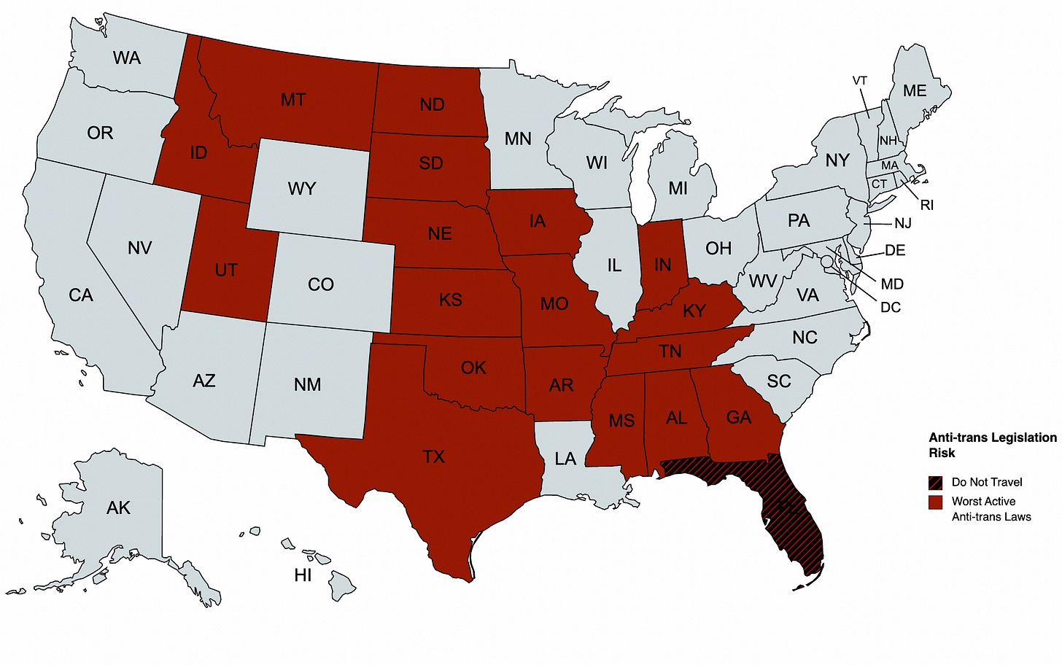
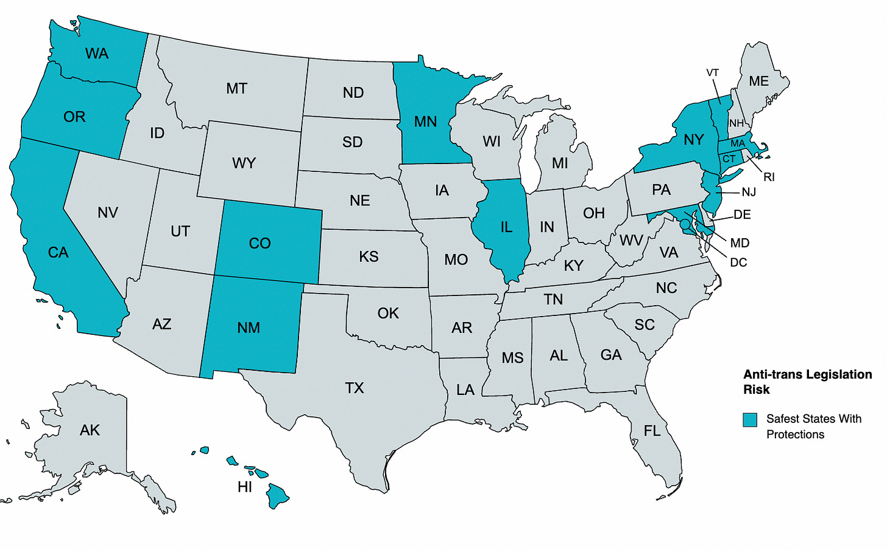
Two Categories
Anti-Trans
AL, AR, FL, GA, IA, ID, IN, KS, KY, MO, MS, MT, ND, NE, OK, SD, TN, TX, UT
Pro-Trans
CA, CO, CT, HI, IL, MA, MD, MN, NJ, NM, NY, OR, VT, WA
May Anti-Trans Legislative Risk Map, Erin Reed, Erin in the Morning 2023

Slide 13
Statistical Analysis
Unpaired T-Test
Grubb’s Outlier

Slide 14
03
Results

Slide 15
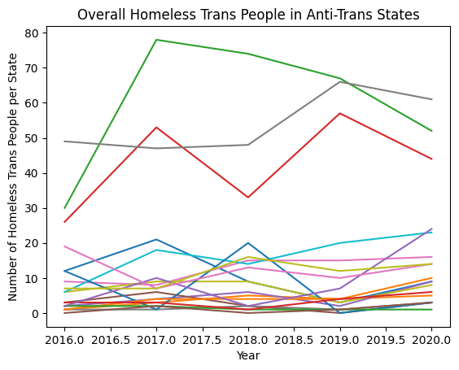
Anti-Trans Results
Anti-Trans
AL, AR, FL, GA, IA, ID, IN, KS, KY, MO, MS, MT, ND, NE, OK, SD, TN, TX, UT
Maxes: FL, TX, GA
No Outliers

Slide 16
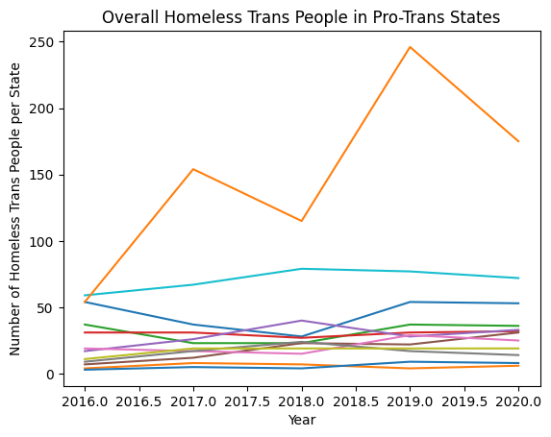
Pro-Trans Results
Pro-Trans
CA, CO, CT, HI, IL, MA, MD, MN, NJ, NM, NY, OR, VT, WA
Maxes: WA, OR, CO
Outliers (Not Included): CA, NY

Slide 17
T-Test Results
Year | Anti-Trans Mean | Pro-Trans Mean | p
2016 | 10.05263158 | 25.41666667 | 0.03586317686
2017 | 14.94736842 | 34.66666667 | 0.1443711941
2018 | 14.42105263 | 33.66666667 | 0.07763979126
2019 | 14.57894737 | 47.75 | 0.1149430736
2020 | 16.21052632 | 42 | 0.08480630185

Slide 18
NOT SUPPORTED

Slide 19
New Hypotheses
01
02
03
Trans vs Overall
Trans vs CoC
Overall vs CoC
Is there a correllation between the Overall Homeless Trans Population and the Overall Homeless Population? Yes.
Is there a correllation between the Overall Trans Population and the amount of CoC centers in the state? Yes.
Is there a correllation between the Overall Homeless Population and the amount of CoC centers in the state?
Yes.

Slide 20
04
New Experiement

Slide 21
Statistical Analysis
Two Categories
Grubb’s Outlier
Linear Regression
Same Two Categories

Slide 22
New Hypothesis 1 Results
Year | Anti-Trans R^2 | Anti-Trans R^2
2016 | .912 | .924
2017 | .838 | .908
2018 | .888 | .964
2019 | .862 | .838
2020 | .855 | .95
Average | .871 | .917
Trans vs Overall
Outliers (Anti): FL
Outliers (Pro): CA
Results include nonsignificant outliers.
Hypothesis: Somewhat Supported

Slide 23
New Hypothesis 2 Results
Year | Anti-Trans R^2 | Anti-Trans R^2
2016 | .428 | .017
2017 | .748 | .002
2018 | .714 | .001
2019 | .585 | .013
2020 | .575 | .005
Average | 0.609 | .0076
Trans vs CoC
Outliers (Anti): N/A
Outliers (Pro): CA, NY
CoC Total (Anti): ~116 /19
CoC Total (Pro): ~102/11
Results include nonsignificant outliers.
Hypothesis: Not Supported

Slide 24
New Hypothesis 3 Results
Year | Anti-Trans R^2 | Anti-Trans R^2
2016 | .428 | .456
2017 | .748 | .433
2018 | .714 | .43
2019 | .585 | .463
2020 | .575 | .397
Average | 0.61 | .436
Overall vs CoC
Outliers (Anti): FL
Outliers (Pro): CA
CoC Total (Anti): ~89 /18
CoC Total (Pro): ~128/11
Results include nonsignificant outliers.
Hypothesis: Not Supported

Slide 25
Possible Errors
26%
6%
70%
Avoided
Denied
Mistreated
6% of survey respondents were denied access to a homeless shelter, including the 4% who were denied for being trans.
70% of survey respondents were mistreated at the homeless shelter.
26% of survey respondents who were homeless avoided homeless shelters.
National Center of Transgender Equality, 2015 Transgender Survey

Slide 26
05
For the Future

Slide 27
Bibliography
James, S. E., Herman, J. L., Rankin, S., Keisling, M., Mottet, L., & Anafi, M. (2016). The Report of the 2015 U.S. Transgender Survey. Washington, DC: National Center for Transgender Equality. https://transequality.org/sites/default/files/docs/usts/USTS-Full-Report-Dec17.pdf
Reed, E. (2023, 19 5). May Anti-Trans Legislative Risk Map. Erin in the Morning. https://www.erininthemorning.com/p/may-anti-trans-legislative-risk-map
PIT and HIC Data Since 2007. (2023). HUD Exchange.
https://www.hudexchange.info/resource/3031/pit-and-hic-data-since-2007/

Slide 28
THANKS!
DO YOU HAVE ANY QUESTIONS?
zenithrowankile@gmail.com
https://www.linkedin.com/in/zenith-kile-01073725a/

