Slide 1





What? Why? How?
Notes:
Hacktoberfest is a virtual, month-long celebration of open source, organized by DigitalOcean, with support from partners and open source contributors, maintainers, event organizers, and open source enthusiasts around the world.

Slide 2
What is hacktoberfest?
Less beer than the name implies
Submit 4 pull requests
In October
To public participating* repos
Get a T-shirt and stickers
Or plant a tree

Slide 3
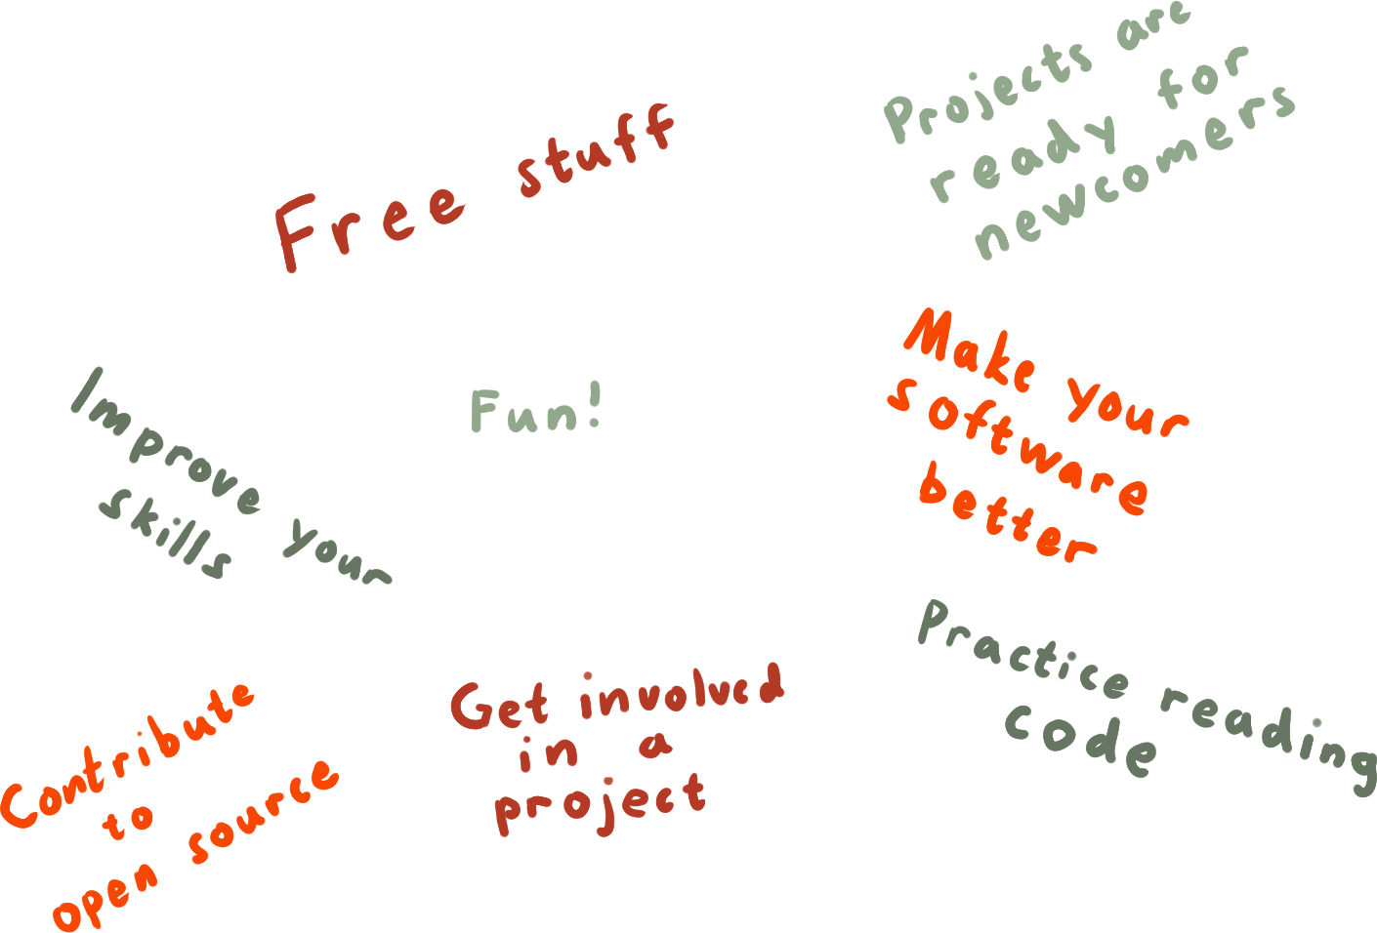
Why?

Slide 4
What is a Pull Request?
Notes:
To help encourage a safe, inclusive, and fun Hacktoberfest experience for everyone this year, we recommend for all event organizers to host your Hacktoberfest meetups, online.
So what is an online meetup? You may also hear it being called a virtual meetup. We’ll be using both terms interchangeably throughout this video. Essentially, an online meetup is an interactive gathering of people that happens on the internet. We stress the interactive part. It’s not a lecture. You’re creating a space for your community to come together, connect, and interact online.

Slide 5

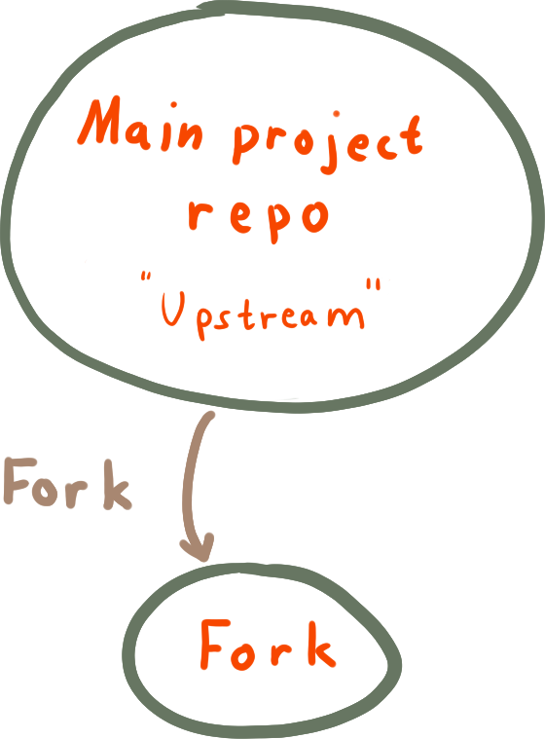

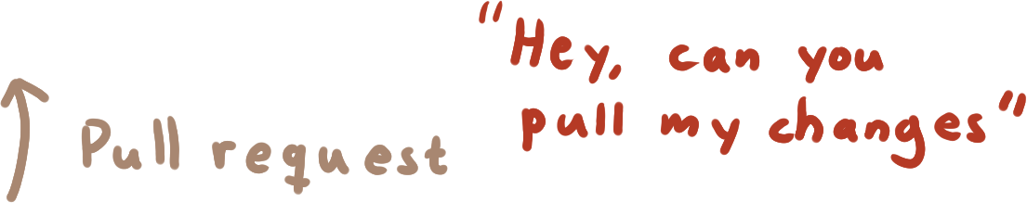
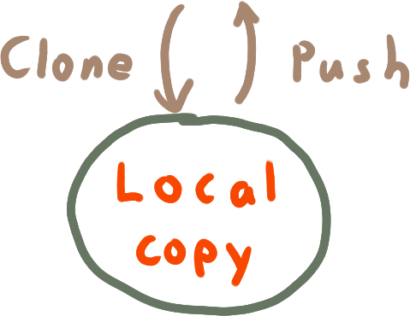
Notes:
Firstly, you can help anyone who is completely new to Hacktoberfest and the world of open source software. Your online meetup can provide a space with mentors and content designed specifically for beginners.

Slide 6
How to participate?
Sign up
Find a project*
(Find or open an issue)
Code (or write documentation etc.)
Make the PR
Get it accepted
Notes:
To help encourage a safe, inclusive, and fun Hacktoberfest experience for everyone this year, we recommend for all event organizers to host your Hacktoberfest meetups, online.
So what is an online meetup? You may also hear it being called a virtual meetup. We’ll be using both terms interchangeably throughout this video. Essentially, an online meetup is an interactive gathering of people that happens on the internet. We stress the interactive part. It’s not a lecture. You’re creating a space for your community to come together, connect, and interact online.

Slide 7
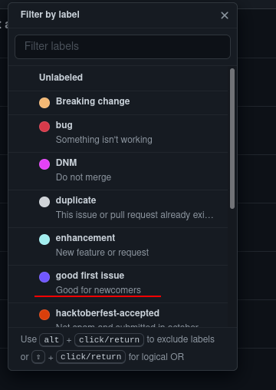
Finding a project
Useful project
Eligible
Something interesting
Language
Issue lists
Good scope
Cool tech
Notes:
To help encourage a safe, inclusive, and fun Hacktoberfest experience for everyone this year, we recommend for all event organizers to host your Hacktoberfest meetups, online.
So what is an online meetup? You may also hear it being called a virtual meetup. We’ll be using both terms interchangeably throughout this video. Essentially, an online meetup is an interactive gathering of people that happens on the internet. We stress the interactive part. It’s not a lecture. You’re creating a space for your community to come together, connect, and interact online.

Slide 8
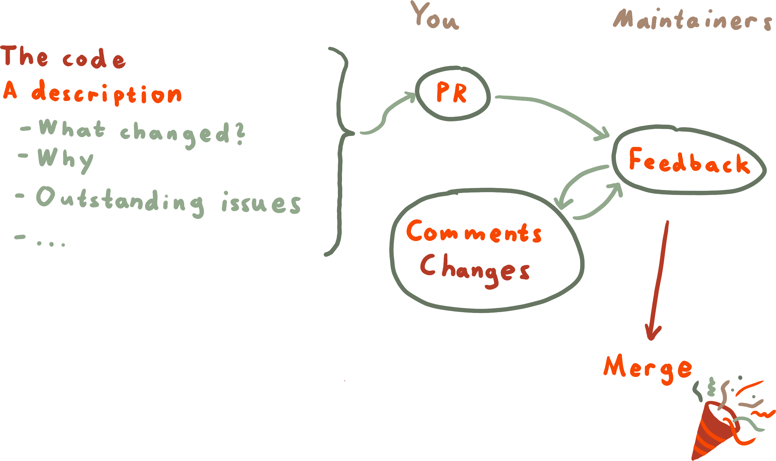
Submitting your PR
Notes:
Part of the reason Hacktoberfest works so well is because it’s a remote participation event.
People can contribute to the program from wherever they are in the world, and they can work asynchronously in whatever time zone.

Slide 9
Rules
PRs must be accepted in October
Approved or Merged in participating repo
or labeled “hacktoberfest-accepted”
Participating repos have the Hacktoberfest tag
PRs must be meaningful. No spam etc.
Notes:
Part of the reason Hacktoberfest works so well is because it’s a remote participation event.
People can contribute to the program from wherever they are in the world, and they can work asynchronously in whatever time zone.

Slide 10
Tips
A way to get into OSS
Aim for 1 or 2 “big” PRs
Have fun
PRs to own repos count
Notes:
Part of the reason Hacktoberfest works so well is because it’s a remote participation event.
People can contribute to the program from wherever they are in the world, and they can work asynchronously in whatever time zone.

Slide 11
Workshop
C++ på svenska https://github.com/TheZoq2/sweplusplus
Spade (Filter by good-first-issue)
https://gitlab.com/TheZoq2/spade
Sylt (Filter by good-first-issue)
https://github.com/FredTheDino/sylt-lang
Anything else
https://github.com/topics/hacktoberfest
https://gitlab.com/explore/projects?topic=hacktoberfest
Notes:
Part of the reason Hacktoberfest works so well is because it’s a remote participation event.
People can contribute to the program from wherever they are in the world, and they can work asynchronously in whatever time zone.

Slide 12
Thanks for listening!
Presented by

