Slide 1

Predicting Rate of Penetration (ROP) for new well plans
Ziwei Li (zl106@rice.edu)
Xinyang Song(Xinyang.Song@rice.edu)
January 29, 2022

Slide 2
Exploratory Data Analysis
Feature Extraction
Model Fitting
Prediction
Determine what variables should be taken into consideration
Visualize data to observe correlation between variables
Use the fitted model to predict
Using Neural Network Model
Encoding categories variables
Extract important features by using PCA

Slide 3
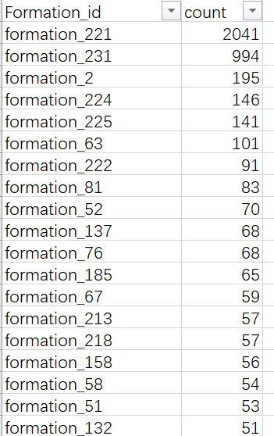
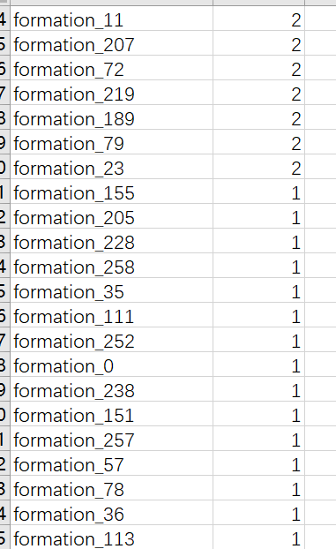
Exploratory Data Analysis
Imbalanced Data
181 kinds of Formation
have less than 20 data!
Drop this variable
Formation_id and corresponding counts

Slide 4
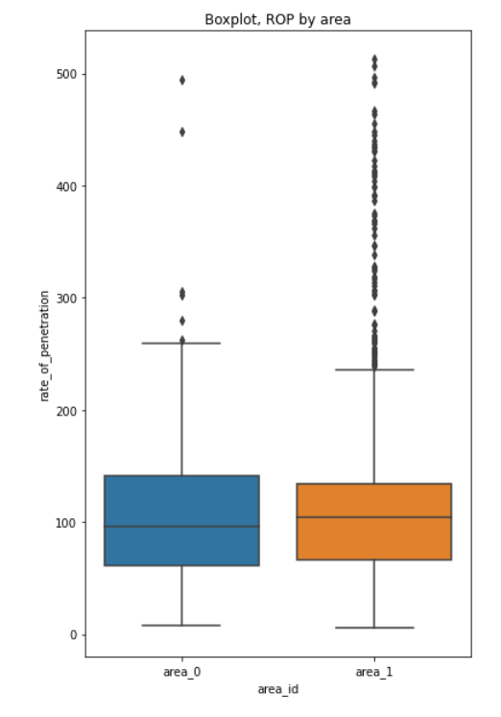
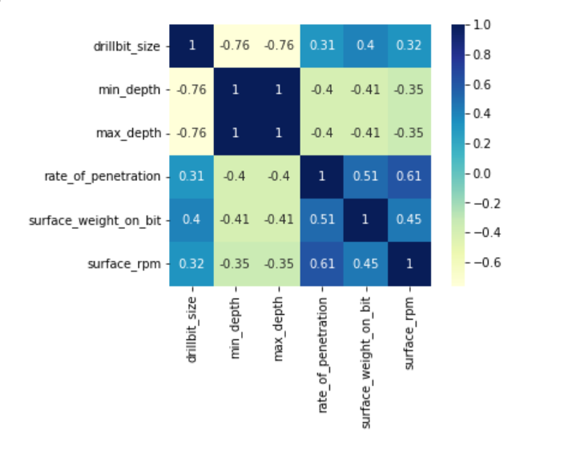
Data Visualization
Correlation Analysis
Boxplot by Area

Slide 5
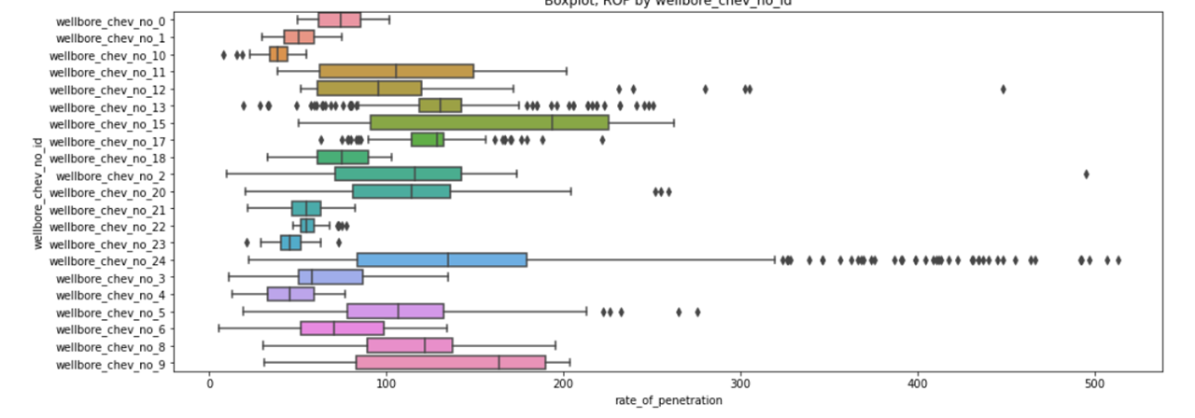
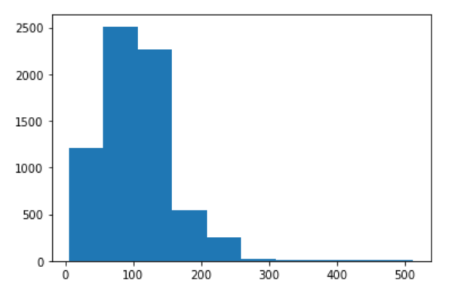
Data Visualization
Boxplot by wellbore number
ROP Histogram

