Slide 1

Github
Ashvini Patel
Thea Robinson

Slide 2
Background
GitHub is a global company that provides hosting for software development version control using Git. It is a subsidiary of Microsoft, which acquired the company in 2018 for $7.5 billion. It offers all the distributed version control and source code management functionality of Git as well as adding its own features. It provides access control and several collaboration features such as bug tracking, feature requests, task management, and wikis for every project.

Slide 3
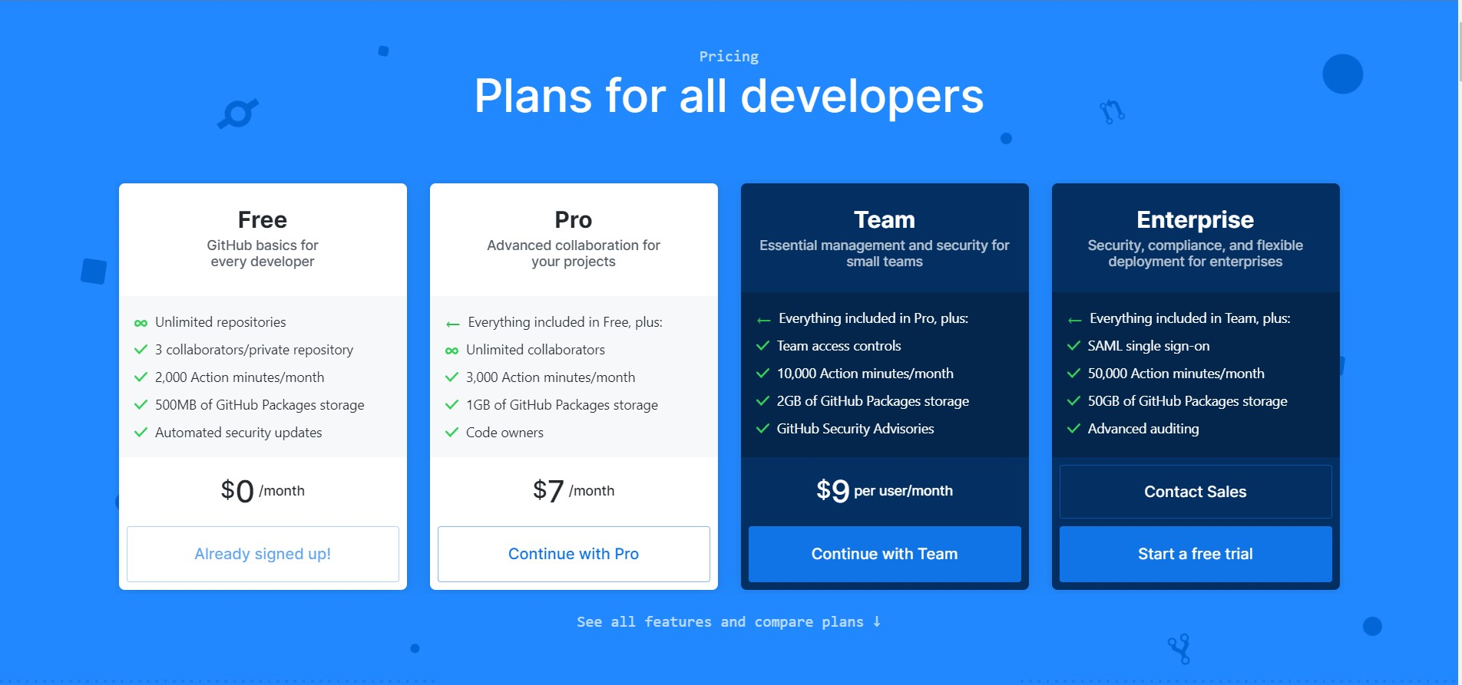
Pricing
Plans:
https://github.com/pricing
Plans are based on per-user pricing
Organizations pay based on team size to access advanced collaboration and management tools for teams
Can include security and deployment controls.

Slide 4
What is it?
Code hosting Git repository that allows you and others to work on projects from anywhere.
Easier to contribute to open source projects
Tracks changes in your code across versions
Documentation

Slide 5
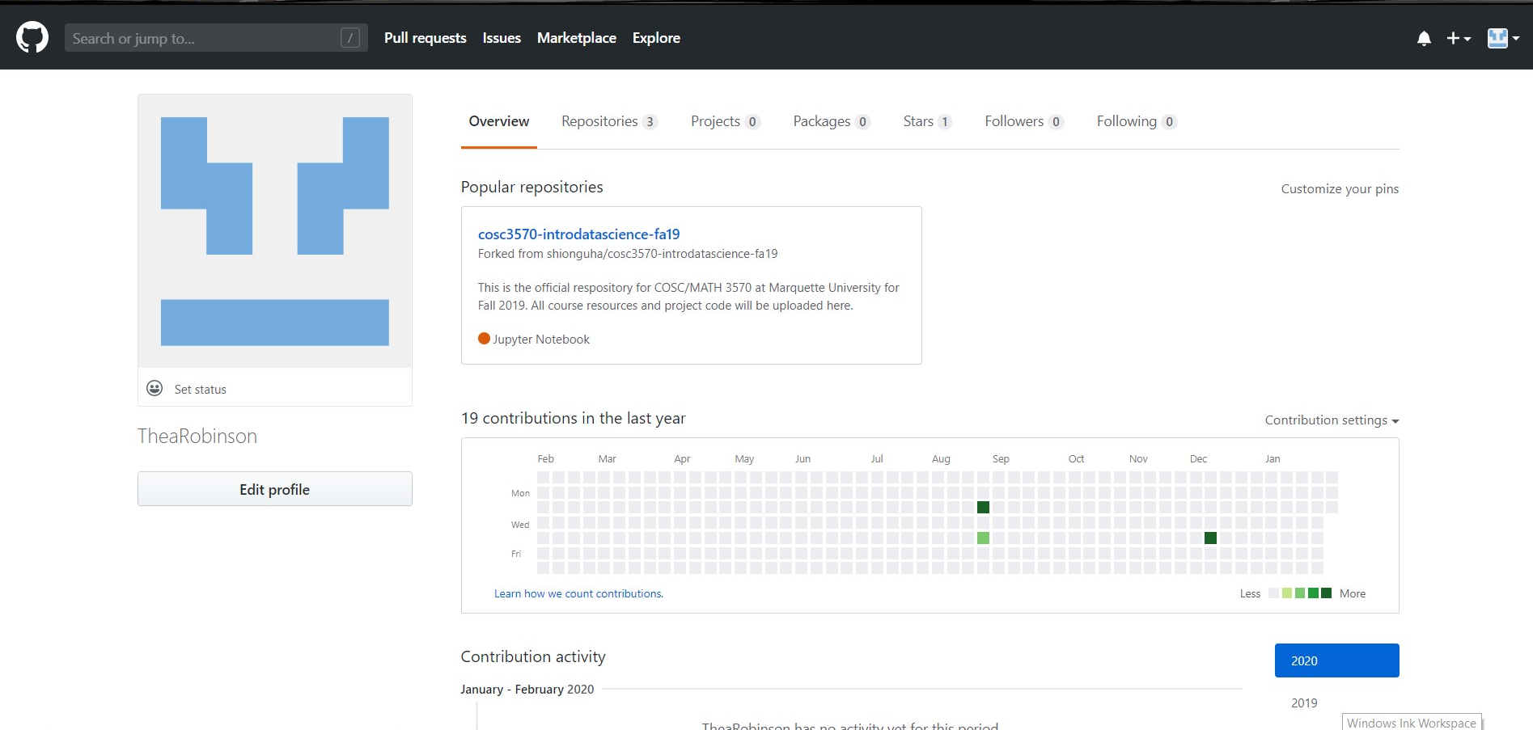
Web-Based Interface
https://github.com/
Overview of Account
Can manage repositories, projects, and packages
View projects or repositories that you have starred
Favorites/bookmark

Slide 6
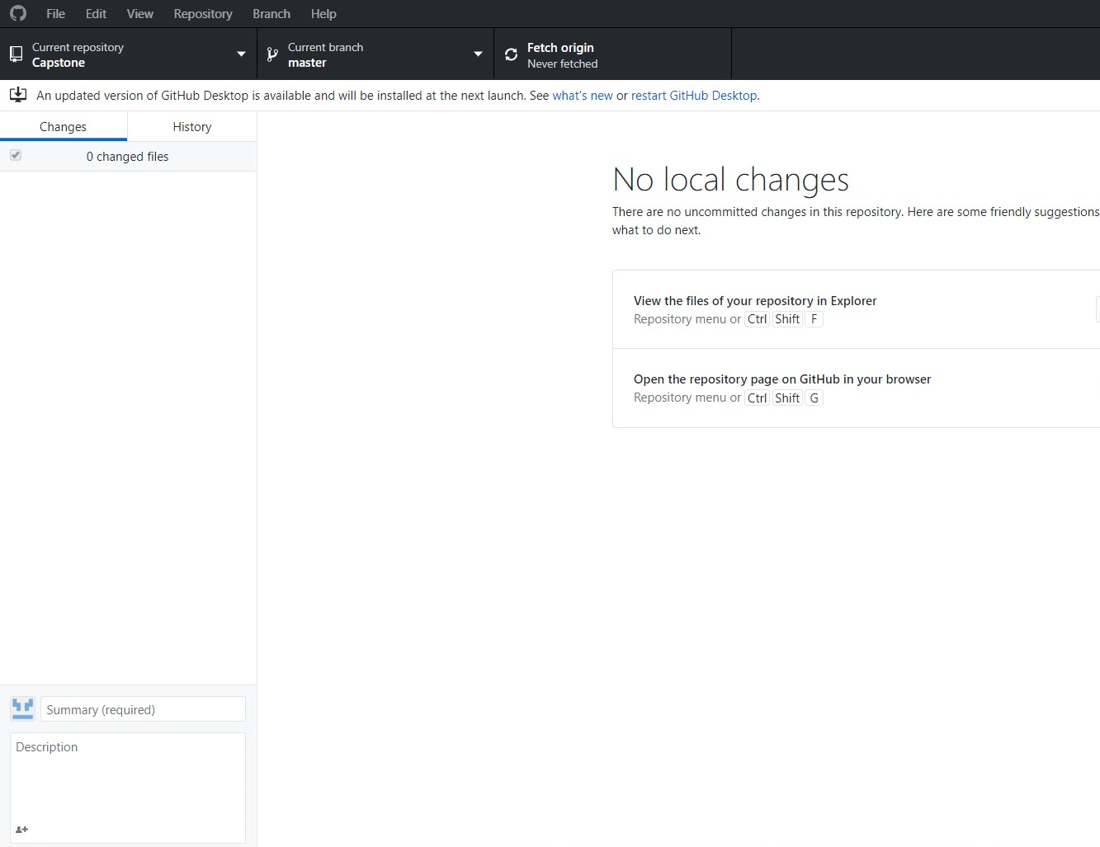
Desktop Application
To Download:
https://desktop.github.com/
Used mostly to push, pull, and commit changes to your repository.

Slide 7
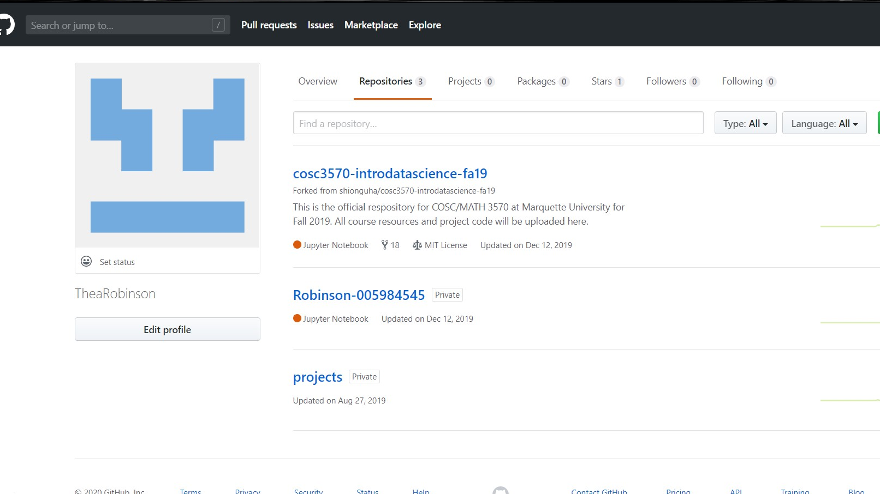
Repositories
Repositories are like folders for projects that contains all the files for that project and stores each file's revision history.

Slide 8
Repository Functions
Push
Pull
Commit
Clone
Fork
Branch

