Slide 1

CV1711 ENGINEERING DRAWING & 3D BUILD INFO MODEL (LAB)

Slide 2
Instructor Information
NAME: HUANG XINYA
EMAIL: XINYA002@e.ntu.edu.sg
TEL: 81903868
NAME: YU XIAO
EMAIL: XIAO004@e.ntu.edu.sg
TEL: 88635869
Any questions? Feel free to reach out!
Notes:
This is my contact information.
U can take a picture
If u have any question, pls feel free to contact me via the email.

Slide 3
Course Structure
PART I - Engineering Drawing – 2D – Autodesk CAD
W1
W2
W3
W4
W5
W6
W7
Recess
Week
1st Angle
3rd Angle
AutoCAD Basics
Orthographic
Projection
Quiz1
Auxiliary Projection
PART II – Building Information Model – 3D – Autodesk Revit
W8
W9
W10
W11
W12
W13
Revit
Basics
Handson Practice
Review
Self-based Learning
Quiz2

Slide 4
Grade & Attendance
Grade Structure
Quiz1 (50%) + Quiz2 (50%)
Attendance
Attendance will be taken during the last 15 minutes of class.
Attendance does not count toward the final grade; however, students are encouraged to attend in person, as exam-related tips will be shared in class.

Slide 5
Quiz Absence Policy
Request an Absence
(1) Submit your Medical Certificate (MC) to the School administration.
(2) Email the Course Coordinator (gun.kim@ntu.edu.sg).
(3) Email the instructor.
Grade Structure with Absence
With an approved MC or valid reason, the remaining quiz will count as 100%.
Otherwise, 50% will be deducted for a missed quiz.
Missing both quizzes will result in a FAIL.

Slide 6
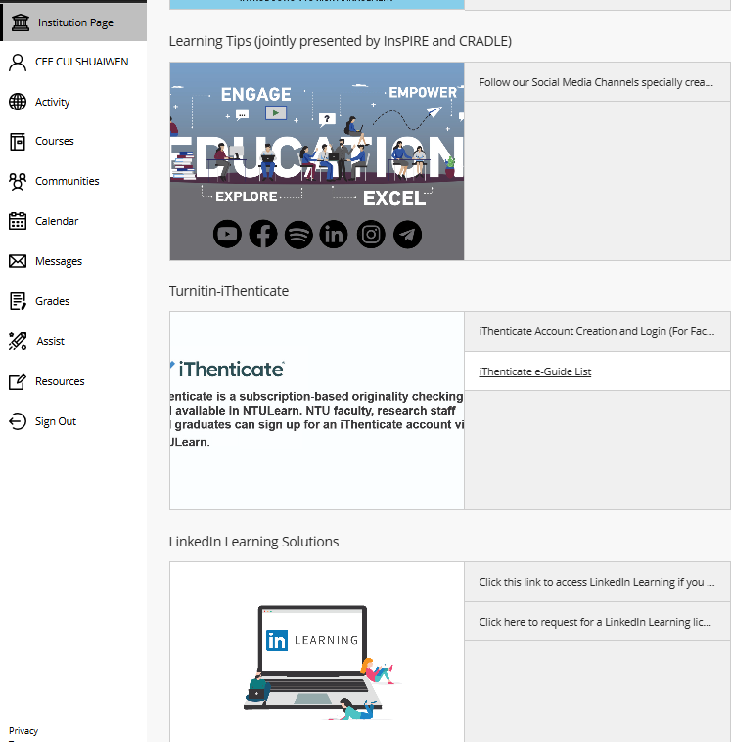
Linkedin Video Access Issue?

Slide 7
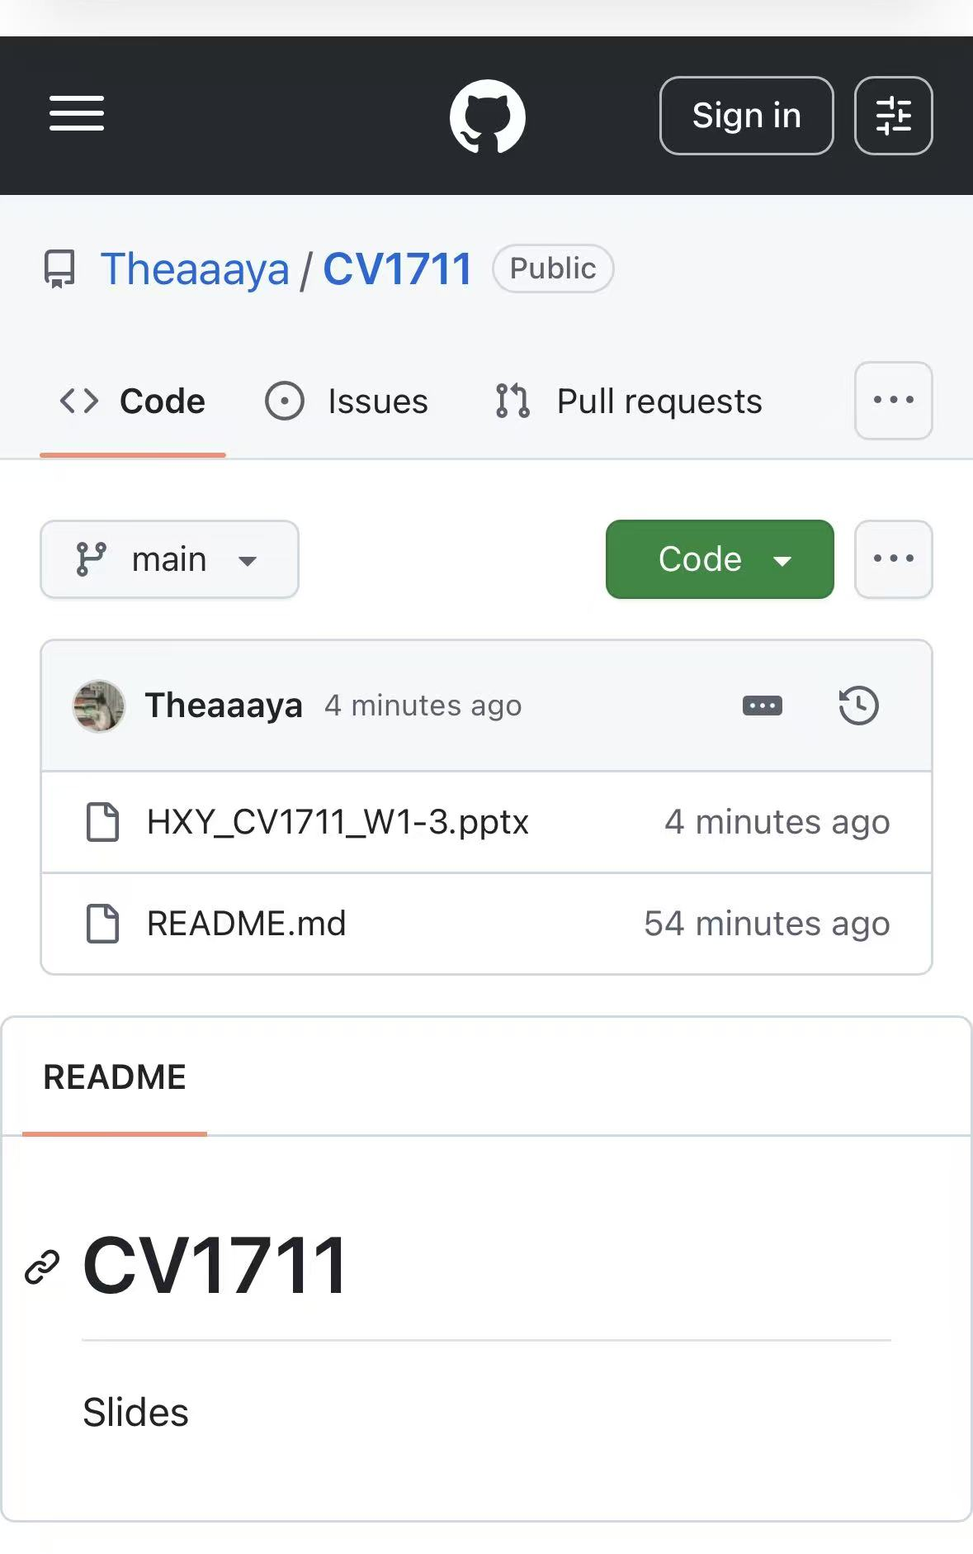
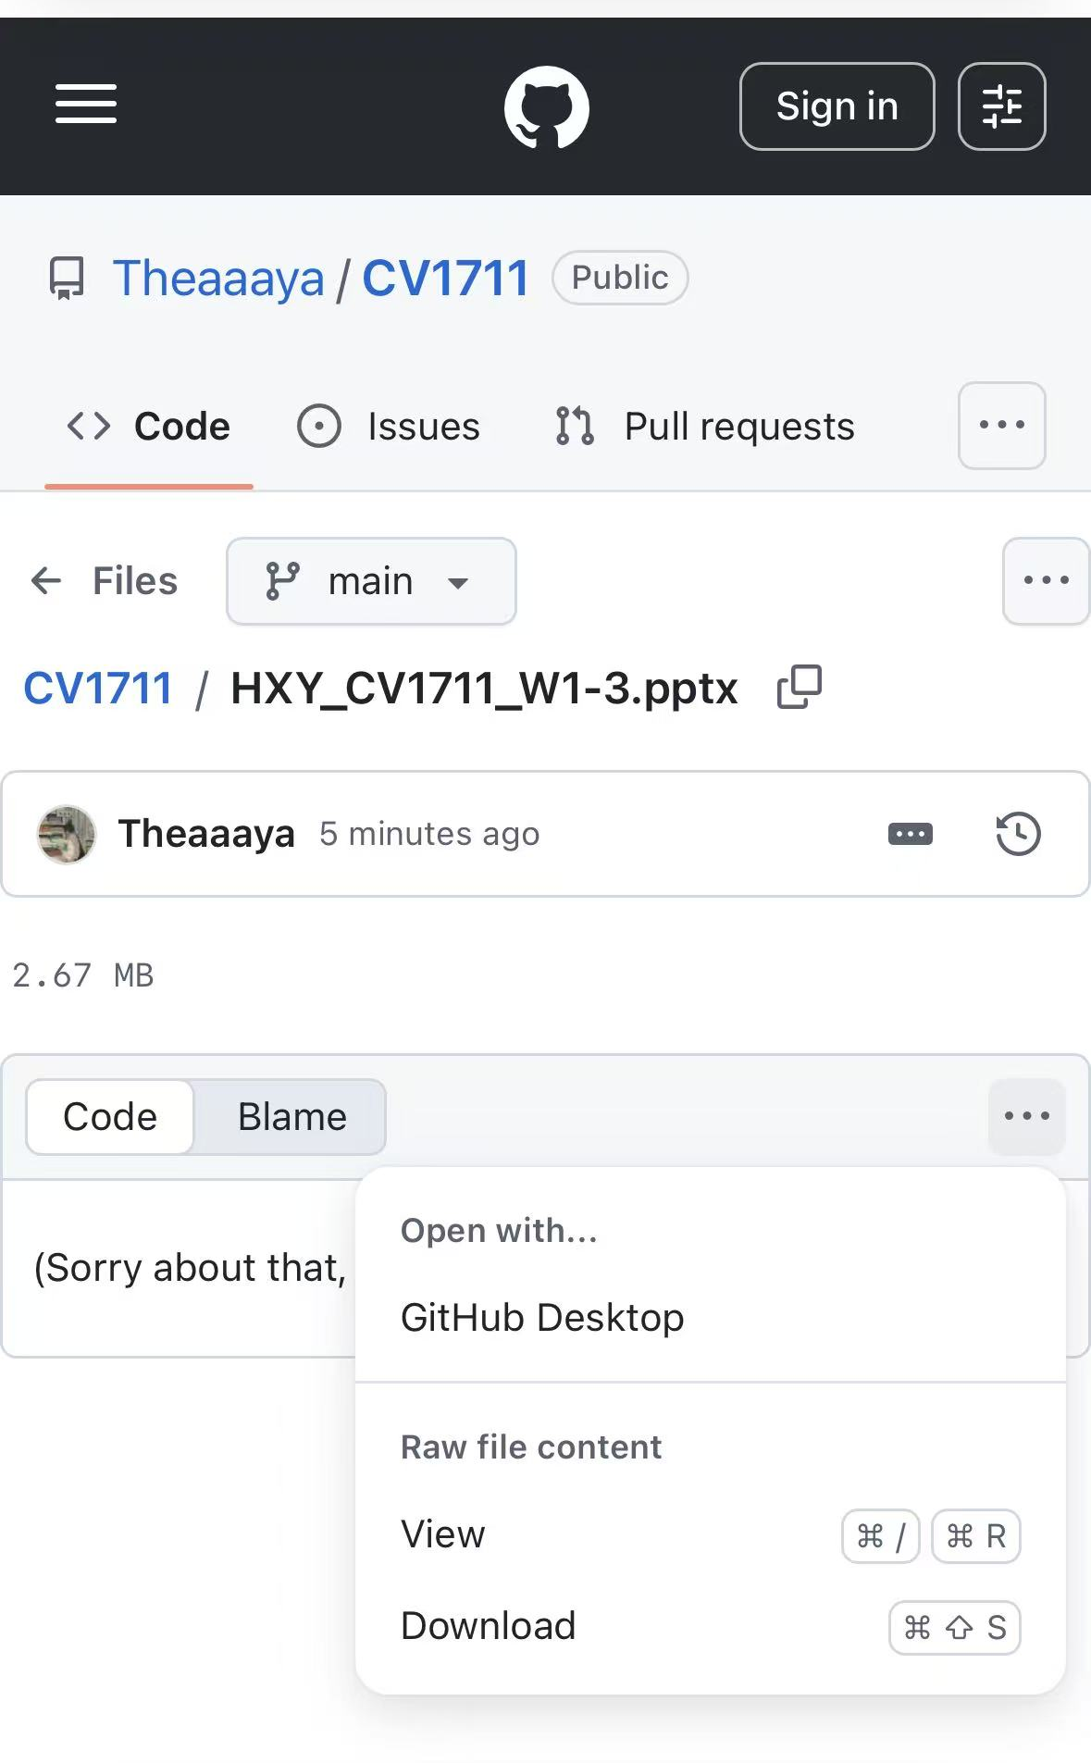
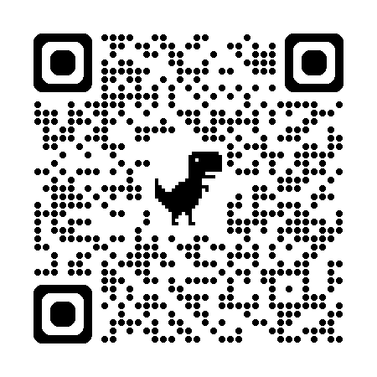
Where to download the slides?

Slide 8
WEEK 1 & 2 – CAD Basics
Learn AutoCAD basics on NTULearn
Follow the notes (Course Content > Content > Note-Part 1) on NTULearn, you do NOT need to watch all the videos.
Complete E1 & E2
Submit E2 by the end of week 2
Mark your attendance before leaving
Save files & sign out before leaving

Slide 9
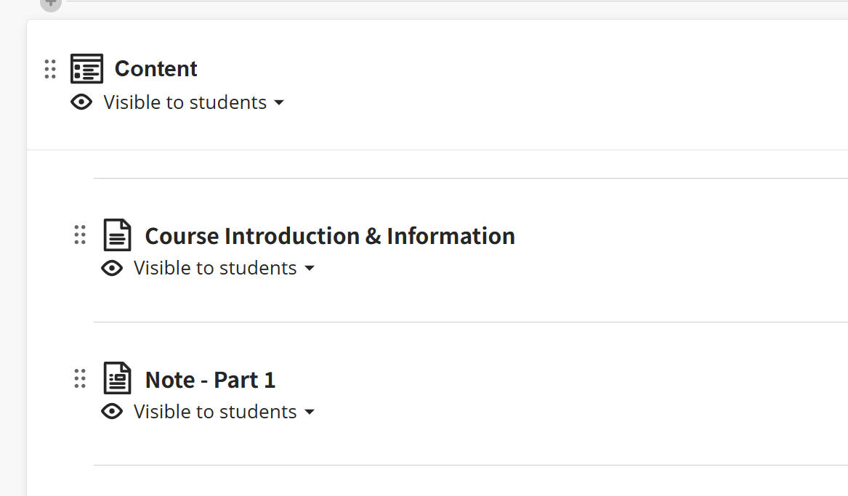
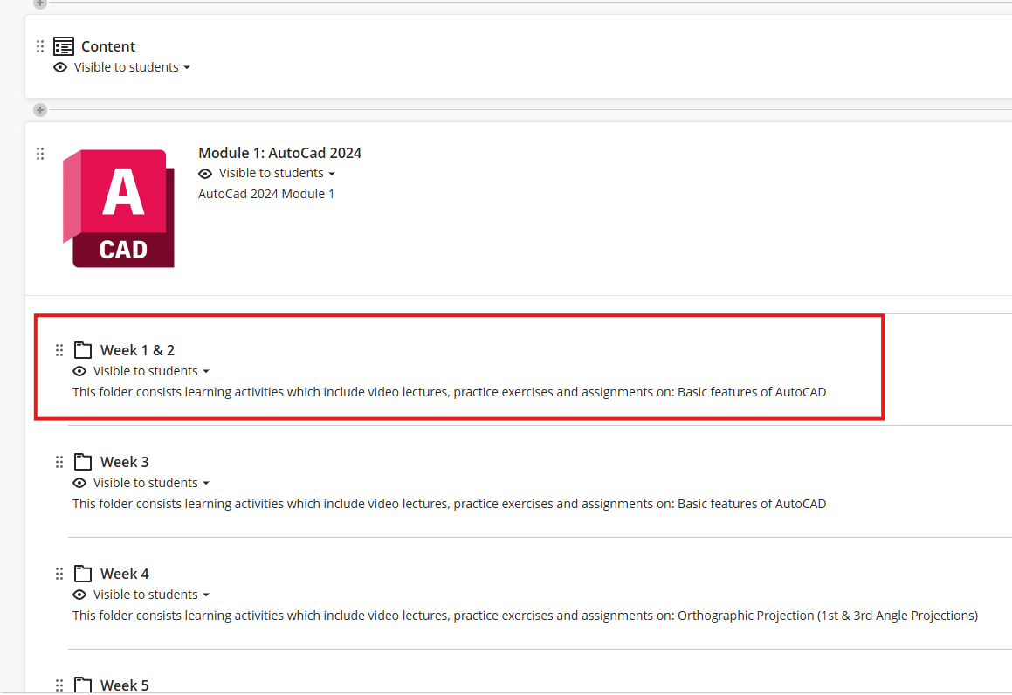
WEEK 1 & 2 – Learning material
Submit E2 ONLY by the end of Week 2
No need to submit E1!
Notes:
Here’s the learning material u need to follow on NTULearn

Slide 10
WEEK 3 – CAD Basics
Follow the instructions and videos on NTULearn
Follow the notes (Course Content > Content > Note-Part 1) on NTULearn, you do not need to watch all the videos.
Complete E3, E4 & E5
Submit E3 & E5 by the end of week 3
Mark your attendance at the end of class
Save files & sign out before leaving

Slide 11
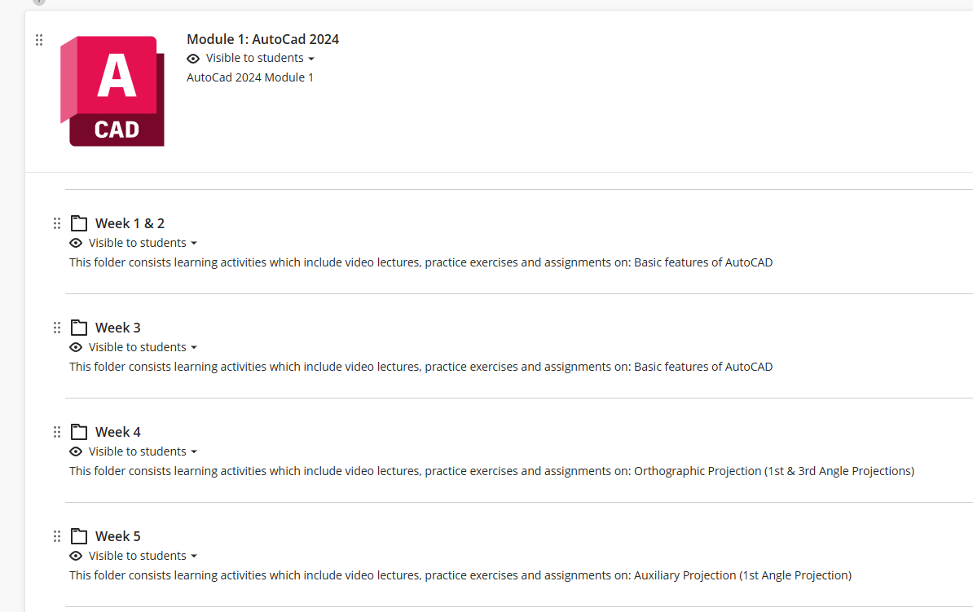
WEEK 3 – CAD Basics
Submit E3 & E5 by the end of Week 3
Notes:
Here’s the learning material u need to follow on NTULearn

